Slide 1
Predictive analysis of ambient conditions for crop growth using Internet of Things
S A Hariprasad 18BCE0868
Nikhil K 18BCE2321

Slide 2
Abstract
In a rapidly developing country like India, which has the world’s highest growing GDP Urbanization is being seen in every nuke and corner of the country.
The difference between the population density of the cities and rural areas are very high. The population of the cities are growing exponentially every year, because of which the agricultural farms in and around the cities are being converted into residential sky scrapers.
The need and demand for crops and food is growing up but the area to grow is going down. Due to this alarming scenario, hydropic agriculture has risen in popularity and practice.
It is a form of agriculture in which the plants are grown with restricted water supply.
In this work, we are growing coriander plant in a controlled environment with constant monitoring, the controlled environment being restricted water supply I,e Hydroponic farming. Various parameters like Soil pH, Moisture levels etc. are recorded on daily basis and made into a data set.
This data set, then with the help of Supervised Machine Learning algorithms we are going to Co-Relate the data collected via IOT by the help of Regression Models ,find the trends within the taken parameters and give an idea as to which conditions give a better yield.
Keywords: Supervised Machine Learning Algorithms, Regression Models, Controlled Environment, Hydroponic, Urbanization

Slide 3
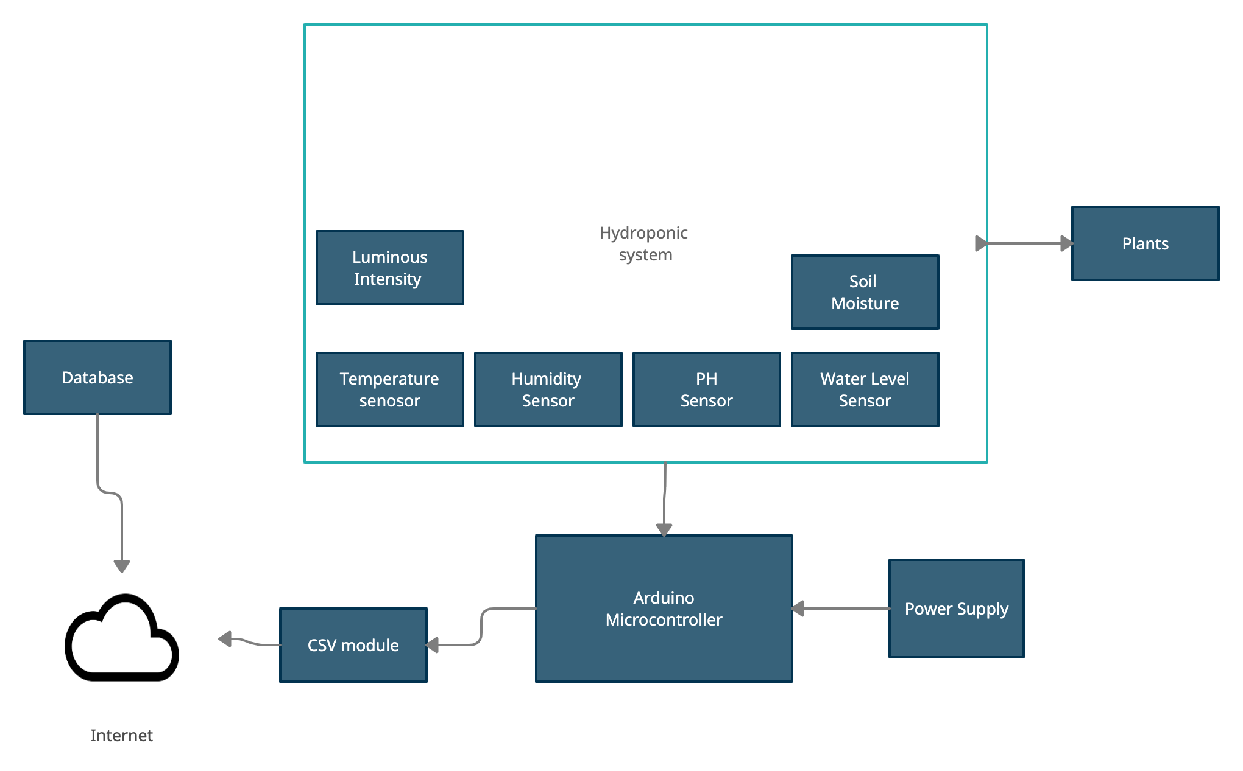
System Architecture

Slide 4
System Architecture Description
Water-Level Sensor - A water-level sensor is a device used in the detection of the water level. Maintaining Water level helps the root absorb correct amount of water and makes sure that the plant doesn't gets spoiled.
pH Sensor - Optimal pH levels are critical to healthy plants and high yields in both soil and hydroponics gardening. Maintaining those optimal levels, especially in soilless growing systems, calls for frequent, accurate pH testing. Ideal pH levels maximize a plant’s nutrient uptake. Those nutrients, in turn, increase a plant’s vigor and productivity.
Soil Moisture Sensor - This soil moisture sensor can be used to detect the moisture of soil or judge if there is water around the sensor, let's you know if the plants in the mesh pot require water or not. The units used in calculating is bars.
DHT22 Temperature/Humidity Sensor - The DHT22 is a humidity and temperature sensor with a single wire digital interface. The sensor is calibrated so you can get right to measuring relative humidity and temperature.
Luminous Intensity Sensor- Helps to capture the amount of sunlight hitting the product

Slide 5
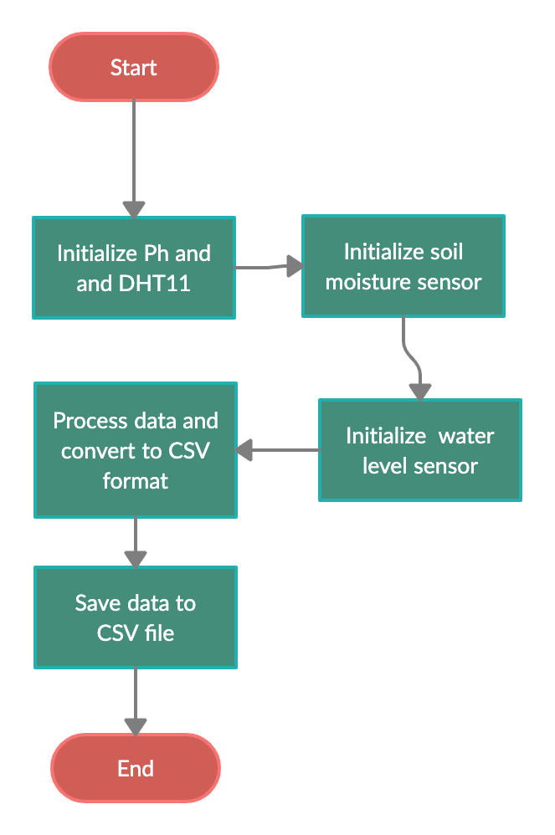
Flow Chart
In the following Hydroponic system the data is being collected by a CSV module that collects data from Arduino serial monitor and saves data in a CSV file.
The Arduino board initializes the sensor and collects data every 10 minutes and sends the data to the CSV file

Slide 6
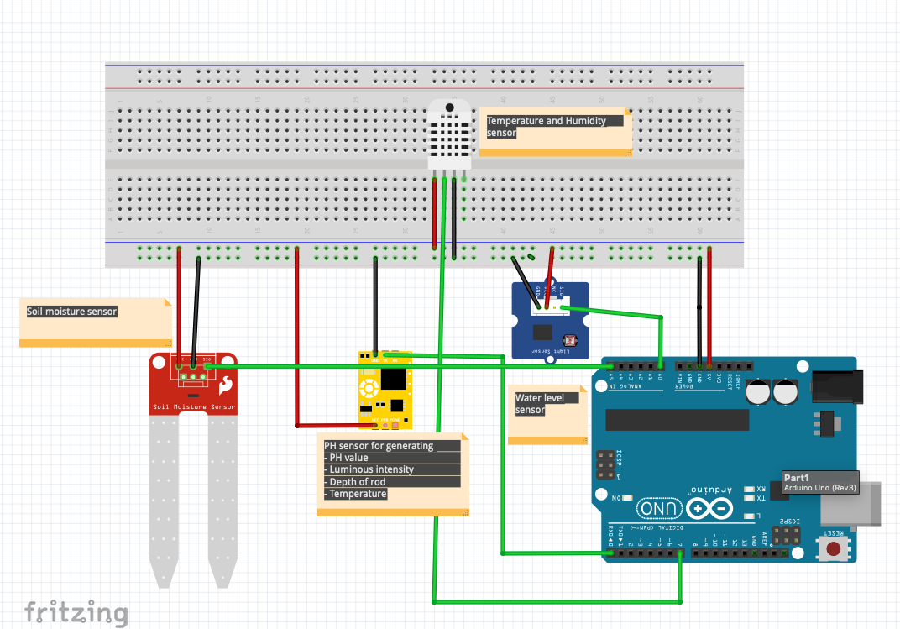
Circuit Diagram

Slide 7
Circuit Connection
Sensor connection from Arduino
SENSOR | FROM | TO
PH SENSOR | TX | RX
 | VCC | VCC
 | GND | GND
DHT 22
 | VCC | VCC
 | GND | GND
SOIL MOISTURE | DATA | A1
 | VCC | VCC
 | GND | GND
WATER LEVEL SENSOR | DATA | A2
 | VCC | VCC
 | GND | GND

Slide 8
Methodology Adapted

Slide 9
Expected Results

Slide 10
Implementation (i) Dataset Collection
PARAMETER | MAX | MIN
PH | 27.13 | 0
LUMINOUS INTENSITY | 228 | 0
HUMIDITY | 82.5 | 43.6
TEMPERATURE | 38.6 | 25.5
SOIL MOISTURE | 693 | 676
WATER LEVEL | 731 | 153
TYPE | DESCRIPTION
Data set Characteristic | Multivariant
Attribute Characteristics | Timestamp, Integer, Real
Associated Tasks | Regression
Number of Instances | 1559
Number of attributes | 8

Slide 11
Implementation (ii) Water Level Consumed By crops
Date | Water consumed that Day | Total Water consumed
11/02/21 | 6000 | 6000
12/02/21 | 6000 | 6000
13/02/21 | 6000 | 6000
14/02/21 | 6000 | 6000
15/02/21 | 6000 | 6000
16/02/21 | 6000 | 6000
17/02/21 | 6000 | 6000
18/02/21 | 6000 | 6000
19/02/21 | 6000 | 6000
20/02/21 | 200 | 6200
21/02/21 | 200 | 6400
22/02/21 | 200 | 6600
23/02/21 | 200 | 6800
24/02/21 | 200 | 7000
25/02/21 | 200 | 7200
26/02/21 | 200 | 7400
27/02/21 | 200 | 7600
28/02/21 | 200 | 7800
01/03/21 | 200 | 8000
02/03/21 | 200 | 8200
03/03/21 | 200 | 8400
04/03/21 | 50 | 8450
05/03/21 | 50 | 8500
06/03/21 | 50 | 8550
07/03/21 | 50 | 8600
08/03/21 | 50 | 8650
 | TOTAL WATER | 8.65 Liters

Slide 12
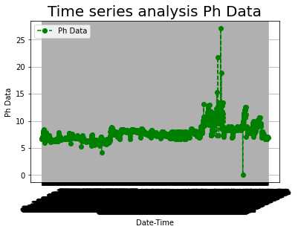
Implementation (iii) Time Series Analysis of Dataset
Description

Slide 13
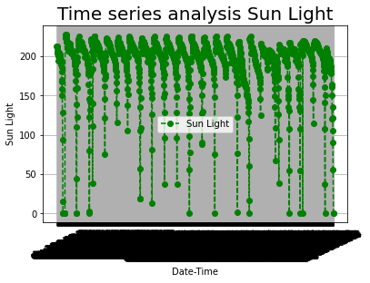
Implementation (iii) Time Series Analysis of Dataset
Description

Slide 14
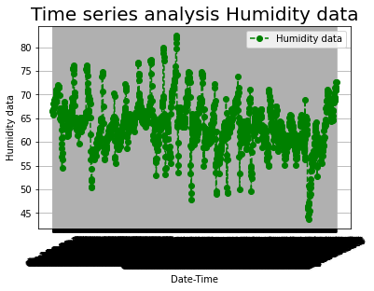
Implementation (iii) Time Series Analysis of Dataset
Description

Slide 15
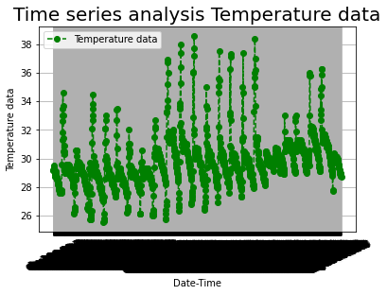
Implementation (iii) Time Series Analysis of Dataset
Description

Slide 16
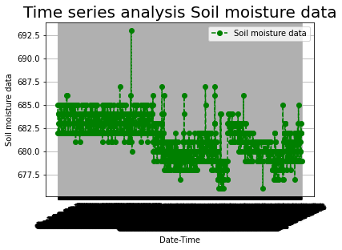
Implementation (iii) Time Series Analysis of Dataset
Description

Slide 17
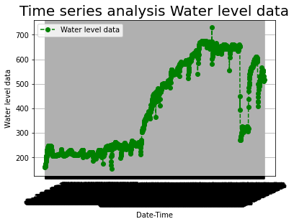
Implementation (iii) Time Series Analysis of Dataset
Description

Slide 18
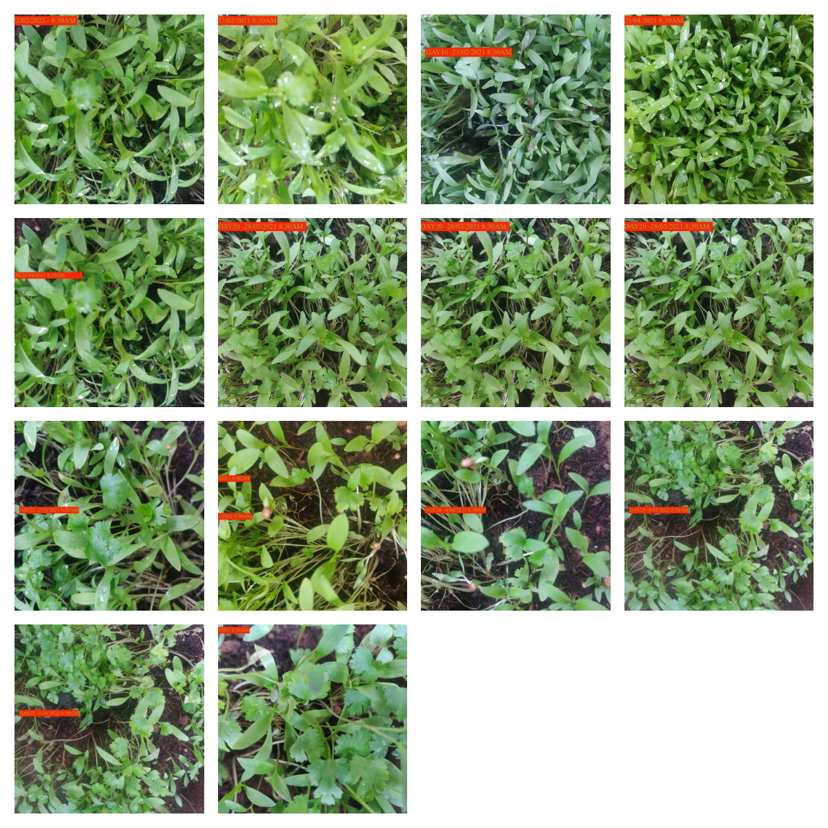
Implementation (iv) Images of Each Phase of Crop Growth

Slide 19
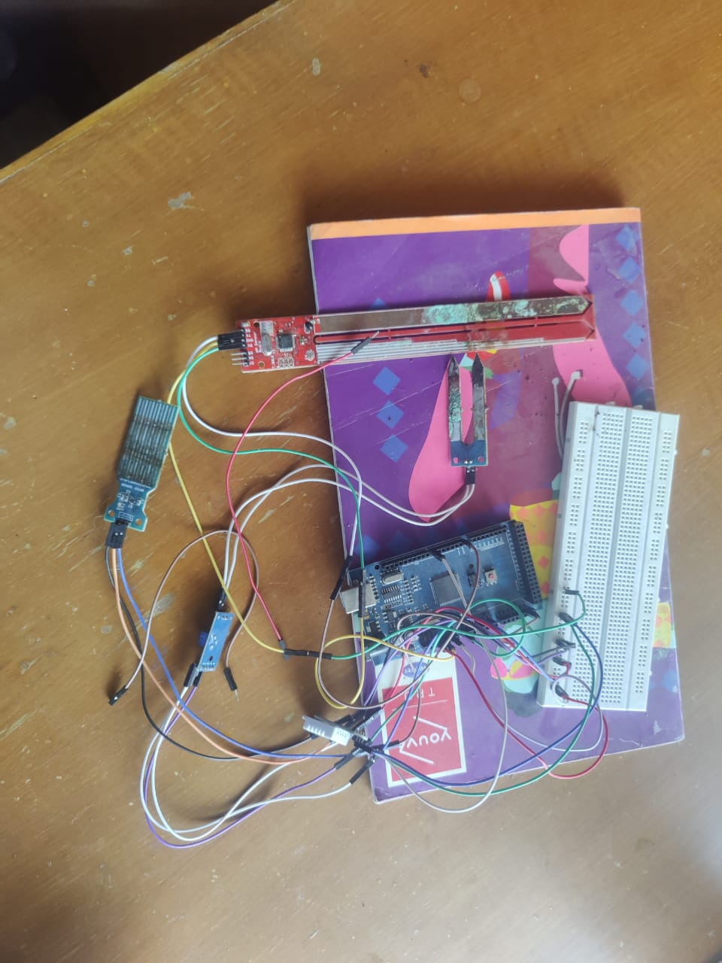
Implementation (iv)Hardware Implementation

Slide 20
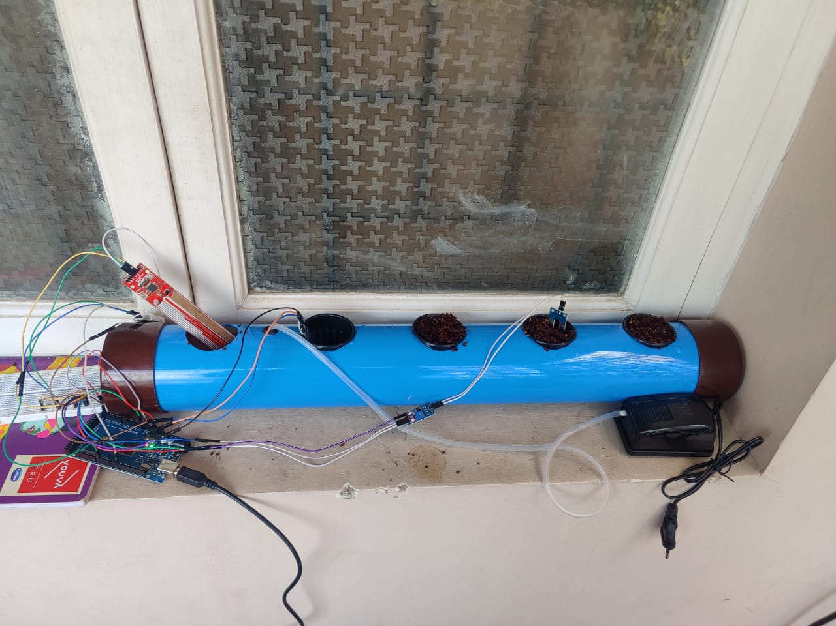
Implementation (iv)Full Project Setup

Slide 21
Details of Hardware And Software
Hardware requirements
Arduino Mega 2560
Temperature sensor (DHT-22)
Humidity Sensor (DHT-22)
Water Level Sensor
Soil Moisture Sensor
PH Sensor
Luminous Intensity Sensor
WIFI module (ESP 8266)
Breadboard
Jumper wires
Pump
Water Tube
5V motor
5V power supply
Software requirements
Python Version 3.9.0
Sklearn (Machine learning Library and Evaluation )
Pandas (Handling CSV files)
Numpy (Handling Arrays in python)
Arduino Software (To upload code to UNO board)
MAC OS version 11.6 128GB storage
VS code editor

Slide 22
References
A. Nichani, S. Saha, T. Upadhyay, A. Ramya and M. Tolia, "Data Acquisition and Actuation for Aquaponics using IoT," 2018 3rd IEEE International Conference on Recent Trends in Electronics, Information & Communication Technology (RTEICT), 2018, pp. 46-51, doi: 10.1109/RTEICT42901.2018.9012260.
H. K. Srinidhi, H. S. Shreenidhi and G. S. Vishnu, "Smart Hydroponics system integrating with IoT and Machine learning algorithm," 2020 International Conference on Recent Trends on Electronics, Information, Communication & Technology (RTEICT), 2020, pp. 261-264, doi: 10.1109/RTEICT49044.2020.9315549.
P. Srivani, Y. Devi C. and S. H. Manjula, "A Controlled Environment Agriculture with Hydroponics: Variants, Parameters, Methodologies and Challenges for Smart Farming," 2019 Fifteenth International Conference on Information Processing (ICINPRO), 2019, pp. 1-8, doi: 10.1109/ICInPro47689.2019.9092043.
C. Joshitha, P. Kanakaraja, K. S. Kumar, P. Akanksha and G. Satish, "An eye on hydroponics: The IoT initiative," 2021 7th International Conference on Electrical Energy Systems (ICEES), 2021, pp. 553-557, doi: 10.1109/ICEES51510.2021.9383694.
S. Gertphol, P. Chulaka and T. Changmai, "Predictive models for Lettuce quality from Internet of Things-based hydroponic farm," 2018 22nd International Computer Science and Engineering Conference (ICSEC), 2018, pp. 1-5, doi: 10.1109/ICSEC.2018.8712676.
S. Jaisankar, P. Nalini and K. K. Rubigha, "A Study on IoT based Low-Cost Smart Kit for Coconut Farm Management," 2020 Fourth International Conference on I-SMAC (IoT in Social, Mobile, Analytics and Cloud) (I-SMAC), 2020, pp. 161-165, doi: 10.1109/I-SMAC49090.2020.9243486.
M. S. Farooq, S. Riaz, A. Abid, K. Abid and M. A. Naeem, "A Survey on the Role of IoT in Agriculture for the Implementation of Smart Farming," in IEEE Access, vol. 7, pp. 156237-156271, 2019, doi: 10.1109/ACCESS.2019.2949703.

