Slide 1
Machine Learning Engineer
R SAHAYA ASHIK LIBU

Slide 2
OFFLINE TASK 1 (classification model )

Slide 3
CONTENTS
01
02
03
ABOUT THE PIPELINE
CODE WALKTHROUGH
RESULT & INFERENCE

Slide 4
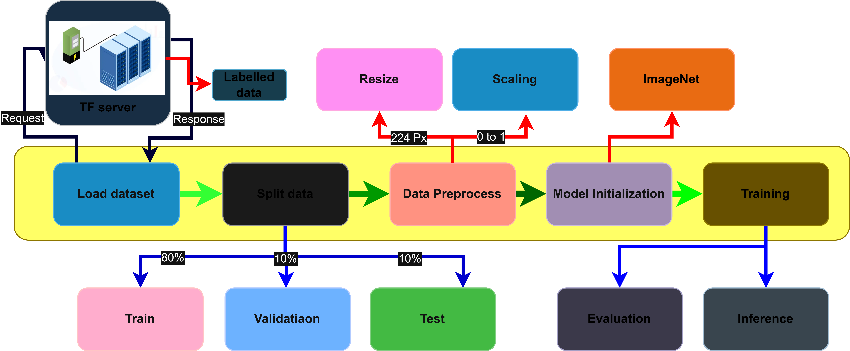
I. ABOUT THE PIPELINE

Slide 5
II. CODE WALKTHROUGH
i. Imports
import tensorflow as tf
import tensorflow_datasets as tfds
import numpy as np
from sklearn.metrics import confusion_matrix, classification_report
import matplotlib.pyplot as plt
TensorFlow & TensorFlow Datasets: Used to load and preprocess datasets efficiently for deep learning.
NumPy: Helps in performing fast numerical and array operations.
Scikit-learn Metrics: Used to evaluate model performance using confusion matrix and classification reports.
Matplotlib: Enables visualization of data and model predictions through plots and graphs.

Slide 6
ii. Testing memory Growth
gpus = tf.config.experimental.list_physical_devices('GPU')
if gpus:
try:
for gpu in gpus:
tf.config.experimental.set_memory_growth(gpu, True)
except RuntimeError as e:
print(e)
GPU Detection: The code checks if any GPUs are available using TensorFlow.
Memory Growth: It enables dynamic memory allocation so TensorFlow uses only the required GPU memory instead of reserving all at once.

Slide 7
iii. Load Dataset
(data, info) = tfds.load('cats_vs_dogs', with_info=True, as_supervised=True)
Dataset Loading: Loads the Cats vs Dogs dataset directly from TensorFlow Datasets (TFDS).
Return Information: The with_info=True argument provides extra details like dataset size, classes, and splits.
Supervised Format: as_supervised=True returns the data as (image, label) pairs, making it ready for training.

Slide 8
iv. Visualize Images
for image, label in data['train'].take(4):
plt.figure()
plt.imshow(image)
plt.title("cat" if label.numpy() == 0 else "Dog")
plt.axis("off")
plt.show()
Sample Visualization: Displays the first 4 images from the training dataset.
Label Display: Shows the corresponding class name — “Cat” for label 0 and “Dog” for label 1.

Slide 9
v. Splitting data
ds_train_full = data['train']
total_count = info.splits['train'].num_examples
train_size = int(0.8 * total_count)
val_size = int(0.1 * total_count)
test_size = total_count - train_size - val_size
train = ds_train_full.take(train_size)
test_val = ds_train_full.skip(train_size)
val = test_val.take(val_size)
test = test_val.skip(val_size)
Full Dataset Reference: ds_train_full = data['train'] stores all training images for splitting.
Dataset Splitting: Calculates sizes for train (80%), validation (10%), and test (10%) using total_count.
Creating Train Set: take(train_size) selects the first 80% of images for training.
Creating Validation & Test Sets: Uses skip and take to separate the remaining 20% into validation and test datasets.

Slide 10
vi. Preprocessing
IMG_SIZE = 224
BATCH_SIZE = 32
def preprocess(image, label):
image = tf.image.resize(image, (IMG_SIZE, IMG_SIZE))
image = tf.cast(image, tf.float32) / 255.0
return image, label
Image Resizing: tf.image.resize resizes all images to a consistent size of 224×224 for model input.
Normalization: tf.cast(...)/255.0 scales pixel values from 0–255 to 0–1, which helps the model train faster and more stably.
Preprocessing Function: Encapsulates both resizing and normalization to apply consistently to all dataset images.
Label Preservation: Returns the original label unchanged, keeping the (image, label) pair format for supervised learning.

Slide 11
vii. Data Loader
train=train.map(preprocess).shuffle(1000).batch(BATCH_SIZE).prefetch(tf.data.AUTOTUNE)
val = val.map(preprocess).batch(BATCH_SIZE).prefetch(tf.data.AUTOTUNE)
test = test.map(preprocess).batch(BATCH_SIZE).prefetch(tf.data.AUTOTUNE)
Apply Preprocessing: .map(preprocess) applies resizing and normalization to all images in the dataset.
Batching: .batch(BATCH_SIZE) groups images into batches of 32 for efficient training.
Shuffling (Train Only): .shuffle(1000) randomizes the training data to improve model generalization.
Prefetching: .prefetch(tf.data.AUTOTUNE) overlaps data preprocessing and model execution to speed up training.

Slide 12
viii. Model Initialization
base_model = tf.keras.applications.MobileNetV2(
input_shape=(IMG_SIZE, IMG_SIZE, 3),
include_top=False,
weights='imagenet’
)
MobileNetV2 Backbone: Used as a feature extractor to capture important patterns from images.
Pre-trained Weights: Loads ImageNet weights to leverage learned visual features for faster and better training.
SSD Lite Reference: Acts like the SSD Lite backbone, but here it’s adapted for classification instead of object detection.

Slide 13
ix. Adding Classification Head
model = tf.keras.Sequential([
base_model,
tf.keras.layers.GlobalAveragePooling2D(),
tf.keras.layers.Dense(128, activation='relu'),
tf.keras.layers.Dropout(0.3),
tf.keras.layers.Dense(2, activation='softmax')
])
model.compile(optimizer=tf.keras.optimizers.Adam(learning_rate=1e-4),
loss='sparse_categorical_crossentropy',
metrics=['accuracy'])
Sequential Model: Combines the MobileNetV2 backbone with a custom classification head for Cat vs Dog prediction.
GlobalAveragePooling2D: Reduces spatial dimensions of feature maps to a single vector for each image.
Dense Layers + Dropout: Adds a fully connected layer with 128 units, ReLU activation, and dropout (0.3) to reduce overfitting.
Compilation: Uses Adam optimizer, sparse categorical cross-entropy loss, and tracks accuracy as the evaluation metric.

Slide 14
x. Model Training
history = model.fit(train,
validation_data=val,
epochs=10)
Model Training: Trains the model on the train dataset for 10 epochs.
Validation: Uses the val dataset to monitor performance after each epoch.
History Object: Stores training and validation metrics (loss and accuracy) for plotting or analysis.

Slide 15
xi. Evaluation
y_true = []
y_pred = []
for images, labels in test:
preds = model.predict(images)
y_true.extend(labels.numpy())
y_pred.extend(np.argmax(preds, axis=1))
cm = confusion_matrix(y_true, y_pred)
print("Confusion Matrix:\n", cm)
report = classification_report(y_true, y_pred, target_names=['Cat', 'Dog'])
print("Classification Report:\n", report)
import seaborn as sns
plt.figure(figsize=(6,6))
sns.heatmap(cm, annot=True, fmt='d', cmap='Blues', xticklabels=['Cat', 'Dog'], yticklabels=['Cat', 'Dog'])
plt.xlabel('Predicted')
plt.ylabel('True')
plt.show()

Slide 16
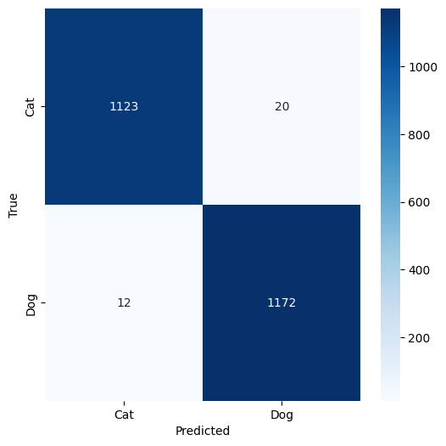
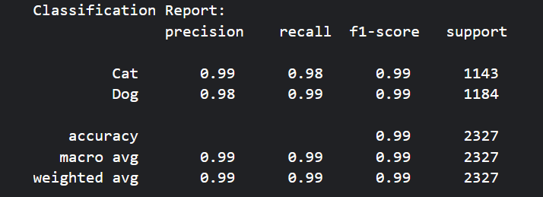
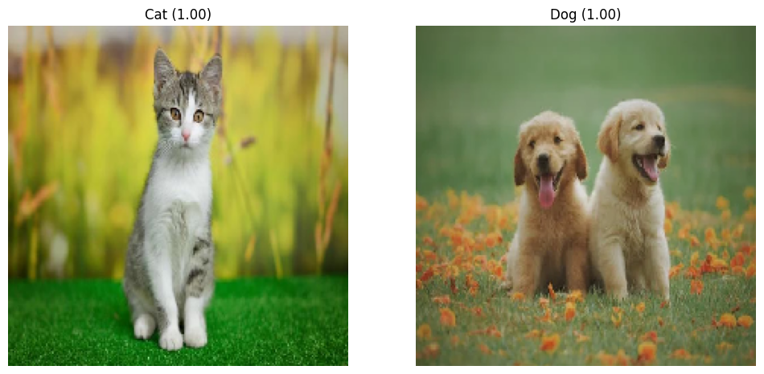
III. RESULT & INFERRENCE

Slide 17
THANK YOU

