Slide 1







IBM Data Analyst Capstone Project
Sahil Chacherkar
30-04-2024

Slide 2



OUTLINE
Executive Summary
Introduction
Methodology
Results
Visualization – Charts
Dashboard
Discussion
Findings & Implications
Conclusion
Appendix

Slide 3

EXECUTIVE SUMMARY
Data collection and analysis
Describe Methods
Data gathering
Data Analysis
Data visualizations
Presentation of Graphs and Trends
Discussion of findings
Final Conclusions of the Research

Slide 4

INTRODUCTION
This presentation report uses data analytics to highlight current and projected trends in the need for skills related to programming languages, databases, platforms and web frames.
The following inquiries were investigated using the data:
1. Which programming languages are most in demand today?
2. What are the most in-demand database skills?
3. What popular IDEs or Web frames are there?
The target audience for this research are IT professionals, HR managers, and anybody else with an interest in the IT sector who wants to learn about the top on-demand IT skills in their respective sectors that will also still be relevant in the future.

Slide 5

METHODOLOGY
Data Sources:
Stack overflow developer 2019 survey
GitHub job posting
Programming language annual salary
Data Wrangling
Data Exploration
Data Cleaning
Data Visualization
IBM Cognos Analyst
Presentation

Slide 6
RESULTS

Slide 7
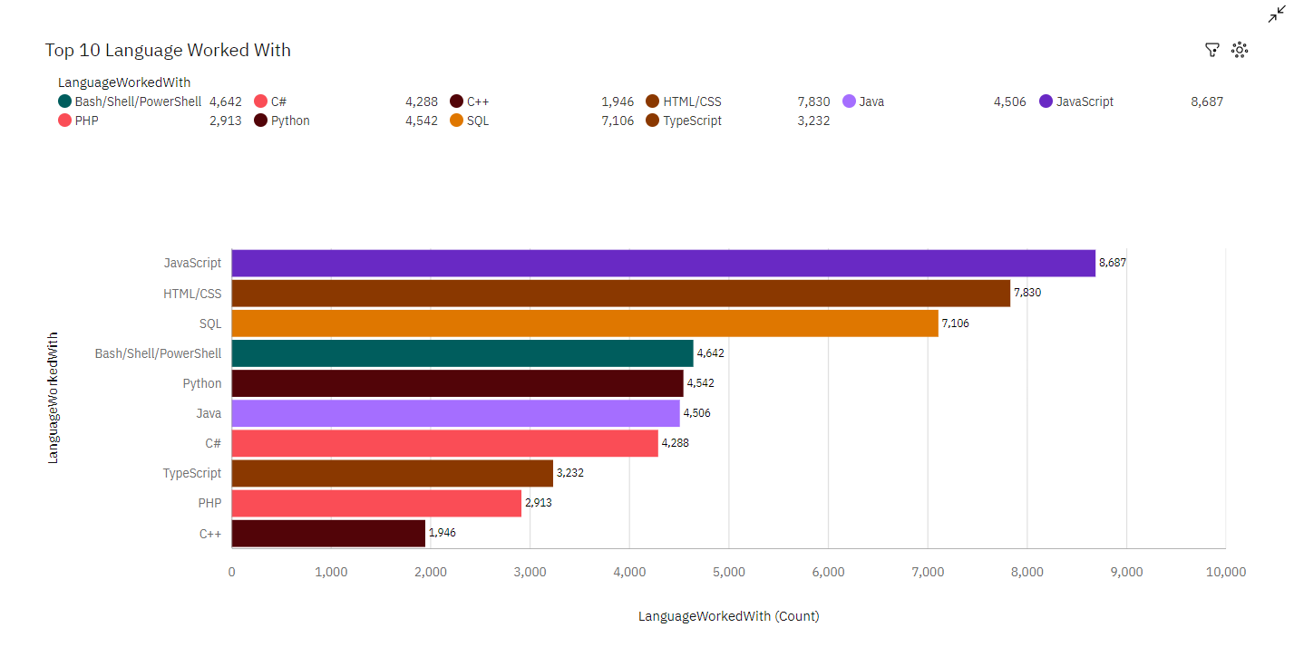
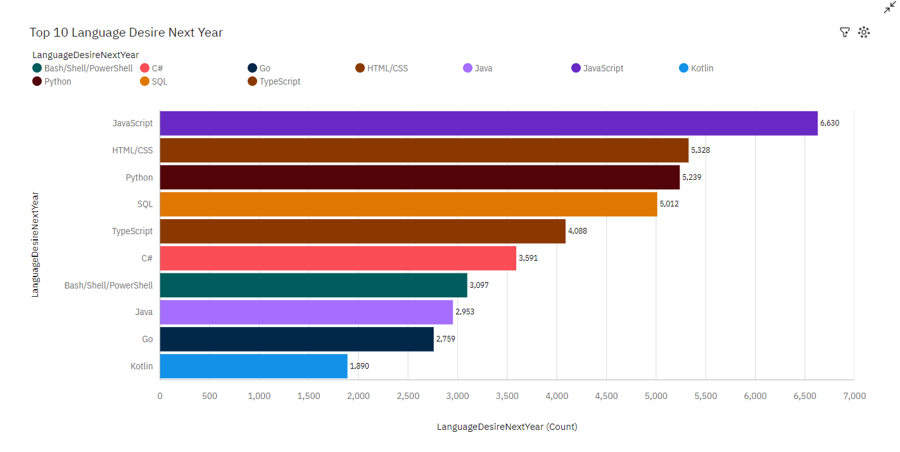
PROGRAMMING LANGUAGE TRENDS
Current Year
Next Year
<Bar chart of top 10 programming languages for the current year goes here.>
< Bar chart of top 10 programming languages for the next year goes here.>

Slide 8
PROGRAMMING LANGUAGE TRENDS - FINDINGS & IMPLICATIONS
Findings
JavaScript is Top most language in the world
JavaScript, HTML/CSS, SQL, Python are top language in current and Future.
Python and TypeScript are being more popular.
Implications
Web developments and Web developers are still in high demands
JavaScript and TypeScript are crucial to learn for developers Implication
Python is the new trending language, especially popular in AI fields

Slide 9
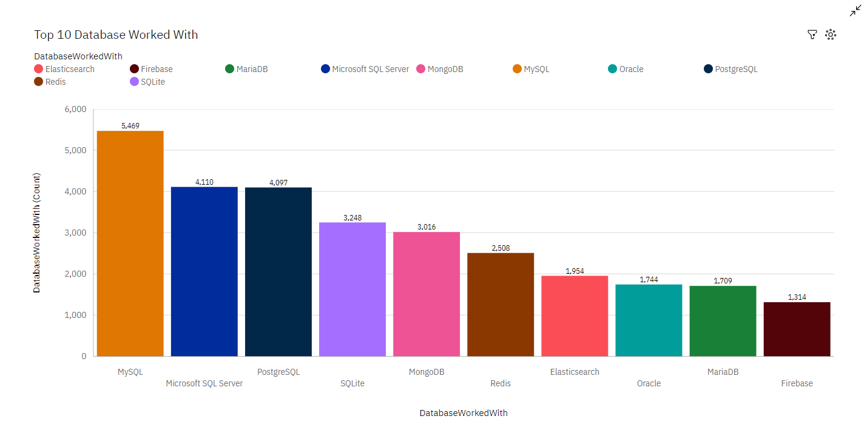
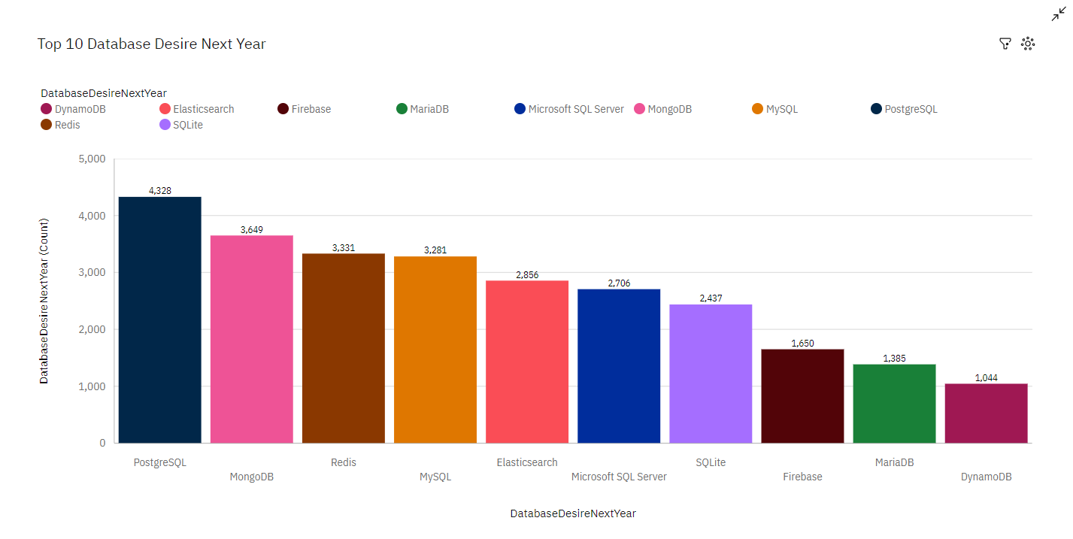
DATABASE TRENDS
Current Year
Next Year
< Bar chart of top 10 databases for the current year goes here >
< Bar chart of top 10 databases for the next year goes here.>

Slide 10
DATABASE TRENDS - FINDINGS & IMPLICATIONS
Findings
MySQL is the most popular database
There are still a lot of companies using Microsoft SQL Server Finding
MongoDB and Redis are the most favorable NoSQL database
Implications
SQL is still a top tool to watch out for in data specialists.
Companies still prefer Open source databases.
Oracle SQL was not among the top 5. It is losing relevance as time passes.

Slide 11

DASHBOARD
https://us3.ca.analytics.ibm.com/bi/?perspective=dashboard&pathRef=.my_folders%2FData%2BAnalyst%2BCapstone%2BProject%2Bweek%2B5&action=view&mode=dashboard&subView=model0000018f2a11f72e_00000000

Slide 12
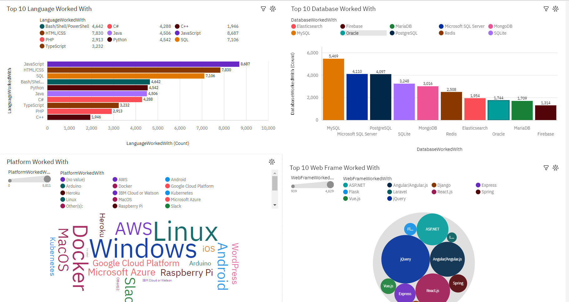
DASHBOARD TAB 1
Screenshot of dashboard tab 1 goes here

Slide 13
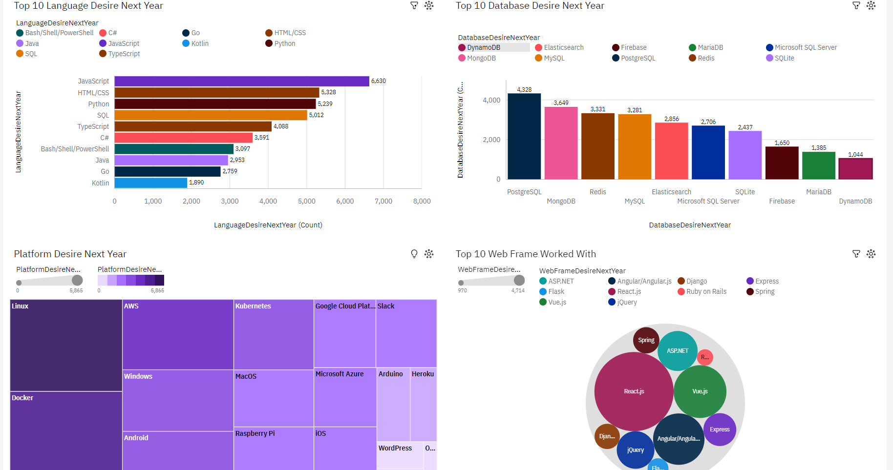
DASHBOARD TAB 2
Screenshot of dashboard tab 2 goes here

Slide 14
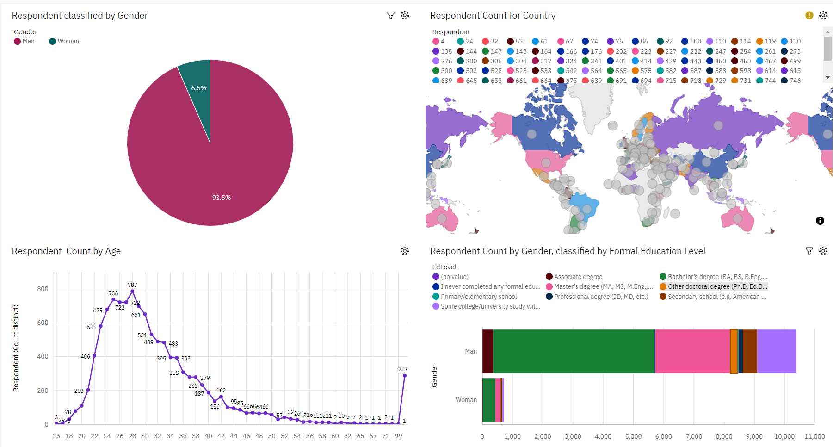
DASHBOARD TAB 3
Screenshot of dashboard tab 3 goes here

Slide 15
DISCUSSION
What is Technology Usage?
What is Trend Now and in Future?
Hoe we close Gender gap in IT?
Education Discrimination in IT Sector

Slide 16
OVERALL FINDINGS & IMPLICATIONS
Findings
Technology trends changes every year
Most people in the IT field have a Bachelors' degree.
USA is the top technology country
Most respondents want to learn Postgre SQL and React JS next year
Implications
Web development is still a very lucrative skill.
Programmers should always follow the latest technology trends Implication
More countries should have the equal chance to be exposed to new technology

Slide 17

CONCLUSION
A good idea of popularity trends of different tools, platforms and languages can be obtained.
It is expedient to stay updated in the Tech sector as the trends keep changing over time.

Slide 18

APPENDIX

Slide 19
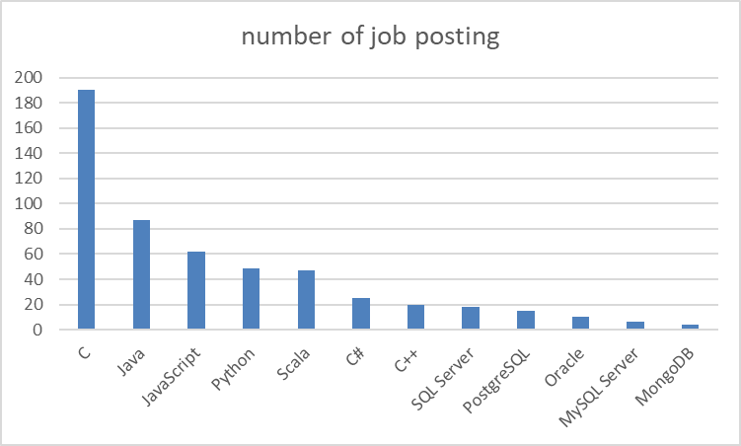
JOB POSTINGS
In Module 1 you have collected the job posting data using Job API in a file named “job-postings.xlsx”. Present that data using a bar chart here. Order the bar chart in the descending order of the number of job postings.

Slide 20
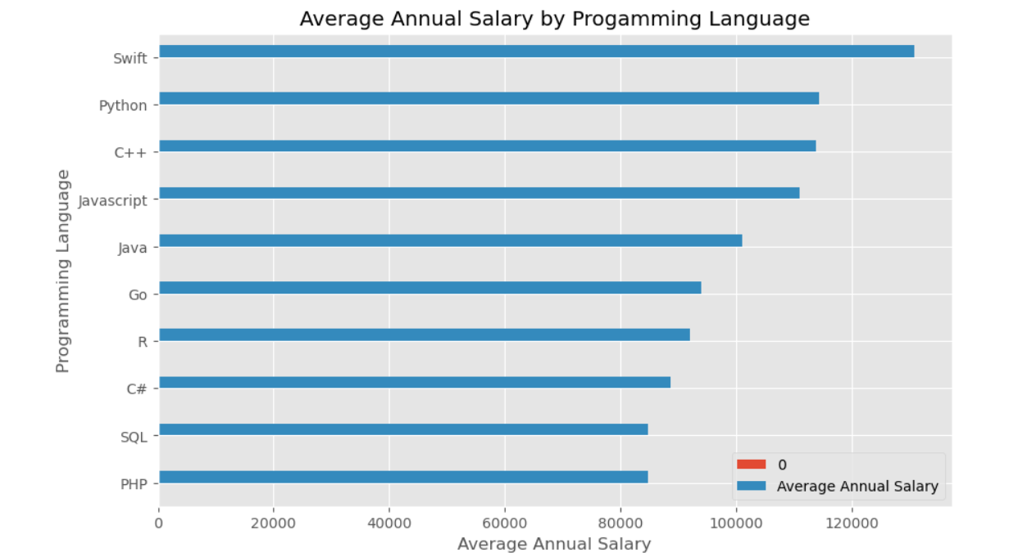
POPULAR LANGUAGES
In Module 1 you have collected the job postings data using web scraping in a file named “popular-languages.csv”. Present that data using a bar chart here. Order the bar chart in the descending order of salary.

