Slide 1
Team COVENANTE
Google Developer Group On Campus — Hackathon
Team Leader: Sahil Lamture
DevOps: Yash Andhle
Frontend & UI: Supriya Choubay
Database Engineer: Shivtej Mahatme
Problem Statement: Open Innovation

Slide 2
Brief About Your Solution and Problem Statement
The Problem
A significant number of college students possess valuable skills — from graphic design and web development to video editing and tutoring — yet have no structured platform to offer these skills within their own campus. Existing freelancing platforms like Fiverr and Upwork are designed for seasoned professionals, leaving students unable to compete, gain experience, or earn. As a result, students graduate with theoretical knowledge but little to no real-world work experience. Within colleges, opportunities are shared through informal WhatsApp groups where requests get lost, there is no accountability, and no way to verify quality or build a credible portfolio.
Our Solution — GigSchool
GigSchool is a campus-exclusive micro-freelancing platform that transforms a college into a self-sustaining skill economy. Students can post gigs, apply for tasks, build verified portfolios, and earn peer reviews — all within a trusted community of their own classmates. By enabling students to earn while they learn and graduate with real, verifiable work experience, GigSchool bridges the gap between academic learning and professional readiness.

Slide 3
Opportunities
a. How is it different from existing ideas?
Unlike mainstream freelancing platforms such as Fiverr, Upwork, or Freelancer, GigSchool is built exclusively for college communities. It is not competing in the open market — it creates a closed, trust-based ecosystem where every user is a verified student. There is no intimidation of competing with experienced professionals, no high commission fees, and no anonymity. Students deal with classmates they can meet in person, making accountability natural. Additionally, GigSchool integrates AI-powered features — from auto-generating gig descriptions to AI-assisted pitch writing and smart review generation — making it effortless for students who have never freelanced before to get started.
b. How will it solve the problem?
GigSchool gives every student a platform to monetize their skills from day one of college. A design student can take on logo projects, a CS student can build websites, a commerce student can offer accounting help — all within campus. The built-in portfolio system, peer reviews, and verified work history create a professional profile that students carry beyond graduation. By the time they enter the job market, they already have real client work, testimonials, and proof of skills — something no classroom project can replace.

Slide 4
List of Features Offered by the Solution
🔥 Standout Features
AI Gig Creator — Students describe what they need in plain English, and AI auto-generates a complete, professional gig listing
AI Pitch Writer — Generates tailored application pitches so students can apply confidently, even with zero freelancing experience
AI Review Assistant — Helps students write thoughtful, constructive reviews after gig completion
College-Only Access — Restricted to verified college emails, creating a safe, trusted, closed community
Core Platform
Gig Marketplace — Post, browse, and apply for campus gigs across categories like design, coding, tutoring, and content writing
Smart Application System — Apply with pitches, track real-time status, and receive instant notifications
Portfolio Builder — Upload and showcase work directly on your profile to build credibility
Reviews & Ratings — Peer-reviewed reputation system that builds a verifiable track record
Bookmarking — Save gigs of interest for quick access later

Slide 5
Google Technologies Used in the Solution
Google Gemini AI
Gemini AI is deeply integrated throughout the entire GigSchool user journey, powering three core AI features that differentiate the platform:
AI Gig Creator: Auto-generates complete gig listings — title, description, requirements — from a simple natural language prompt
AI Pitch Writer: Crafts personalized, compelling application pitches tailored to each gig, helping students stand out
AI Review Assistant: Generates thoughtful peer reviews based on the gig experience, maintaining quality feedback across the platform

Slide 6
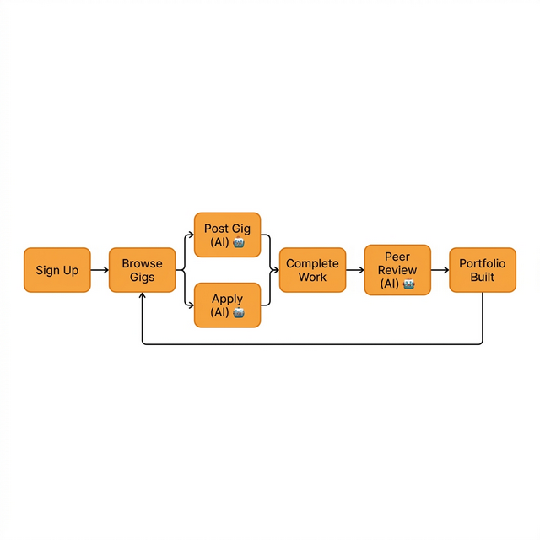
Process Flow Diagram

Slide 7
Wireframes/Mock diagrams of the proposed solution
Live Demo After Presentation
A fully functional demonstration of GigSchool will be presented live

Slide 8
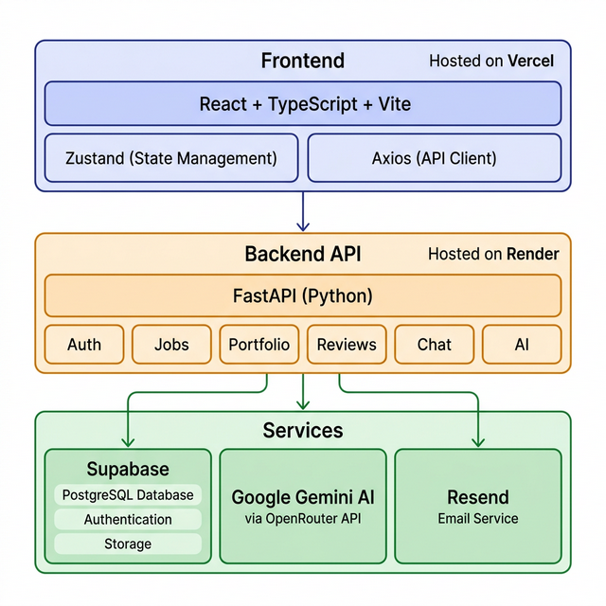
Architecture Diagram of the Proposed Solution

Slide 9
Additional Details / Future Development
Campus Analytics Dashboard: Shows college-wide stats: most in-demand skills, total gigs completed, money earned by students — data the college administration would love
Collaboration Rooms: Students can team up on bigger gigs together, splitting work and earnings — turning solo freelancing into team projects
AI-Powered Resume Builder: Automatically generates a professional resume from a student's GigSchool activity — gigs completed, reviews received, portfolio pieces — ready to share with recruiters
Mobile App: Native Android/iOS app for on-the-go access to gigs and notifications
In-App Payments: Integrated payment system so students can pay for gigs directly through GigSchool, with escrow protection for both parties

Slide 10
Provide Links To Your:
1. GitHub Public Repository
2. Demo Video Link (3 Minutes)
3. MVP Link
(Links to be added)

Slide 11
Thank You!
Team COVENANTE
GigSchool — Your Campus, Your Skills, Your Economy

