Slide 1

Trending places in TORONTO
Capstone Report

Slide 2
Introduction
A famous restaurant chain, headquartered in London, had slowly expanded their arms to various untouched cities in Europe.
Collaborated with major local players in approximately 34 cities in western Europe
The company wants to expand its boundary and this time they have their eye on Toronto. The company is looking forward for major experience and food players also they are looking forward for some trending places in Toronto.

Slide 3
Data
Focus here is to shortlist trending areas in the Toronto, and not the exact Restaurants and Entertainment centers.
Data from Foursquare.com as well various other website, also we will be loading some CSV containing data which might be helpful for our analysis.

Slide 4
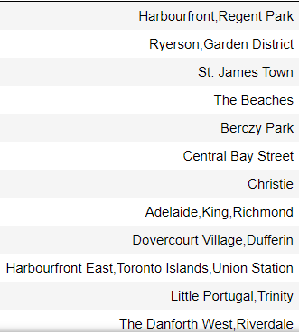
Findings
Users rating and average number people visiting that area, helps in shortlisted several places in the Toronto

Slide 5
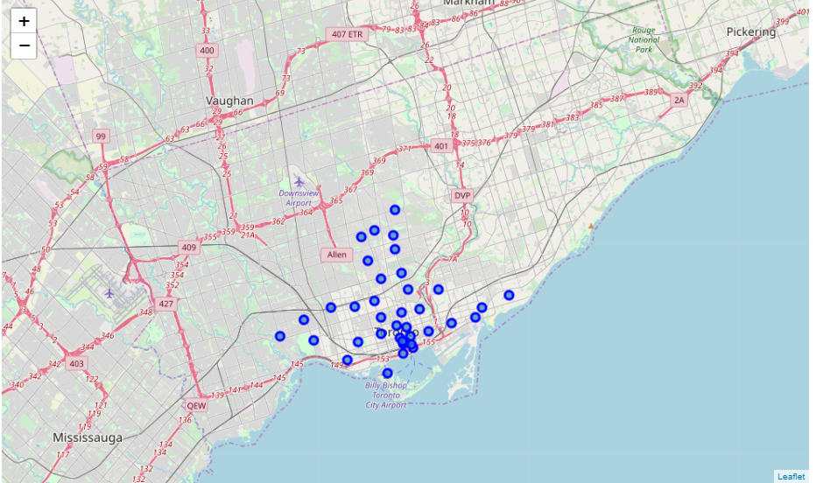
The Company should definitely have a look at these places in Toronto.
These places could significantly benefit the collaboration decision

