Slide 1
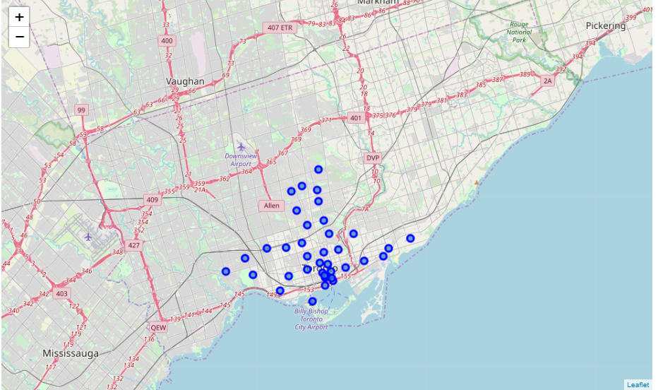

Trending places in TORONTO
Capstone Report

Slide 2
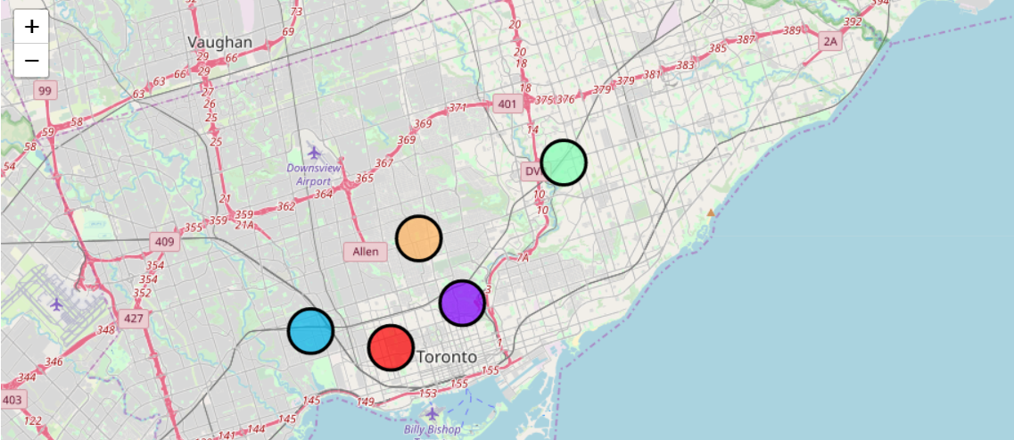
Introduction
A famous restaurant chain, headquartered in London, had slowly expanded their arms to various untouched cities in Europe.
Collaborated with major local players in approximately 34 cities in western Europe
The company wants to expand its boundary and this time they have their eye on Toronto. The company is looking forward for major experience and food players also they are looking forward for some trending places in Toronto.

Slide 3
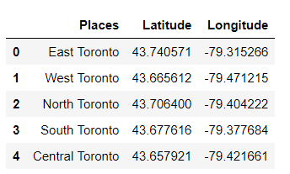
Data
Focus here is to shortlist trending areas in the Toronto, and not the exact Restaurants and Entertainment centers.
Data from Foursquare.com as well various other website, also we will be loading some CSV containing data which might be helpful for our analysis.
We had divided the whole Toronto into 5 main regions called North ,West, South, East and Central Toronto. We will be selecting one out of the five areas

Slide 4
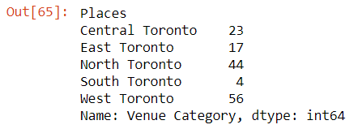
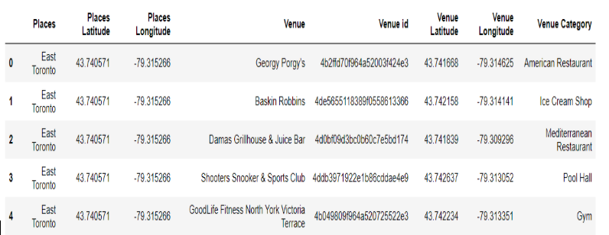
Findings
We load the data in python and also use Foursquare API to generate a series of results which includes the trending area in Toronto.
Then we plot an histogram to visualise different places based on the number of different counts of venue.
We explore the different venue using the Foursquares credentials and converting the obtained Json file in to the pandas dataframe for our further analysis.

Slide 5
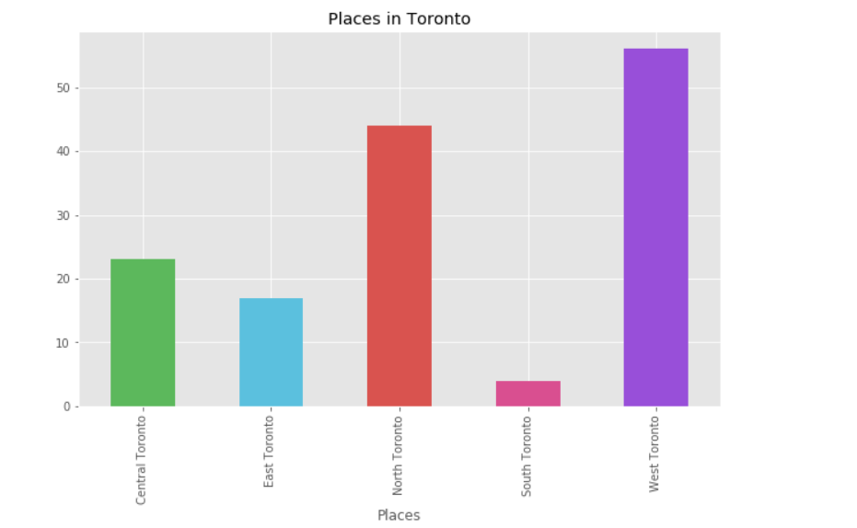
Findings
We group the places accordingly to the different venues counts on the data frame.
We load the data in python and also use Foursquare API to generate a series of results which includes the trending area in Toronto.
Then we plot an histogram to visualise different places based on the number of different counts of venue.

Slide 6
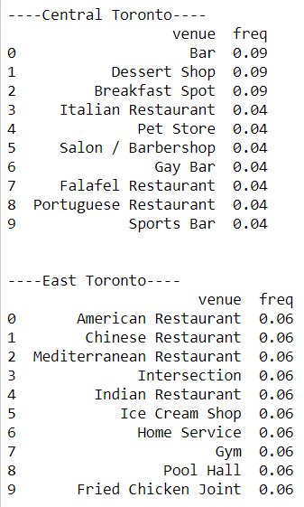
Findings
We select top 10 venues in each of the five zones, the python output is as follows:
Based on the users rating and average number people visiting that area, we had shortlisted several places in the Toronto.

Slide 7
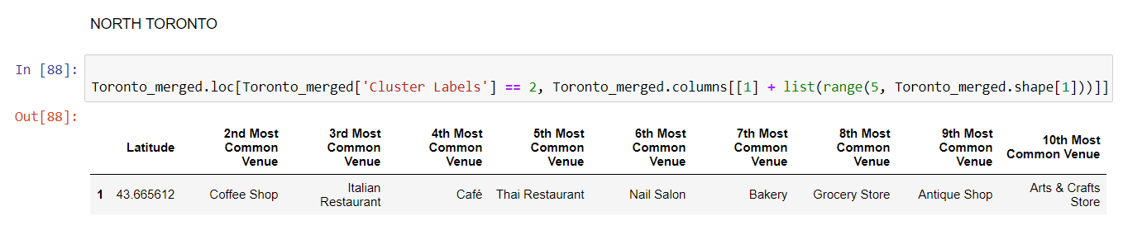
Results
North Toronto should be the place where the company should target to acquire new partner in food industry as it has 4 out 10 food centres in the most common venue table.
Also all 4 of them fall under top 4 most common venue in North Toronto.

Slide 8
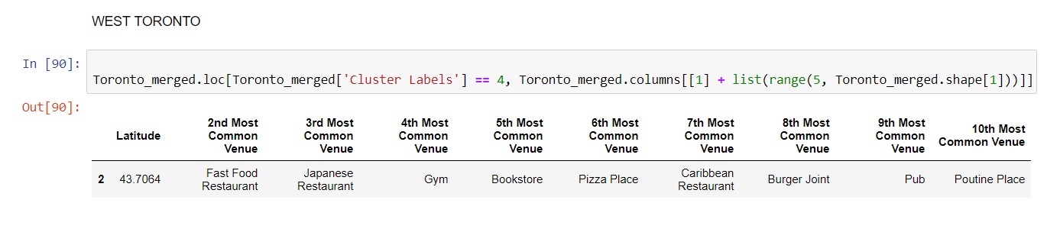
Results
B. Apart from North Toronto the
Company can also Look
forward in central Toronto
As west Toronto has 5 food centres out of its 10 most common venues list.

