Slide 1

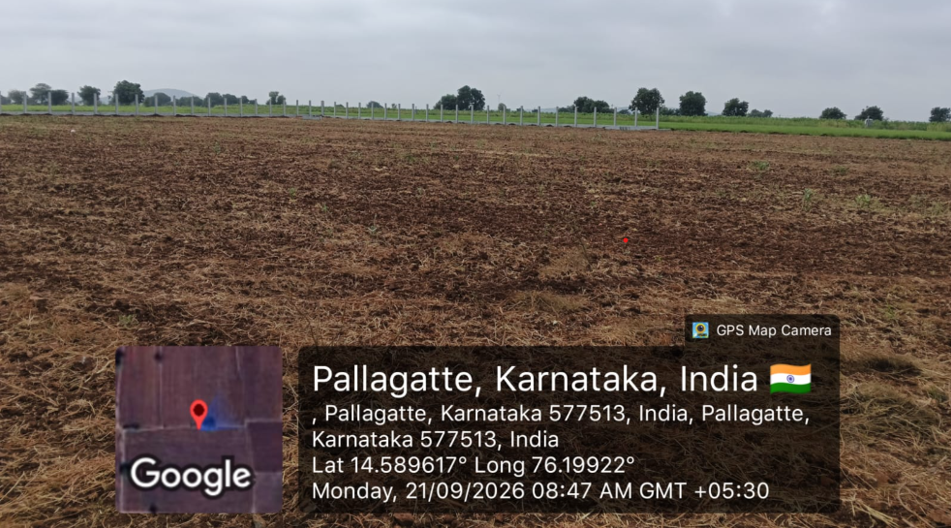
Confidential. Prepared for Swelect Energy Systems Ltd by Dexler Energy.
DEVELOPERS OF SOLAR POWER PLANTS
Weekly Project Report
WEEK 43
Reporting week ending 17 Oct 2026
CLIENT
PROJECT
Swelect Energy Systems Ltd
5 MW AC / 7 MWp DC ground-mount solar park
LOCATION
COMMISSIONING (COD)
Pallaghatta, Karnataka
28 Nov 2026 baseline
Forecast 18 Dec 2026
Pallaghatta 5MW Solar Park · Site Construction & Commissioning Track
Prepared by Project Delivery, Dexler Energy
1

Slide 2
Confidential. Prepared for Swelect Energy Systems Ltd by Dexler Energy.
Delivery Timeline
Swelect Energy Systems Ltd · Week 43 · 17 Oct 2026
OVERALL PROGRESS
DAYS TO COD
COMMISSIONING DATE
36%
Plan: 66.1% · -30.1% Behind
42
Forecast: 63 days (+21d slip)
28 Nov 2026
Forecast COD: 18 Dec 2026 · HOTO: 31 Jan 2027
Workstream
Jul
Aug
Sep
Oct
Nov
Dec
Jan
TODAY
KEY STAGE MILESTONES
Land
33%
1
CEIG approval
04 Nov 26
Approvals
2%
Delayed / Critical Path
CEIG Approval
5%
2
PV module installation
06 Nov 26
WBA
0%
In Progress
Bay Work
0%
Bay work completion
3
17 Nov 26
Transmission Line
52%
Critical Path
Site Land Prep
100%
Synchronisation approval
4
27 Nov 26
Detailed Engineering
100%
Statutory Gate
Procurement & Delivery
34%
5
Commissioning (COD)
28 Nov 26
Construction
22%
Contractual COD
Handover (HOTO)
0%
6
Final handover (HOTO)
15 Dec 26
Compound Wall
50%
Final Handover
Progress to date
Behind schedule
Complete
Planned position today
Source: Swelect Gantt sheet · 12 workstreams · 6 milestone gates strictly bounded
2

Slide 3
Confidential. Prepared for Swelect Energy Systems Ltd by Dexler Energy.
Status Detail · week ending 17 Oct
Swelect Energy Systems Ltd · Week 43 · 17 Oct 2026
WBS | Task / Activity Name | Planned Finish | Status & Delay | Progress
1.1 | TB Meeting & Bay Estimate | 19 Sep 26 | Delayed 20 d · CP | 0%
1.2 | New GO Application for Additional 2 MW | 23 Sep 26 | Delayed 16 d · CP | 30%
1.3 | NA Conversion | 25 Sep 26 | Delayed 14 d · CP | 0%
1.4 | Hudbast survey | 25 Sep 26 | Delayed 14 d · CP | 0%
1.5 | Bay Work Payment Intimation | 25 Sep 26 | Delayed 14 d · CP | 0%
1.6 | Bay Work Taken Approval | 01 Oct 26 | Delayed 8 d · CP | 0%
2.1 | DC cables | 25 Sep 26 | Delayed 14 d | 40%
2.2 | Control room | 25 Sep 26 | Delayed 14 d | 0%
3.1 | Transmission Line | 10 Oct 26 | In progress | 50%
2.3 | Inverter | 15 Oct 26 | In progress | 35%
2.4 | Inverter Transformer | 17 Oct 26 | In progress · CP | 35%
4.1 | MCS Drawing, Street Light, SCADA cable Laying (Drawings) | 23 Sep 26 | Completed 30 Sep | 100%
4.2 | Solar Module (Supply) | 28 Sep 26 | Completed 25 Sep | 100%
+ 18 further open items in the project Gantt · Complete weekly schedule tracked in single view
3

Slide 4
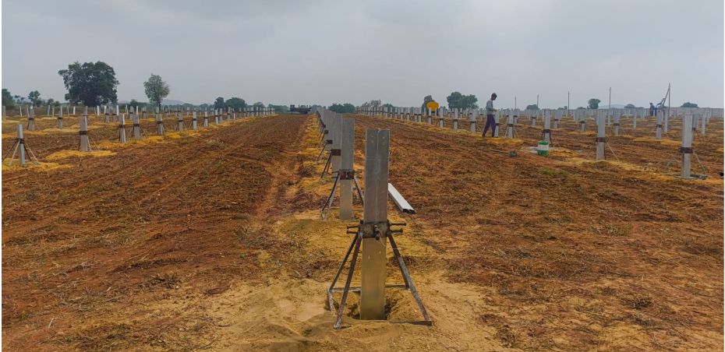
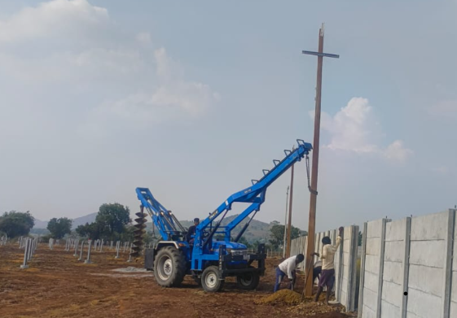
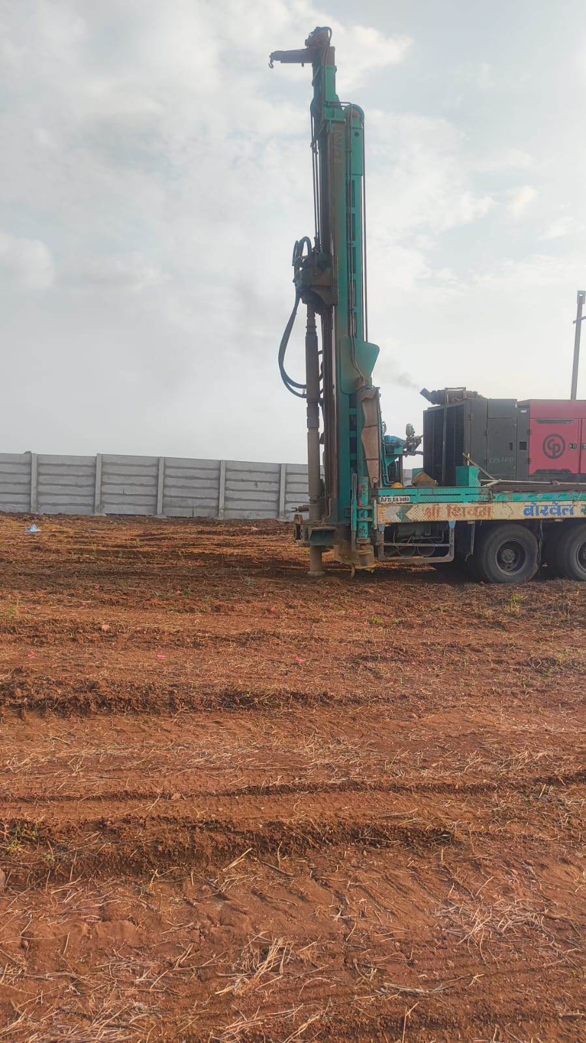
Confidential. Prepared for Swelect Energy Systems Ltd by Dexler Energy.
Site Progress & Next Two Weeks Look-Ahead
Swelect Energy Systems Ltd · Week 43 · 17 Oct 2026
Switchyard & Control Room Civil Works
Solar Array Area & Transmission Line Route
Inverter & Transformer Foundation Yard
NEXT TWO WEEKS LOOK-AHEAD EXECUTION PLAN (14-DAY CRITICAL SCHEDULE)
Transmission Line work in progress
Critical Path
Due 10 Oct
TAQC Inspection for PCVCB & Metering Panel (CP)
Critical Path
Due 12 Oct
Excavation work for DC and AC cable trench
Civil Works
Due 13 Oct
Foundation of Inverter, Transformer, HT panel (CP) work in progress
Critical Path
Due 15 Oct
Inverter delivery
Procurement
Start 17 Oct
Cable inspection is going delivery by 22nd Oct
Inspection FAT
Starts 22 Oct
Switchyard & Pile Casting completion
Milestone Gate
Due 28 Oct
4

Slide 5
Confidential. Prepared for Swelect Energy Systems Ltd by Dexler Energy.
Risks and Client Actions
Swelect Energy Systems Ltd · Week 43 · 17 Oct 2026
PROJECT RISKS & BOTTLENECK ITEMS
WHAT WE NEED FROM YOU (CLIENT ACTIONS)
GO Name Transfer / Change
OPEN
ACTION ITEM 1: Share Holding Agreement Execution
Description & Current Status:
Awaiting Share Holding Agreement from Swelect Management.
Awaiting Shareholding Agreement from Swelect.
Urgency / Critical Dependency:
Potential Project Impact:
This agreement is the primary prerequisite for Government Order (GO) Name Transfer sanction. Without this document, statutory evacuation clearance cannot proceed.
Can affect the statutory approval timelines and COD synchronization schedule.
Mitigation Strategy:
Dexler liaison team actively coordinating with Swelect legal team to expedite draft execution.
ACTION ITEM 2: Commercial Payment Clearance
Transmission Line RoW & Bay Synchronization
CRITICAL PATH
Request for 25% payment towards other Class 1 materials and construction materials.
Right of Way clearance and Bay work payment sanctions are tracked daily to maintain target COD alignment.
Commercial Justification & Site Impact:
Disbursement is required to release long-lead vendor dispatches (Inverter stations, Bay equipment, balance of system structural elements) to maintain schedule momentum.
Client points of contact: Dexler Project Delivery team.
Escalation Level: Immediate Executive Review · Requested by Dexler PMO
5

