Slide 1
Credit Card Fraud Detection Using Data Mining & Machine Learning Techniques
Rama Tejaswini Thotapalli
Priya Yadav
Jessica Mathias
Sai Ashrith Aduwala
Farhaan Patel

Slide 2
Flow Of Talk
Introduction/Problem Statement
Dataset Collection
Data Visualization
Preprocessing Techniques
Implementation Methods
Performance Evaluation and Results
Innovation
Tools Used
Conclusion

Slide 3
Introduction
Credit Card Fraud
Done by using false identity
Done by using stolen credit card
Key factors credit card frauds are recognized
Location: Purchase made from different location
Items you buy: If you deviate from your regular buying
pattern or time
Frequency: Make large number of transactions in short period of time
Amount: Suddenly if the costly items are purchased

Slide 4
Problem Statement
There has been a growing amount of financial losses due to credit card frauds as the usage of credit cards become more common.
So there is a need, classify which transaction is fraud and non fraud based on the transaction factors.

Slide 5
Dataset Collection
Volume : No. of rows before preprocessing, Rows: 500,000, Features: 320. After PCA, 84,807 records and 31 most prominent features were chosen.
Velocity: This project too works with high velocity data of credit card transactions captured over a period of 2 days from European card holders
Veracity: The dataset has been used in several IEEE research papers which can be authenticated. Also the dataset is prepared by a payment service company called Vesta whose existence and authenticity are validated
Variety: Sensitive date which makes it hard to obtain. The dataset used in this paper is provided by two sources, IEEE-CIS in conjunction with Vesta Corporation which is a payment service company.

Slide 6
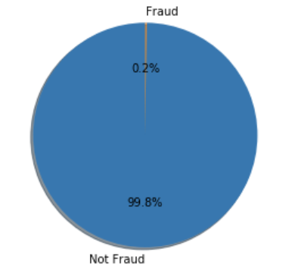
Data Visualization
Data Exploration

Slide 7
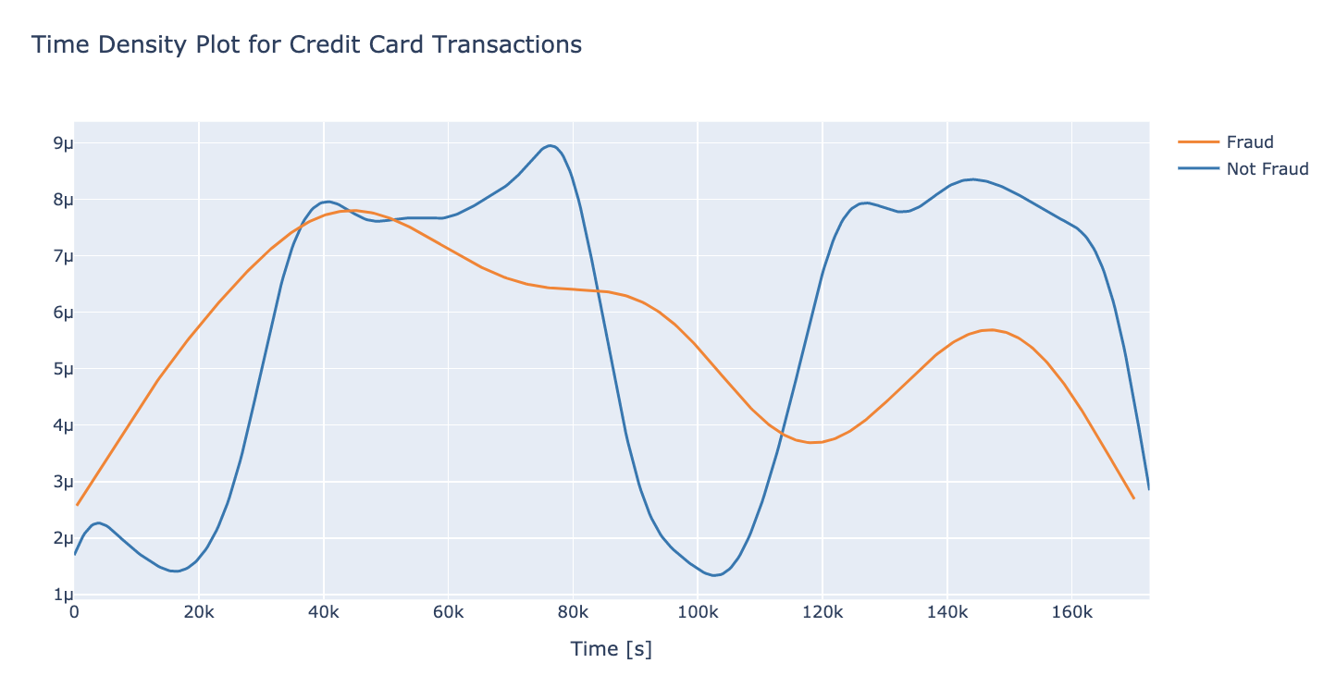
Time Density Plot

Slide 8
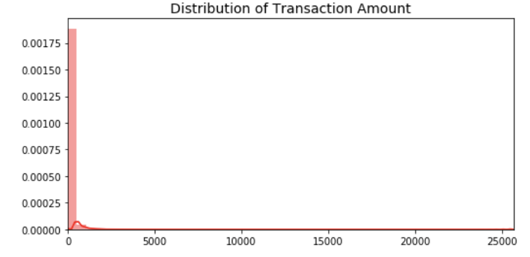
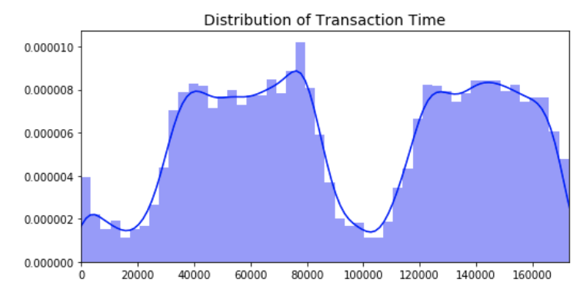
Transaction amount Vs Transaction time

Slide 9
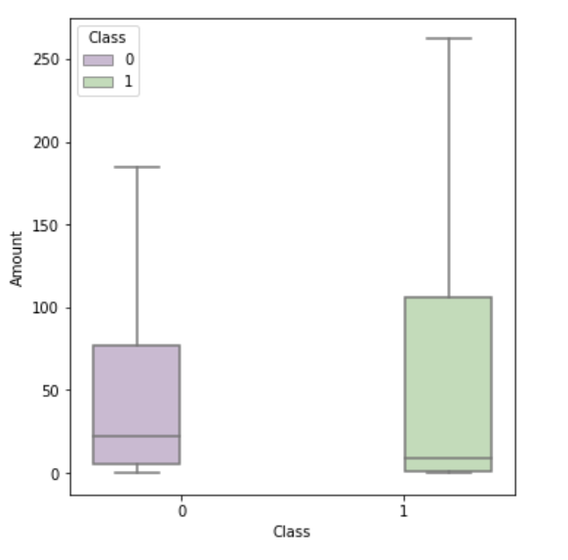
BoxPlots showing fraudulent transactions

Slide 10
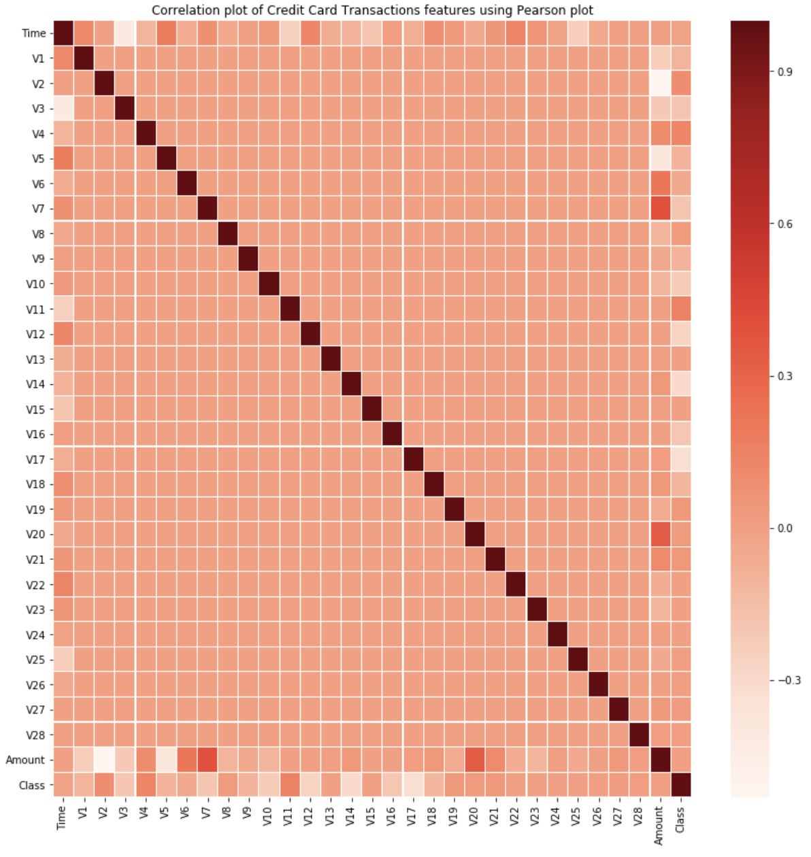
Correlation Plot

Slide 11
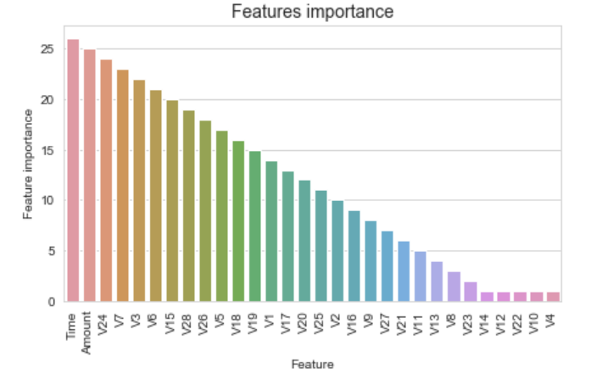
Feature Importance

Slide 12
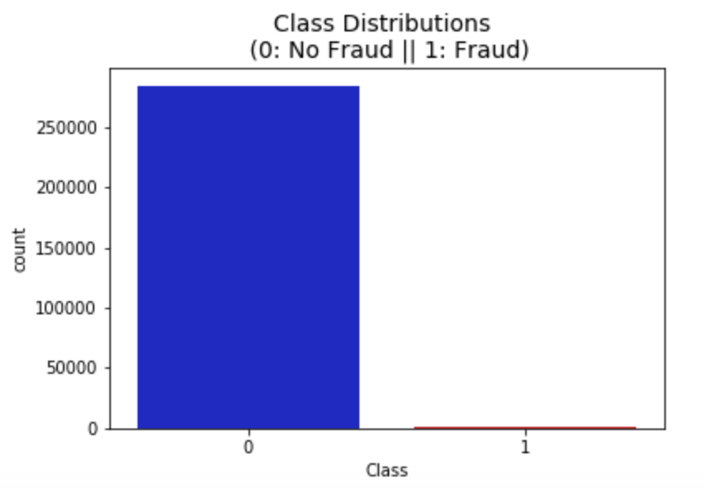
Challenges Of Dataset
The data is highly skewed.
Normal Machine Learning algorithms would give 99%+ Accuracy.
But we can get 99.8% accuracy even if we classify all Frauds as Legitimate.

Slide 13
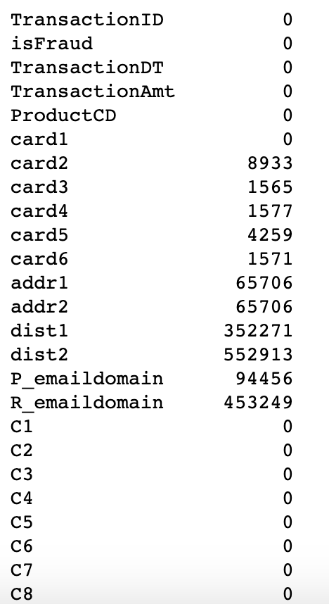
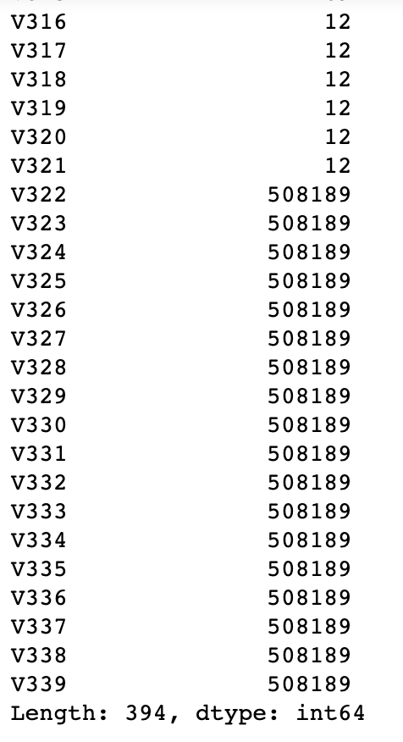
Challenges Of Dataset cont.
Dataset contains many null values

Slide 14
Data Preprocessing
Techniques used in Data Preprocessing
Data Cleaning
Memory Reduction
Under Sampling
Dimensionality Reduction
Feature Selection
Outlier detection

Slide 15
Data Cleaning
The data can have many irrelevant and missing parts. To handle this part, data cleaning is done. It involves handling of missing data, noisy data etc.
In our dataset so many columns has null values. These are handled by ignoring columns with more than 0.7 percent of null values.
Filled missing values by their mean

Slide 16
Data Transformation
This step is taken in order to transform the data in appropriate forms suitable for mining process.
This involves following ways:
Normalization
Standard Scalar
Attribute selection

Slide 17
Memory Reduction
Memory reduction techniques will reduce the memory
usage of the data.
In our dataset, the column values are changed to int32 ,
Int16 and int64 based on the maximum and minimum values of the dataset.
From this the memory reduced to almost 94 MB from 150
MB. There is almost 74.5% reduction in the memory usage.

Slide 18
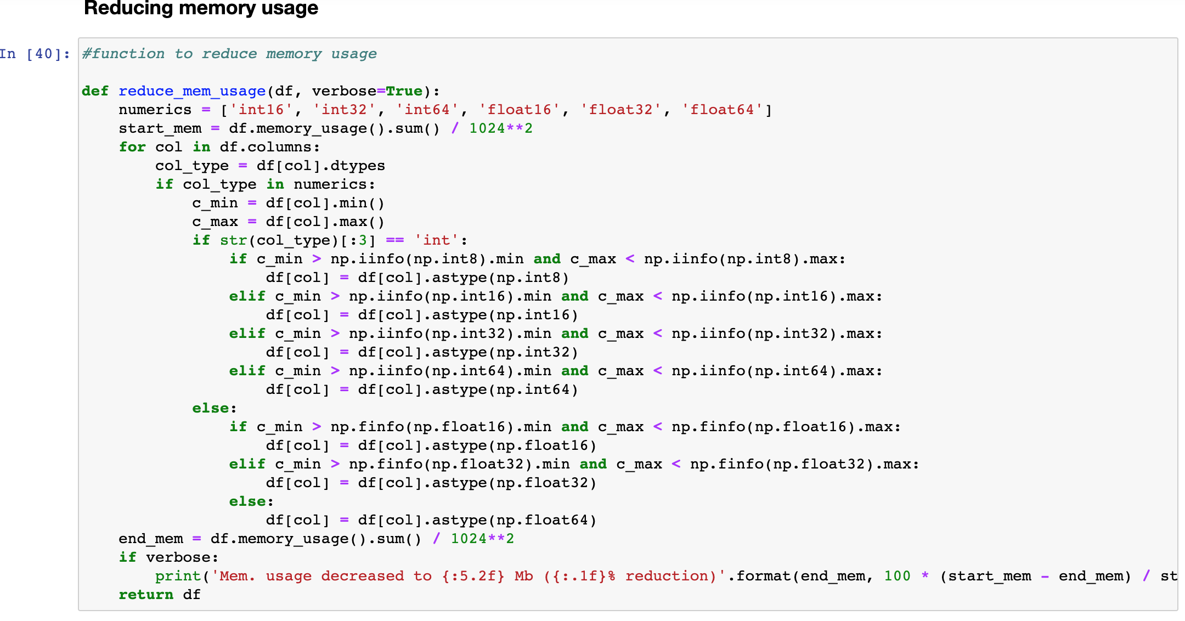
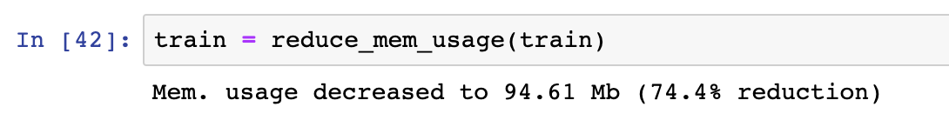
Memory Reduction Cont.

Slide 19
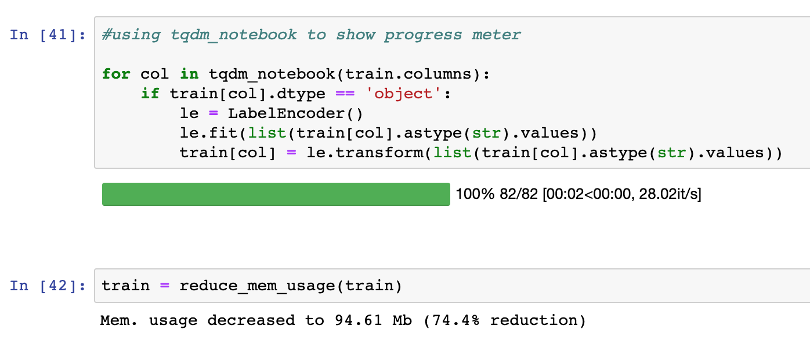
Memory Reduction Cont.

Slide 20
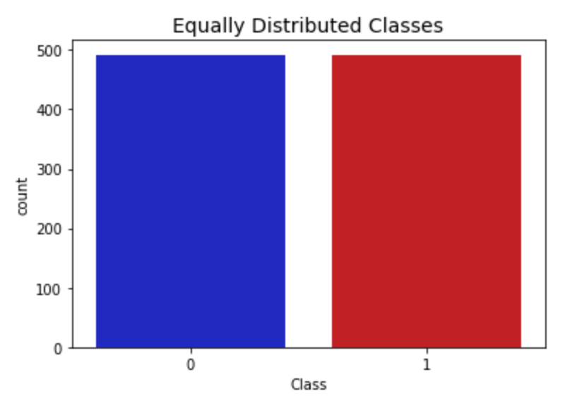
Sampling
Data Sampling is a statistical technique used to select, manipulate and analyze the representative subset of the data.
Here our dataset is skewed, the fraud transactions are only 492, we did under sampling of the data using stratified K fold.

Slide 21
Dimensionality reduction
In order to get rid of this, we uses data reduction technique. It aims to increase the storage efficiency and reduce data storage and analysis costs.
The various steps to data reduction are:
Attribute Subset Selection:
Highly relevant attributes should be used, rest all can be discarded
Dimensionality Reduction:
If after reconstruction from compressed data, original data can be retrieved, such reduction are called lossless reduction else it is called lossy reduction.
For this dataset, I have used Principle component analysis.

Slide 22
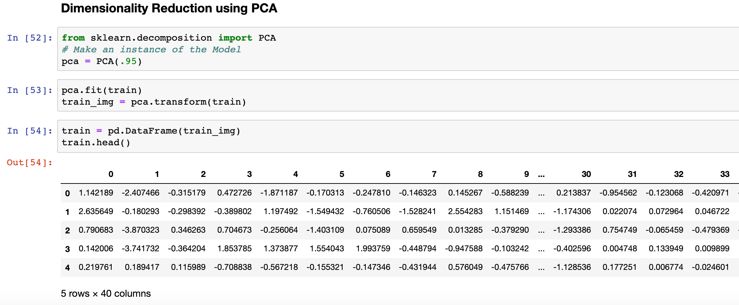
Principal component analysis

Slide 23
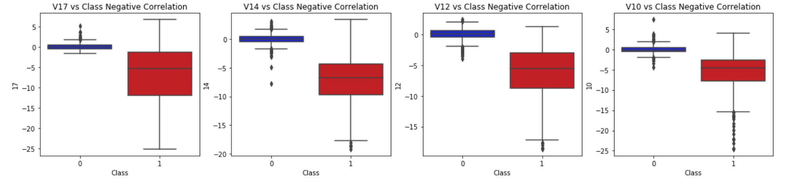
Detecting Outliers
For credit card fraud detections, outliers are very important in the dataset, as it will detect the abnormal characteristics which leads to the fraud detection.
For that purpose, we have analyzed the outliers.
Box plots are used to detect outliers.

Slide 24
Data mining Models
We have used supervised as well as unsupervised methods for the classification of fraud and non fraud transactions.
Supervised
Logistic Regression
Support Vector Machines
Decision Tree
K Nearest neighbor
Neural Networks
Unsupervised
K Means Clustering

Slide 25
Performance Evaluation and Results
Evaluation metrics used
Confusion Matrix
Accuracy Score
Cross Validation Score
ROC-AUC Curves
Precision & Recall Curves

Slide 26
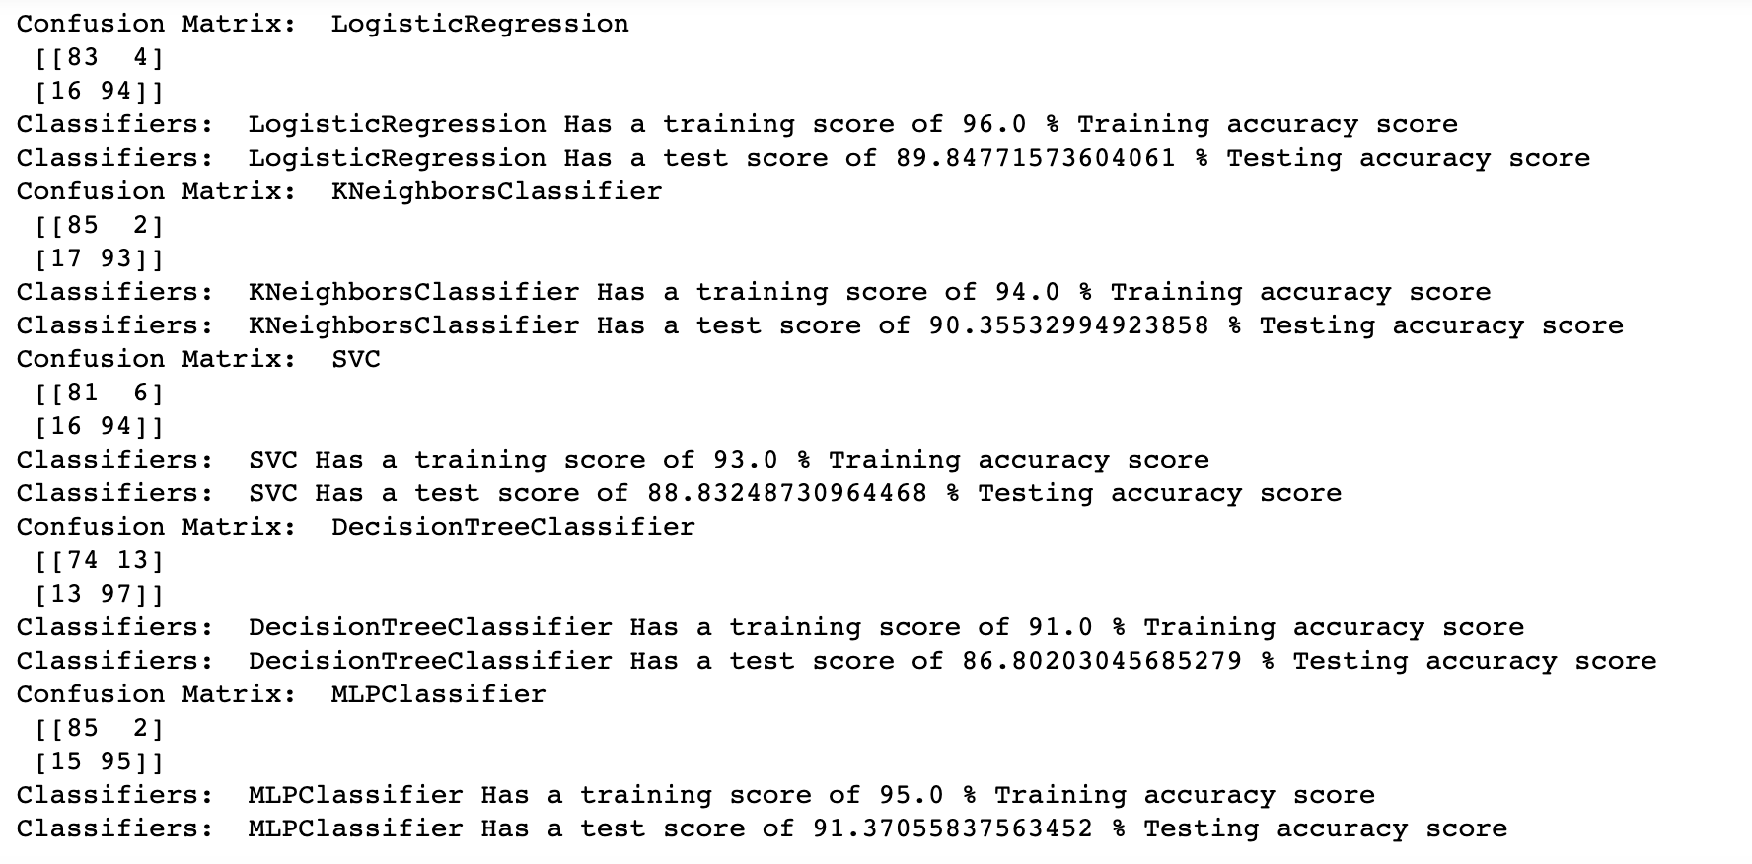
Accuracy Score

Slide 27
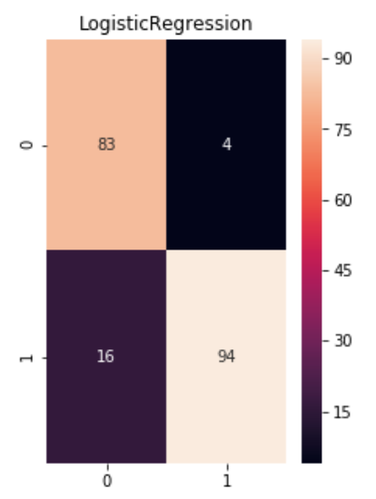
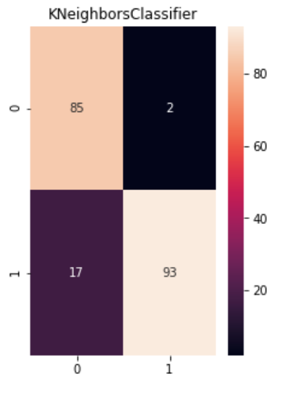
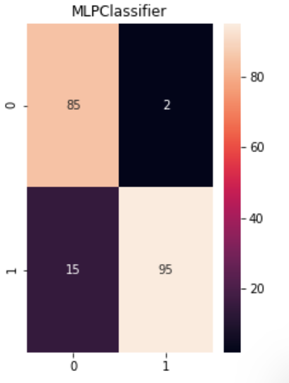
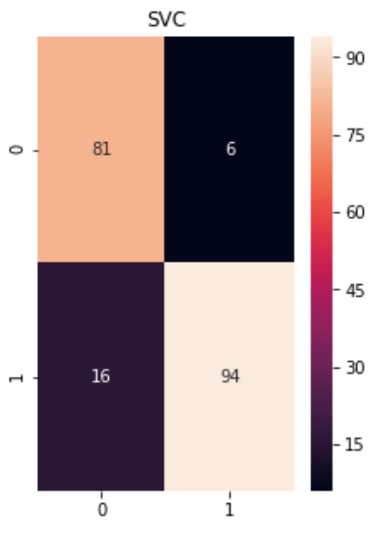
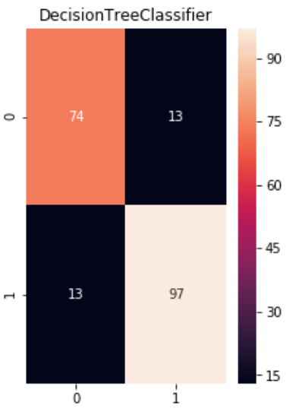
CONFUSION MATRIX COMPARISON

Slide 28
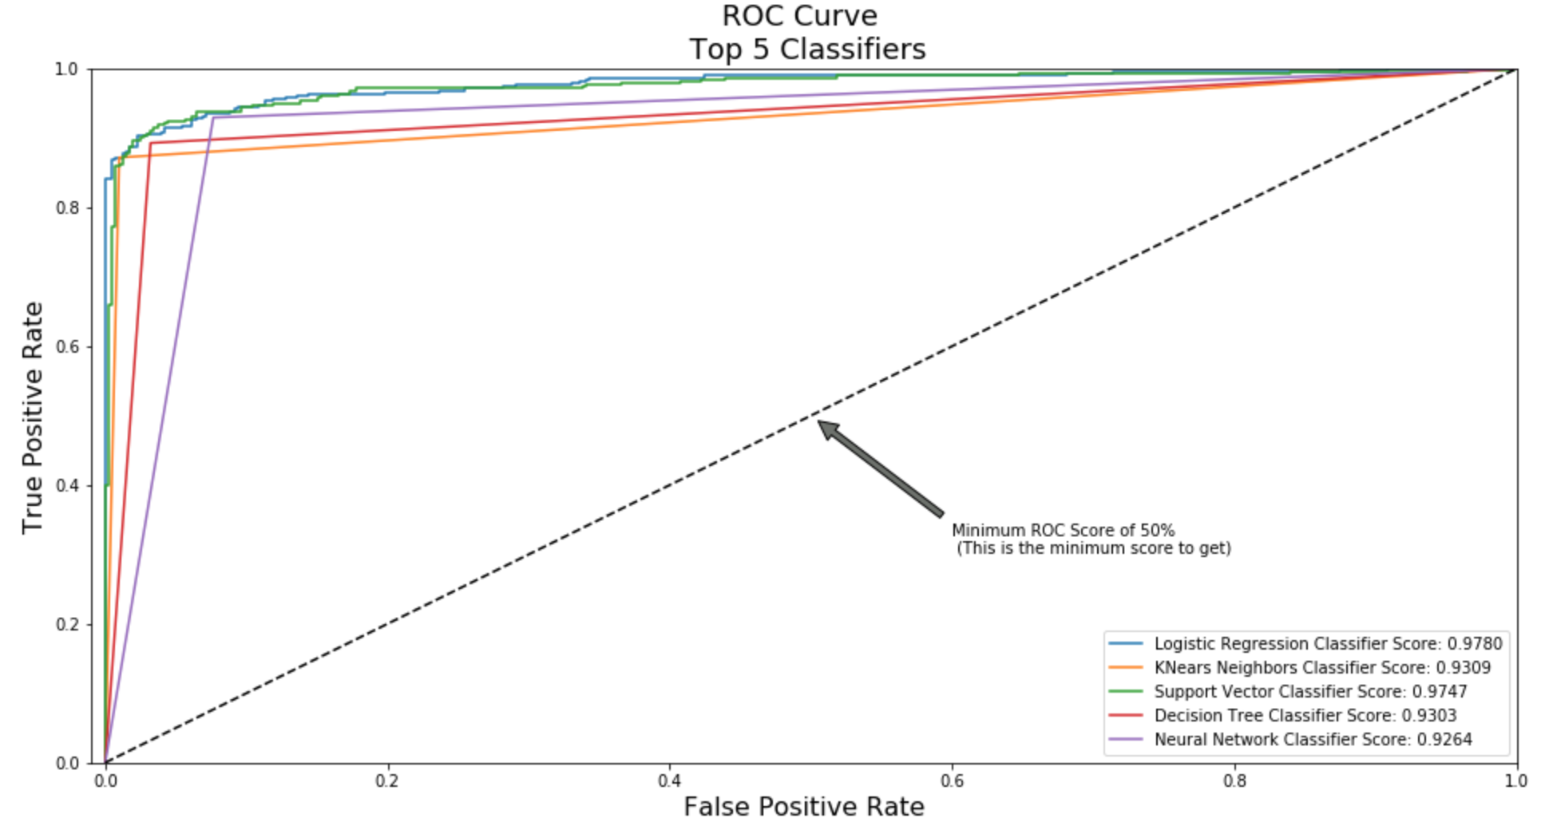
ROC-AUC CURVES

Slide 29
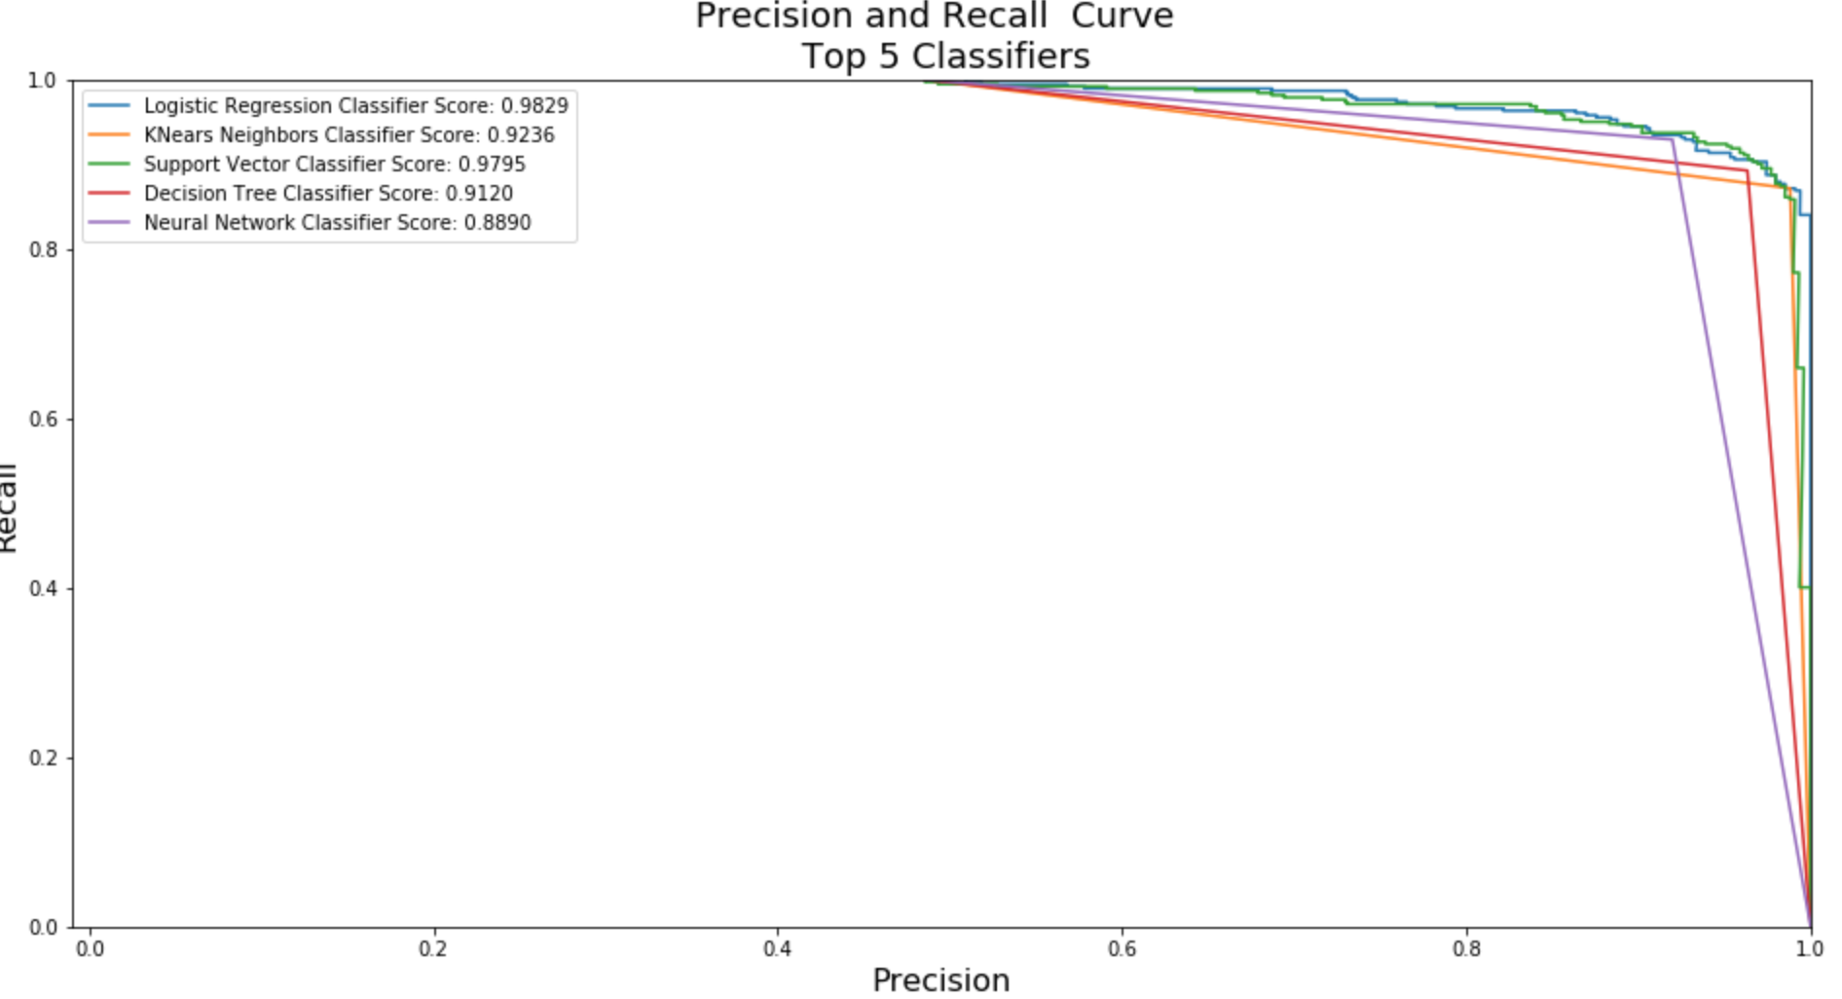
PRECISION & RECALL

Slide 30
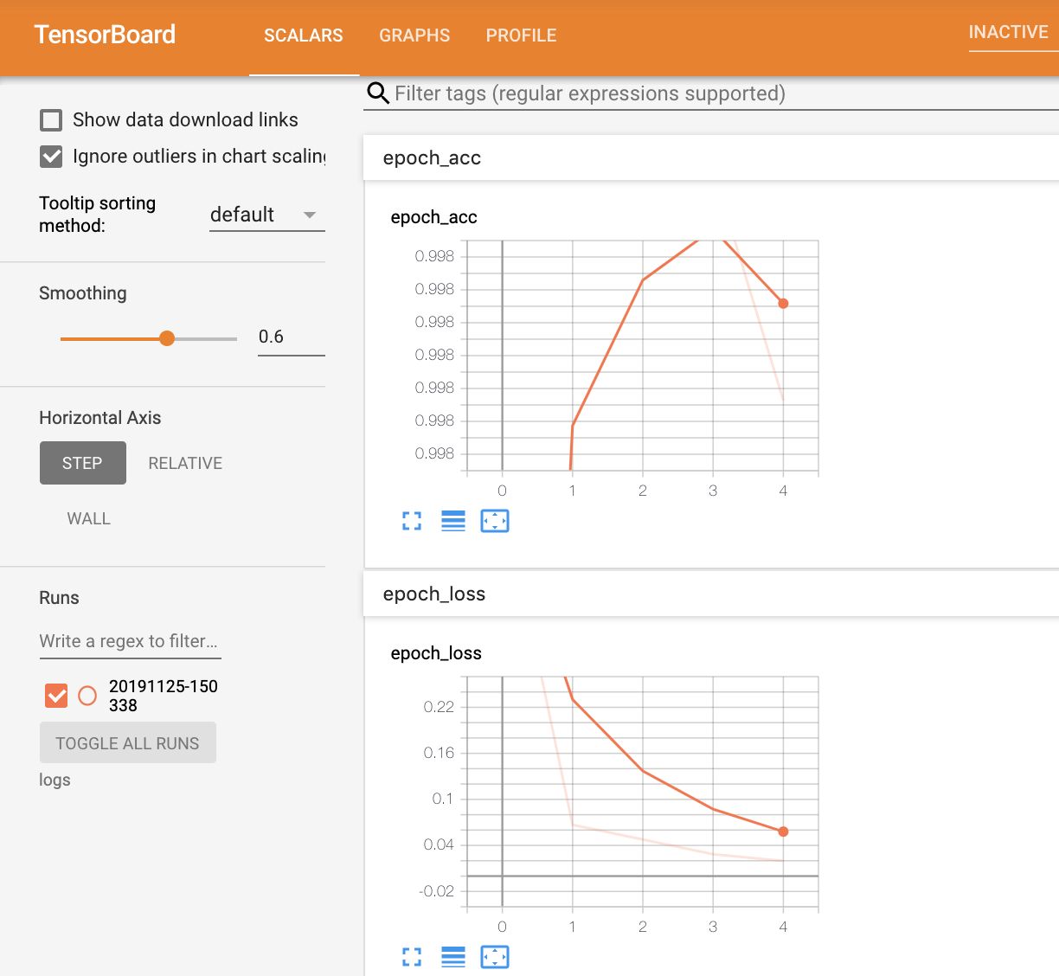
Using Tensorflow to train the model

Slide 31
Innovation
Amazon SageMaker
Amazon SageMaker is a fully managed service that allows developers and data scientists to build, train, and deploy machine learning models.
Amazon SageMaker includes three modules: Build, Train, and Deploy.
The Build module provides a hosted environment to work with your data, experiment with algorithms, and visualize your output.
The Train module allows for one-click model training and tuning at high-scale and low cost.
The Deploy module provides a managed environment for you to easily host and test models for inference securely and with low latency.

Slide 32
Tools Used
AWS Sagemaker
Amazon AWS SageMaker is a platform that is professionally operated. It performs the entire machine learning workflow. Using AWS SageMaker, with far less effort and lower cost, our models get to production faster. Additionally, we can provide API to connect to our project.
Tensor Flow
It is an open source library used for machine learning applications.
Google Collab
It is a cloud service which provides python programming platform along with free GPU.
Anaconda and virtual environment
It provides a virtual environment to implement machine learning models
Github
Github was used in order for the team to collaborate on the different tools and techniques used in the project

Slide 33
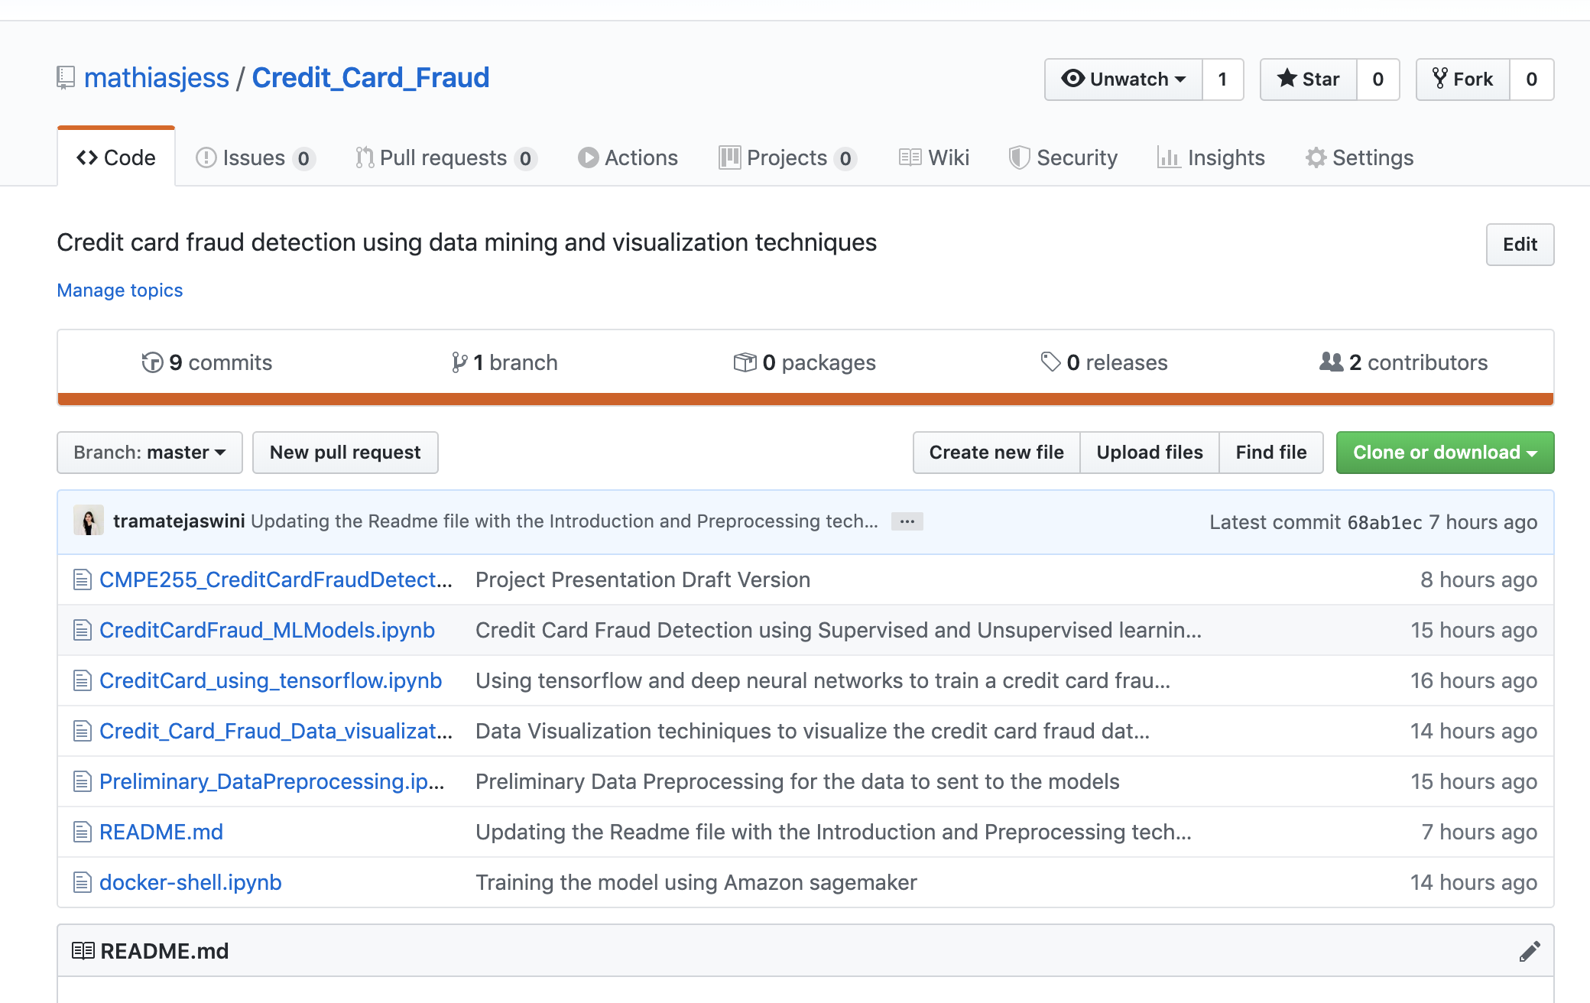
Use of Github
Github Url: https://github.com/mathiasjess/Credit_Card_Fraud

Slide 34
Technical Difficulties
Dataset: The data for credit cards transactions falls into the sensitive category which made it difficult to find an authentic dataset on the internet.
Size of the Data set: The size of the available data is really less because of security and confidential reasons.
Exact parameter evaluation: Determining the credit card fraud and having a higher accuracy for the same is difficult as the dataset is highly imbalanced. The error cost of misclassifying fraudulent is higher than the error cost of misclassifying legitimate instances.
Dynamic behavior of the fraudulent: Fraudulent frequently change their behavior after every fraud for fear of not getting caught. Having a Machine Learning model to determine this dynamic behavior is a difficult task.
Sage Maker: Faced a lot of technical issues while deploying a project on AWS Sage maker.

Slide 35
Team Work
No. | Task | Team Members Involved
1 | Data Collection | Farhaan Patel, Ashrith
2 | Data Visualization | Jessica, Priya
3. | Data Preprocessing | Tejaswini, Ashrith
4. | Implementing Supervised and Unsupervised learning models | Priya, Jessica, Tejaswini
5. | Neural Networks and tensorflow | Tejaswini, Jessica
6. | Deploying model on AWS Sagemaker | Farhaan, Priya
7. | Project Report and PPT | Jessica, Priya, Ashrith, Tejaswini, Farhaan

Slide 36
Lessons Learnt
Data preprocessing is a very important step in machine learning workflow. Initially we could able to get only 60% accuracy due to lack of proper data preprocessing.
Now, after performing proper preprocessing of data we were able to achieve accuracy more than 90%.

Slide 37
Conclusion
Six classifiers based on different machine learning techniques (K-nearest neighbors and Logistic Regression, SVM , Decision tree , Neural Networks and K Means clustering) are trained on real life of credit card transactions data and their performances on credit card fraud detection evaluated and compared based on several relevant metrics.
Results from the experiment shows that the Logistic regression shows significant performance for training score and Neural networks performed better for testing score among all metrics evaluated.

Slide 38
Rubric
Rubric Point | Completion Status
Data Collection | Yes, Collected European transaction data
Variety | Yes
Visualization | Yes
Significance to the real world | Yes, This project is significant to real world
Data Reduction | Yes
Veracity - Data Preparation activities | Yes
Report | Yes
Tools Usage | Yes
Volume | Yes, 500000 rows of transactions,339 columns
Version Control | Yes used Github
Lessons Learnt | Included in report and ppt
Prospects of winning competition/publications | Yes

Slide 39
Rubric
Rubric Point | Completion Status
Velocity | It’s a streaming data of 2 days
Innovation | Yes, Used SageMaker
Evaluation of Performance | Yes completed
Team work | Yes
Technical Difficulty | Yes , included in report and ppt
Code Walkthrough
Presentation Skills
Discussion /Q&A

Slide 40
References
[1] Malini, M. Pushpa “Analysis on credit card fraud identification techniques based on KNN and outlier detection” in 2017 Third International Conference on Advances in Electrical, Electronics, Information, Communication and Bio-Informatics (AEEICB),27-28 Feb. 2017 IEEE
[2] K. R. Seeja and Masoumeh Zareapoor “FraudMiner: A Novel Credit Card Fraud Detection Model Based on Frequent Itemset Mining”, The Scientific World Journal, Volume 2014
[3] Sahil Dhankhad ; Emad Mohammed ; Behrouz Far “Supervised Machine Learning Algorithms for Credit Card Fraudulent Transaction Detection: A Comparative Study” 2018 IEEE International Conference on Information Reuse and Integration (IRI)
[4] John O. Awoyemi ; Adebayo O. Adetunmbi ; Samuel A. Oluwadare “Credit card fraud detection using machine learning techniques: A comparative analysis” 2017 International Conference on Computing Networking and Informatics (ICCNI)

Slide 41



THANK YOU

Slide 42

ANY QUESTIONS?

