Slide 1
Voice-Based Email & Messaging Assistant
Milestone 1: Setup & Authentication
Timeline : Weeks 1-2 | January 2026
Prepared by : Sai Chandhan Reddy
Guided by : Dr. Santhiya krishnasamy

Slide 2
Milestone 1: Overview
Phase: Setup & Authentication (Weeks 1-2)
Status: COMPLETED
System Name: Aira (Voice Assistant)
Focus: Authentication with voice + facial biometrics
Deliverable: Fully functional authentication module
Ready for: Email integration (Milestone 2)

Slide 3
8-Week Project Vision
Goal: Hands-free email & messaging for all users
Target: Visually impaired users, busy professionals
Milestone 1 (Weeks 1-2): Authentication
Milestone 2 (Weeks 3-4): Gmail integration
Milestone 3 (Weeks 5-6): Messaging + AI features
Milestone 4 (Weeks 7-8): Deployment + admin tools

Slide 4
Milestone 1 Deliverables - Complete
User registration (email/password + OAuth)
Facial biometric authentication system
Voice command recognition (10-state machine)
User profile & preference management
Multi-language support (10 languages)
Complete database schema (2 tables)
12 RESTful API endpoints
Security implementation + testing

Slide 5
Technology Stack
Backend:
• Flask - Web framework
• SQLAlchemy - ORM
• Werkzeug - Security
• google-auth - OAuth
• Pillow - Images
• SQLite - Database
Frontend:
• Web Speech API - STT/TTS
• face-api.js - Face detection
• HTML5 Canvas - Capture
• JavaScript ES6+
• CSS3 - Styling

Slide 6
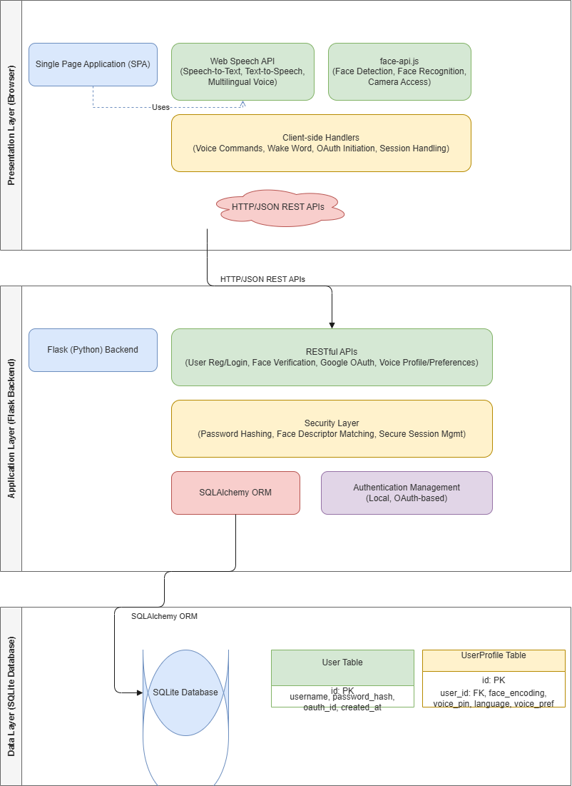
Three-Tier Architecture

Slide 7
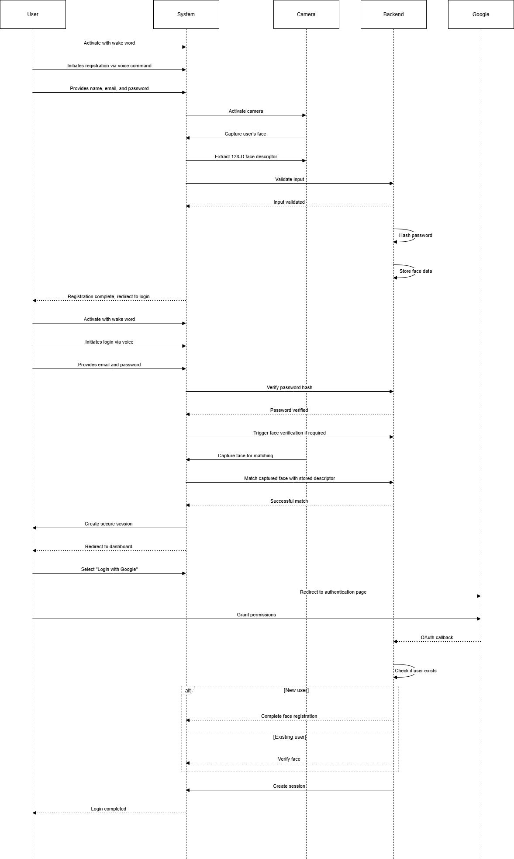
System Workflow

Slide 8
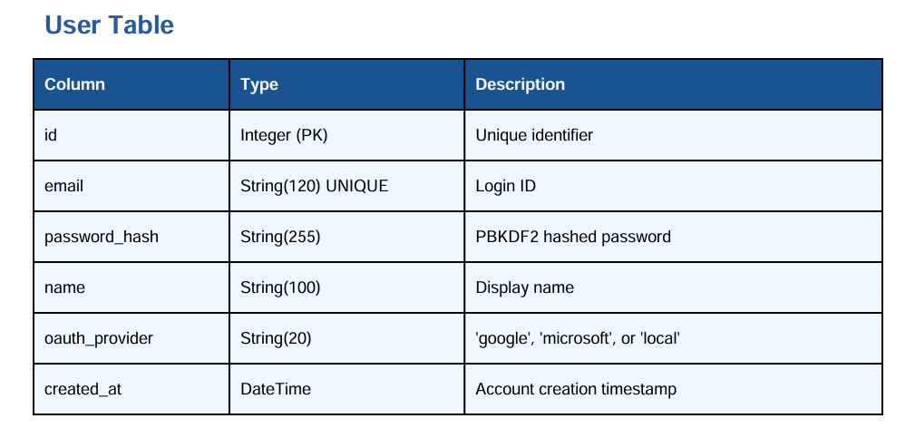
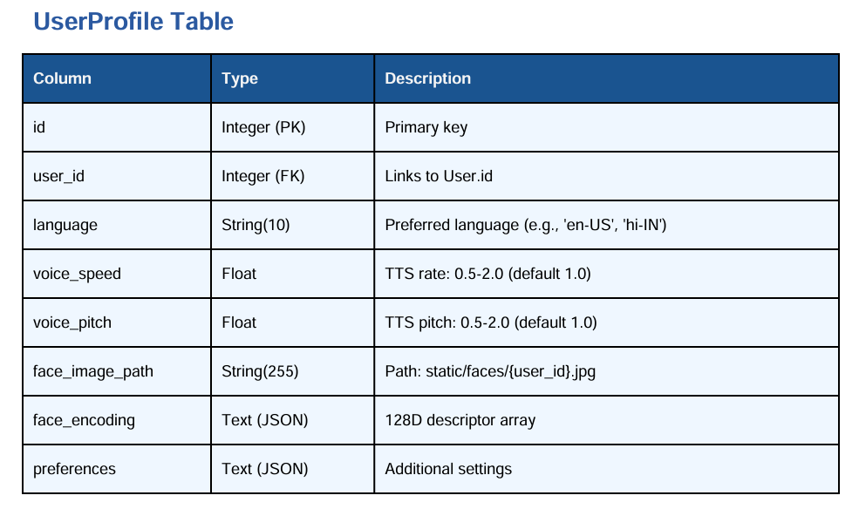
Database Design

Slide 9
Facial Biometric Security
Technology: face-api.js (TensorFlow.js)
Detection: TinyFaceDetector (~50ms)
Descriptors: 128-dimensional vectors
Verification: Euclidean distance threshold < 0.6
Accuracy: 98%+ (good lighting), 85-90% (poor lighting)
Security: Mathematical representation, not images
Processing: Client-side detection, server validation

Slide 10
Voice Commands & State Machine
Wake Word: 'aira' activates system
10-State Machine: Intelligent conversation flow
Speech Recognition: Web Speech API + fallback
Speech Synthesis: Multi-language TTS
Commands: login, register, logout, change language
Voice Controls: faster, slower, higher/lower pitch
10 Languages: EN, HI, TA, TE, KN, ML, ES, FR, DE, JA

Slide 11
State Machine States
IDLE → Wait for 'aira' wake word
LISTENING_FOR_COMMAND → login/register/logout
WAITING_EMAIL → Capture email input
WAITING_PASSWORD → Capture password
WAITING_FACE_CAPTURE → Camera activation
LOGGED_IN → Dashboard with preferences
Context-aware: Prevents accidental commands

Slide 12
Multi-Layer Security
🔐 Password Hashing: PBKDF2-SHA256 with salt
👤 Biometric Auth: 128D face descriptors
🔑 Sessions: Server-side with Flask-Session
🛡️ CORS Protection: Origin restrictions
✅ Input Validation: Server-side sanitization
📁 File Security: Restricted permissions
🔒 HTTPS Ready: Optional Talisman support

Slide 13
Testing Results
Functional Testing: 10/10 passed (100%)
Performance Metrics:
• Voice recognition: ~300ms
• Face detection: ~50ms
• API response: <320ms
• Total login time: ~3.2 seconds
Browser Support: Chrome, Firefox, Safari, Edge ✓

Slide 14
Project Timeline
Milestone 1 (Weeks 1-2): Setup & Authentication
User registration/login, voice command recognition
Milestone 2 (Weeks 3-4): Email Integration
Gmail API, email operations, TTS reading
Milestone 3 (Weeks 5-6): Messaging & AI
WhatsApp, Telegram, summarization, smart replies
Milestone 4 (Weeks 7-8): Deployment
Voice PIN, admin dashboard, Docker, cloud

Slide 15
Milestone 1 Highlights
All deliverables completed on time
Exceeded requirements (OAuth + biometrics)
Sub-second performance
Multi-layered security
Full voice accessibility
Production-ready code
Architecture ready for email integration
100% test pass rate

Slide 16
Conclusion
Delivered robust authentication foundation
Voice-driven interaction with biometric security
Multi-language support across 10 languages
Excellent performance and user experience
Clean, modular, scalable architecture
Thank you!

