Slide 1
Voice-Based Email & Messaging Assistant
Milestone 2 : Speech Recognition & Gmail Integration
Timeline : Weeks 3-4 | January 2026
Prepared by : Sai Chandhan Reddy
Guided by : Dr. Santhiya krishnasamy

Slide 2
Milestone 2 Overview
Phase: Speech Recognition & Gmail (Weeks 3-4)
Status: ✓ COMPLETED
Building on: Milestone 1 authentication foundation
Deliverable: Voice-controlled Gmail assistant (MVP)
Key Achievement:
100% hands-free email management capability

Slide 3
8-Week Project Timeline
✓ M1 (Weeks 1-2): Authentication & Voice - DONE
User registration, face biometrics, basic voice commands
✓ M2 (Weeks 3-4): Speech & Gmail - DONE
Advanced STT, Gmail API, NLU, email management
→ M3 (Weeks 5-6): Messaging & AI - Planned
WhatsApp, Telegram, summarization, smart replies
→ M4 (Weeks 7-8): Deployment - Planned
Admin tools, Docker, cloud deployment

Slide 4
Milestone 2 Objectives - All Achieved
✓ Integrate advanced speech recognition (3 engines)
✓ Implement natural language understanding (NLU)
✓ Connect Gmail API with OAuth2
✓ Enable email CRUD operations via voice
✓ Add text-to-speech for email reading
✓ Create Gmail UI with email numbering
✓ Achieve 100% hands-free email management
✓ Comprehensive testing (100% pass rate)

Slide 5
Technology Stack
Speech & NLU:
• Whisper - 95% STT accuracy
• Vosk - Offline, real-time
• Google STT - Cloud fallback
• Transformers - Intent recognition
• PyTorch - ML framework
• PyAudio - Audio processing
Gmail & Output:
• Gmail API - Email operations
• OAuth2 - Secure authentication
• pyttsx3 - Offline TTS
• gTTS - Online TTS
• HTML5/JS - Gmail UI
• NumPy, SciPy - Processing

Slide 6
Multi-Engine Speech Recognition
3 STT Engines with Automatic Fallback:
1. Whisper (OpenAI):
95% accuracy, 1-2s latency
Best for accuracy, configurable models
2. Vosk:
85% accuracy, <500ms latency
Offline mode for privacy
3. Google STT:
90% accuracy, cloud-based fallback

Slide 7
NLU & Intent Recognition
Intent Recognition (90%+ accuracy):
Supported Intents:
read_email - Check and read messages
send_email - Compose new email
reply_email - Reply to messages
delete_email - Remove emails
search_email - Query-based search
next_email, previous_email - Navigation

Slide 8
Complete Gmail Integration
OAuth2 Flow: Secure Gmail API access
Email Operations:
Read: Fetch messages with pagination
Send: Compose and send emails
Reply: Thread-based conversations
Delete: Move to trash
Search: Query-based filtering

Slide 9
Natural Email Reading (TTS)
Multi-Engine TTS:
pyttsx3: Offline, cross-platform
gTTS: Online, Google-powered
Features:
Customizable speed (0.5-2.0x)
Customizable pitch (0.5-2.0)
Natural email formatting
Multi-language support (10 languages)

Slide 10
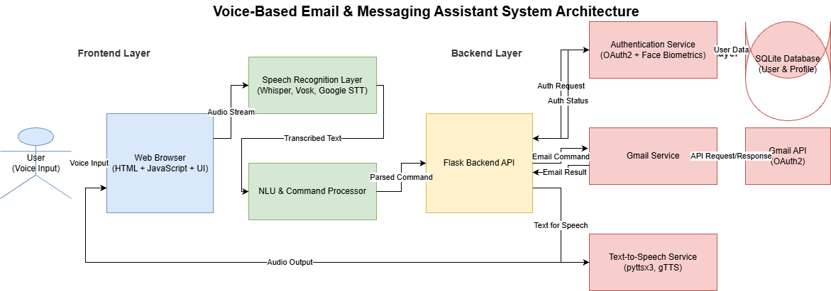
System Architecture

Slide 11
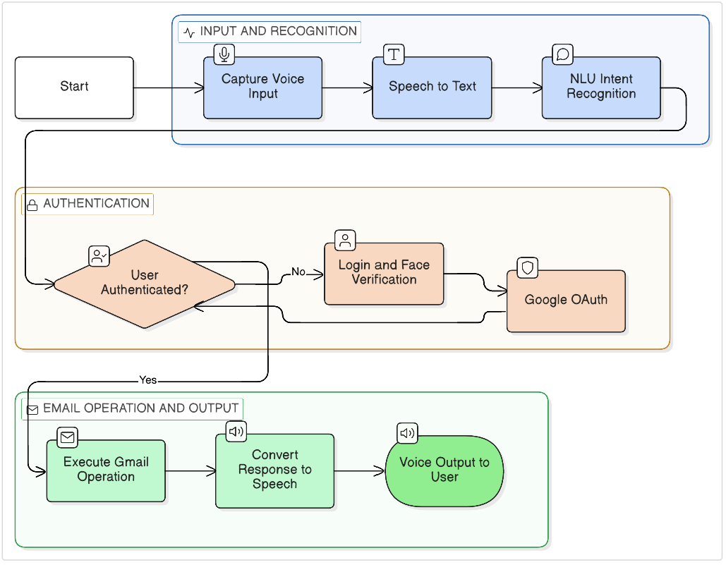
System Workflow

Slide 12
Security Features
Gmail OAuth2:
Secure token storage with encryption
Automatic token refresh
Limited scopes (read, send, modify only)
Privacy:
Offline STT option (Vosk) for sensitive data
Local audio processing by default
Protection:
Input validation and sanitization
Rate limiting for API quotas
CORS protection on endpoints

Slide 13
Testing & Performance
Testing Results:
• STT Tests: 30/30 ✓
• NLU Tests: 25/25 ✓
• Gmail Tests: 35/35 ✓
• TTS Tests: 15/15 ✓
• Voice Cmds: 40/40 ✓
• Total: 145/145 (100%) ✓
Browser Support:
• Chrome, Firefox, Safari, Edge ✓
Performance Metrics:
• Whisper STT: 95%
• Vosk STT: 85%
• NLU Intent: 90%+
• Email Fetch: 200-500ms
• STT Latency: 0.5-2s
• API Response: 150-500ms
Memory: 300MB-1GB
(depends on model size)

Slide 14
Milestone 2 Highlights
Multi-engine STT (95% accuracy with Whisper)
Natural language understanding (90%+ intent)
Complete Gmail integration via OAuth2
100% hands-free email management
Natural email reading with TTS
Production-ready code (~3,500 lines)
100% test pass rate

Slide 15
Challenges & Solutions
Challenges:
• Multiple STT engines
• Gmail OAuth complexity
• Email numbering UX
• TTS HTML cleanup
• Memory usage (Whisper)
• Real-time processing
Solutions:
• Unified interface + fallback
• Token management system
• Visual badges + voice ref
• HTML parser for clean text
• Model size config + Vosk
• Hybrid Web API + server

Slide 16
Conclusion
Advanced multi-engine speech recognition
Complete Gmail integration
100% hands-free email management
All objectives met on schedule
Thank you!

