Slide 1

Team Name : The Amazinators
Team Leader Name : Sai Chandhan Reddy Annapureddy
Problem Statement : AI-Powered Marketplace Assistant for Local Artisans
Live Demo: https://gen-ai-hackathon-472505.web.app
Video Demo:

Slide 2
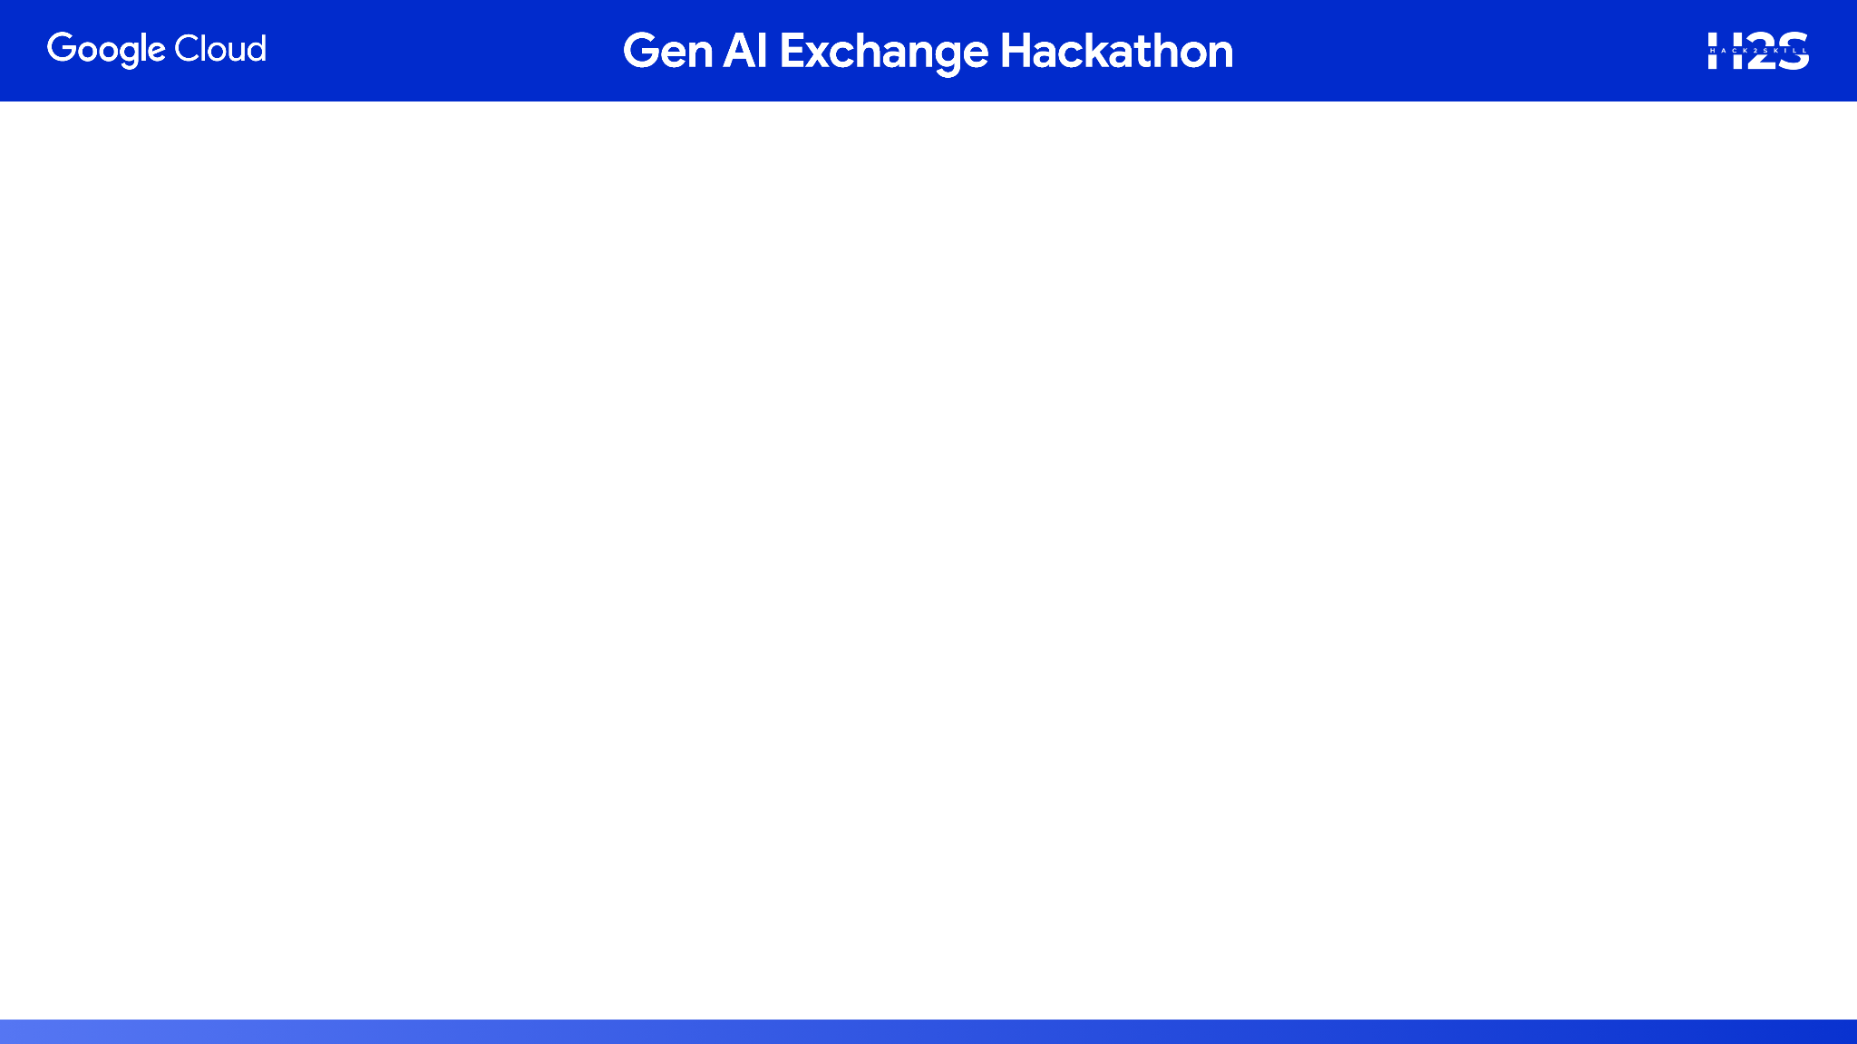
Brief about the prototype:
KraftAI is an innovative AI-powered platform that transforms craft images into compelling product descriptions and marketing content. Our solution bridges the gap between talented artisans and effective digital marketing by leveraging advanced computer vision and natural language processing technologies.

Slide 3
Problem Analysis and Solution
PROBLEM IDENTIFIED:
68% of Indian artisans struggle with digital marketing (Source: FICCI Report 2023)
Traditional crafts losing market share to mass-produced items
Artisans spend 40% of time on marketing instead of crafting
Generic AI tools lack cultural context and craft-specific knowledge
Our Solution:
Instant Content Generation: Upload an image, get professional marketing content in seconds
Craft-Specific Understanding: AI prompted to recognize materials, techniques, and artistic elements
Brand Voice Consistency: Maintains authentic artisan storytelling while being market-ready
Scalable Marketing: Enables bulk content creation for entire product catalogs

Slide 4
Competitive Analysis
VS. EXISTING SOLUTIONS:
Generic AI Tools (ChatGPT, Copy.ai):
❌ No craft-specific knowledge
❌ Cannot analyze images for materials/techniques
❌ Lacks cultural context integration
✅ KraftAI: Deep craft understanding with heritage context
E-commerce Tools (Shopify, Etsy):
❌ Basic listing features only
❌ No intelligent pricing suggestions
❌ Limited storytelling capabilities
✅ KraftAI: Comprehensive marketing suite with cultural storytelling

Slide 5
Unique Selling Propositions
CULTURAL HERITAGE INTELLIGENCE: AI platform trained specifically on Indian traditional crafts
VISUAL ANALYSIS PRICING: Advanced computer vision determines complexity and suggests market pricing
ARTISAN-CENTRIC DESIGN: Interface designed specifically for traditional craftspeople
MULTI-CULTURAL BRIDGE: Content that connects traditional values with modern marketing needs

Slide 6
Features
Image Processing & Analysis:
High-resolution image upload (up to 5MB)
Multi-format support (JPG, PNG)
Advanced computer vision for craft recognition
Material and technique identification
Content Generation:
Product descriptions with emotional storytelling
SEO-optimized content for better online visibility
Suggested pricing

Slide 7
Features
Social Media Suite:
Platform-specific content
Trending hashtag suggestions
Cultural context integration
Market Intelligence:
Product descriptions with emotional storytelling
SEO-optimized content for better online visibility
Suggested pricing

Slide 8
User Experience
Intuitive drag-and-drop interface
Real-time content preview
One-click copy functionality
Mobile-responsive design
Batch processing capabilities

Slide 9
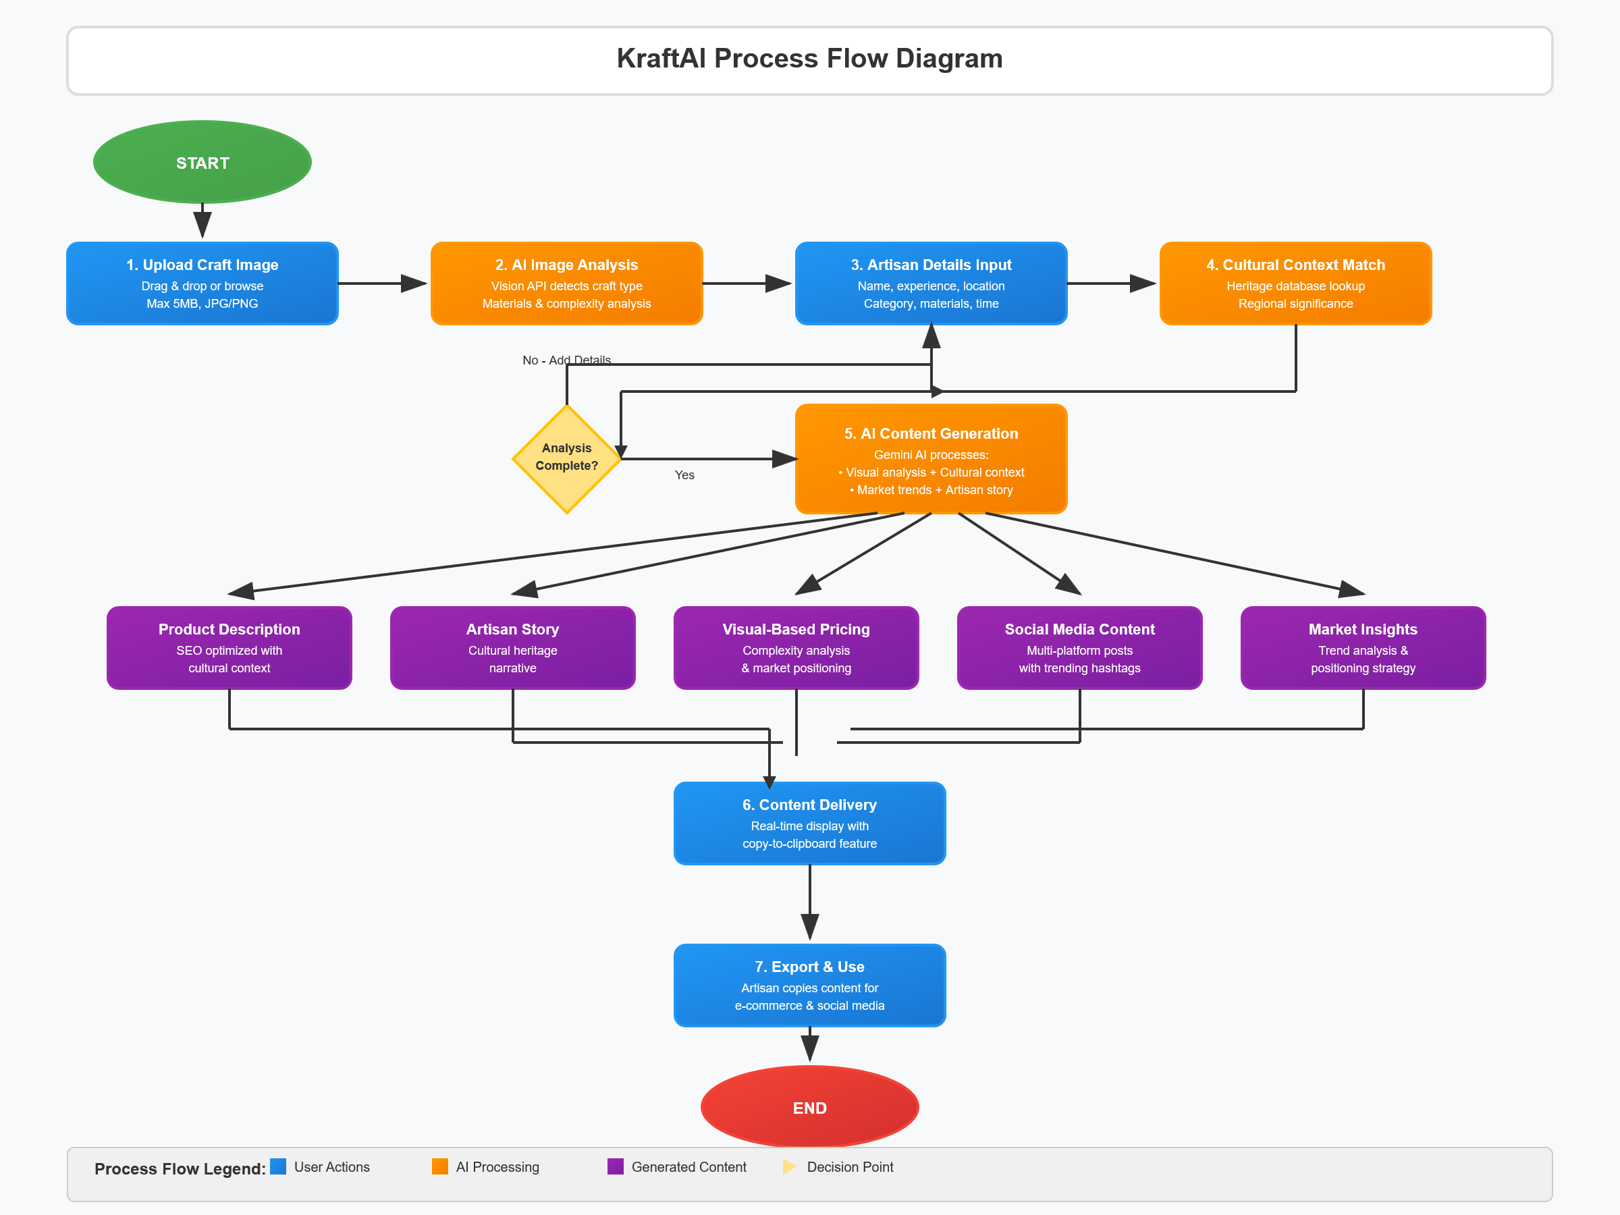
Process Flow Diagram

Slide 10
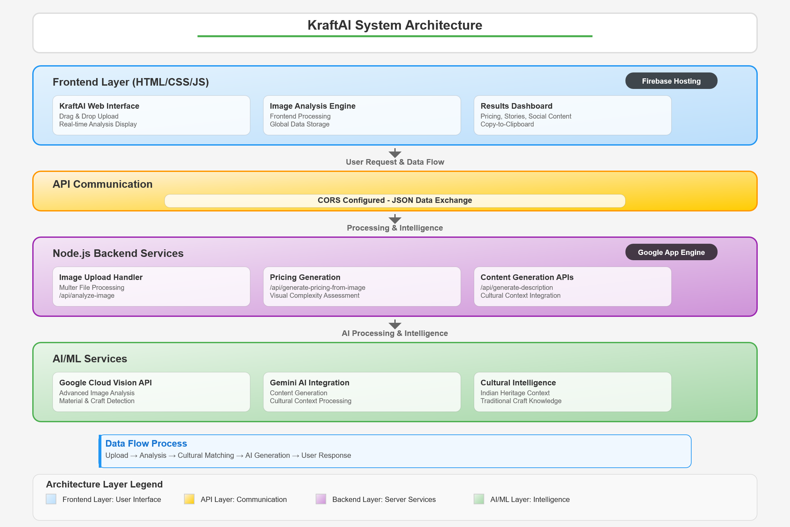
Architecture Diagram

Slide 11
Technology Stack
FRONTEND: HTML, CSS, JavaScript
BACKEND: Node.js, Express.js, Multer
AI/ML: Google Vision API, Gemini AI
HOSTING: Google App Engine, Firebase
SECURITY: CORS, Helmet, Rate Limiting

Slide 12
Impact and Scalability
Social Impact:
- Empowers 10,000+ artisans with digital marketing
- Preserves traditional craft knowledge digitally
- Promotes cultural heritage globally
Scalability Plan:
Phase 1: Pan-India deployment
Phase 2: Regional language support
Phase 3: International markets
Phase 4: B2B solutions for organizations

Slide 13


