Slide 1
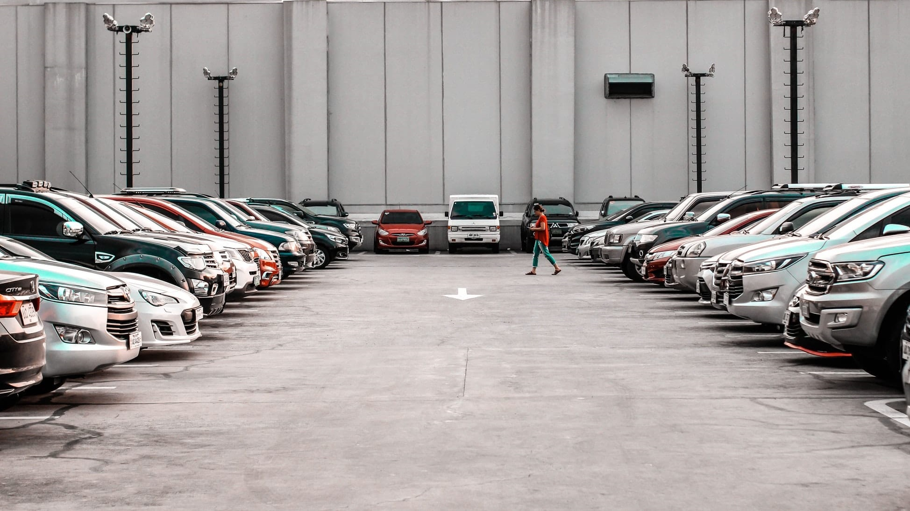
PARKING LOT SPACE DETECTION USING OPEN CV
By:
J.Sai Charan – 17011U0507
Mudassir Ahmed – 17011U0503

Slide 2
CONTENT:
Introduction
What parking really cost
Proposed solution
Hough transform
openCv as Paint Brush
Program flow
Conclusion
References

Slide 3
Introduction
A problem faced in major metropolitan areas is the search for parking space. Looking for parking space always wastes travelling time
Therefore, unsupervised parking lots detection has been currently employed in many systems for counting the number of parking spaces, identifying the location, monitoring the changes of space status over the time.

Slide 4
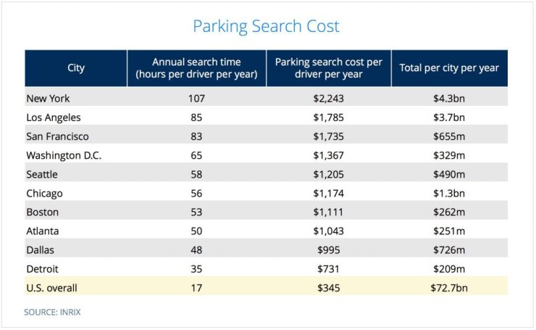
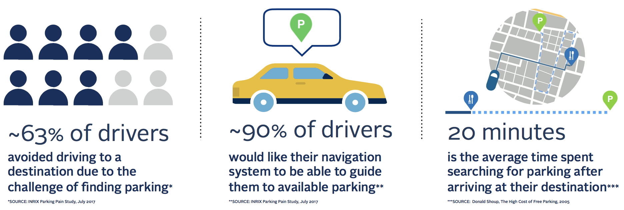
What parking really cost:

Slide 5
The real question ?
What could be done to avoid all of this

Slide 6

Proposed Solution:
In our approach we use openCV to automatically detect whenever a parking space was available or occupied.
Use of Hough Transform (feature extracting technique)
Use of Guassian Blur and Canny edge detection

Slide 7
Hough Transform
The Hough transform is a feature extraction technique used in image analysis, computer vision, and digital image processing.
OpenCV encapsulates the math of the Hough Transform into HoughLines method.
Further abstraction is captured in HoughLinesP method, which is the probabilistic model of creating lines with the points that HoughLines method returns.

Slide 8
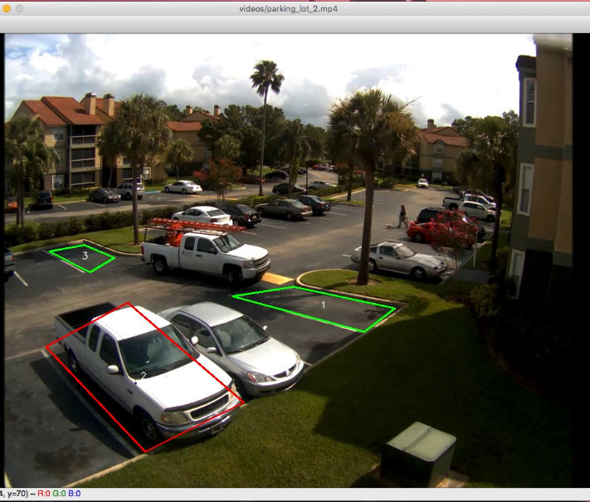
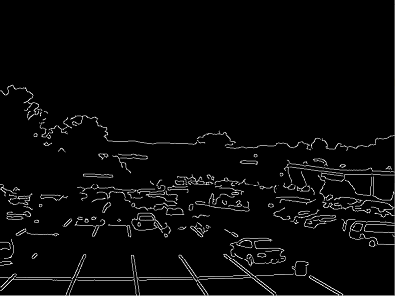
Opencv as Paint Brush
You can easily paint on OpenCV images. For this you need to call the setMouseCallback(‘window_name’,image_name) function on opencv.

Slide 9
Program Flow
User inputs file name for a video, a still image from the video, and a path for the output file of parking space coordinates.
User clicks 4 corners for each spot they want tracked. Presses 'q' when all desired spots are marked.
Video begins with the user provided boxes over the video. Occupied spots initialized with red boxes, available spots with green.
Car leaves a space, the red box turns green.
Car drives into a free space, the green box turns red.

Slide 10
Conclusion:
The idea of implementing openCV to visual the image and spot is pretty easy and cost effective when compared to using sensors and human monitoring
This process can save huge amount of time and money when compared to traditional techniques
However, there are a few challenges limiting the performance in transfer learning including the shadows of the buildings on the parking spaces, strong solar reflection from the vehicles, vehicles parked outside or in between the designated bays by the drivers and the bias of the training data used

Slide 11
References
https://docs.opencv.org/master/
http://ceur-ws.org/Vol-2087/paper5.pdf
https://easychair.org/publications/open/2STV
Fabian, T. (2008). An algorithm for parking lot occupation detetction. Computer Information Systems and Industrial Management Applications (pp. 165-170). IEEE
Fabian, T. (2008). An algorithm for parking lot occupation detetction. Computer Information Systems and Industrial Management Applications (pp. 165-170). IEEE

Slide 12
Thank you
Any queries??

