Slide 1
T24 - Introduction

Slide 2
Agenda
T24 Overview
Functional Features
Core Systems
Business Modules
Core Modules
Functional Architecture
Upgraded + Integrated T24 Technologies

Slide 3
T24 Overview

Slide 4
Overview
Globus (T24) is a banking software product from Temenos Group AG (Switzerland). Globus, which is re-phrased as T24 (Temenos 24) is a 24-hour real-time banking application that provides multiple application server support with non-stop processing.
T24 is a fully integrated modular core banking solution covering a broad spectrum of functional requirements for Retail Banking, Private Banking, Corporate Banking, Universal Banking, Islamic Banking, and Microfinance sectors. Banks can support all their business channels online and in real time 24/7.

Slide 5
Functional Features of T24
Based on the functionality, T24 application can be divided in to following modules:
  The Core System
  Main Business Modules (Retail, Commercial, Private, Treasury) and Specific Business Modules (Trade Finance, Islamic Banking)
  Core Support Modules

Slide 6
Core Systems
Though T-24 is a modular based, a group of mandatory applications forms the core system. Some of the core system comprises:
Customer: Customer module is core to T24. It works on centralised Customer details. All descriptive details of a Customer are stored only in Customer application
Accounts: The accounts module processes both clients and internal accounts
Financial Accounting: Automatically maintains general ledger accounts and ensures that the financial accounting automatically reconciles with the underlying business
Static Files: A group of files are dedicated to record all static data mandatory to run a banking business activity: Company, Dates, Country details, Currency details, Interest details, Category etc.

Slide 7
Main Business Modules
Modules are grouped based on business lines as below:
Retail & Commercial banking - Savings & Current Accounts, Teller, Funds Transfer & Standing, Orders, Cheque & Card Management & Clearing, Loans & Deposits, Mortgage / Loan and Document Image Facility
Private Banking - Personal banking and Asset management, Securities & Management Module and Fiduciaries
Treasury - Foreign Exchange, Money Markets, REPO, Securities and SWAPS
Specific Business Modules - Trade Finance and Islamic banking

Slide 8
Core Support Modules
This series of applications are in connection with all previous modules, mostly on real-time.
Limits : The limits module provides the ability for the on-line monitoring and reporting of all client credit exposure.
Collateral Management : Collateral management information may be recorded in the Limits module and reported against on-line exposure monitoring.
Multi - Company - Multi - Branch: Used in T24, when separate sets of books need to be maintained for multiple entities within the overall group.
Management Information: Provides financial management information on customers, products, departments, including income and expense, average balances.
Risk Management: T24 offers centralised control of credit and market risk through the Limits and Position Management modules.
Delivery Module: Delivery Module includes all electronic payment set-up and monitoring: advices, SWIFT, SIC and many other customizable layers.

Slide 9
T24 Functional Architecture

Slide 10
T24 Functional Features
Temenos T24 is a product for international financial services market
It has comprehensive functions
  Integrated
  Timely
    Real time and Batch
  Multi-currency
It has core functionality
It has optional applications

Slide 11
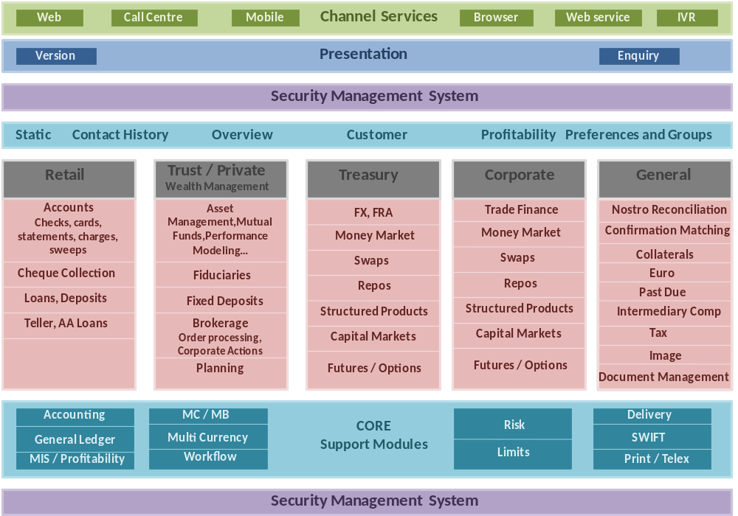
T24 Functional Architecture

Slide 12
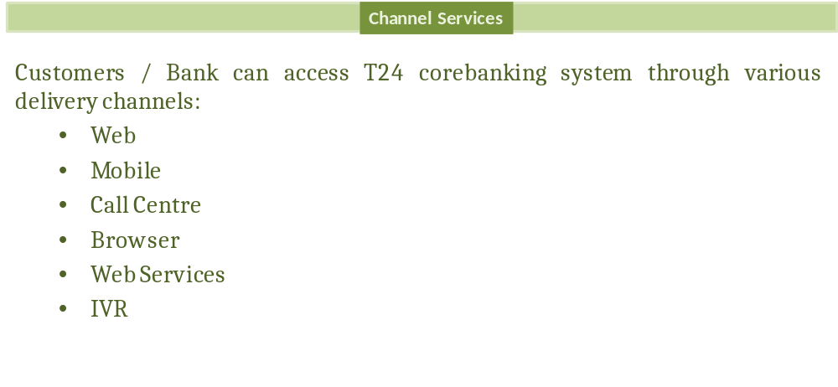
Channel Services

Slide 13
Upgraded + Integrated T24 Technologies
Arrangement Architecture(AA)
Temenos Payments Suite/Hub (TPS/TPH)
Insight (Reporting)
Financial Crime Mitigation (FCM)
Triple’A Plus (TAP) – Wealth Management
Infinity – Digital platform
Temenos Connect Internet Banking (TCIB)
Temenos Connect Mobile Banking (TCMB)
Integration Frame worked (IF).

Slide 14
Thank You

