Slide 1
SMART ID ENTRY SYSTEM USING RFID TECHNOLOGY
VIDYA JYOTHI INSTITUTE OF TECHNOLOGY (Autonomous)
Under the guidance of:
Faculty name: Dr. A. Anusha
Designation: Associate Professor
By : Team-17 AI-B
22911A35A7 - P. Varshith Naidu
22911A35C1 – V. Sai Charan
22911A3565 - A. Sri Ram

Slide 2
Problem Statement
Develop a smart ID entry system utilizing RFID technology to enhance access control, security, and user convenience. The system will automate identification processes, grant access in real-time, and log entry/exit records. It aims to replace traditional manual verification methods with an efficient and secure solution.

Slide 3
Abstract
The Smart ID Entry System revolutionizes access control by utilizing a single RFID card for multiple applications. Seamlessly integrated with IoT, it enables secure access to offices, laboratories, and restricted areas. Through real-time monitoring, it ensures efficient management of diverse access points, from doctor appointments to server room access. This innovative solution enhances convenience and security, streamlining operations while providing comprehensive access control across various environments.

Slide 4
Literature Survey
S.NO | TITLE | METHODOLOGY | METRICS | LIMITATIONS
1 | RFID TECHNOLOGY AND ITS APPLICATIONS IN INTERNET OF THINGS (IOT) | Research, Requirements Gathering, System Design, System Design, System Design, Testing, Deployment , Evaluation | Read Range, Latency, Scalability, Cost per Tag | Tag Collision, Security and Privacy Concerns, Data Management
2 | SMART ATTENDANCE MONITORING SYSTEM USING IOT AND RFID | Preliminary Assessment, System Design, Hardware and Software Selection System Implementation | Accuracy Metrics, Efficiency Metrics, System Reliability Metrics | System Reliability, Standards and Interoperability, Power Requirements
Department of Artificial Intelligence

Slide 5
Literature Survey
S.NO | TITLE | METHODOLOGY | METRICS | LIMITATIONS
3 | SMART TRANSPORTATION SYSTEM USING RFID | Preliminary Evaluation, IoT Gateway Setup, Monitoring and Maintenance | Efficiency, System Reliability, Operational Metrics | Interference and Attenuation, System Reliability, Standards and Interoperability
4 | RFID-BASED ATTENDANCE SYSTEM | System Design,Software Development,Integration, Data Preprocessing, Testing and Calibration | Accurate Rate, System Uptime, Read Rate, Preprocessing Speed, Data Security and Maintenance Frequency | Security Concerns, Cost,Interference, Read range limitations, Dependency on power supply
Department of Artificial Intelligence

Slide 6
Literature Survey
Paper 1: RFID TECHNOLOGY AND ITS APPLICATIONS IN INTERNET OF THINGS (IOT)
Published by & Year: IEEE 17 May 2012
Radio frequency identification system (RFID)is an automatic technology and aids machines or computers to identify objects , record metadata or control individual target through radio waves. Connecting RFID reader to the terminal of Internet , the readers can identify , track and monitor the objects attached with tags globally, automatically, and in real time, if needed.

Slide 7
Literature Survey
Paper 2: SMART ATTENDANCE MONITORING SYSTEM USING IOT AND RFID
Published by & Year: IEEE 2019
This work proposes an RFID-based attendance system using IoT to address irregular student attendance concerns in educational institutes, replacing time-consuming traditional methods. It combines IoT and RFID , two prominent technology trends , to offer a solution for efficient attendance monitoring.

Slide 8
Literature Survey
Paper 3: SMART TRANSPORTATION SYSTEM USING RFID
Published by & Year: Association for Computing Machinery 19 February 2019
This paper explores IoT and RFID technology integration in transportation, emphasizing smart parking and digitalized challan systems. It promises automation, cost-effectiveness, and improved user experiences for enhanced productivity and government transparency.

Slide 9
Literature Survey
Paper 4:RFID-BASED ATTENDANCE SYSTEM
Published by & Year: IEEE 6 October 2009
An RFID-based attendance system leverages RFID technology to automate and streamline attendance tracking. It enhances accuracy, efficiency, and security by replacing manual sign-ins with electronic data capture, enabling real-time attendance recording, reducing errors, and preventing fraudulent entries.

Slide 10
Existing System
The existing access control system relies on barcode reader tags , limiting flexibility and security. Each application requires a distinct tag , complicating management and increasing costs. Unlike our Smart ID Entry System , there's no single tag capable of accessing multiple areas. This lack of integration results in inefficiencies and compromises security. By contrast, our system streamlines access control, utilizing RFID technology and IoT connectivity to provide seamless, secure, and versatile solutions for modern environments.

Slide 11
Limitations
Accuracy Limitations:
Read Range : RFID tags may have a limited read range, especially passive tags, affecting the system's accuracy.
System Reliability Limitations:
System Uptime : System failures, maintenance, or technical issues may lead to downtime, affecting the reliability of the system.
Tagging and Tag Placement:
Difficulty in Attachment : Difficulty in attaching tags to certain materials or products, or to maintain integrity of tags

Slide 12
Proposed System / Innovation
System Architecture Design:
RFID Tags: Attached to user IDs or cards.
RFID Readers: Placed at entry points to read RFID tags.
Data Management: Stores and processes RFID data.
Maintenance: Maintaining data in Google sheets
RFID Tagging Strategy:
Attach RFID tags to user IDs or cards.
Ensure proper attachment to avoid tag loss or damage.

Slide 13
Proposed System / Innovation
System Evaluation and Optimization:
Continuously evaluate the system's performance and address any emerging limitations through iterative improvements.
Gather feedback from users to identify areas for optimization.

Slide 14
Modules
MODULE-1: Node MCU (ESP8266)
Node MCU (ESP8266) serves several functions crucial for IoT applications:
Wi-Fi Connectivity: Enables devices to connect to the internet.
GPIO Pins: Supports digital input/output for interfacing with sensors and actuators.
ADC: Analog-to-digital conversion for reading analog sensors.
SPI, I2C, UART: Communication interfaces for connecting with other devices.
Programming: Supports programming in Lua, Arduino IDE, and MicroPython.

Slide 15
Modules
MODULE-2: RFID Reader Module (MFRC522)
RFID Tag Detection: Identifies and reads RFID tags in its proximity.
Communication Interface: Uses SPI for data exchange with microcontrollers.
Data Processing: Manages protocol and timing for RFID tag communication.
MODULE-3: Arduino IDE
Code Editor: Provides a text editor for writing and editing Arduino sketches (programs).
Compiler: Translates Arduino sketches into machine code that microcontrollers can execute.
Uploader: Transfers compiled code from IDE to Arduino boards for execution.

Slide 16
Modules
MODULE-4:Google Sheets API
Data Manipulation: Allows reading, writing, and modifying Google Sheets data programmatically.
Automation: Enables automating tasks such as updating sheets, and managing data with scripts.
Integration: Facilitates integrating Google Sheets with other applications and services via API calls.
MODULE-5: RFID Tags
Identification: RFID tags uniquely identify objects or individuals.
Tracking: Enables real-time tracking of items or assets.
Authentication: Supports access control and authentication processes.

Slide 17
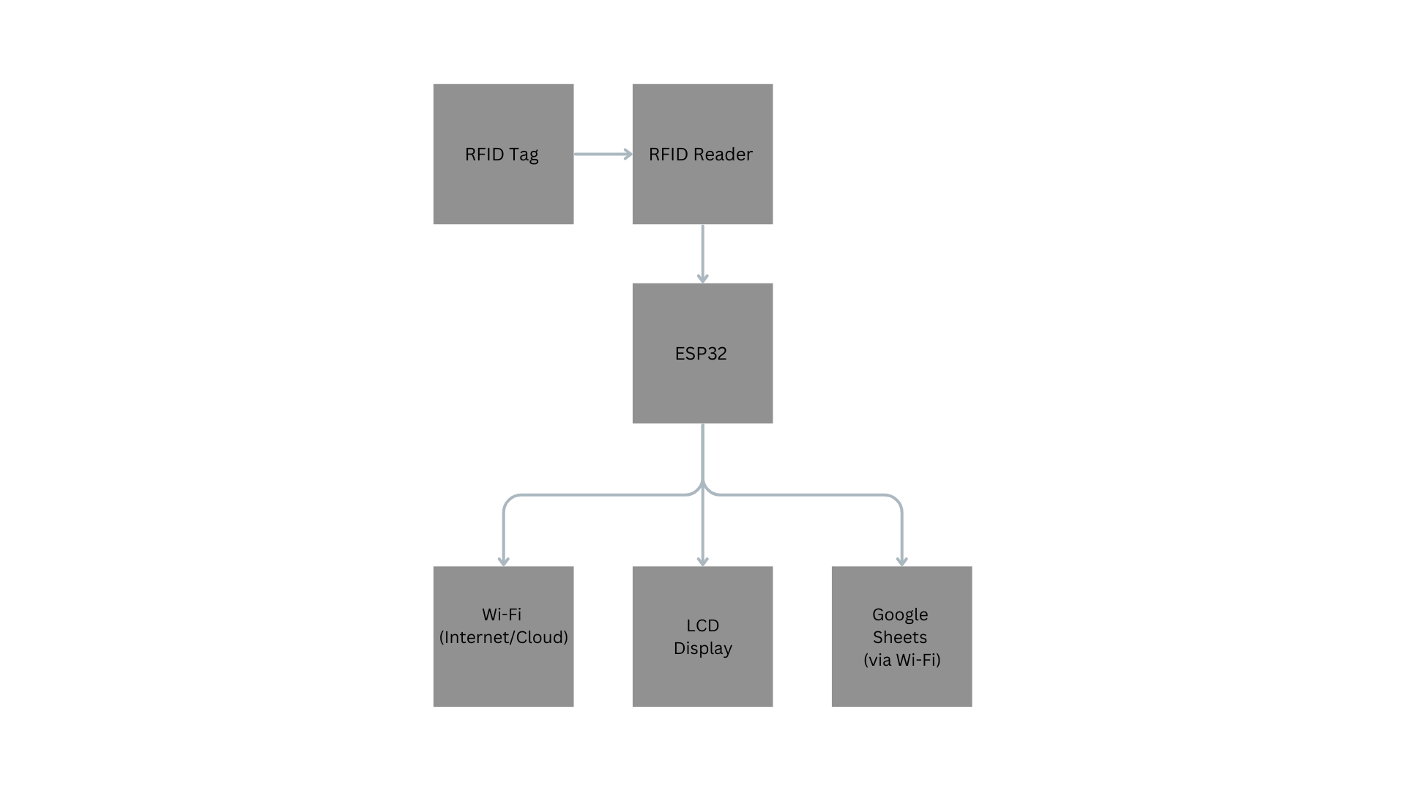
Block diagram
Block Diagram for Smart ID entry system using RFID technology
Department of Artificial Intelligence

Slide 18
Result
Wi-Fi Connection: Connects the Node MCU (ESP8266) to a Wi-Fi network using provided credentials.
RFID Initialization: Initializes the MFRC522 RFID reader for tag scanning.
RFID Scanning: Continuously scans for nearby RFID tags.
ID Extraction: Extracts and identifies the unique ID of detected RFID tags.
ID Printing: Outputs the unique RFID tag ID to the serial monitor.
Google Sheets Logging: Logs the extracted RFID tag ID into a Google Sheets document.
IoT Application: Demonstrates a practical IoT solution for real-time data logging.
Department of Artificial Intelligence

Slide 19
Conclusion
The code successfully integrates a Node MCU (ESP8266) with an RFID reader (MFRC522) and Google Sheets API to create a real-time RFID tag logging system. It establishes a Wi-Fi connection, initializes the RFID reader, continuously scans for RFID tags, and extracts and prints their unique IDs. Upon detecting an RFID tag, the unique ID is sent to a Google Sheets document for logging purposes. This setup provides an efficient and reliable method for tracking RFID tags, making it useful for applications such as attendance systems, inventory management, and access control. The integration demonstrates the potential of IoT solutions for automated data collection and management.
Department of Artificial Intelligence

Slide 20
VIDYA JYOTHI INSTITUTE OF TECHNOLOGY (Autonomous)
THANK YOU

