Slide 1
Category review: Chips
June 2020
Retail Analytics
Brand note: If client logo is not required, use alternate title page layout right click slide thumbnail > Layout > Title

Slide 2
Notes:
To view Privacy video explaining how important data privacy is to Quantium, please click here: https://www.youtube.com/watch?v=Zq1QDAkoRzU
or here Q:\Company Reference\Brand & Design\Brand videos\Q Privacy.mp4
At Quantium, we believe that data is the behavioural footprint of humanity and that it has to be treated with the utmost care and responsibility.
Histories, attitudes, indeed lives are stored within it in ways that aren’t always apparent – and that’s what makes its potential so powerful.
To work with it responsibly, sensitively, we set ourselves the highest data privacy protection and governance standards.
We have spent 17 years perfecting privacy-by-design and secure-by-design principles. Central to this is not holding any personally identifiable information about people –
we neither receive it, and put the necessary protections in place to be unable to decipher it.
Every aspect of handling data is safeguarded: from its de-identification, to its encryption – data security is paramount and of the highest grade.
We pride ourselves on gaining the trust of iconic organisations around the world through years of securely working with their data,
and in turn the trust that builds with their stakeholders.

Slide 3
Executive summary
01
Task 1
"Mainstream" customers in these life stages are more likely to make higher total sales compared to "Budget" and "Premium" customers in the same life stages. By making marketing strategies and promotions effectively engage and retain this customer segment.
02
The trial initiatives in stores 77 and 86 were generally successful in boosting both sales and customer engagement. However, further analysis and adjustments may be required for store 88 to optimize its performance during the trial period.
Task 2

Slide 4
01
Mainstream - young singles/couples prefer the brands Kettle, Doritos, and Pringles in 175g,150g and 134g sized packs. By making marketing strategies and promotions towards these brands and pack sizes effectively engage and retain this customer segment, potentially leading to increased sales and brand loyalty.

Slide 5
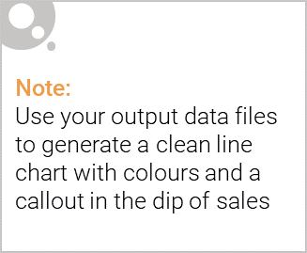
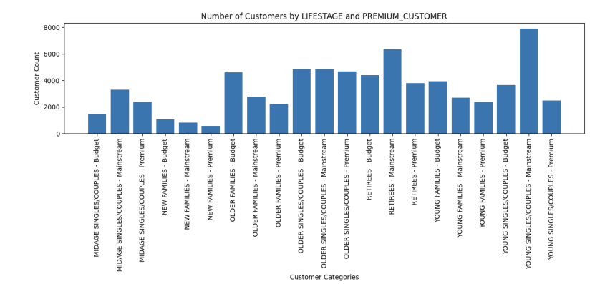
Mainstream - young singles/couples who buy chips contributes to there being more sales.

Slide 6

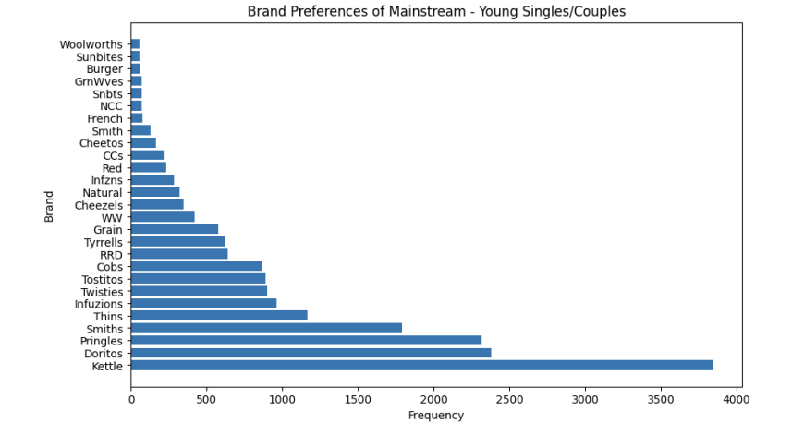
Among the Mainstream - Young Singles/Couples customer segment. Kettle, Doritos, and Pringles emerge as the top brand preferences.

Slide 7
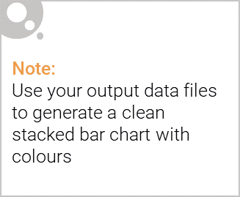
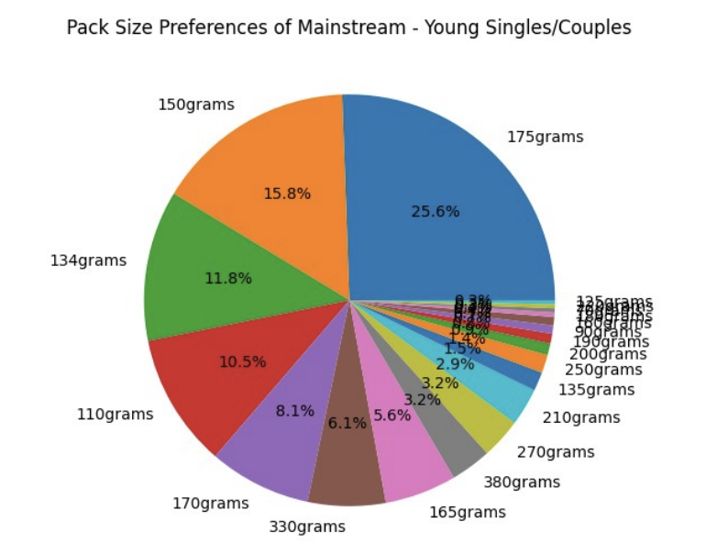
Editable (delete this)
More than half of Mainstream - Young Singles/Couples customer segment prefer the pack sizes among 175g,150g and 134g.

Slide 8
02
The trial initiatives in stores 77 and 86 were generally successful in boosting both sales and customer engagement. However, further analysis and adjustments may be required for store 88 to optimize its performance during the trial period.

Slide 9
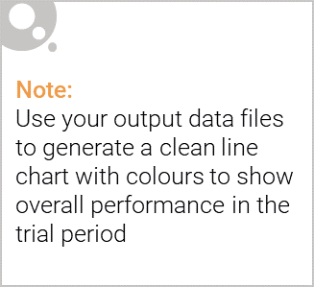
In a three-month trial period, comparing the performance of trial stores 77, 86, and 88 with their respective control stores 233, 155, and 237.
The results indicate that trial store 77 and 86 demonstrated sales performance outside the 5% to 95% confidence interval of the control store for two of the three trial months, while also showing a significant difference in customer count during all three months.
For trial store 88, its sales performance deviated outside the confidence interval for two of the three months, concurrent with deviations in customer count during trial period.

Slide 10
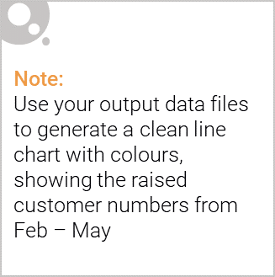
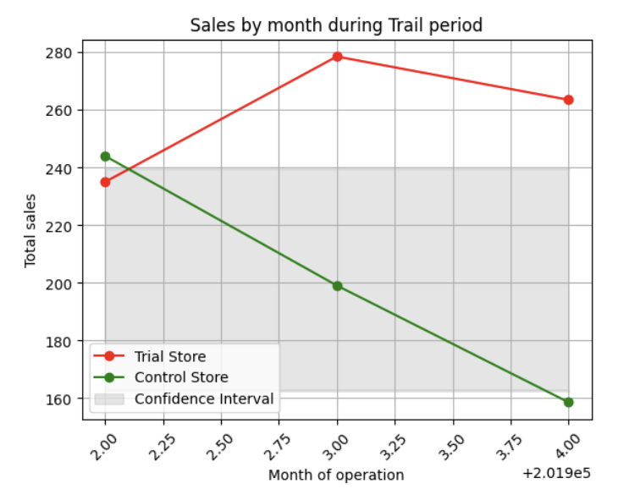
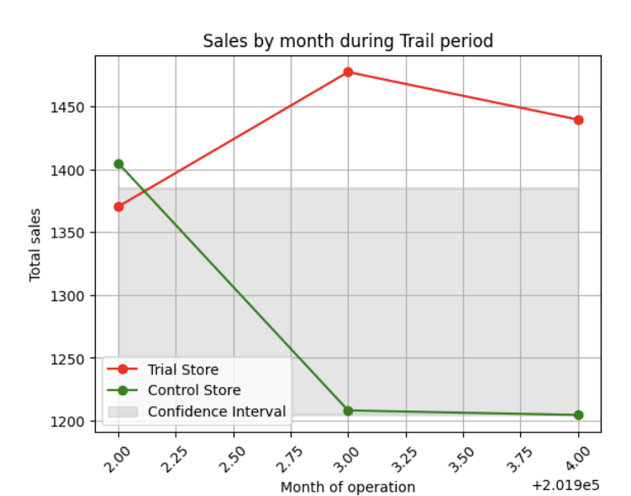
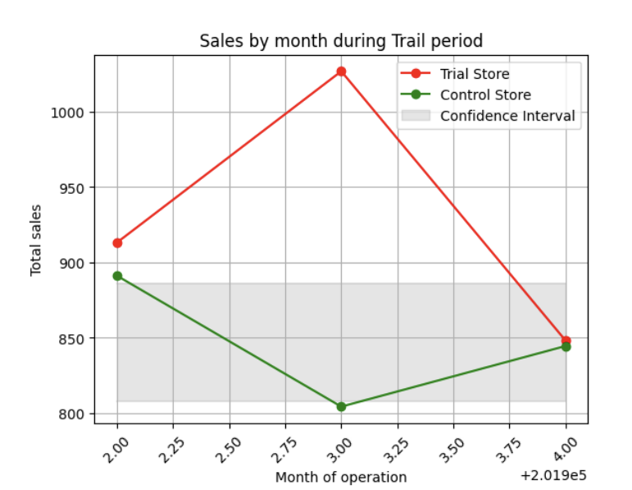
Trail store – 77
Control store - 233
Trail store – 88
Control store - 237
Trail store – 86
Control store - 155

