Slide 1

BTP-1 · FINAL PRESENTATION
Design and Implementation of IEEE 802.3
1 Gb/s Ethernet MAC / PHY Interface in Verilog-2001
Presented by: L. Sai Srivardhan Reddy · Roll No. 23EC37032
Department of Electronics & Electrical Communication Engineering
Supervisor: Prof. Aneek Adhya
G. S. Sanyal School of Telecommunications
Indian Institute of Technology Kharagpur · November 2026
Notes:
1.7.2013
1.7.2013
Good morning. This is my BTP-1 report on an Ethernet media-access controller and physical-interface block, written from scratch in Verilog-2001. There is no vendor MAC IP here: every module was written by me, and the design is proven as a pair by a transmit-plus-receive loopback.
‹#›
‹#›

Slide 2




MOTIVATION
Introduction & Project Motivation
The project
      XGS-PON (10 Gbps symmetric fibre) on a Xilinx UltraScale FPGA — part of India's first indigenous OLT / ONU prototype.
      To test the rest of the optical hardware, the system needs a working processor interface: MicroBlaze soft processor + DRAM.
The problem
      The project used Xilinx licensed Ethernet IP. The trial licences have expired.
      A new licence costs about ₹7–8 lakh — more than our budget.
      Without a MAC, the board cannot send or receive any frame. The GTY transceiver, DMA engine and MicroBlaze stay idle.
      Licensed IP is a black box: we cannot see why a frame is dropped, or change padding, gap and error reporting.
Our answer: we built our own Ethernet MAC. It is free to use on any port, and every rule in it follows IEEE 802.3.
IEEE 802.3 Ethernet MAC / PHY interface · Verilog-2001 · BTP-1
2 / 17
Notes:
1.7.2013
1.7.2013
Our research group is building an XGS-PON optical communication system, 10 Gbps symmetric, on a Xilinx UltraScale FPGA, as part of India's first indigenous OLT and ONU prototype. To test the rest of the optical hardware we need a working processor interface, a MicroBlaze soft processor with DRAM, and that needs an Ethernet MAC. The Xilinx licensed Ethernet IP trial has expired and a new licence costs about seven to eight lakh rupees. So we wrote our own MAC, free to use on any port, with every rule following IEEE 802.3.
‹#›
‹#›

Slide 3
BACKGROUND
OSI Stack & Ethernet Frame
The seven OSI layers, and the one we build
The frame this block builds (Clause 3)
L7
Application · Modbus / application payload
7 × 0x55
preamble
0xD5
SFD
DA
6 octets
SA
6 octets
T/L
2
payload+pad
FCS
4
L6
Presentation · format, TLS
      MAC (Media Access Control), Layer 2: builds the frame — preamble, padding, CRC — and checks it on receive.
      PHY (Physical layer), Layer 1: sends the bits as signals on the line. It talks to the MAC over GMII / MII.
L5
Session · connection state
L4
Transport · TCP, port 502
L3
Network · IPv4 + ARP
      Minimum frame: 64 octets. Body is padded to 60 (Cl. 4.4.2)
      Gap between frames: 96 bit-times = 12 cycles (GMII) or 24 (MII)
      CRC-32: a good frame ends with the value 0xDEBB20E3
L2
Data Link · Ethernet MAC: framing, addressing, CRC-32
THIS
WORK
L1
Physical · GMII 8-bit @ 125 MHz → PCS/PMA + serialiser
Our block: host AXI4-Stream ↔ MAC ↔ GMII. PCS/PMA are inside the GTY transceiver.
IEEE 802.3 Ethernet MAC / PHY interface · Verilog-2001 · BTP-1
3 / 17
Notes:
1.7.2013
1.7.2013
From the stack down: software owns layers seven to three, the GTY owns the serial side, and the MAC is the whole of Layer 2 plus the GMII hand-off to Layer 1. Everything on this slide is a constant I had to enforce in RTL: sixty octets of body, ninety-six bit-times of gap, and a reflected CRC sent low octet first. MAC means Media Access Control, Layer 2: it builds and checks the frame. PHY means the physical layer, Layer 1: it puts the bits on the line. They talk over GMII or MII.
‹#›
‹#›

Slide 4
SCOPE
Project Scope & Contributions
What this work contributes
Project scope
      Open & Portable Implementation: Vendor-neutral, royalty-free IEEE 802.3 MAC/PHY-interface core written in Verilog-2001 (clean RTL, no generated wrappers).
      Complete Datapath Design: Features a 7-state TX controller (handling pad, FCS, preamble, IFG) and a store-and-forward RX pipeline with typed error reporting.
      Pin-to-Pin Testbench Verification: GMII loopback bench with TX connected directly to RX and line-level corruption injection, proving the system as a unified pair rather than isolated parts.
1
TX MAC
covered
2
RX MAC
covered
3
Top-level MAC
covered
4
Verification
covered
5
IP / register front-end
parked
6
FPGA bring-up
parked
Scope so far: steps 1–4 are done, and the TX, RX and loopback tests all pass.
Stages of work: Study → Architecture → RTL → Verify → Synthesise
IEEE 802.3 Ethernet MAC / PHY interface · Verilog-2001 · BTP-1
4 / 17
Notes:
1.7.2013
1.7.2013
The build was planned as six steps; four are in this report and two are parked. Contributions: an open and portable implementation, a complete datapath design, and pin-to-pin verification with the TX connected directly to the RX. The build was planned as six steps; four are in this report and two are parked. On the right is how the work actually ran: study the clauses, split the datapaths, write the RTL, verify with self-checking benches, then an elaboration check in Yosys. Stating the boundary earns more confidence than hiding it.
‹#›
‹#›

Slide 5
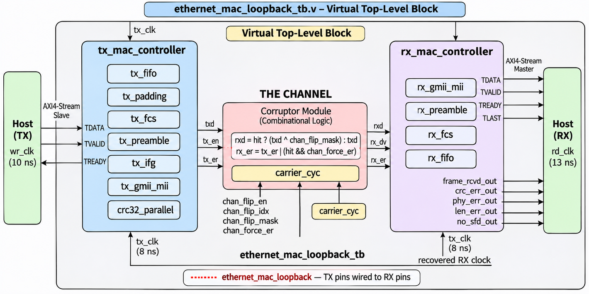
SYSTEM VIEW
System View: Loopback Test Setup
      A channel in the middle: it can flip bits on purpose, to test error handling.
      One write port, one read port — all else is inside the MAC.
      Two FIFOs cross clocks. Only Gray-coded counts cross.
      1 Gb/s = 125 MHz × 8 bits (GMII). MII: 4 bits, 25 MHz = 100 Mb/s.
      Three unrelated clocks: host write 10 ns (100 MHz, AXI-class), wire 8 ns (125 MHz), host read 13 ns (≈77 MHz).
Why a loopback: TX pins go straight into RX pins, so TX and RX are proven as one working pair.
IEEE 802.3 Ethernet MAC / PHY interface · Verilog-2001 · BTP-1
5 / 17
Notes:
1.7.2013
1.7.2013
This is the loopback test setup: TX pins are wired straight to RX pins through a channel that can flip bits on purpose. One write port, one read port. Speed: GMII moves 8 bits per 125 MHz clock, so 1 Gb/s; MII moves 4 bits, 25 MHz gives 100 Mb/s. Host write clock 100 MHz (10 ns) is a realistic AXI-class fabric clock; wire is 8 ns; host read is 13 ns, about 77 MHz. The three clocks are unrelated, so the crossing is properly tested.
‹#›
‹#›

Slide 6
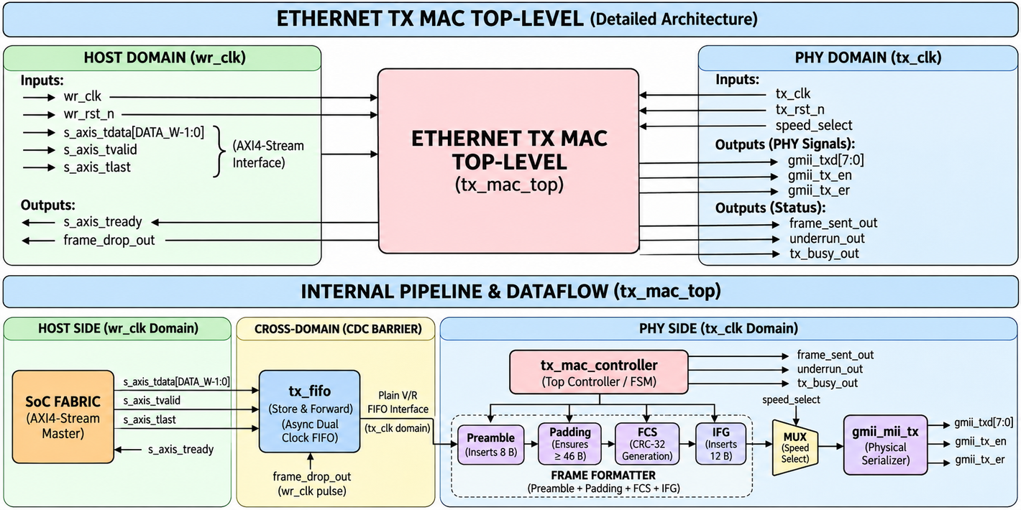
TRANSMIT DATAPATH
TX MAC Top-Level Architecture
      Host side (wr_clk): AXI4-Stream in, tready back.
      tx_fifo crosses to the wire clock and sends a frame only after tlast.
      tx_mac_controller adds preamble, padding, FCS and the gap.
      gmii_mii_tx drives the pins: 8 bits (GMII) or 4 bits (MII).
Padding note: “≥ 46 B” in the diagram is the payload minimum. Our MAC counts the whole body (addresses + type + payload), so it pads to 60 octets.
IEEE 802.3 Ethernet MAC / PHY interface · Verilog-2001 · BTP-1
6 / 17
Notes:
1.7.2013
1.7.2013
The TX top level: host side on wr_clk, the FIFO crossing to tx_clk, then the controller and gmii_mii_tx. The diagram says padding to 46 bytes: that is the payload minimum. Our MAC counts addresses, type and payload together, so the same rule shows up as padding to 60 octets.
‹#›
‹#›

Slide 7
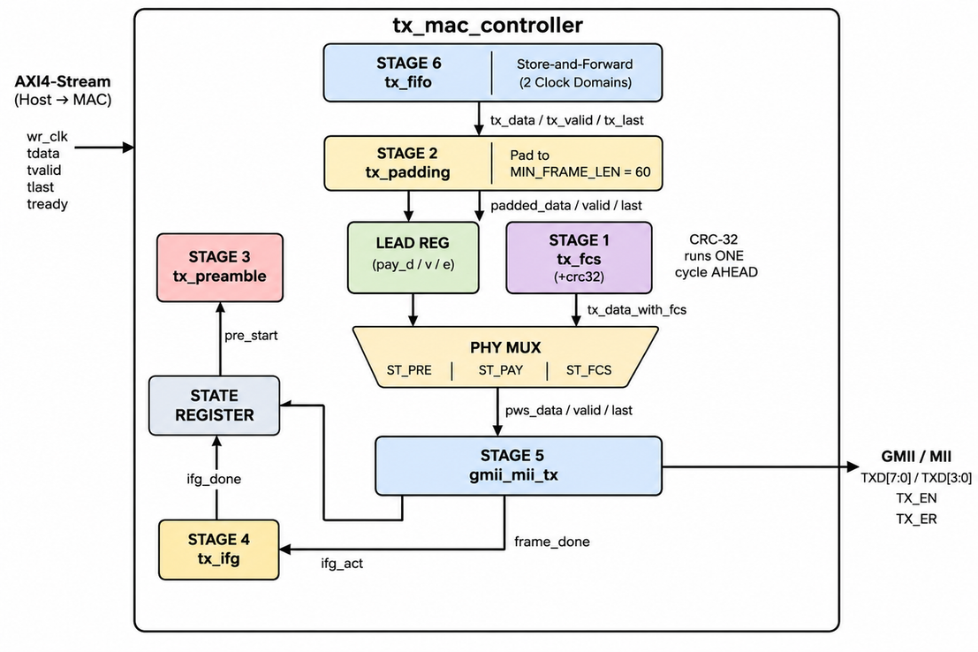
TRANSMIT DATAPATH
TX MAC Controller & Design Decisions
      Body padded to 60 octets — minimum frame is 64 with the 4-octet FCS (Cl. 4.4.2). tx_padding_tb
      FCS sent low octet first — polynomial 0x04C11DB7, seed 0xFFFFFFFF, known answer 0xCBF43926. tx_fcs_tb
      Gap of 96 bit-times — 12 cycles in GMII, 24 in MII. tx_ifg_tb
      FIFO sends only after tlast — no half frame ever reaches the wire. tx_fifo_tb
      Preamble skips padding and CRC — 7 × 0x55 + 0xD5 (Cl. 3.2.1–3.3). tx_preamble_tb
A star, not a chain: the wire order (preamble → body → FCS) differs from the data order (body → pad → CRC), so the controller picks the source each cycle.
IEEE 802.3 Ethernet MAC / PHY interface · Verilog-2001 · BTP-1
7 / 17
Notes:
1.7.2013
1.7.2013
The diagram is the argument: the controller is the hub and the other blocks are sources it selects, which is why the FCS is a tap and the preamble is a parallel source. The five decisions on the right are the constants I had to get right, each with the clause and the bench that pins it down.
‹#›
‹#›

Slide 8
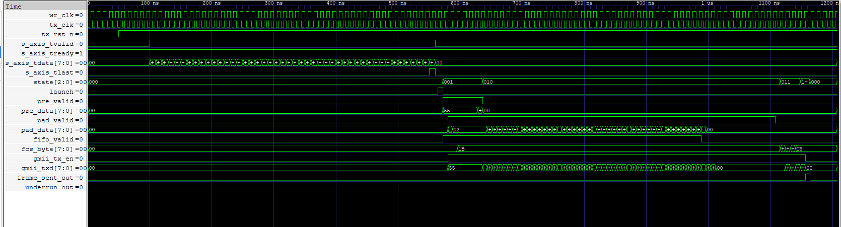
WAVEFORM
TX Waveform: Idle → Preamble → Body → FCS
      Host writes a short body on s_axis. The FIFO holds it until tlast, then the controller launches.
      On the wire (gmii_txd): preamble 0x55, then the body padded up to 60 octets, then the 4-octet FCS.
      gmii_tx_en falls right after the last FCS octet, and frame_sent_out pulses once.
IEEE 802.3 Ethernet MAC / PHY interface · Verilog-2001 · BTP-1
8 / 17
Notes:
1.7.2013
1.7.2013
Point at three things in this capture: the preamble 0x55 octets, the body padded up to 60, and gmii_tx_en falling right after the last FCS octet, followed by one frame_sent_out pulse.
‹#›
‹#›

Slide 9
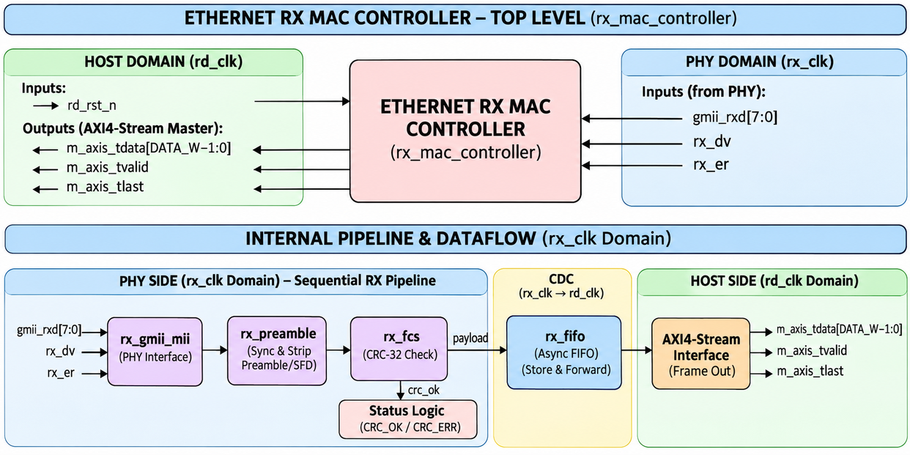
RECEIVE DATAPATH
RX MAC Pipeline & Design Decisions
      Preamble stripped at the SFD — Clause 4.2.4.2.1 allows as few as 3 octets. rx_preamble_tb
      Residue check, no comparator — result 0xDEBB20E3 on the same CRC engine. rx_fcs_tb
      One-octet hold-back at the pins — finds the last octet when RX_DV falls. rx_gmii_mii_tb
      Store-and-forward FIFO — commit on crc_ok, rewind on crc_err. rx_fifo_tb
      Error types kept separate — crc_err, len_err, phy_err. rx_mac_controller_tb
CRC result comes one cycle late: the last FCS octet enters the CRC engine on the last cycle, so the result is ready on the next. The store-and-forward FIFO is built for this.
IEEE 802.3 Ethernet MAC / PHY interface · Verilog-2001 · BTP-1
9 / 17
Notes:
1.7.2013
1.7.2013
Same shape as transmit, different discipline: nothing is published until the frame is known good. The one structural difference is the hold-back octet at the pins, because the last octet of a frame is only identified on the falling edge of RX_DV.
‹#›
‹#›

Slide 10
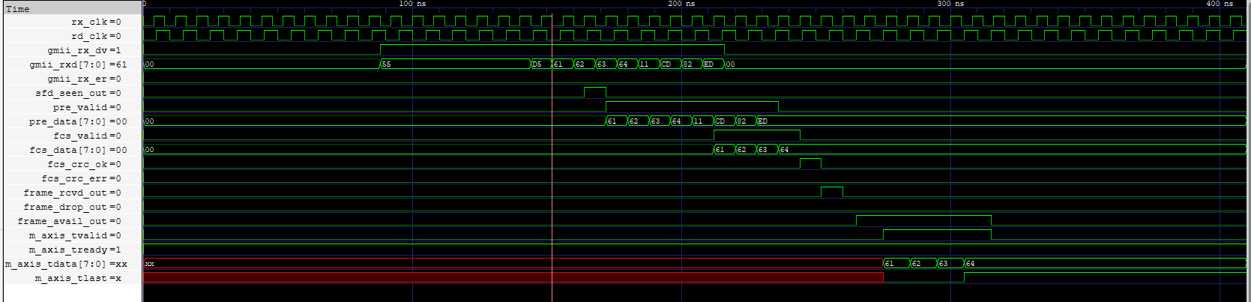
WAVEFORM
RX Waveform: RX_DV to a Completed AXI Transfer
      SFD seen after the preamble; then the body octets move on through the pipeline.
      fcs_crc_ok pulses after the last FCS octet, then frame_rcvd_out.
      Only then does m_axis_tvalid rise, and the frame leaves on m_axis with tlast on the last octet.
IEEE 802.3 Ethernet MAC / PHY interface · Verilog-2001 · BTP-1
10 / 17
Notes:
1.7.2013
1.7.2013
The receive capture is the mirror image, with one extra idea: the receiver never publishes until the verdict is known. Point at the frame arriving on RXD, the one-octet hold-back at the pins, and m_axis_tvalid rising only after the residue check passes.
‹#›
‹#›

Slide 11
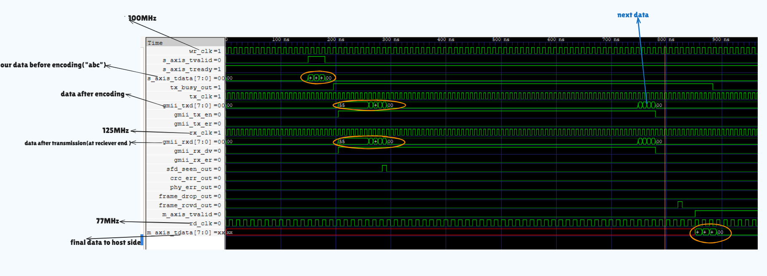
WAVEFORM
Loopback Waveform: Good Frame
      “abc” (3 octets) is padded into a legal frame, sent on the wire, and comes back byte-identical.
      Three clocks at once: 100 MHz host write, 125 MHz wire, ≈77 MHz host read.
IEEE 802.3 Ethernet MAC / PHY interface · Verilog-2001 · BTP-1
11 / 17
Notes:
1.7.2013
1.7.2013
Left capture of the loopback claim: the three-octet write abc is padded into a legal frame and returns byte-identical. The annotations show the three clocks: 100 MHz write, 125 MHz wire, about 77 MHz read.
‹#›
‹#›

Slide 12
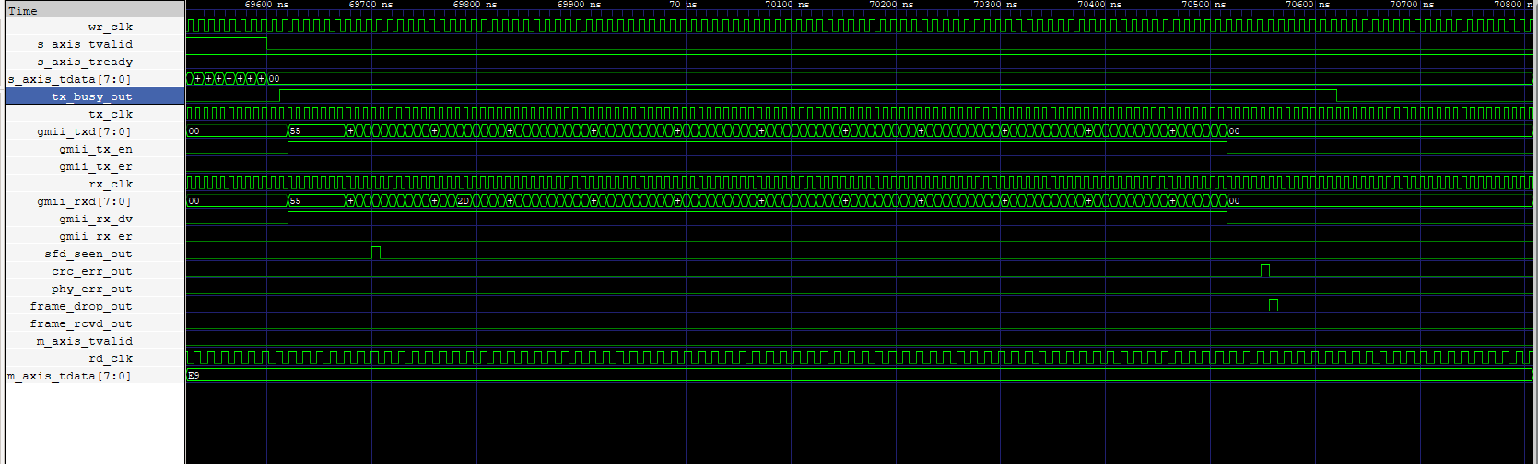
WAVEFORM
Loopback Waveform: Corrupted Frame
      One bit flipped on the wire: crc_err_out and frame_drop_out pulse.
      m_axis_tvalid stays low — nothing reaches the host.
      The next good frame is received normally (checked in the loopback test).
IEEE 802.3 Ethernet MAC / PHY interface · Verilog-2001 · BTP-1
12 / 17
Notes:
1.7.2013
1.7.2013
Right capture: one bit flipped in flight gives a crc_err pulse and a frame drop, and nothing is delivered to the host. All seventy-two wire octets were tested one by one.
‹#›
‹#›

Slide 13
EVIDENCE
Test Cases: What Each Module Was Tested For
Level | Module | Key test cases
TX | tx_padding | 1-byte frame padded to 60; 59 / 61-byte boundaries; reset mid-frame, next frame clean
TX | tx_preamble | SFD on the wire = 10101011, LSB first; stall at every octet; reset mid-burst
TX | tx_ifg | Gap = 96 bit-times (12 cycles GMII, 24 MII); speed change mid-gap ignored
TX | tx_fcs | CRC of “123456789” = 0xCBF43926; back-to-back frames; reset mid-frame
TX | tx_fifo | No half frame visible; oversize frame dropped cleanly; 200 MHz → 25 MHz write/read ratio
TX | tx_gmii_mii | 64- and 1518-octet frames, GMII and MII; underrun aborts with TX_ER; speed change mid-frame
TX | tx_mac_controller | Length sweep 1–70 octets; CRC residue 0xDEBB20E3 on every frame; reset and recovery
TX | tx_edge_case | 1-octet runt; 59 / 60 / 61 boundary; tvalid with no tlast; write clock 500 / 100 / 25 MHz
RX | rx_gmii_mii | RX_ER on one octet reported at frame end; MII nibbles joined; odd nibble discarded
RX | rx_preamble | 3- and 20-octet preambles accepted; missing SFD detected; corrupted preamble rejected
RX | rx_fcs | One flipped bit caught; FCS in wrong octet order rejected; runt frame rejected
RX | rx_fifo | Bad frame erased, next frame overwrites it; oversize frame dropped whole; slow consumer
RX | rx_mac_controller | Good / bad frames alternate, only good arrive; junk carrier cannot hang; 0x55 / 0xD5 in payload
Both | loopback (TX → RX) | Corrupt each wire octet in turn: no frame leaks; all 8 single-bit errors caught; bad SFD → no_sfd
IEEE 802.3 Ethernet MAC / PHY interface · Verilog-2001 · BTP-1
13 / 17
Notes:
1.7.2013
1.7.2013
This slide lists the key test cases for each module, picked as the important ones, not the easy ones. Each module has its own self-checking testbench, and the loopback tests the whole TX plus RX pair together.
‹#›
‹#›

Slide 14
EVIDENCE
Results
Level | Bench | Status
TX unit | tx_mac_controller_tb | PASS
TX edge | tx_edge_case_tb + tx_protocol_checker | PASS
TX unit | tx_padding_tb | PASS
TX unit | tx_preamble_tb | PASS
TX unit | tx_ifg_tb | PASS
TX unit | tx_fcs_tb | PASS
TX unit | tx_fifo_tb | PASS
TX unit | tx_gmii_mii_tb | PASS
RX unit | rx_gmii_mii_tb | PASS
RX unit | rx_preamble_tb | PASS
RX unit | rx_fcs_tb | PASS
RX unit | rx_fifo_tb | PASS
RX chain | rx_mac_controller_tb (pins → AXI) | PASS
Combined | ethernet_mac_loopback_tb (TX + RX, 3 clocks) | PASS
      All benches pass at every level: unit → chain → loopback
      Test frame “abc” is padded, sent TX → RX and received correctly
      Corrupt any octet on the wire: nothing is delivered, crc_err every time
      The next good frame is received normally
Tools used: VS Code with the OSS CAD Suite (Icarus Verilog, GTKWave, Yosys), and GitHub for project management.
IEEE 802.3 Ethernet MAC / PHY interface · Verilog-2001 · BTP-1
14 / 17
Notes:
1.7.2013
1.7.2013
Every bench passes. The loopback proves a test frame goes through TX then RX correctly, and that corrupting any octet on the wire delivers nothing and raises crc_err. Tools: VS Code, the OSS CAD Suite (Icarus Verilog for simulation, GTKWave for waveforms, Yosys for synthesis checks) and GitHub for project management. If asked about known gaps: the TX side has no oversize-frame check, TX_ER cannot be driven from outside the MAC controller, and a reset in the middle of a frame is not flagged on the wire. These are small and not datapath bugs.
‹#›
‹#›

Slide 15
CLOSE
Limitations & Future Work
Limitations
Future Work
      IP wrapper not built yet — needed to use the MAC in the main design.
      No board bring-up yet: no synthesis, timing or pin-level results. All results so far are from simulation.
      Clock crossings are argued by design, not shown in simulation (a simulator has no metastability).
      Build the IP wrapper, test it on an FPGA by sending an image or other data, then integrate it into the main design.
      Synthesis, timing closure and a board demo: connect the MAC to MicroBlaze + DRAM, drive the GTY transmitter, and use known frames to test the XGS-PON hardware.
IEEE 802.3 Ethernet MAC / PHY interface · Verilog-2001 · BTP-1
15 / 17
Notes:
1.7.2013
1.7.2013
Limitations: the IP wrapper is not built yet, MII is not yet tested with it, the design is full duplex only, it has no PAUSE, MDIO, address filtering, VLAN or statistics, there is no board bring-up yet, and clock crossings are argued by design because a simulator cannot show metastability. Future work: build the wrapper, test it on the FPGA by sending an image or data, integrate it, then half duplex, flow control, management, filtering, and finally synthesis, timing and a board demo that connects the MAC to MicroBlaze and DRAM and drives the GTY transmitter to test the XGS-PON hardware. The core is verified, the limits are stated, and the next steps are clear.
‹#›
‹#›

Slide 16
CLOSE
Key Takeaways & References
Key Takeaways
      Working 1 Gb/s MAC in plain Verilog-2001, no vendor IP.
      Both datapaths designed and proven together by a pin-to-pin loopback.
      All testbenches pass.
References
[1] IEEE Std 802.3-2022, IEEE Standard for Ethernet, Section 3, Clause 36, “Physical Coding Sublayer (PCS) and Physical Medium Attachment (PMA) sublayer, type 1000BASE-X”.
[2] IEEE Std 802.3-2018, §3.2.1–3.3, §3.2.9, §4.2.4, §4.4.2 and §22.2.
[3] IEEE Std 1364-2001 (Verilog HDL). [4] ARM, AMBA AXI4-Stream Protocol Specification, ARM IHI 0051A. [5] Icarus Verilog, GTKWave, Yosys.
IEEE 802.3 Ethernet MAC / PHY interface · Verilog-2001 · BTP-1
16 / 17
Notes:
1.7.2013
1.7.2013
Key takeaways: a working 1 Gb/s MAC in plain Verilog-2001, both datapaths proven together by the loopback, and all testbenches passing. References are on this slide.
‹#›
‹#›

Slide 17
BTP-1 · FINAL PRESENTATION
Thank you
L. Sai Srivardhan Reddy · Roll No. 23EC37032
Department of Electronics & Electrical Communication Engineering
Supervisor: Prof. Aneek Adhya
G. S. Sanyal School of Telecommunications
Indian Institute of Technology Kharagpur · BTP-1 · November 2026
Notes:
1.7.2013
1.7.2013
That is the report. The MAC is hand-written, verified, and proven end to end by the loopback. Thank you.
‹#›
‹#›

