Slide 1

UNDER THE GUIDELINES OF
POOVARASAN RAJA
SUBMITTED BY
T. SAI HARI HARA CHANDRA
(23017_177)

Slide 2
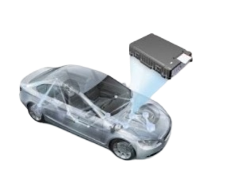
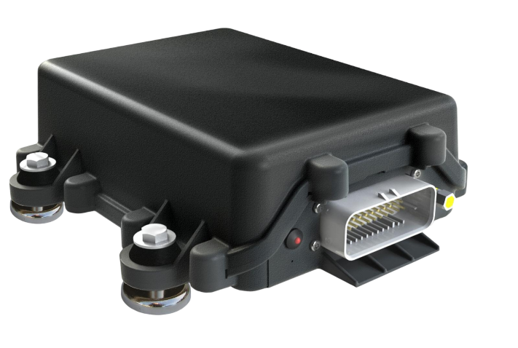
CAR BLACK BOX

Slide 3
CONTENTS
Topics Learned
Abstract
Introduction
Need Of Car Black Box
Embedded System(ES)
Microcontroller & Microprocessor
How To Choose ES?
Requirements
Schematic Diagrams
Project Requirement Details
Applications
Conclusion
References

Slide 4
Topics Learning During This Project
Embedded C Programming
Introduction To Microcontroller
Microcontroller Vs Microprocessor
Embedded Systems
Types Of Embedded Systems
Microcontroller PIC18F4580
Types Of Memory (EEPROM, PROM, Mask, ROM, SRAM, DRAM, Flash Memory)
Interrupts & All required Peripherals
Components like (LED’s, Digital Keypad, Matrix Keypad, Timers, Potentiometer, CLCD, RTC, I2C Protocols, UART etc…)

Slide 5
ABSTRACT:
The "Car Black Box" project aims to develop an integrated system that acts as a data recorder and monitoring device for vehicles. This system, commonly known as a black box, will capture and store critical information related to the vehicle's operation, providing valuable insights for accident analysis, driver behavior assessment, and overall vehicle performance evaluation.

Slide 6
Introduction
What is Car Black Box?
A Car black box is a device which is installed in your vehicle in your car which will monitor your driving, like it will record event like accident, if accident will happen it will record, speed it will record, mileage it will record.
Few car black box records location too.
It is also called as event data recorder.
The black box is an extremely durable electronic device capable of recording valuable information in the moments.

Slide 7
Need Of Car Block Box
Car Black Box mostly focuses on enhancing safety standards of driven vehicle by monitoring vehicle performance and diving behaviour.
Whatever records recorded by this box can be viewed by law enforcement agencies in case of any issue.
If there any issue, your insurance company can also check this box and if you done the insurance you will get the money.

Slide 8
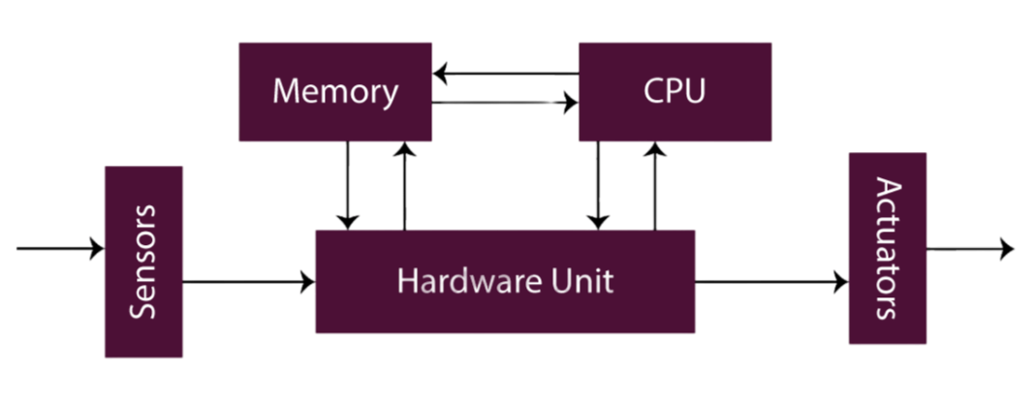
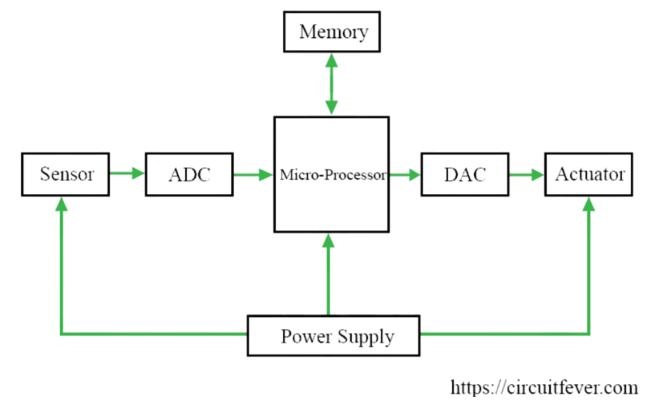
Embedded Systems
Embedded system is combination of any hardware and software which is intended to do specific task.
A General Purpose System(GPS) is used to perform large numbers of tasks whereas an Embedded System(ES) is used to perform specific task.
Types of Embedded systems:
1. Standalone System
2. Real Time System
3. Networked
4. Mobile

Slide 9
Microcontroller & Microprocessor
An integrated circuit which is capable of being programmed to perform a specified task
It has design restrictions such as memory size, I/O capabilities, peripheral functions etc..
Choose a microcontroller based on applications, performance, price, availability of tools and special capabilities.

Slide 10
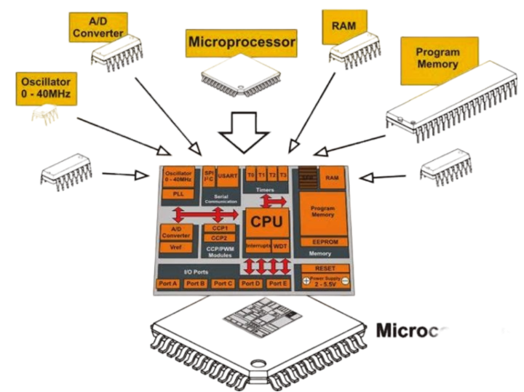
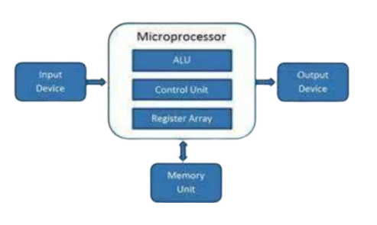
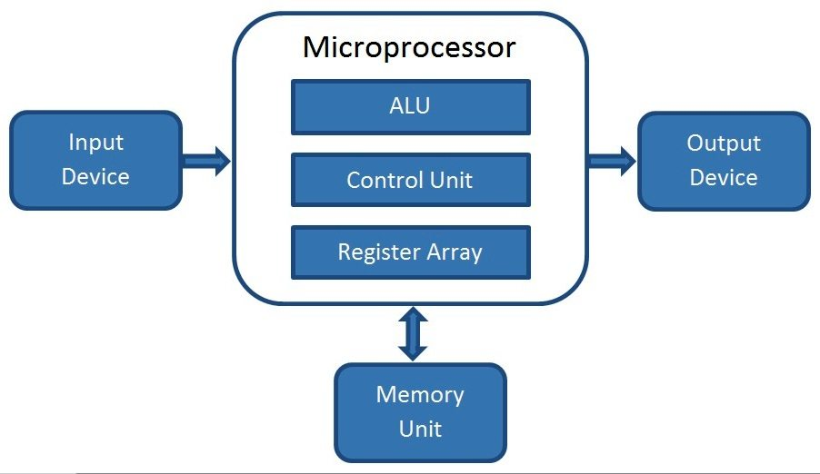
Microcontroller Vs Microprocessor
The difference between microcontroller and microprocessor is, in microcontroller all components will be in single chip, less flexible & less design complexity.
controller
While in microprocessor all components are assembled separately, more flexible and more design complexity

Slide 11
How To Choose Embedded System?
Low power consumption
Cost Efficiency
Efficient use of processing power
Reliability
Efficient use of memory

Slide 12
Requirements
Software
Hardware
MPLAB X IDE V5.35
MPLAB X IPE V5.35
Tera Term
TinybldWin
PicsimLab
PIC18F4580 Microcontroller
Display 16 x 2 CLCD
Matrix keypad (Switches)
Potentiometer
External EEPROM Memory
Microcontrollers
RTC(Real Time Clock)
Knowledge of Embedded C is the basic requirement.

Slide 13
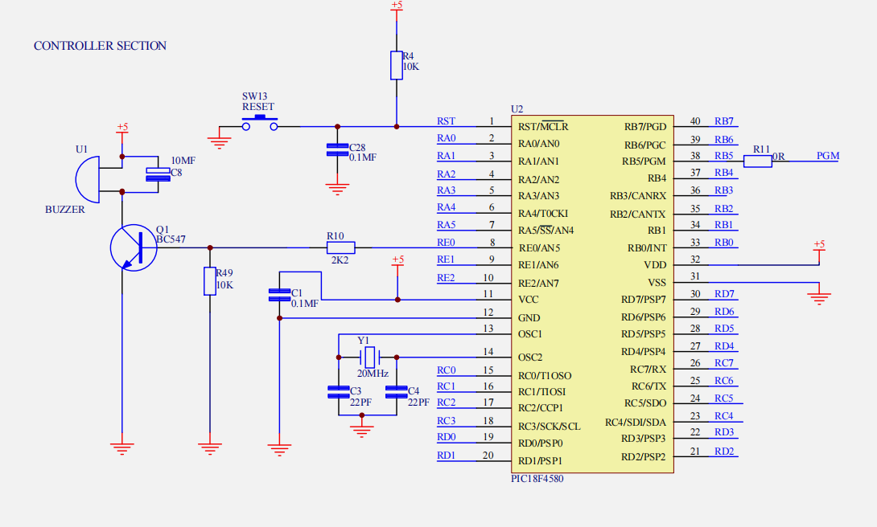
Schematic Diagrams

Slide 14
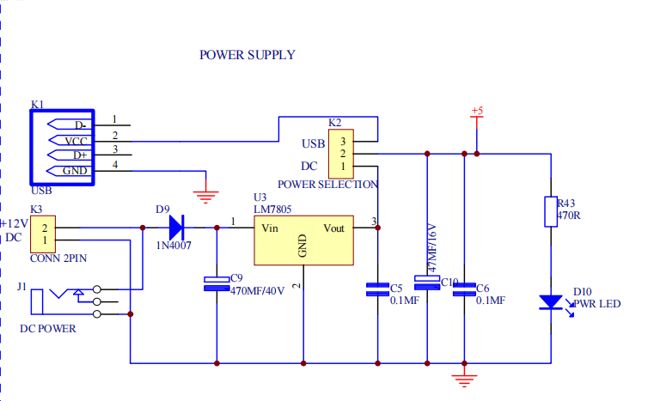
Power Supply

Slide 15
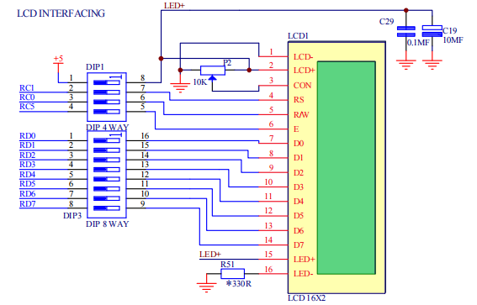
CLCD Interfacing

Slide 16
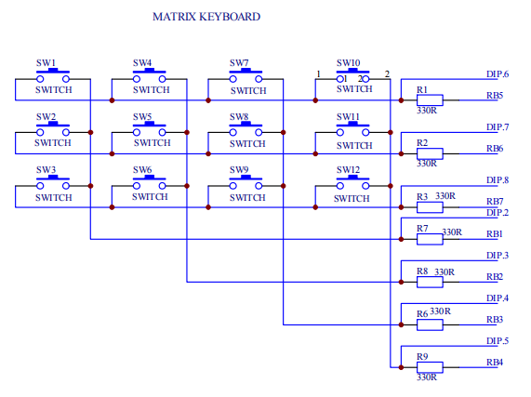
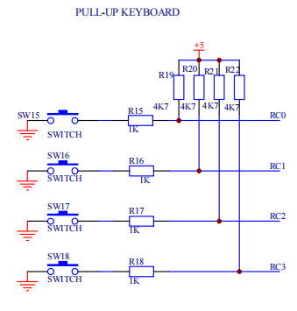
Matrix Keyboard Interfacing

Slide 17
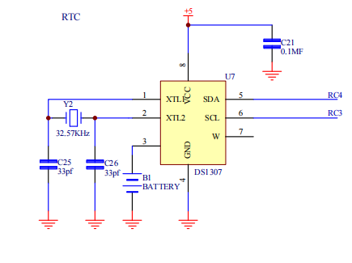
RTC(Real Time Clock) Interfacing

Slide 18
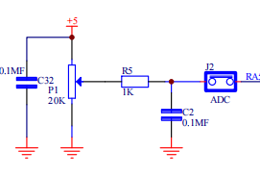
ADC | Potentiometer

Slide 19
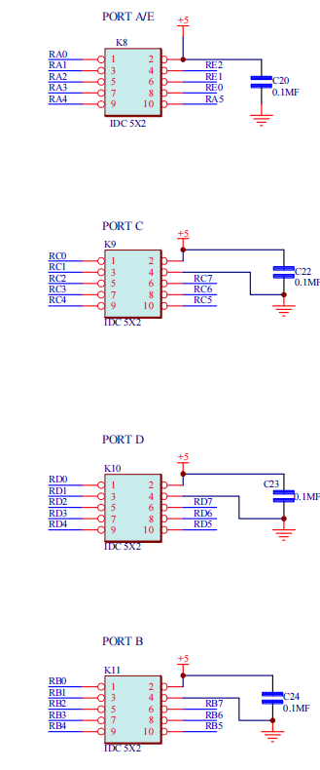
PORT A/E INTERFACING

Slide 20
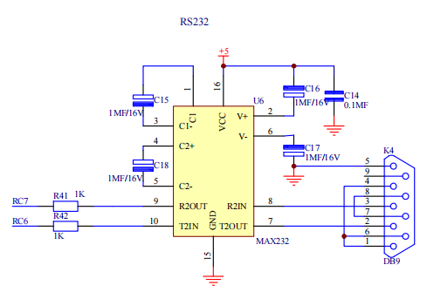
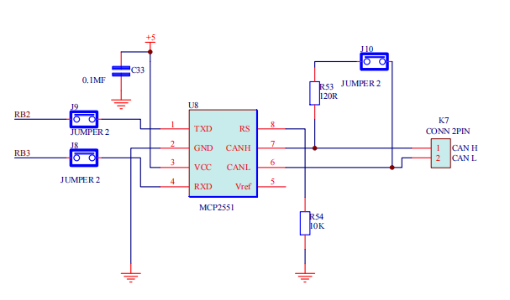
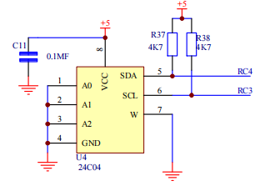
RS232 & MCP2551

Slide 21
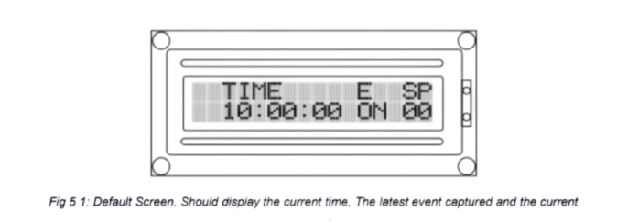
Project Requirement Details
Default Screen
When the system is in Operation Mode, it would act like a dash board which would show the current time, speed of vehicle and the latest occurred event.

Slide 22
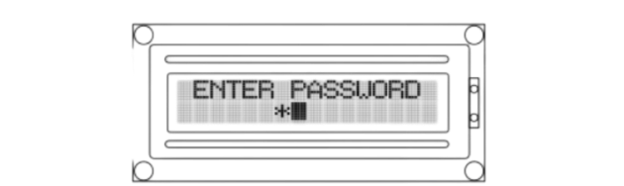
Login Screen
On press of the UP or DOWN (User Keys) keys the system should prompt for password.
The password would be the combination of 4 presses (User Keys).
Each press should be denoted a "*" symbol.
Every wrong entry would, re prompt for password (Max 3 times for every 15 minutes).
Incomplete key press (pause of 3 seconds) would lead to Default Screen
Fig 5 2: User Login.
The user needs to enter the password to browse through the available menu

Slide 23
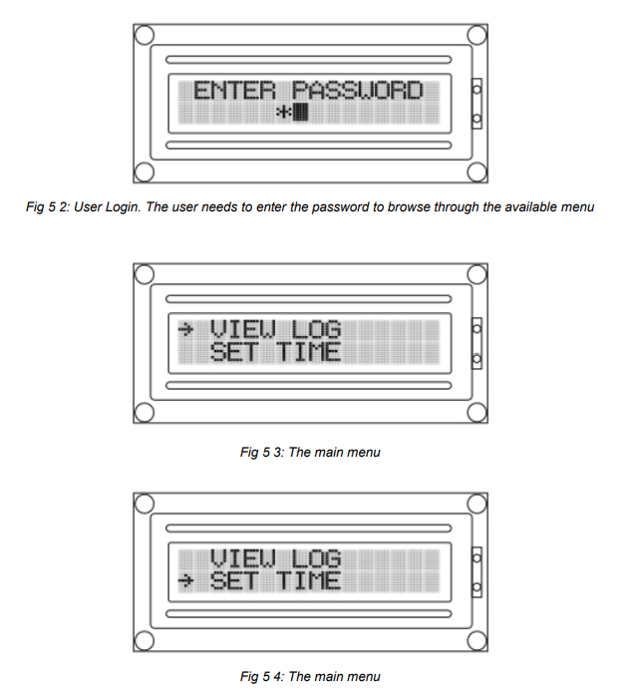
Main Menu
The main menu should contain 5 option
View Log
Set Time
Download Log
Clear Log
Change Password
Fig 5 3: The main menu
The UP / DOWN keys are used to navigate
A long press of UP Key should enter the selected menu
A long press of DOWN Key should logout
Idle screen for more than 5 secs should logout
Fig 5 4: The main menu

Slide 24
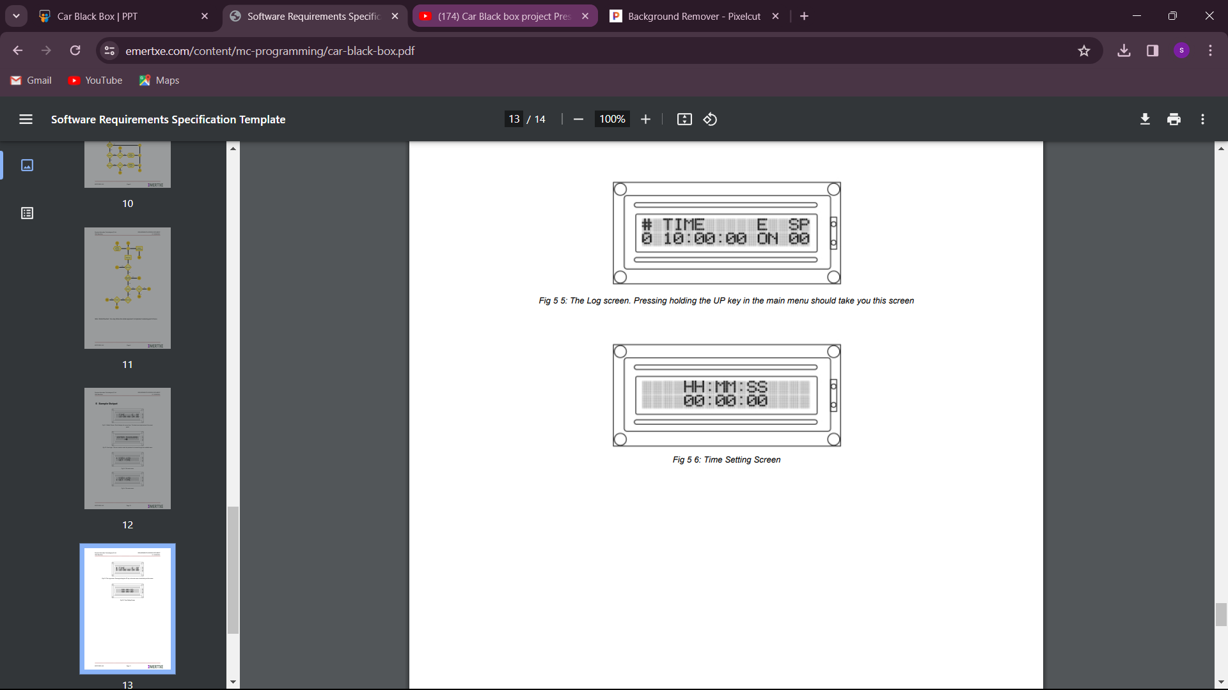
View Log
Should display all the events captured with log index starting from 0, like “EVENT NUMBER” “EVENT SIGNATURE” “EVENT TIME” “SPEED AT THE EVENT”
The UP and DOWN key will be used to scroll the entries
Rollover on reaching the max log entries
The system should be live (capture events occurred) even while viewing the log
A long press of UP Key should take you back to main menu
A long press of DOWN Key should logout
Fig 5 5:
The Log screen. Pressing holding the UP key in the main menu should take you this screen

Slide 25
Set Time
Should show the current time. The Secs field should blink indicating the field to be changed
The UP key should be used to increment the time. Rollover on reaching max
The DOWN key will be used to choose the field.
A long press of UP Key should take you back to main menu
Fig 5 6: Time Setting Screen

Slide 26
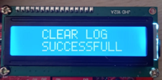
Clear Log
All logs should be Cleared.
It displays Logs cleared Successfully.
In events clear log is stored as a event.
A message appears on the screen saying that the Log is cleared from the External EEPROM. Now, in the View log mode; rest of the Events will not be visible to User. Scrolling operation will be ineffective.

Slide 27
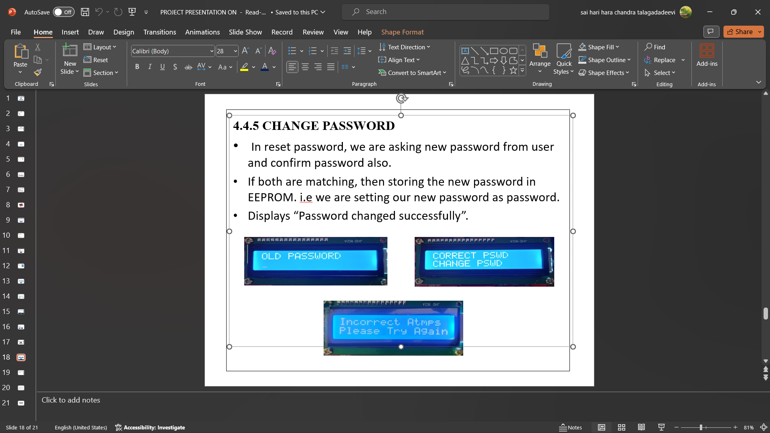
Change Password
In reset password, we are asking new password from user and confirm password also.
If both are matching, then storing the new password in EEPROM. i.e we are setting our new password as password.
Displays “Password changed successfully”.

Slide 28
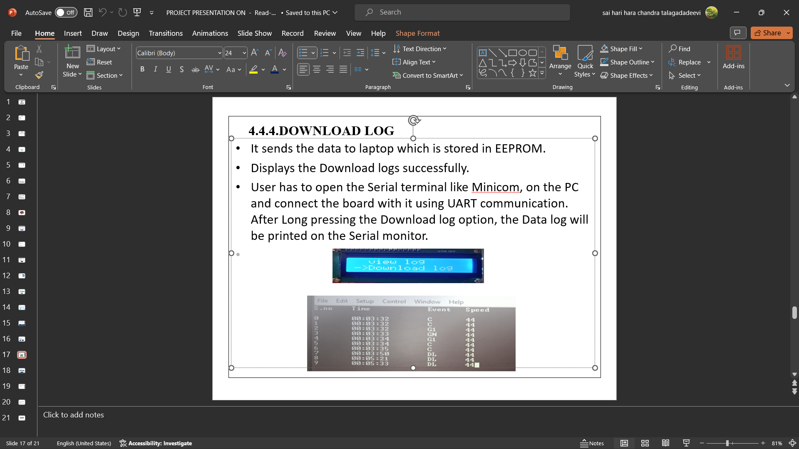
Download Log
It sends the data to laptop which is stored in EEPROM.
Displays the Download logs successfully.
User has to open the Serial terminal like Minicom, on the PC and connect the board with it using UART communication. After Long pressing the Download log option, the Data log will be printed on the Serial monitor.

Slide 29
Application
The Black box can be installed in some automobiles to record various events. These events which are electronically sensed can often proactively detect any issue in the vehicle .
For example : Engine fault
Monitor the fleet (Driver over speeding)
By doing pro-active maintenance of the automotive vehicle.

Slide 30
Conclusion
By implementing car black box which would log critical activities on the car and take appropriate action in case of rash driving. Negligence in the driving would be meeting the daily schedule and go off duty or to earn extra money. So by implementing the mentioned solution it would be easy to track how the vehicle is being used, handled and the efficiency of the vehicle.
The proposed solution is to log all the critical events like the gear shifts with current speed , and time. The system should allow to get the information stored in the black box by using the password to view or download the log If required.

Slide 31
References
Event Data Recorder – Wikipedia
Car Black Box – A sample technical specification
Download project document in PDF format

Slide 32
EL FIN [THE END]
Thank You

