Slide 1
INSURAI – Smart Insurance Management System
Presented By: Rachapudi Sai Sree
Technologies: React JS, Spring Boot, MySQL
Internship Project — Infosys Springboard

Slide 2
Introduction
INSURAI is a full‑stack insurance platform that simplifies interaction between customers, agents, and admins. Provides policy management, appointments, receipts, multi‑language support.

Slide 3
Problem Statement
- Manual policy management
- No unified platform
- Agent verification is inefficient
- No receipt authenticity check
- Lack of multilingual UI & dark mode

Slide 4
Objectives
- Centralized insurance system
- Policy browsing & purchase
- Appointment scheduling
- Admin control panel
- Multilingual UI (EN, HI, TE, TA)
- Dark mode UI

Slide 5
System Architecture
Frontend: React JS
Backend: Spring Boot
Database: MySQL
Security: JWT Authentication
Email OTP
PDF Generator
i18next Multilingual System

Slide 6
Core Features Implemented
- JWT Authentication
- Customer Dashboard
- Agent Dashboard
- Admin Panel
- Policy CRUD
- PDF Receipts
- Appointment Booking
- Multi‑Language Support
- Dark Mode

Slide 7
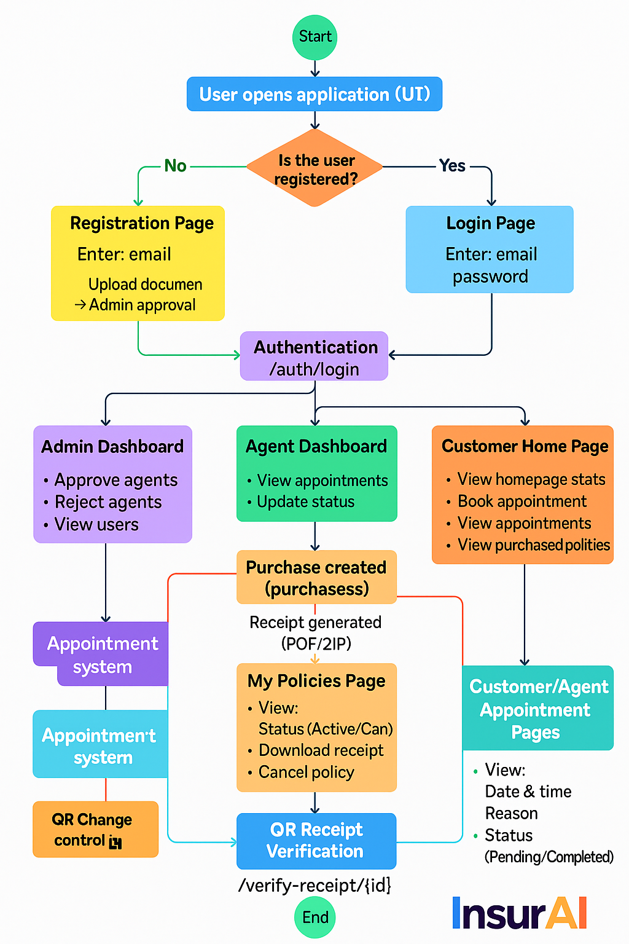

Slide 8
FUTURE SCOPE
Integration with Real Payment Gateways
AI-Based Policy Recommendation System
Smart Claim Processing System
Real-Time Chat Bot for Customer Support
Real-Time Notification System
Multi-Language Expansion Using AI Translation
Agent Performance Analytics & Commission System
Mobile App Version (Android + iOS)
Policy Comparison Tool
Cloud Deployment and CI/CD Pipelines

Slide 9
Conclusion
INSURAI is a complete insurance automation system.
Secure, scalable, multilingual, modern UI.
Fully functional workflows for all roles.

Slide 10
Thank You

