Slide 1
Smart Energy Consumption & Billing
Analytics Dashboard
A Domain-Aligned Analytics Case Study Inspired by Fluentgrid Prepared by Sai Abhilash

Slide 2
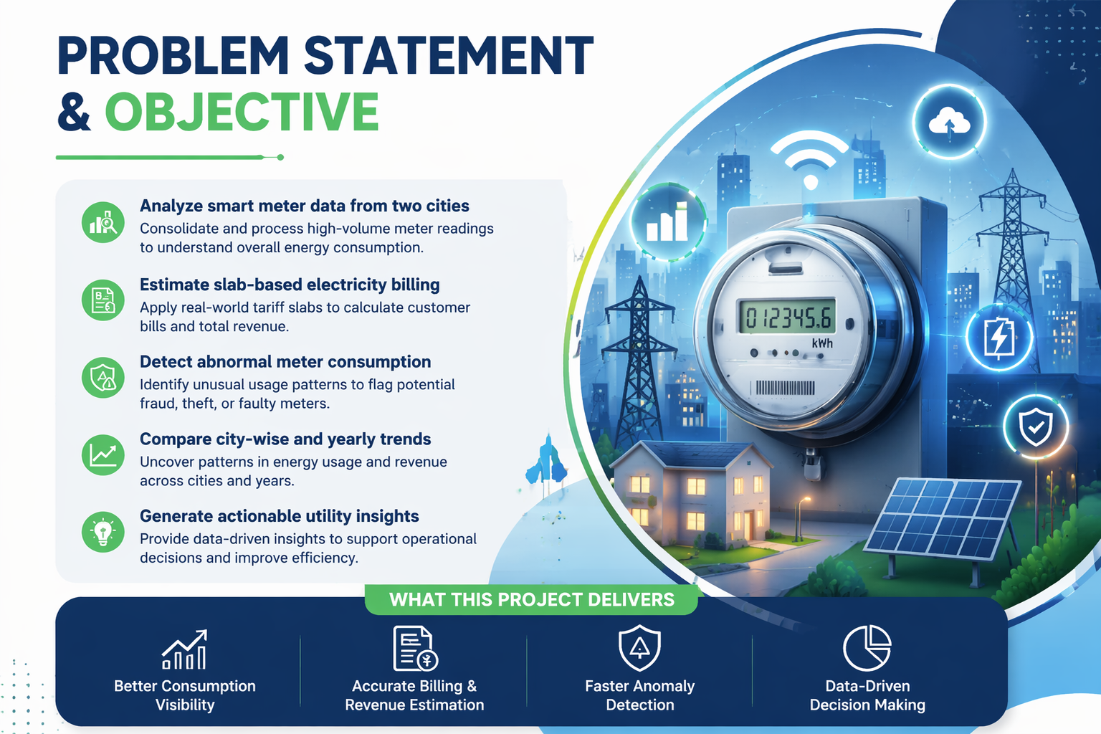

Slide 3
Technical Workflow
• Python ETL with Pandas
• Data cleaning and merging
• Monthly aggregation
• Anomaly detection logic
• SQL storage and querying
• Power BI dashboard creation

Slide 4
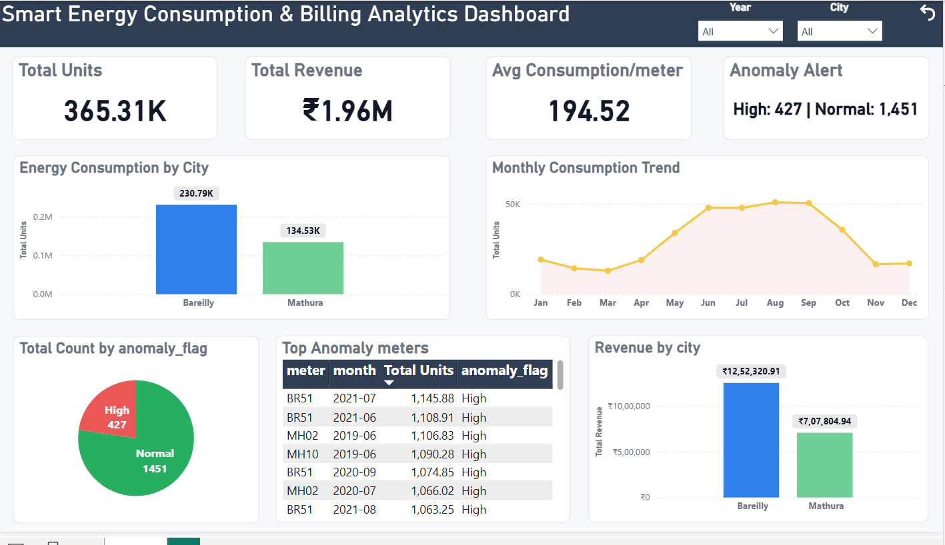
Dashboard Overview
• Total Units: 365.31K
• Revenue: ₹1.96M
• Avg Consumption: 194.52
• Anomalies: 427 High
• Dynamic year/city filters

Slide 5
Key Business Insights
✔ Bareilly drives majority of revenue (63%)
✔ Mathura has higher anomaly concentration (risk zone)
✔ ~23% consumption records are abnormal
✔ Peak usage observed in summer months
✔ 156% growth in Bareilly (2019 → 2020)
✔ Repeated anomalies in specific meters

Slide 6
Business Value to Fluentgrid
✔ Enables smart meter analytics for utilities ✔ Improves revenue through consumption insights ✔ Detects anomalies (~23%) for loss prevention ✔ Supports demand forecasting (seasonal trends) ✔ Enhances operational efficiency (risk zones) ✔ Provides interactive decision-making dashboards ✔ Scalable for smart city implementations

Slide 7
Thank You Excited to Contribute to Fluentgrid as an Intern

