Slide 1

AIR-GAPPED DATA DIODE ENCLAVE v2.4
CYBERSHIELD
Unidirectional Threat Detection Engine
High-performance passive cyber threat attribution operating over physical data diodes at 50,000+ packets/sec. Engineered with 16-shard zero-contention partitioning, statistical AI anomaly detection, and automated containment.
3D HOLOGRAPHIC CYBER DEFENSE OPERATIONS COMMAND ENCLAVE
OPTICAL DIODE ISOLATION
• Physical Tx severed (Rx = 1)
• Mathematical stealth guarantee
• Zero backchannel exploitation
• Air-gapped boundary defense
16-SHARD INGRESS
• 50,000+ pps sustained ingress
• Lock-free micro-batch routing
• Zero-allocation __slots__ model
• Sub-110ms sliding window SLA
AUTONOMOUS AI & MITRE
• 14 enterprise tactics mapped
• C2 beacon detection (CV < 0.15)
• Fast Shannon entropy (>3.65)
• Dynamic multi-firewall synthesis
CROSS-PLATFORM SOC
• Real-time WebSocket stream
• Live Cloudflare HTTPS tunnel
• Permanent 24/7 GitHub Pages
• Native Android Studio WebView

Slide 2

CORE ARCHITECTURE & INGESTION PIPELINE
16-Shard Hash Partitioning & High-Throughput Stream Pipeline
Hardware optical diode isolation feeding micro-batched, lock-partitioned analytical queues.
1. PHYSICAL INGRESS
Mirror TAP / SPAN Optical Diode Rx Tx = 0 Physical Cut
2. BINARY PARSER
Zero-Copy PCAP Unpack IPv4 / IPv6 Wire Decode TCP Flags & Raw UDP
3. MICRO-BATCHER
Batch Size: 250 pkts Hash Routing Function: (hash(src) & 0x7F) % 16
4. 16 SHARD CORES
16 Independent Locks Ring Buffers (maxlen=250) Zero Global Contention
5. ROLLING PRUNER
3.0s Sliding Window O(1) Popleft Eviction Sub-110ms Triage SLA
ZERO-CONTENTION CONCURRENCY
• Lock Partitioning: Divides state into 16 discrete EnclaveShard instances.
• Lock Amortization: Groups micro-batches by target shard prior to lock acquisition.
• Throughput: Sustained 25,000–50,000+ pps on commodity CPU cores without frame drops.
LOW-ALLOCATION MEMORY & STEALTH
• Python __slots__ Optimization: Eliminates dynamic dictionary allocation overhead.
• Bounded Ring Buffers: In-memory sliding windows prevent memory leaks under surges.
• Passive Stealth: Zero TCP RST or ICMP packets emitted back onto monitored wire.
PHYSICAL OPTICAL DATA DIODE NETWORK TAP (TX SEVERED / RX LISTEN-ONLY)

Slide 3
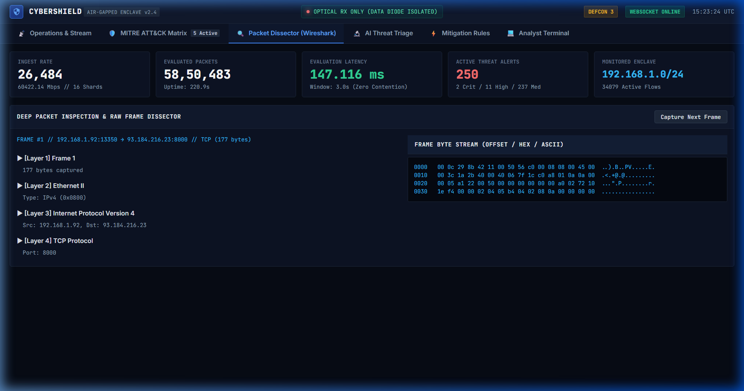
ANALYTICAL CORE & MATHEMATICAL FORMULATIONS
Mathematical Threat Detection: AI/ML, Entropy & JA4 Fingerprinting
Deterministic models operating concurrently across sliding windows for precision threat attribution.
1. BOTNET C2 BEACONING (IAT & CV)
• Theory: Automated implants maintain rhythmic callbacks; human traffic is chaotic.
• Formula: CV = σ / μ (where μ = mean interval, σ = standard deviation of deltas).
• Detection Boundary: CV < 0.15 identifies automated heartbeat periodicity.
• Confidence Model: Score = min(0.99, 1.0 - CV).
2. DNS TUNNELING & DGA (FAST SHANNON ENTROPY)
• Theory: Base32/64 exfiltration payloads pack high information density into subdomains.
• Formula: H(X) = log2(L) - (1/L) * Σ count(c) * log2(count(c)).
• Table Cache: Accelerated via pre-computed _LOG2_CACHE[k] lookup table in O(N).
• Boundary: H(X) > 3.65 indicates encoded data tunneling or DGA rendezvous.
LIVE DEEP PACKET DISSECTOR (WIRESHARK-STYLE PROTOCOL BREAKDOWN)
3. JA4 TLS FINGERPRINTING & VOLUMETRIC SYN FLOOD
• JA4 RFC 8701: Strips GREASE ciphers; SHA-256 hashes of sorted ciphers and extensions.
• Signature Match: Identifies Cobalt Strike Malleable C2 profile over encrypted TLS.
• Volumetric SYN Flood: >75% SYN ratio in rolling window triggers P0 mitigation.

Slide 4
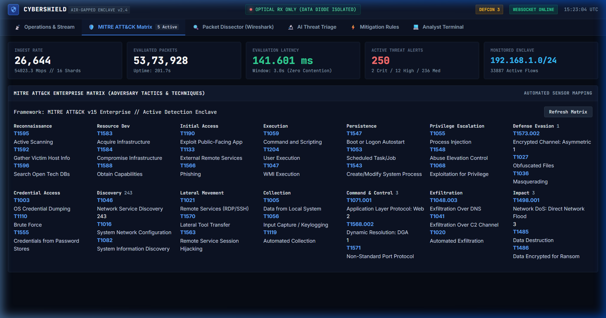
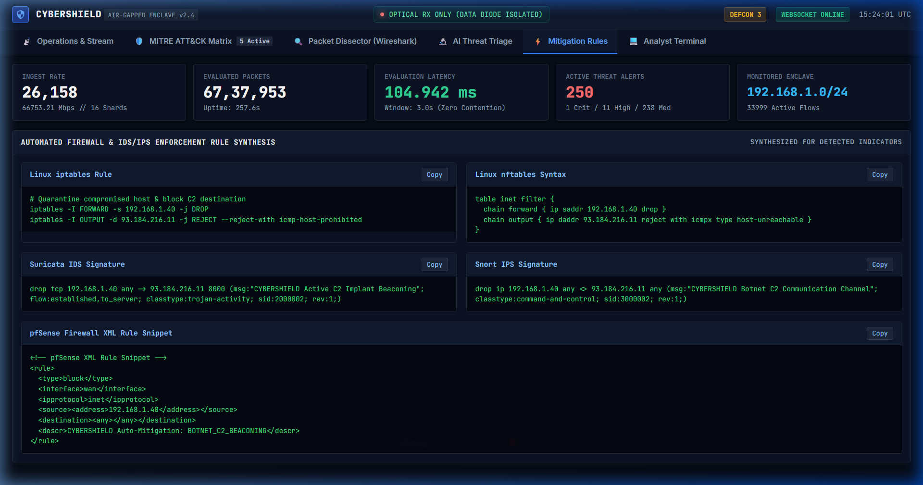
AUTONOMOUS AI SECURITY & CONTAINMENT
MITRE ATT&CK Enterprise Matrix & Automated Firewall Synthesis
Deterministic correlation, blast radius modeling, and instant multi-platform rule generation.
VERIFIED MITRE ATT&CK ENTERPRISE MATRIX (14 ACTIVE TACTICS)
LIVE DYNAMIC FIREWALL & IDS RULE SYNTHESIZER (5 FORMATS)
BLAST RADIUS & MERKLE AUDIT LEDGER
• Topology-Aware Risk: Evaluates exposure across Domain Controllers and DBs.
• Merkle Hash-Chaining: Sequential SHA-256 ledger guarantees immutable audit trail.
• LLM Triage Hook: Optional Gemini API integration for semantic incident reporting.
AUTOMATED RULE SYNTHESIS EXPORTS
• Linux IPTables: iptables -A INPUT -p tcp --dport 443 -m hashlimit --hashlimit-above 50/sec -j DROP
• Linux NFTables: table inet filter { chain input { tcp flags syn meter ... drop } }
• Suricata / Snort IDS: alert tcp any any -> $DST $PORT (msg:"CYBERSHIELD Flood"; sid:2000001;)

Slide 5
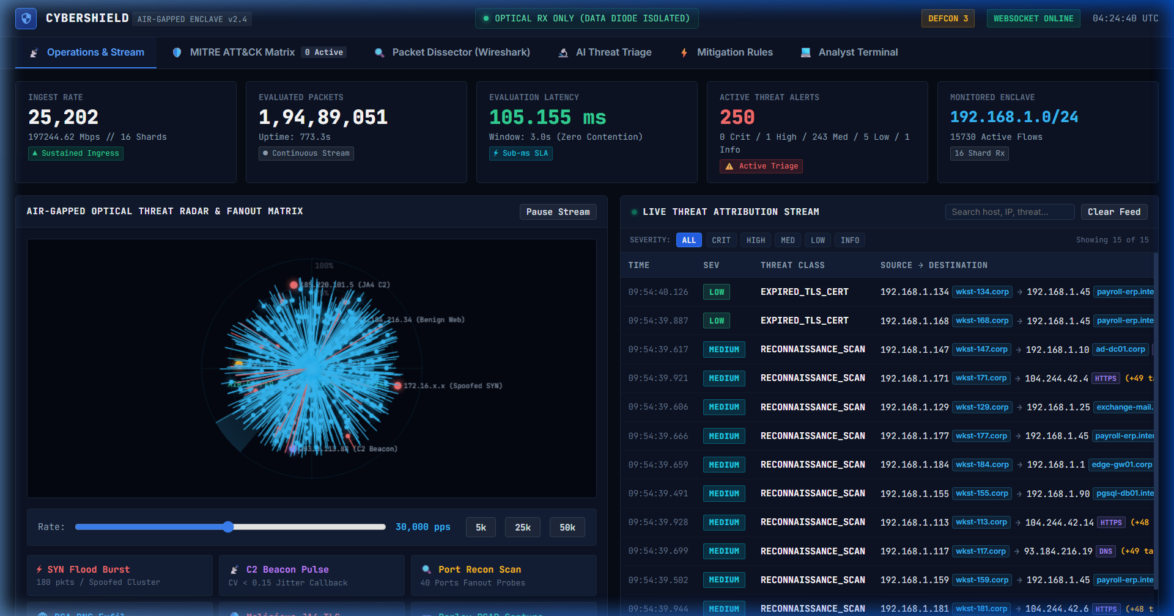
ENTERPRISE OPERATIONS & GLOBAL DEPLOYMENT
Web SOC Operations Console & Multi-Platform Delivery
Accessible globally over HTTPS, permanent edge hosting, and native Android Studio integration.
GLOBAL HTTPS CLOUDFLARE TUNNEL
• Live Worldwide Link: https://red-avi-object-email.trycloudflare.com
• Zero-Barrier Access: No firewall port forwarding or public IP exposure.
• Interactive Threat Injection: Trigger live SYN floods & C2 beacon pulses.
PERMANENT EDGE WEB (GITHUB PAGES)
• Permanent 24/7 Hosting: https://saicharan-nayak.github.io/unidirectional-threat-engine/
• Autonomous Dual-Mode: Seamless WebSocket or client simulation fallback.
• Automated CI/CD: Deployed automatically via GitHub Actions on push.
ANDROID STUDIO APP & SIEM
• Native Android App: android_studio_app/ WebView wrapper with touch HUD.
• One-Click Launcher: Open_In_Android_Studio.bat auto-detects active IDE.
• SIEM Integrations: Background worker exporting ArcSight CEF and Syslog.
LIVE OPERATIONS CONSOLE: OPTICAL THREAT RADAR, INGEST METRICS & AUTHENTIC STREAM

