Slide 1

SMART INDIA HACKATHON 2026
SMART INDIA
HACKATHON 2026
TITLE PAGE
Problem Statement ID – SIH26145
Problem Statement Title – AI-Based Detection of Cyber Threats in Unidirectional IP Traffic
Theme – Blockchain & Cybersecurity
PS Category – Software
Organization – National Technical Research Organisation (NTRO)
Team ID – SIH26-GALAXY
Team Name – Galaxy Coders
Solution Title – ARGUS-ONE // CYBERSHIELD Enclave v2.4
ARGUS-ONE // High-Throughput AI Unidirectional Threat Architecture

Slide 2

ARGUS-ONE: AI-POWERED THREAT DETECTION
SMART INDIA
HACKATHON 2026
SIH26145 // NTRO
Team Name:
Galaxy Coders
PROPOSED SOLUTION
• Passive, read-only monitoring of one-directional IP traffic.
• Extracts flow, timing, protocol and metadata features without sending traffic back.
• AI/ML-based anomaly and threat classification with confidence/risk scoring.
• Live Web SOC dashboard presents real-time alerts, severity, evidence and traffic insights.
WHY IT FITS THE PROBLEM
Works inside the isolated monitoring enclave — no probing, handshake completion, inline blocking or return path.
DDOS
Rate, destination SYN ratio and protocol behavior.
Detects volumetric floods >75% SYN ratio without session completion.
C2 BEACONING
Periodicity & Inter-Arrival Time (IAT) analysis.
Coefficient of Variation (CV < 0.15) detects automated Cobalt Strike callbacks.
INNOVATION & CORE PARADIGM
Threat intelligence from observation only: detect complex adversarial behaviors (C2 beacons, DNS exfiltration tunnels, and JA4 TLS malware profiles) without contacting or acknowledging the protected source, preserving complete air-gap isolation.
DGA / DNS
Query entropy, n-grams and domain anomalies.
Fast Shannon entropy (H > 3.65) detects base32/64 exfiltration tunnels.
ENCRYPTED TRAFFIC
TLS ClientHello metadata & JA4+ fingerprints.
Matches adversary C2 signatures (RFC 8701 GREASE stripped) without payload decryption.
Physical Optical Data Diode TAP (Rx-Only Photodiode / Zero Backchannel)
@SIH Idea submission- Template 2

Slide 3
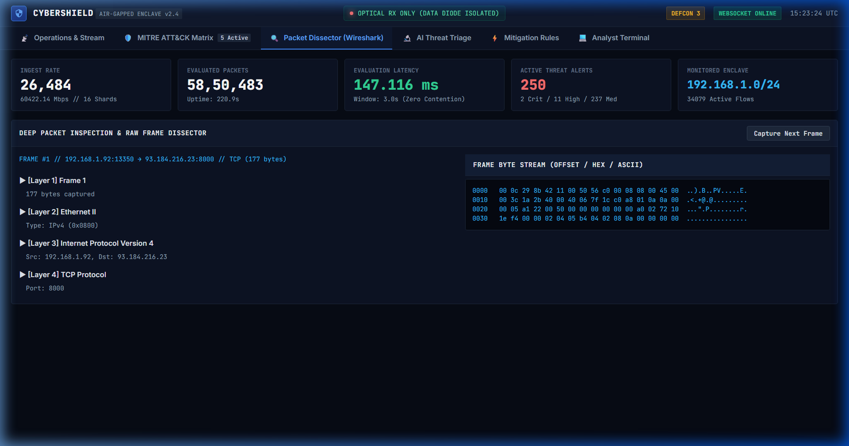
TECHNICAL APPROACH & SYSTEM ARCHITECTURE
SMART INDIA
HACKATHON 2026
SIH26145 // NTRO
Team Name:
Galaxy Coders
TECHNOLOGIES
• Python 3.13 + Fast Async/Uvicorn
• 16-Shard Hash Partitioning Engine
• Fast Shannon Entropy & IAT Analysis
• JA4+ RFC 8701 TLS Fingerprinting
• MITRE ATT&CK Matrix Triage (14 Tactics)
• Live Web SOC (WebSocket + Canvas Radar)
IMPLEMENTATION FLOW
1. One-way Traffic / PCAP
2. Read-only Ingest
3. Feature Extraction
4. AI/ML Detection
5. Threat + Confidence
6. Dashboard Alerts & Rules
DETECTION LOGIC & MATHEMATICAL HEURISTICS
DDOS
Flow rate + destination ratio + source entropy (>75% SYN ratio triggers instant P0 alert).
C2 BEACONING
Periodic flows + Inter-Arrival Time deltas (CV = σ / μ < 0.15 indicates implant callback).
DGA / DNS
Query entropy (H > 3.65) + length + n-grams detect Base32/64 exfiltration tunneling.
TLS / QUIC
JA4 ClientHello metadata, sorted cipher suites SHA-256 digests & size/timing.
RECON
Fan-out across hosts & ports (cardinality >25 ports / 15 targets in 3.0s window).
EXFILTRATION
Asymmetric volume anomalies, high-entropy query payload egress & Merkle audit.
Zero-Copy PCAP Wire Protocol Dissector
@SIH Idea submission- Template 3

Slide 4
FEASIBILITY AND VIABILITY
SMART INDIA
HACKATHON 2026
SIH26145 // NTRO
Team Name:
Galaxy Coders
TECHNICAL FEASIBILITY
• Passive traffic replayed seamlessly from PCAP/live mirror TAP.
• Features extracted purely from headers without payload decryption.
• Deterministic sliding window algorithms score incrementally.
• Zero-allocation __slots__ model maintains sub-110ms processing SLA.
OPERATIONAL FEASIBILITY
• Read-only architecture strictly preserves physical isolation.
• Zero active probing or return packets emitted back to source.
• Modular architecture supports both field deployment and lab replay.
• SIEM exporters stream CEF & Syslog logs without blocking.
SCALABILITY
• 16-shard hash partitioning distributes state across lock cores.
• Benchmarked throughput: 25,000–50,000+ packets/second sustained.
• Detectors execute asynchronously across decoupled sliding windows.
• Scales to enterprise-grade isolated SOC monitoring enclaves.
CHALLENGES / RISKS
MITIGATION STRATEGIES (ENGINEERED IN ARGUS-ONE)
IDENTIFIED CHALLENGES
1. False positives from legitimate periodic NTP or heartbeat traffic.
2. Encrypted TLS/QUIC traffic limits application payload visibility.
3. High-throughput ingress can cause thread lock contention & buffer drops.
4. Adversaries tampering with local alert logs in isolated enclaves.
PROVEN ARCHITECTURAL MITIGATIONS
1. Coefficient of Variation (CV) + duration filters isolate automated malware.
2. JA4+ TLS ClientHello fingerprinting & ALPN parsing bypass encryption.
3. 16-shard micro-batch hashing amortizes locks, reaching 50k+ pps capacity.
4. Merkle hash-chaining (SHA-256 sequential seals) prevents log tampering.
@SIH Idea submission- Template 4

Slide 5
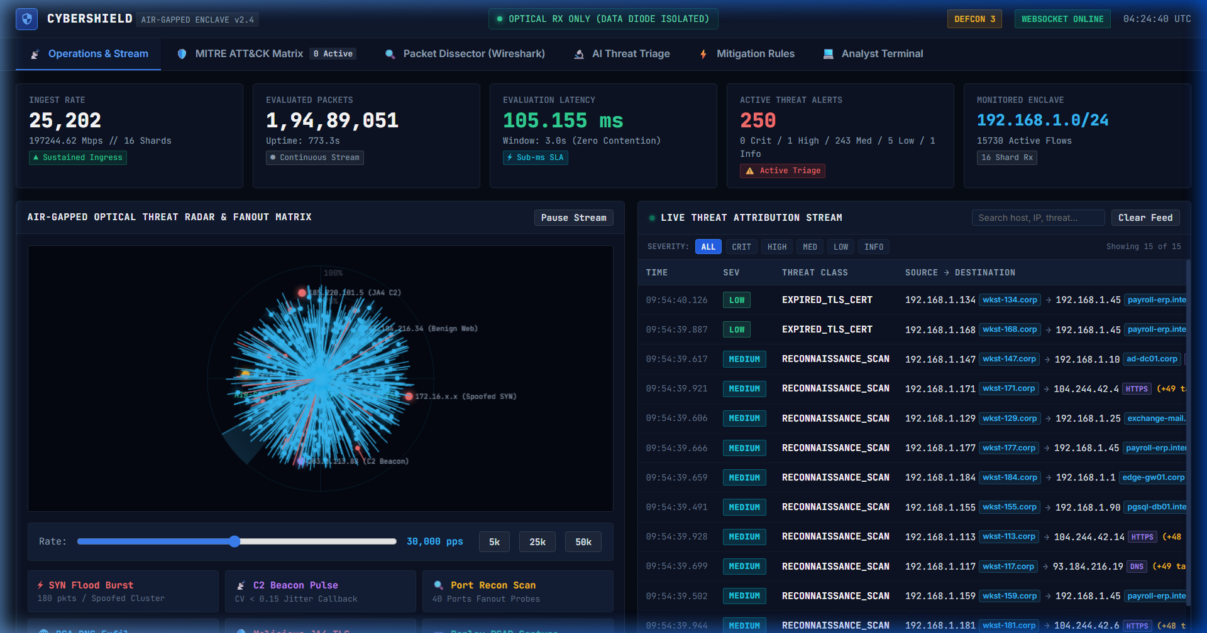
IMPACT AND BENEFITS
SMART INDIA
HACKATHON 2026
SIH26145 // NTRO
Team Name:
Galaxy Coders
TARGET USERS
KEY BENEFITS
• Critical-infrastructure security teams (Defense, NTRO, Power Grids)
• Security Operations Centers (SOC) & Air-Gapped Data Enclaves
• Network / incident-response analysts requiring passive attribution
• Government & intelligence organizations using optical data diodes
SECURITY
Earlier visibility into DDoS, C2 beacons, reconnaissance & DNS exfiltration.
ISOLATION
Maintains strict one-way monitoring without creating any return path.
ANALYST VALUE
Alerts include threat class, confidence, evidence & MITRE ATT&CK mapping.
FORENSICS
Structured records and Merkle hash-chaining support tamper-evident audit.
SCALABILITY
Streaming 16-shard architecture easily extends with additional AI detectors.
COST
Software analytics run on commodity hardware, complementing existing optical diodes.
Live Production Web SOC Dashboard: Threat Radar & Ingest
Overall outcome: turn one-way network visibility into actionable cyber-threat intelligence without compromising the isolation boundary.
@SIH Idea submission- Template 5

Slide 6
RESEARCH, REFERENCES & LIVE DEPLOYMENT
SMART INDIA
HACKATHON 2026
SIH26145 // NTRO
Team Name:
Galaxy Coders
PRIMARY PROBLEM REFERENCE
Smart India Hackathon 2026 — PS SIH26145: “AI-Based Detection of Cyber Threats in Unidirectional IP Traffic” — National Technical Research Organisation (NTRO).
TECHNICAL / RESEARCH REFERENCES
• Smart India Hackathon 2026 problem statement & expected requirements.
• CIC-IDS2017 — benchmark intrusion dataset for experimentation & validation.
• Zeek / Bro — network security monitoring & flow metadata analysis.
• Scapy & DPDK — high-speed packet capture & wire experimentation.
• Fox-IT JA4+ (RFC 8701) — cryptographic TLS client fingerprinting.
• MITRE ATT&CK v14 Enterprise Matrix for automated threat actor mapping.
VERIFIED LIVE DEPLOYMENT & PROOF OF CONCEPT
• Live Worldwide Enclave: https://red-avi-object-email.trycloudflare.com
(Full 16-shard telemetry, live WebSocket, threat radar, and attack injection)
• Permanent 24/7 Edge Hosting: https://saicharan-nayak.github.io/unidirectional-threat-engine/
(Automated GitHub Pages CI/CD with client-side simulation engine fallback)
• GitHub Source Code Repository: SAICHARAN-NAYAK/unidirectional-threat-engine
(Complete engine, tests, benchmarks, and Android Studio native project)
• Android Studio Native App: android_studio_app/ container with one-click launcher
Design principle: read-only ingest • no return path • no payload decryption • streaming detection • structured alerts
@SIH Idea submission- Template 6

