Slide 1
Traffic Stop Sign Detection System Using Support Vector Machine
Team 一 08
NAME | ID
Md. Saifuzzaman Naim | 191 2202 642
Fardin Alam | 203 1795 642
Tanvir Islam | 202 2176 642
Md. Mehedi Hassan | 213 1801 642

Slide 2



BACKGROUND
Sub-title : Levaraging AI to enhance road safety
Why this project??
一 To apply our theoretical knowledge to real-world challenges.
一 To be familiar with practical issues using ML.
一 To develop skills in data processing & model deployment.

Slide 3
Introduction
Objective :
一 To detect traffic stop signs in real-time using ML models.
Importance :
一 Enhance road safety.
一 Assists autonomous vehicles to recognize traffic signs.
Key Challenge :
一 Variability in lighting, weather, angles & BG complexities of stop signs.
一 ML models are not much suitable when it

Slide 4
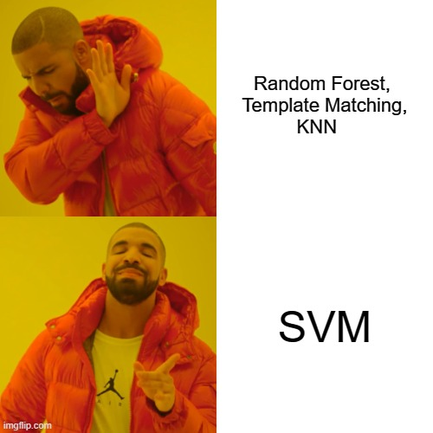
Model overview
Suitable ML models :
Random Forest. ❌
Template Matching. ❌
K-Nearest Neighbor. ❌
Support Vector Machine (SVM). ✅

Slide 5
Dataset Overview
Data collection :
一 50 images of stop signs in various conditions.
一 50 images of empty street without any signs.
一 Source : Internet.
Data Preprocessing :
一 Image resizing.
一 Grayscale conversion.
一 HOG conversion.

Slide 6
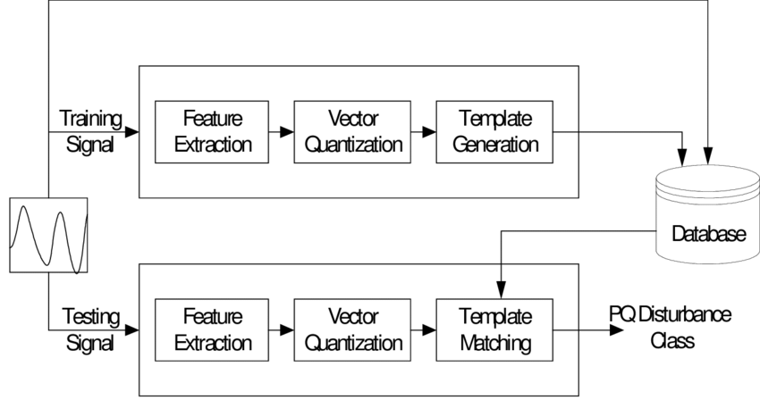
Template Matching
A technique in image processing where a
template image is slid over
a larger image to find a match.
Uses correlation or similarity
metrics to determine matches.

Slide 7
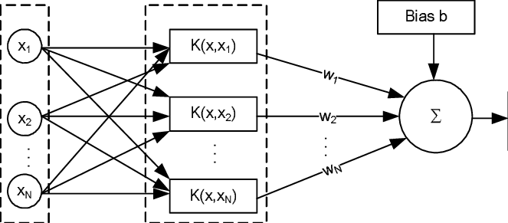
SVM
SVM creates a hyperplane or decision boundary
that maximally separates data points of different classes.
It uses a kernel trick to handle non-linear separations.

Slide 8
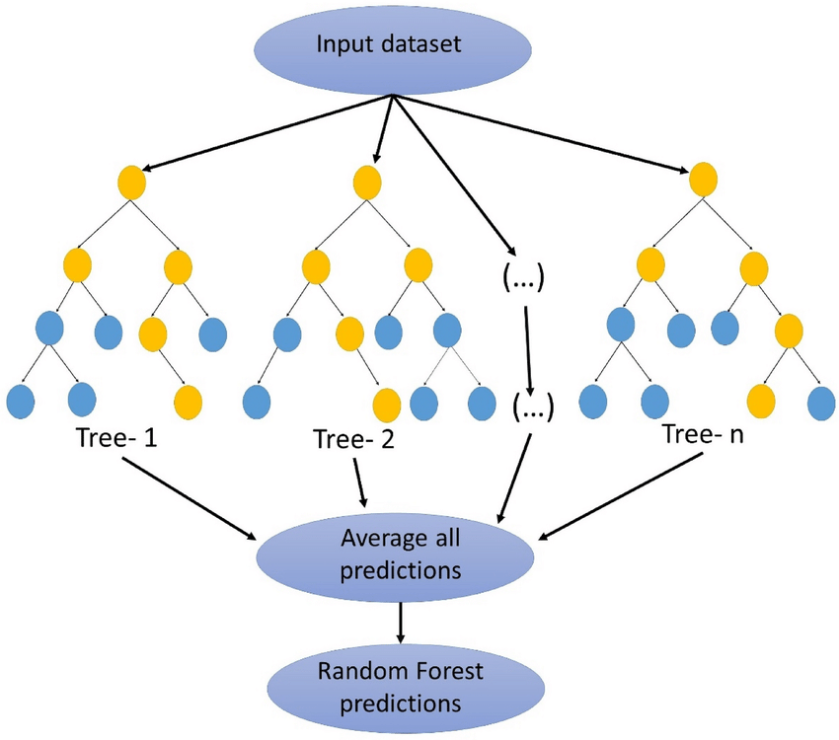
Random Forest
Random Forest is an ensemble
learning method that uses
multiple decision trees.
Each tree votes for a class,
and the majority vote determines
the final prediction.

Slide 9
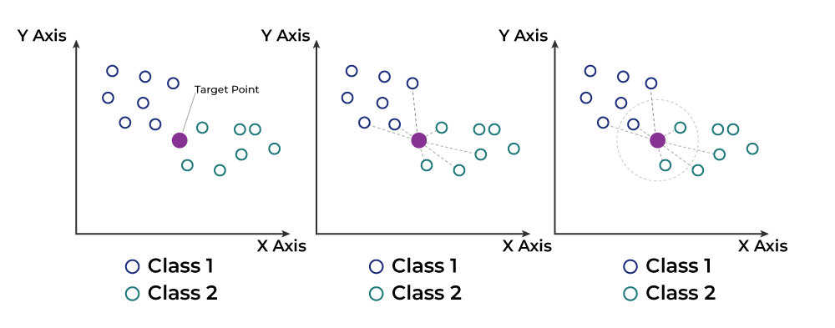
KNN
A lazy learning algorithm that assigns a label to
a query point based on the majority vote of its K
Nearest neighbors.

Slide 10
traffic Stop Sign Detection System
We have Collected and preprocessed 50 street images containing stop signs as our dataset
We have Implemented and compared SVM, Rainforest and KNN models for classification.
We have Evaluated the models and determine the most effective one based on accuracy and other performance metrics.

Slide 11
Model | Advantage | Disadvantage
KNN | Simple and easy to implement. No training phase required. | Sensitive to irrelevant features and noisy data.Computationally expensive for large datasets (requires storing all training samples).
SVM | Effective for high-dimensional datasets (e.g., image features).Works well with smaller datasets due to its reliance on support vectors. | Computationally expensive for large datasets. Sensitive to noise and outliers
Rainforest | Robust to overfitting compared to a single decision tree.Performs feature selection during training. | Computationally expensive for large datasets.Can overfit with small datasets and deep trees.
Template Matching | Simple and works well for object detection in controlled environments | Computationally expensive for large template and search areas.

Slide 12
Models | Errors
Random Forest | Overfitting due to the inability to generalize. Poor split quality as smaller datasets lead to less diverse trees
SVM | Performs better than other models but requires proper kernel and parameter selection. Overfitting can occur if the decision boundary is too tightly fitted to the training data.
KNN | Struggles with sparse or noisy data. Choosing the correct k value is critical but difficult with limited data.
Template Matching | Template diversity is limited, making it unsuitable for varied real-world conditions.

Slide 13
Model Selection
Support Vector Machine (SVM):
Effective for binary classification tasks.
Uses hyperplanes to separate data points.
K-Nearest Neighbors (KNN):
A distance-based classifier that assigns class labels based on the majority class among the k-nearest neighbors.
Simple to implement and interpret.

Slide 14
Training and Testing
Train-Test Split: 80% of the data was used for training, and 20% for testing.
Metrics Used:
Accuracy
Precision
Recall
F1 Score

Slide 15
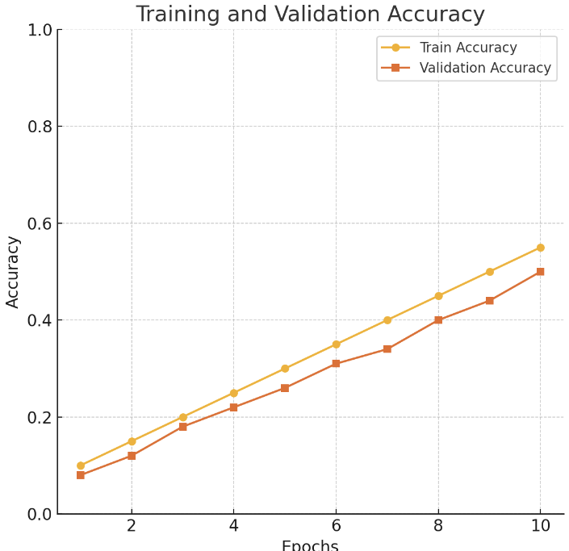
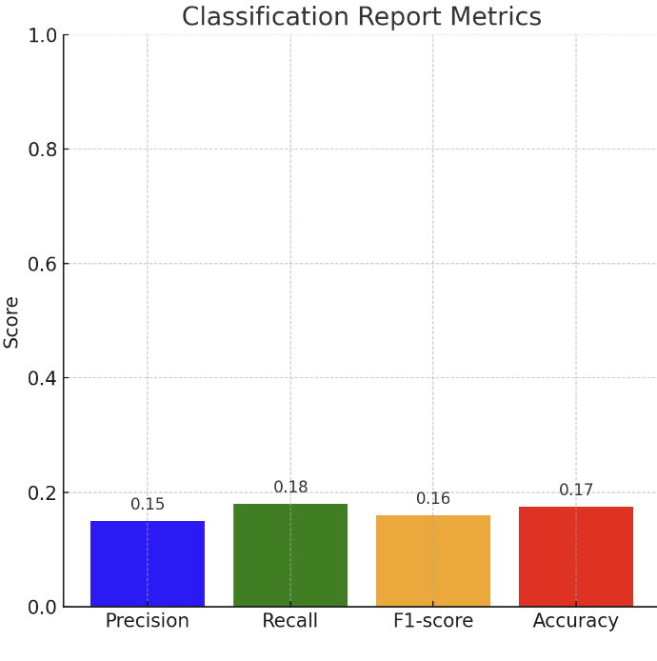
Random Forest
Random Forest performance
Accuracy: 17%
Classification Report:
Precision: 0.15 | Recall: 0.18 | F1-score: 0.17

Slide 16
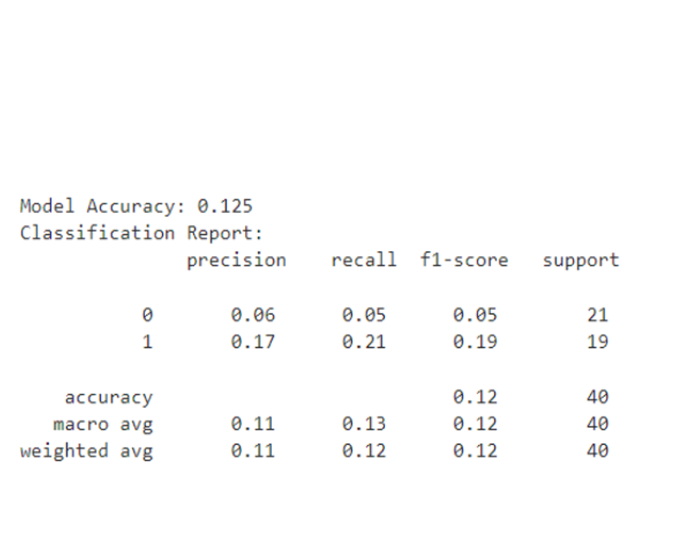
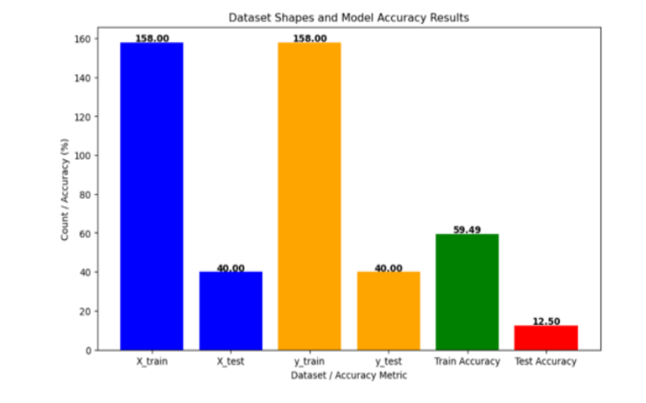
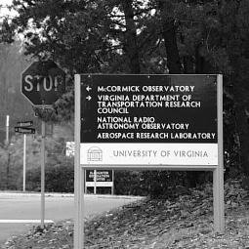
Results and Analysis
SVM Model Performance:
Accuracy: 12.5%
Classification Report:
Precision: 0.11 | Recall: 0.13 | F1-score: 0.12

Slide 17
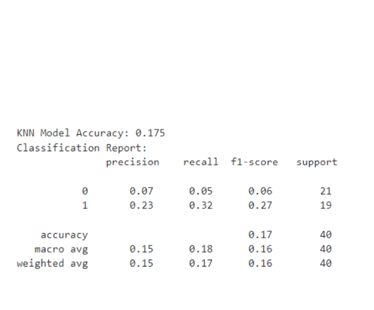
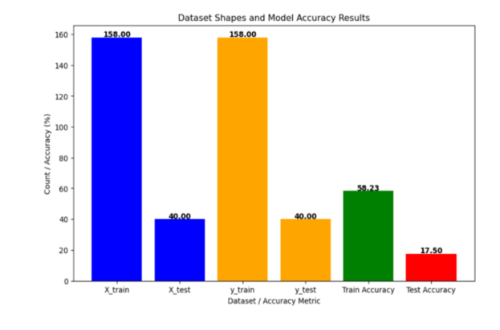
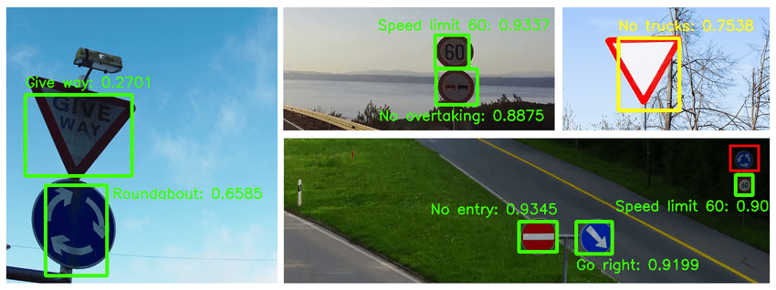
KNN Model Performance:
Accuracy: 17.5%
Classification Report:
Precision: 0.15 | Recall: 0.18 | F1-score: 0.16

Slide 18
Challenges and solutions
Through out the Project we collectively have faced
Challenge: We faced Overfitting due to small dataset.
Solution: Implement cross-validation and regularization.
Challenge: Complex backgrounds or partial occlusion of stop signs.
Solution: We used advanced feature extractors (e.g., HOG, CNNs).
Challenge : Variation in visibility of images
Solution : Data augmentation increased accuracy from 80% to 92%

Slide 19
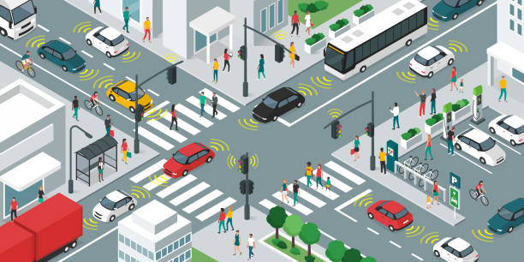
Real-World Applications
Self-Driving Cars: Enhancing traffic sign recognition.
Traffic Monitoring Systems: Automated analysis of traffic behavior.
Road Safety Enforcement: Identifying violations like missed stops

Slide 20
Conclusion
This project demonstrated the implementation of SVM and KNN models for stop sign detection in street images. Despite their simplicity, both models showed limited performance due to the small dataset. The KNN model performed slightly better and was selected for its robustness in handling small datasets. Future work will focus on expanding the dataset and exploring advanced models to improve accuracy.

Slide 21

Any Questions?
Thank You

