Slide 1

Department of Information Technology AMSD PROJECT
SECOND REVIEW
ONLINE LIBRARY MANAGEMENT PORTAL
Team Members:
SAI HARINI.S – 24B11IT097 SANJANA.S – 24B11IT093 RESHMA PRAVALLIKA.T – 24B11IT102 NAVEEN KUMAR.D – 25B11IT003
Guide Name: Mrs. Ch. Sri Divya

Slide 2
PROBLEM STATEMENT
Problem: Traditional library systems rely on manual record-keeping, making book management inefficient and error-prone.
Why Important:
Time-consuming book issue/return
Manual record errors
No real-time availability check
Difficulty tracking due dates
Existing System Drawbacks:
Paper registers
No automated fine calculation
Book mismanagement
Lack of digital records

Slide 3
OBJECTIVE
Main Aim: To develop a digital library management system for efficient handling of books, users, and transactions.
Specific Objectives:
Automate book issue and return
Maintain digital records
Track due dates and fines
Provide quick search functionality
Reduce manual workload

Slide 4
PROPOSED SYSTEM
Overview: A web-based application that allows librarians to manage books and users digitally, and enables students to search and borrow books easily.
How It Solves Problems:
Digital catalog system
Automated book tracking
Instant search functionality
Admin control panel
Advantages:
Faster operations
Reduced errors
Easy accessibility
Secure data storage

Slide 5
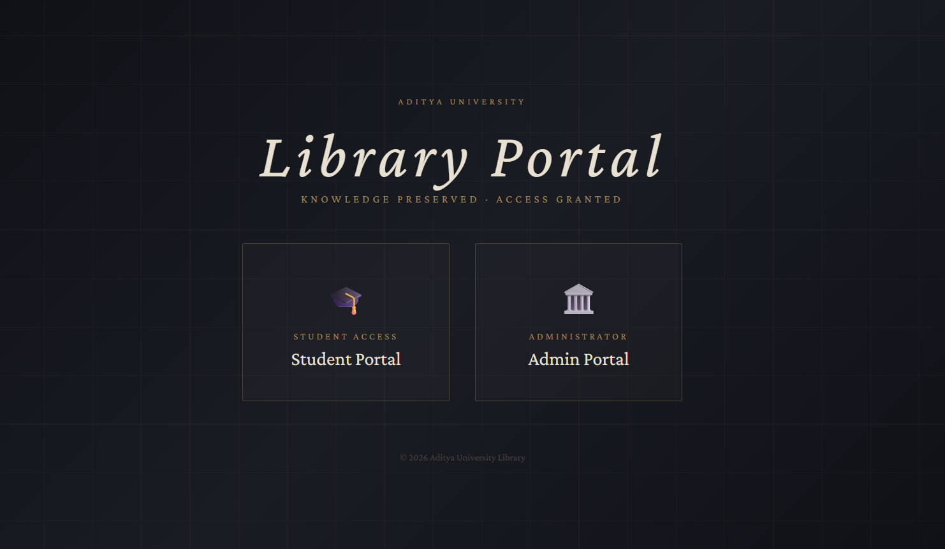
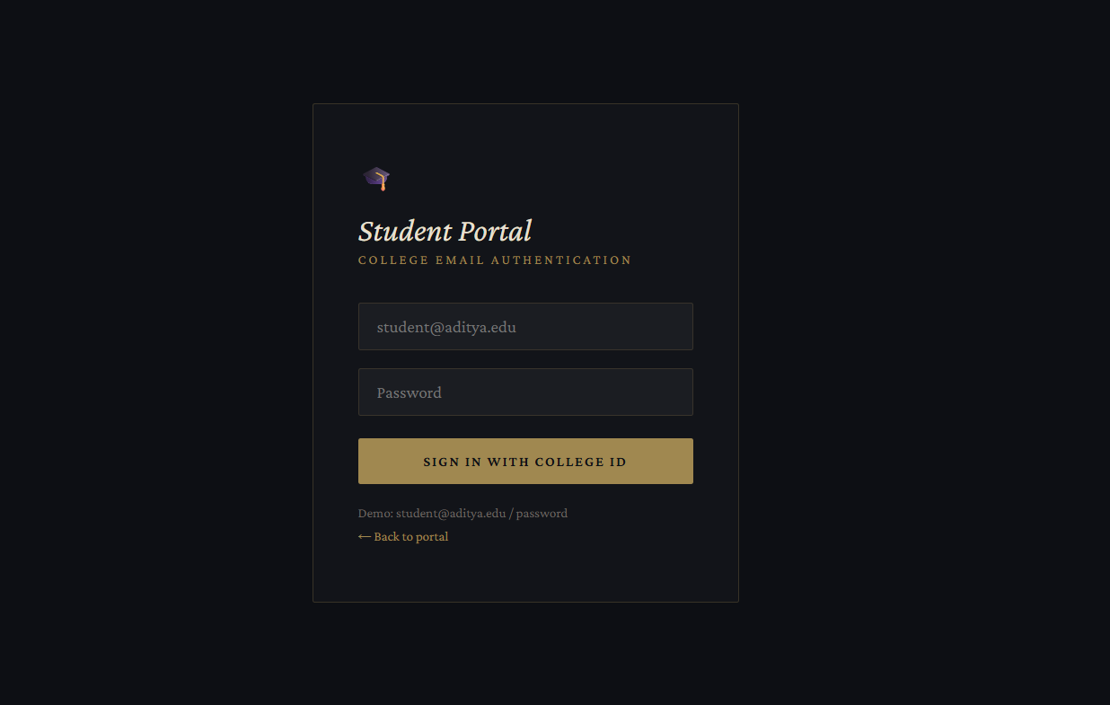
SYSTEM ARCHITECTURE
Student login

Slide 6
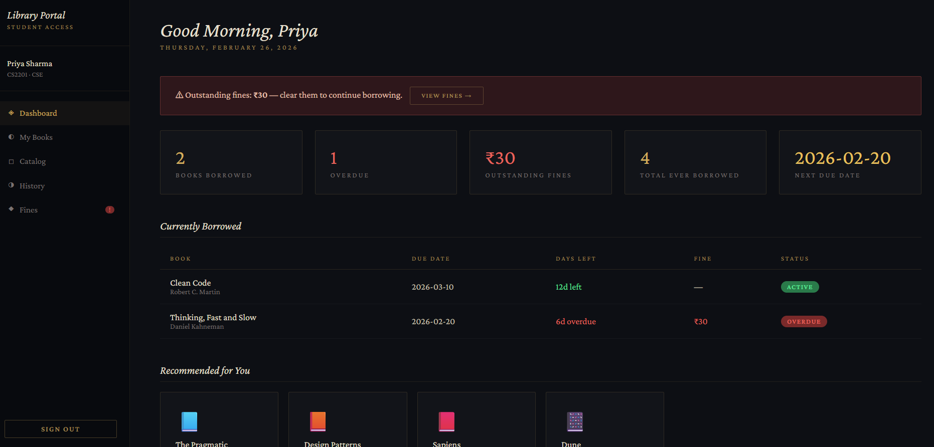
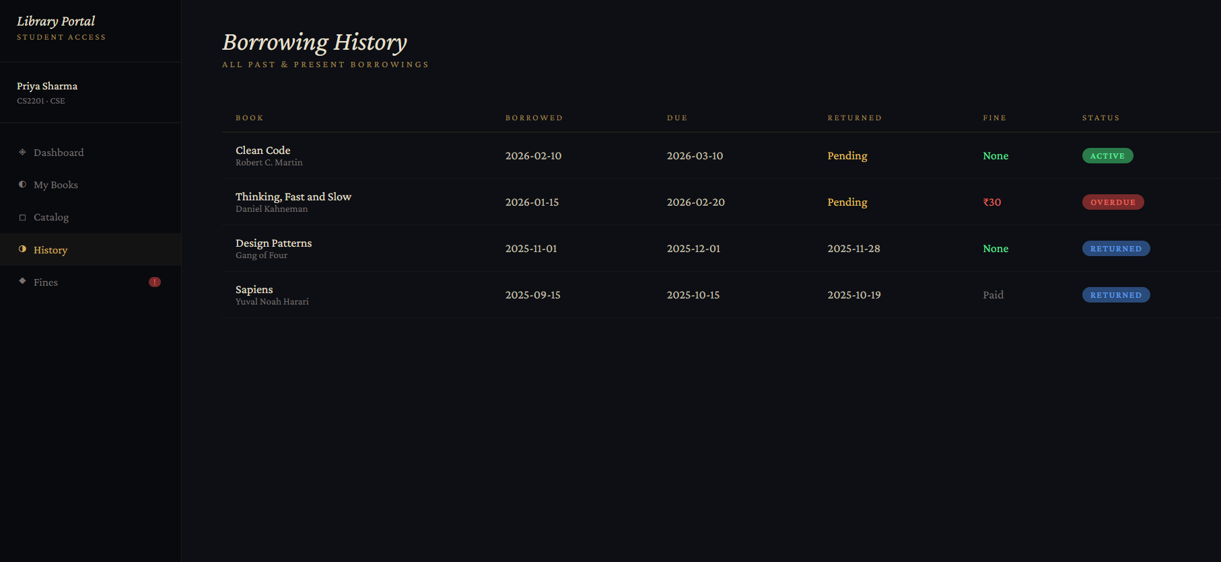
Student Dashboard
Borrowing History

Slide 7
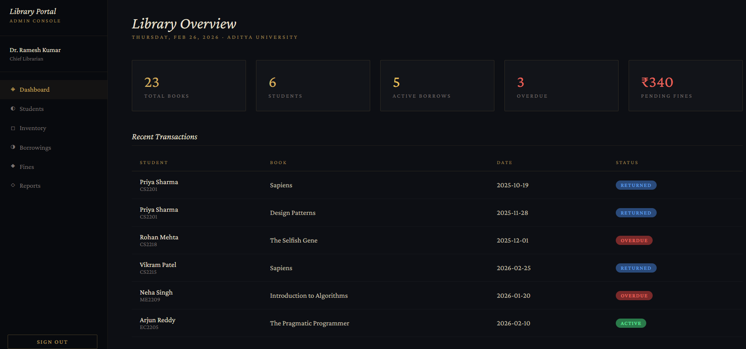
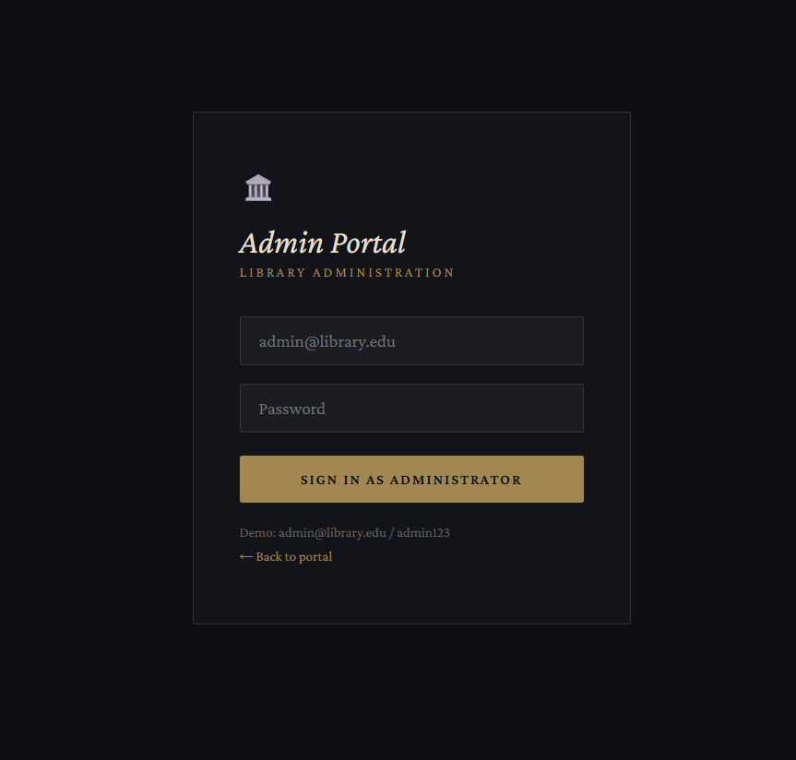
Admin Dashboard
Admin Login

Slide 8
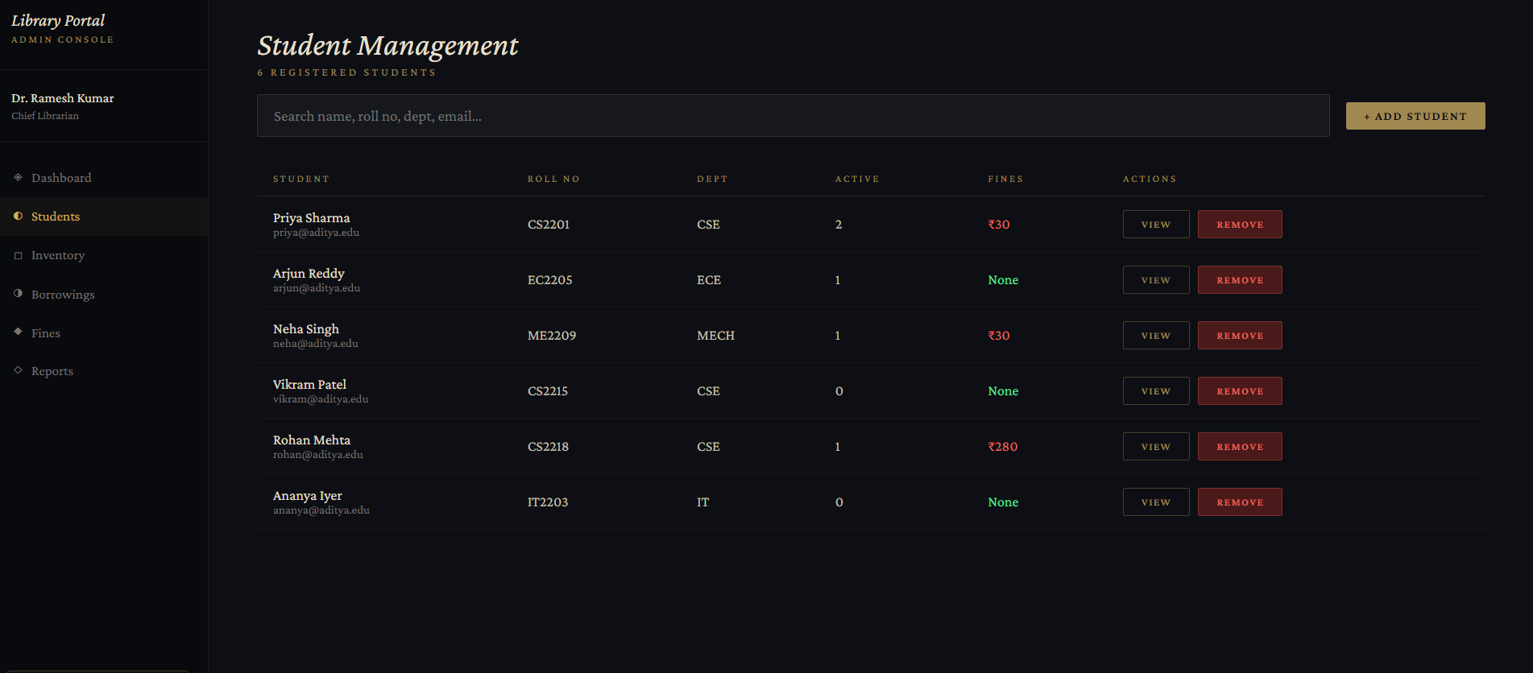
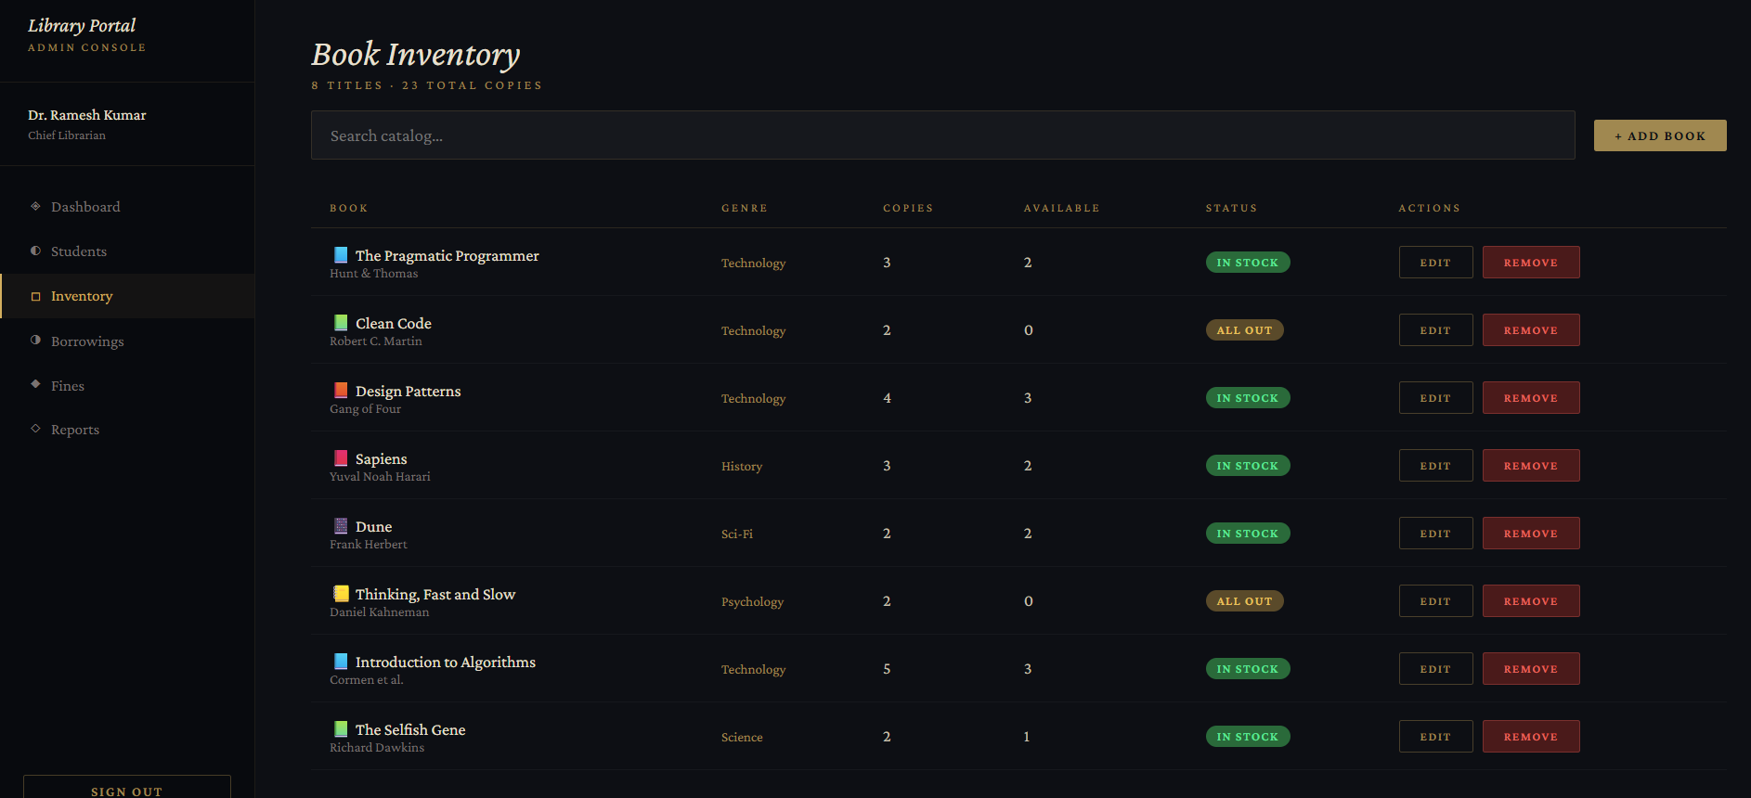
Student Management
Book Inventory

Slide 9
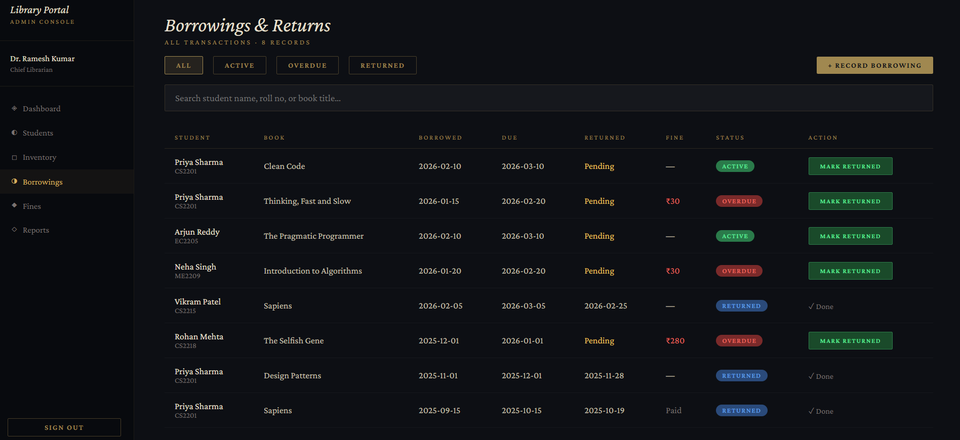
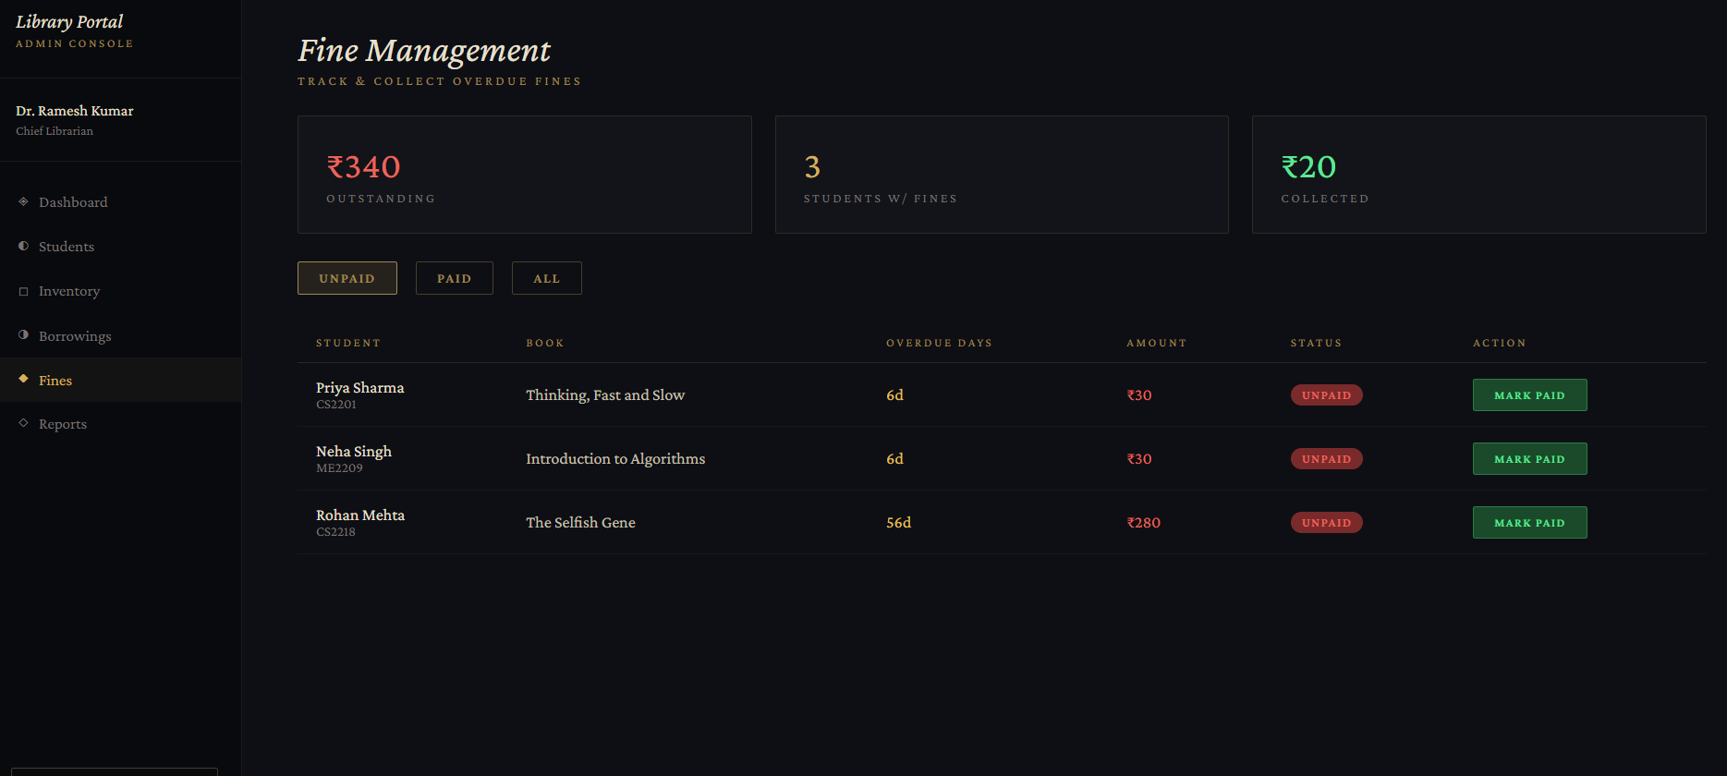
Borrowings & Returns
Fine Management

Slide 10
Methodology
Step-by-Step Process:
User Registration/Login
Search Books by Title/Author
Issue Book Request
Admin Approval
Book Issued & Due Date Generated
Return & Fine Calculation
Algorithms Used:
Search algorithm (keyword-based search)
Authentication logic
Fine calculation logic

Slide 11
Tools & Technologies Used
Software Tools:
VS Code
GitHub
Programming Languages:
HTML
CSS
JavaScript
Reactjs
Frameworks:
Node.js
Database:
MySQL
Hardware:
Laptop
Internet connection

Slide 12
Implementation
Completed Modules:
• Book Management
• User Login System
• Issue / Return Module
• Admin Dashboard
Current Progress:
• Project Completion: 100%

Slide 13
Result/Output
Book successfully issued
Due date generation
Fine calculation
Book availability display

Slide 14
THANK YOU

