Slide 1
LANGUAGE TRANSLATOR
By SAIKAT BHOWAL

Slide 2
TABLE OF CONTENT
1
2
3
4
ABOUT THE PROJECT
The project is about a Language Translator software with Text to Speech feature
5
MAJOR REQUIREMENTS
Hardware requirements
Software requirements
PROJECT GOALS
Increase accuracy
UI will be developed
Launch a webpage
STAGES OF PROJECT
Getting user’s text
Translating the text
Text to Speech
DEMO OF PROJECT
Output working Window

Slide 3
1.About the Project

Slide 4
The purpose of this project was to develop a Python language translator software that would allow users to translate text from one language to another and to hear and learn the proper pronunciation of the translated text
The software was developed using the Tkinter library,Googletrans library,Google Text to Speech(gtts),pyAudio.
The software is a useful tool for translating text from one language to another and to speak out the correct pronunciation . Future work could focus on improving the user interface and making the software more user-friendly.

Slide 5
2.Major Requirements

Slide 6
Hardware Requirements
Laptop/Desktop with proper internet connection.
Software Requirements
Python - The software is based on python programing language.
Python IDE- To run python code it is required.
Tkinter - It is a library to create GUI.
Googletrans - It is a library which supports most of the languages and used to
translate any text to different language.
Gtts - This library is used to convert any text to speech form.
pyAudio - This library is used to play sound.

Slide 7
3.Project Goals

Slide 8
NOW
FUTURE
It is easy to use.
It is accurate.
It is fast.
It can convert text to speech
It could be extended to support more languages.
It could be improved to be more accurate.
It could be made to run on mobile devices.

Slide 9
4.Stages Of Project

Slide 10
Getting User’s text as input
Translating into destination Language
Converting Text to Speech
We will get the text as user input inside the box of Source Text by using the ‘Text’ function. Here google trans library will be used to get the source language as well as the source text. It supports most of the popular languages across the world.
We will create a translate function where source text, source and destination
Language will be stored in variables. Then we will use the “Translator” function of googletrans to translate the source text.
Now we will create a function named speaker and will create another function named get_language_codes to get the language codes supported by gtts Here we will use the gTTs function to convert it into speech. We will use pyAudio to play the sound.

Slide 11
5.Demo Of Projects

Slide 12
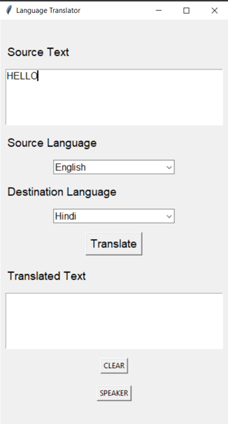
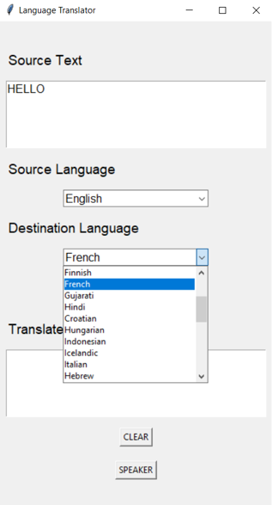
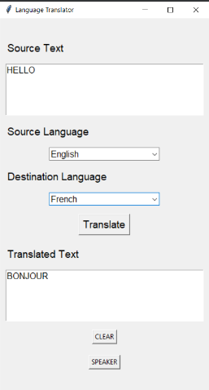
TAKING USER INPUT TEXT
SELECTING DESTINATION LANGUAGE
TRANSLATE

Slide 13
CONCLUSION
It is a real world problem that whenever we travel abroad then we face linguistic problems . Most of the time we don’t know the language of other countries so it hampers the communication between native people and us. To overcome this problem,“ Language Translator” software is very much required to communicate with people of different countries smoothly. Only the translated speech can’t help that much so here comes up with an additional feature that convert the translated speech into the voice which help illiterate people to understand what is asked and it is also helpful to learn the pronunciation of foreign languages
The future of language translation software is bright. With the development of new machine learning techniques, language translation software is becoming more accurate and more user-friendly. This will make it easier for people to communicate with each other across language barriers, regardless of their location.

Slide 14
Thank You…..

