Slide 1
Client Side Scripting
Web Technologies

Slide 2
What is Client Side Scripting
Client side scripting is a process in which the code along with HTML web page is sent to the client by the server. Here, the code refers to the script.
In other simple words, client side scripting is a process in which scripts are executed by browsers without connecting the server.
The code executes on the browser of client’s computer either during the loading of web page or after the web page has been loaded.
Client side scripting is mainly used for dynamic user interface elements, such as pull-down menus, navigation tools, animation buttons, data validation purpose, etc.
JavaScript and jQuery are by far the most important client-side scripting languages or web scripting languages and widely used to create a dynamic and responsive webpage and websites.
The browser (temporarily) downloads the code in the local computer and starts processing it without the server. Therefore, the client side scripting is browser dependent.

Slide 3
What is Client side Script?
A client-side script is a small program (or set of instructions) that is embedded (or inserted) into a web page. It is processed within the client browser instead of the web server.
The script that executes on the user’s computer system is called client. It is embedded (or inserted) within the HTML document or can be stored in an external separate file (known as external script).
The script files are sent to the client machine from the web server (or severs) when they are requested. The client’s web browser executes the script, then displays the web page, including any visible output from the script.

Slide 4
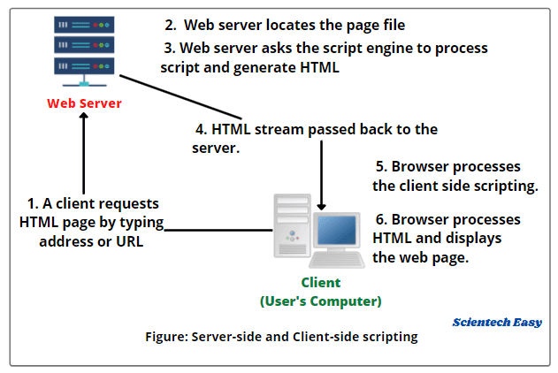

Slide 5
Popular Client side Scripting Language
A language in which a client side script or program is written using syntax is called client side scripting language or client side programming.
The most popular client side scripting languages is as follows:
1. JavaScript
2. VBScript
3. jQuery

Slide 6
JavaScript
JavaScript: It is the most widely client side scripting or programming language. It is based on ECMAScript standard language.
JavaScript is an object based oriented, dynamically typed (or also called weakly typed) scripting language. It runs directly on the browser with the help of an inbuilt interpreter.
Here, weakly typed means the variables are easily converted implicitly from one data type to another.

Slide 7
VBScript and JQuery
VBScript: This scripting language is developed by Microsoft, based on the Visual Basic. It is basically used to enhance the features of web pages in Internet Explorer. VBScript is interpreted by Internet Explorer web browser.
jQuery: jQuery is a fast, small, lightweight JavaScript library. It is used to facilitate a lot of JavaScript code into simple-to-use-functionality.
Most of the biggest companies such as Google, Microsoft, IBM, Netflix, etc. on the Web are using jQuery language

Slide 8
Introduction to JavaScript
JavaScript is a lightweight, cross-platform, and interpreted compiled programming language which is also known as the scripting language for webpages.
It is well-known for the development of web pages, many non-browser environments also use it.
JavaScript can be used for Client-side developments as well as Server-side developments.
JavaScript contains a standard library of objects, like Array, Date, and Math, and a core set of language elements like operators, control structures, and statements.

Slide 9
Year | ECMA | Browser
1995 |  | JavaScript was invented by Brendan Eich
1997 |  | JavaScript became an ECMA standard (ECMA-262)
1997 | ES1 | ECMAScript 1 was released
1998 | ES2 | ECMAScript 2 was released
1999 | ES3 | ECMAScript 3 was released
2008 | ES4 | ECMAScript 4 was abandoned
2009 | ES5 | ECMAScript 5 was released
2015 | ES6 | ECMAScript 6 was released
2017 | ES6 | Full support for ES6 in Edge 15
2018 | ES6 | Full support for ES6 in all browsers **

Slide 10
Features of JavaScript
With advances in browser technology and JavaScript having moved into the server with Node.js and other frameworks, JavaScript is capable of so much more.
few things that we can do with JavaScript:
JavaScript was created in the first place for DOM manipulation.
Functions in JS are objects. They may have properties and methods just like another object.
Can handle date and time.
Performs Form Validation although the forms are created using HTML.
No compiler is needed.

Slide 11
Applications of JavaScript
Web Development: Adding interactivity and behavior to static sites JavaScript was invented to do this in 1995.
Web Applications: With technology, browsers have improved to the extent that a language was required to create robust web applications.
Server Applications
Games
Smartwatches
Art
Machine Learning
Mobile Applications

Slide 12
Where to put JavaScript in an HTML Document ?
Scripts can be placed inside the body or the head section of an HTML page or inside both the head and body.
We can also place javascript outside the HTML file which can be linked by specifying its source in the script tag.

Slide 13
JavaScript in head
html>
<head>
<script>
function gfg() {
document.getElementById("demo").innerHTML = “Welcome to javascript";
}
</script>
</head>
<body>
<h2>
JavaScript in Head
</h2>
<p id="demo" style="color:green;">
Example program
</p>
<button type="button" onclick="gfg()">
click it
</button>
</body>
</html>

Slide 14
JavaScript in <body>
Placing scripts at the bottom of the <body> element improves the display speed, because script interpretation slows down the display.
<!DOCTYPE html> <html> <body> <h2>Demo JavaScript in Body</h2> <p id="demo">A Paragraph</p> <button type="button" onclick="myFunction()">Try it</button> <script> function myFunction() { document.getElementById("demo").innerHTML = "Paragraph changed."; } </script> </body> </html>

Slide 15
External JavaScript
External file: myScript.js
function myFunction() { document.getElementById("demo").innerHTML = "Paragraph changed."; }
External scripts are practical when the same code is used in many different web pages.
JavaScript files have the file extension .js.
To use an external script, put the name of the script file in the src (source) attribute of a <script> tag:
<script src="myScript.js"></script>
You can place an external script reference in <head> or <body> as you like

Slide 16
External JavaScript Advantages
Placing scripts in external files has some advantages:
It separates HTML and code
It makes HTML and JavaScript easier to read and maintain
Cached JavaScript files can speed up page loads
To add several script files to one page - use several script tags:
Example
<script src="myScript1.js"></script> <script src="myScript2.js"></script>

