Slide 1


Indian Institute of Information Technology
Nagpur
Department of
Electronics and Communication Engineering
Final Year B.Tech Semester
Internship Presentation - 1
Presented by
Academic Mentor
Mulkalla Saikumar
BT19ECE073
Dr. Paritosh Peshwe
Just like footprints in the sand, Each step signifies the journey

Slide 2








Agenda
About Company
Internship Role
Project Description
Technologies Used
Work Done
Learnings

Slide 3
About The Company
Ericsson, is a Swedish Multinational Networking and Telecommunications Company Headquartered in Stockholm. The company sells Infrastructure, Software, and Services in Information and Communications Technology for Telecommunications Service providers and Enterprises, including, among others, 3G, 4G, and 5G equipment, and Internet Protocol (IP) and Optical Transport Systems. Ericsson has over 57,000 granted patents.
Ericsson's business includes Technology Research and Development, Network Systems, Cloud Software and Services, Enterprise Wireless Solutions and Global Communication Platform. Ericsson has its Market Areas in North America, Europe, Latin America, Middle East, Africa, South East Asia, North East Asia, Oceania and India.
Ericsson’s Research and Development addresses several facets of Network Architecture, Wireless Access Networks, Radio Access Technologies, Broadband Technologies, Multimedia Technologies, Software Services and Security.

Slide 4


About My Role
Role: IT Software Developer(Intern) – R&D Unit
Duration: 6 Months(6th June, 2022 – 6th December, 2022
I have joined Ericsson as Software Developer Intern for Ericsson Mobile Financial Services(MFS) Ericsson Wallet Platform(EWP) Project on June 6th , 2022.
My day to day responsibilities include Completion of task given by Team Lead regarding BUCs and TRs in EWP Project.
BUCs → Business Use Cases.
TRs → Trobule Reports.

Slide 5

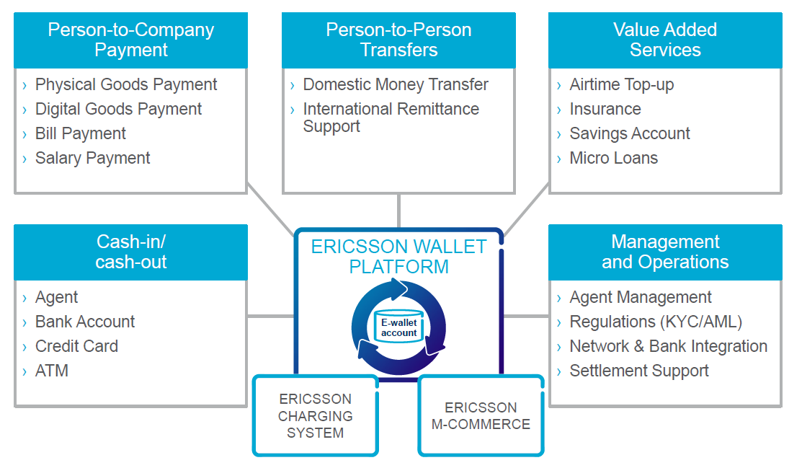
Ericsson Wallet Platform(EWP)
- A Platform For Mobile Financial Services

Slide 6









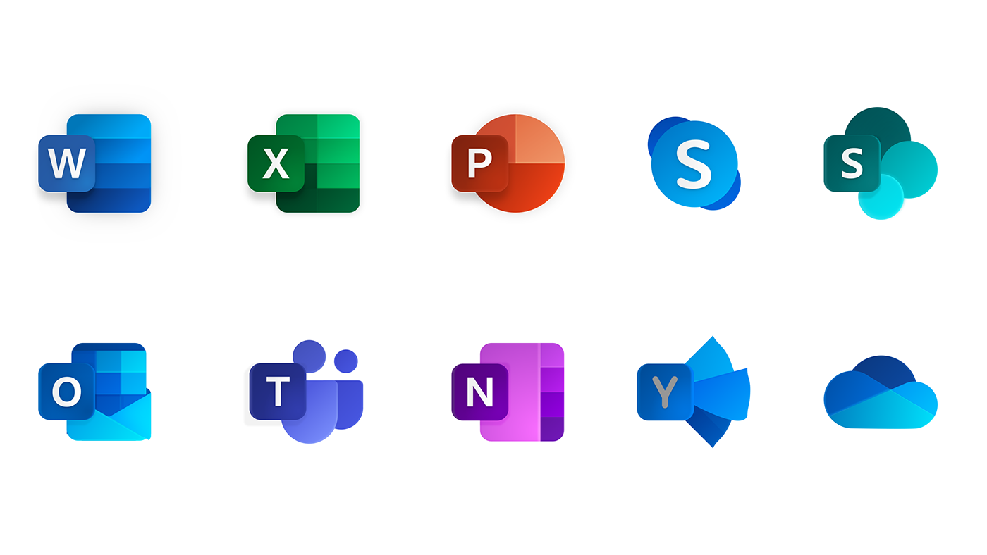


Technologies Used
Java
Jenkins
Kubernetes
Oracle
Helm
Jira
Citrix
Microsoft Office
Gerrit and Gitlab
Gradle
Confluence

Slide 7


Work Done
Gone Through Onboarding Material
Web and Lwac Kata Exercises
Updating 3PP’s Used in EWP
Unit Test(UT) for the BUC 18066
Basic Test(BT) for the BUC 18066 backporting
Checking the pipelines for Project Repository branches and retriggering them to get
them green in Jenkins.
Testing the Code Changes for the Backporting of BUC 18066.
Involved in Answering TR HZ95086
Involved in Answerin TR HZ95663

Slide 8


Learnings from the Internship
Got a habit of coding in multiple languages like Python, Java
Working in Team.
Improved Communication Skills
Writing Test Cases
Background of processing engines to create and deploy Project.
Being a Good Listener

Slide 9


References
Ericsson Internal Documentation
https://en.wikipedia.org/
https://www.gsmdome.com/
https://www.jenkins.io/
https://kubernetes.io/
https://helm.sh/
https://www.atlassian.com/

Slide 10



Thank You

