Slide 1
SECURE DATA HIDING IN IMAGES USING STEGANOGRAPHY
Presented By: A SAI KUMAR
Student Name : APPALA SAI KUMAR
College Name & Department : MALLA REDDY UNIVERSITY
(CYBER SECURITY)

Slide 2
OUTLINE
Problem Statement
Technology used
Wow factor
End users
Result
Conclusion
Git-hub Link
Future scope

Slide 3
Problem Statement
The growing need for secure transmission and storage of sensitive information has led to the development of steganography, which is the art of hiding data in various forms of media, such as images. However, current techniques may lack adequate security, are prone to attacks, or result in noticeable changes to the host image. Therefore, there is a need to develop a secure image steganography technique that ensures confidentiality without compromising the visual quality of the image.

Slide 4
Technology used
Steganography Algorithms:
Least Significant Bit (LSB)
Encryption:
Advanced Encryption Standard (AES)
Programming Languages & Tools:
Python (for implementation and prototyping).
Libraries: OpenCV, Pillow (for image processing), NumPy (for numerical operations).
GitHub for code sharing and version control.
,

Slide 5
Wow factors
Security: By combining steganography with encryption, sensitive data remains protected even if the image is intercepted.
Visual Integrity: The technique preserves the image’s quality while hiding large amounts of data.
Stealth and Robustness: The use of advanced methods like DCT or DWT makes it resistant to common image manipulation

Slide 6
End users
Government and Military Organizations:
For secure communication and covert data transfer.
Corporates:
Secure internal communications and file sharing within organizations.
Private Users (General Public):
Individuals who want to hide their sensitive information in images for personal privacy or confidential communications.
Cybersecurity Experts:
To securely store and transfer data while preventing unauthorized access.

Slide 7
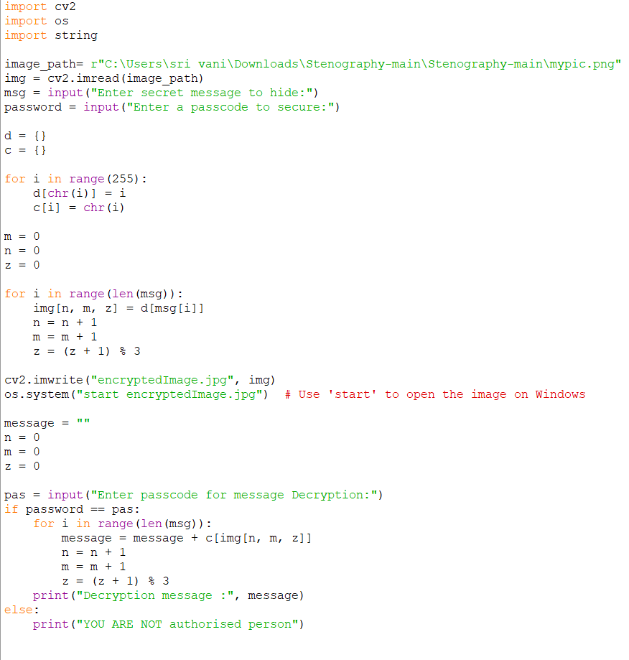
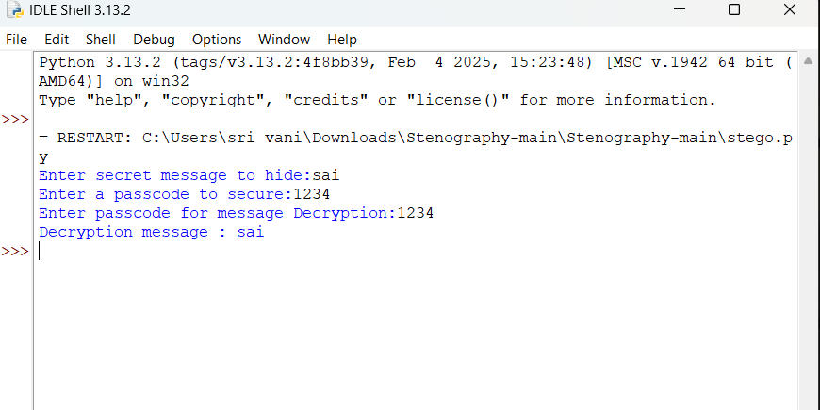

Results
Screenshots of the outcome (min 3)

Slide 8
Conclusion
Secure data hiding using steganography is a valuable tool for protecting sensitive information during storage or transmission. By combining encryption with advanced steganographic methods (such as DCT, DWT, or LSB), this system ensures that the hidden data remains confidential and difficult to detect, even with advanced detection techniques. While it offers significant benefits in security and privacy, ongoing research is necessary to develop even more robust and efficient method.

Slide 9
GitHub Link
https://github.com/SAIKUMAR173/STEGANOGRAPHY.git

Slide 10
Future scope
Real-time Applications:
Implementing steganography techniques for real-time video or voice communications.
AI-Driven Steganography:
Using AI and deep learning to dynamically adjust steganographic methods based on the content of the image and the required security level.
Multi-layer Steganography:
Combining multiple steganographic methods (LSB, DCT, DWT) to hide information in different layers, increasing security.
Blockchain Integration:
Using blockchain for tracking and validating the integrity of images and the data they carry, enhancing security against tampering.

Slide 11
THANK YOU…

