Slide 1
J-difference Editing Toolkit (JET)
About
J-difference Editing Toolkit (JET) is a software package designed for the batch analysis of J-difference editing magnetic resonance spectroscopy (MRS) data, such as MEGA-PRESS MRS spectra.
JET is capable to process Raw data acquired from all major clinical (i.e., Siemens, GE, Philips) and preclinical (i.e., Bruker) MRI scanners.
JET is implemented in Matlab, and is distributed as executables, except for the configuration functions being distributed as source code, allowing necessary users modifications.
JET is fully automated and does not require user intervention to minimize software operator variances in MRS data quantification.

Slide 2
J-difference Editing Toolkit (JET)
Team
Major Developers
Chen "Raphael" Liu, MS; Nanyan "Rosalie" Zhu, MA; Jia Guo, PhD.
Contributors
David J. Ma, MS; Roshell Li, MS;
Jochen Weber, MS; Kay C. Igwe, MS; Emily Turner Wood, MD, PhD; Wafae Labriji, MS; Vasile Stupar, PhD; Gregory Smith, PhD.
Collaborators
Scott A. Small, MD; Douglas L Rothman, PhD; Robin de Graaf, PhD; Neil Harris, PhD; Florence Fauvelle, PhD; Yanping Sun, PhD.
Inventor and Correspondence
Jia Guo, PhD. (Email: jg3400@columbia.edu)

Slide 3
J-difference Editing Toolkit (JET)
Installation Guide

Slide 4
J-difference Editing Toolkit (JET)
Clone from GitHub repository.
git clone https://github.com/SAIL-GuoLab/JET
Organize your data inside “./Data/” folder, in the following hierarchy: ./Data/vender/scanner/study/session/
Modify and run JET_main_script.m
You can find a more comprehensive tutorial in Installation_Guide.txt.
For more questions, please contact Dr. Jia Guo at jg3400@columbia.edu.

Slide 5
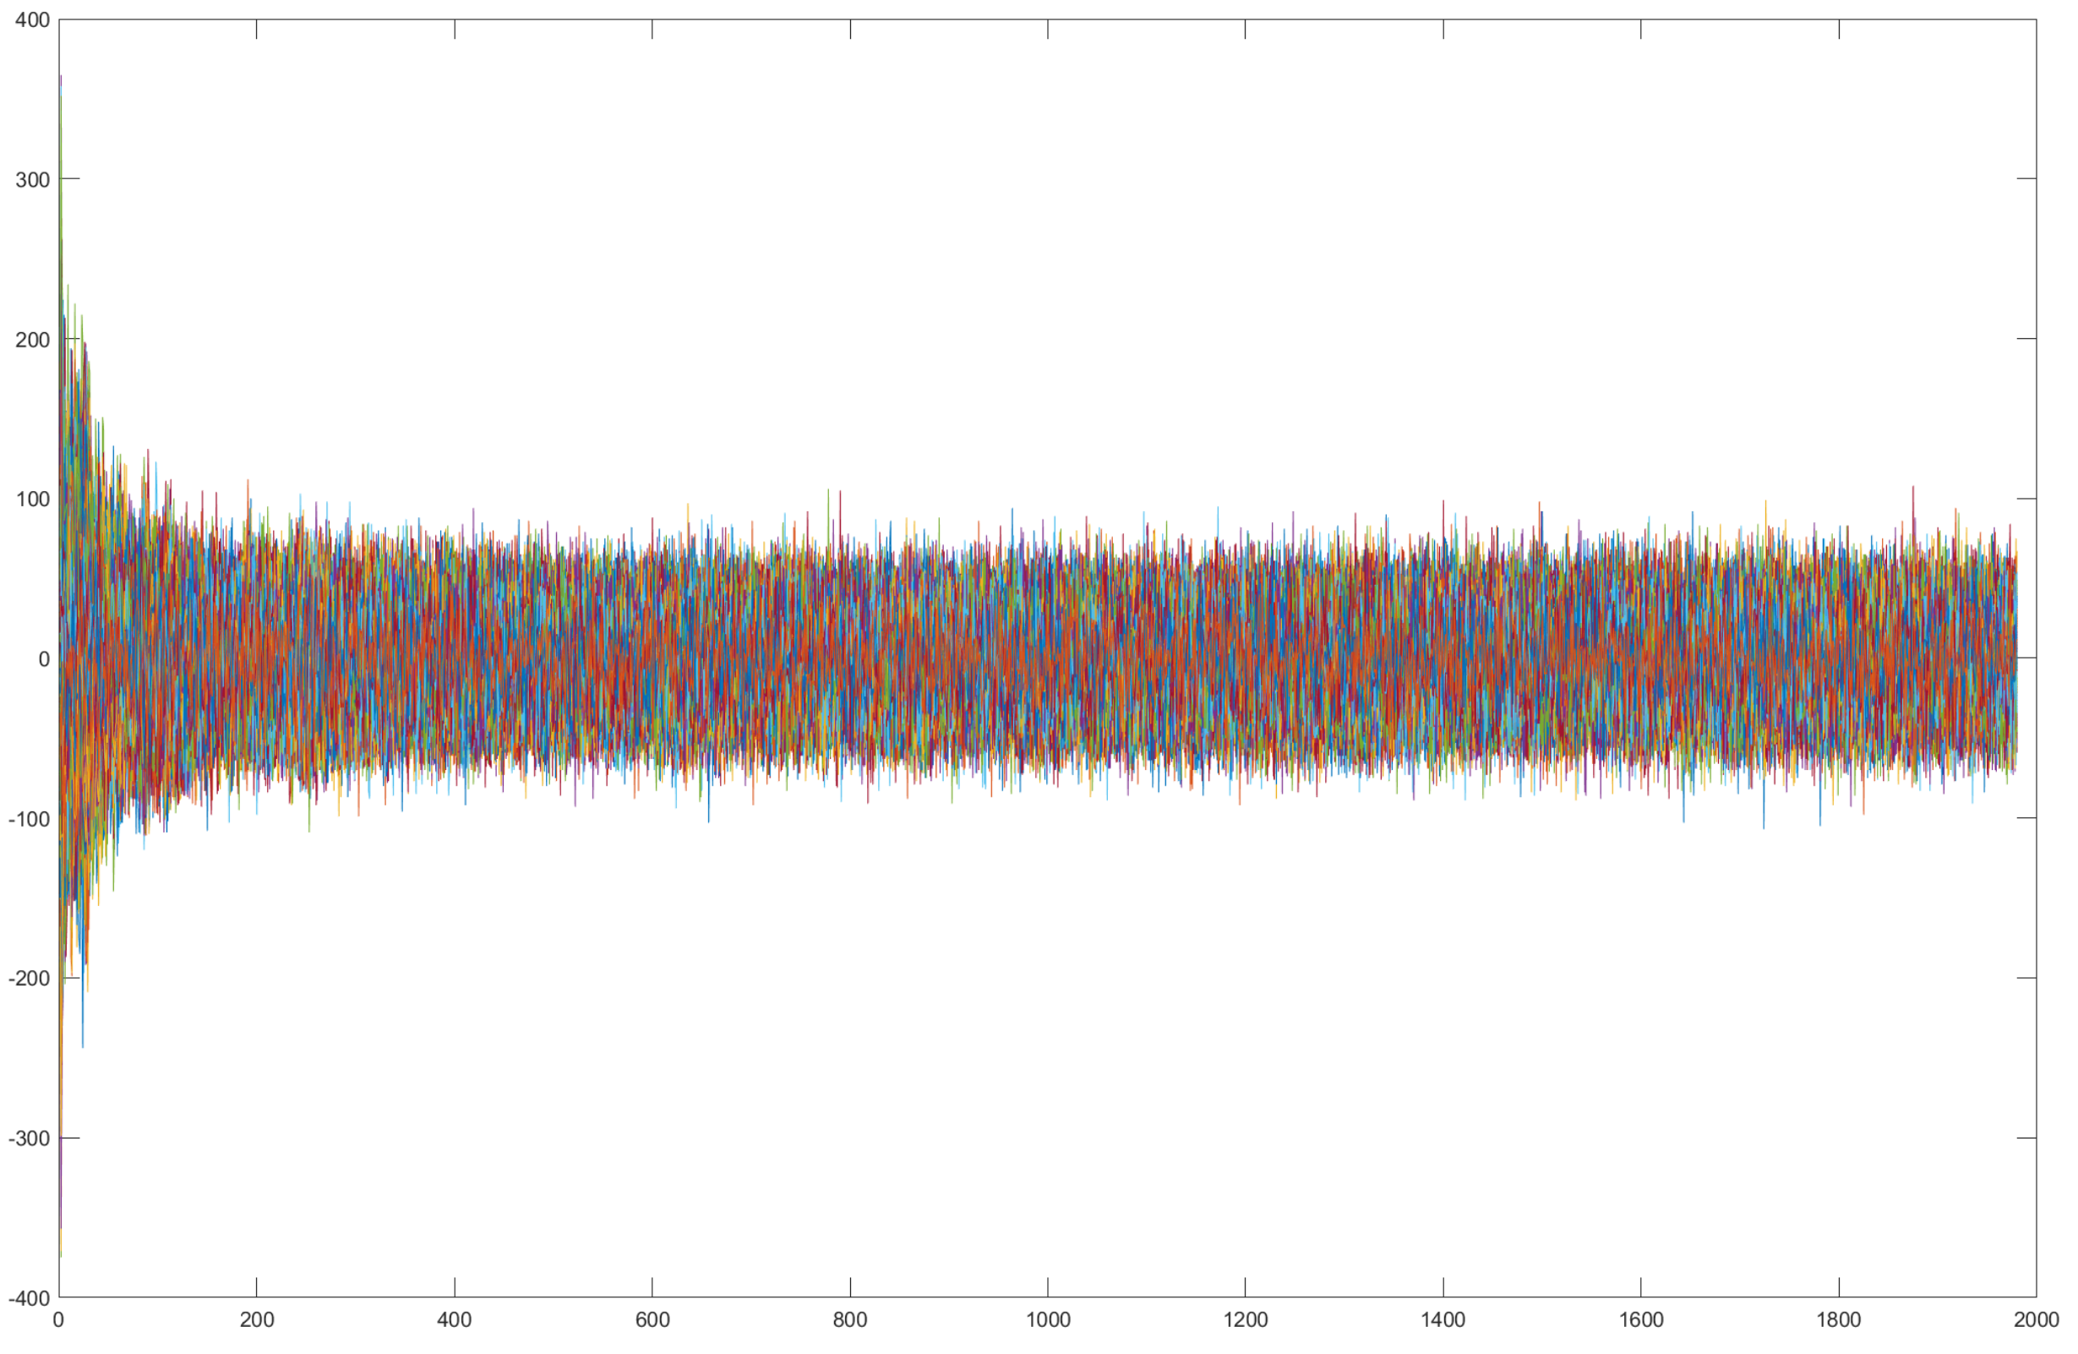
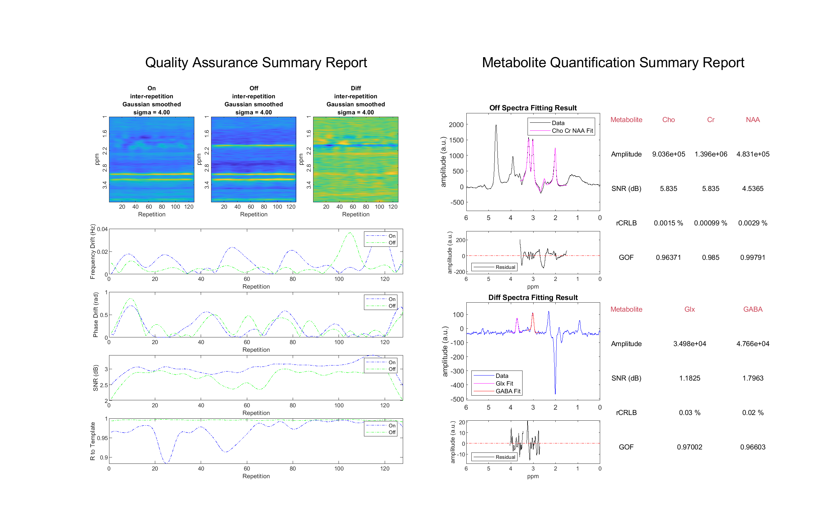
J-difference Editing Toolkit (JET)
Purpose
To provide a complete toolbox that performs registration and metabolite quantification in MR spectroscopy.
From Raw Data
To Quantification

Slide 6
J-difference Editing Toolkit (JET)
Technical Overview
Please see JET_2.0_TechnicalWhitePaper.pdf for more details

Slide 7
J-difference Editing Toolkit (JET)
Modules × 5
Data Structure × 1
1. Initialization
JET_STR.Loader.coil_type
...
JET_STR.Loader
2. Loader
JET_STR.SR.params
JET_STR.SR
...
3. Spectrum Registration
JET_STR
JET_STR.SF.data
JET_STR.SF
...
4. Spectral Fitting
JET_STR.Report.report_dir
JET_STR.Report
...
5. Report

Slide 8
J-difference Editing Toolkit (JET)
1. Initialization
2. Loader
Define where the raw data are located, where to save the report, where to store the processed data, etc.
3. Spectrum Registration
4. Spectral Fitting
5. Report

Slide 9
J-difference Editing Toolkit (JET)
1. Initialization
2 options of data loading
Loader by vendor
Raw Data
2. Loader
or
Converter by vendor
Loaded Structure
3. Spectrum Registration
4. Spectral Fitting
5. Report

Slide 10
J-difference Editing Toolkit (JET)
1. Initialization
Goal: Combine each individual spectrum from all coil channels and repetitions, after proper removal of frequency and zero-order phase difference, to result in one single ON spectrum and one single OFF spectrum.
Principle: Use a line-broadened version of the spectra (higher SNR, less authentic) as a representation of the version without line-broadening (lower SNR, more authentic) to calculate the necessary frequency and phase shift, and then apply the shift to the more authentic version to prepare it as the input for spectral fitting. Thus we ensure minimal manipulation and great preservation of the signal.
2. Loader
3. Spectrum Registration
RC, ZF, LB
More Processing
params
4. Spectral Fitting
FT
FIDs
Spectra
RC, ZF
Less Processing
Spectra
for fitting
5. Report
RC: remove compensate points (typically first 68 points in FID)
ZF: zero-filling
LB: line-broadening
params: parameters of frequency and zero-order phase shift

Slide 11
J-difference Editing Toolkit (JET)
3.1 Coil-channel combination
1. Initialization
Incoming data: 3D spectra.
(number of coil channels)×(number of repetitions)×(spectra length)
Goal: Remove the frequency and phase differences that are specific to coil-channel but independent of repetitions.
Strategy:
Use the inter-repetition mean 2D spectra as the representation for each coil channel to calculate the coil-channel-specific corrections required, and apply the same corrections over all repetitions in the same coil channel.
(number of coil channels)× (spectra length)
Procedure:
Use ACME as phase correction initialization.
Use Icoshift as frequency correction initialization.
JET SR algorithm to correct for frequency and zero-order phase.
Channel combination by taking mean over coil channel.
Outcome: 2D, coil-channel combined spectra.
(number of repetitions)×(spectra length)
2. Loader
3. Spectrum Registration
4. Spectral Fitting
5. Report

Slide 12
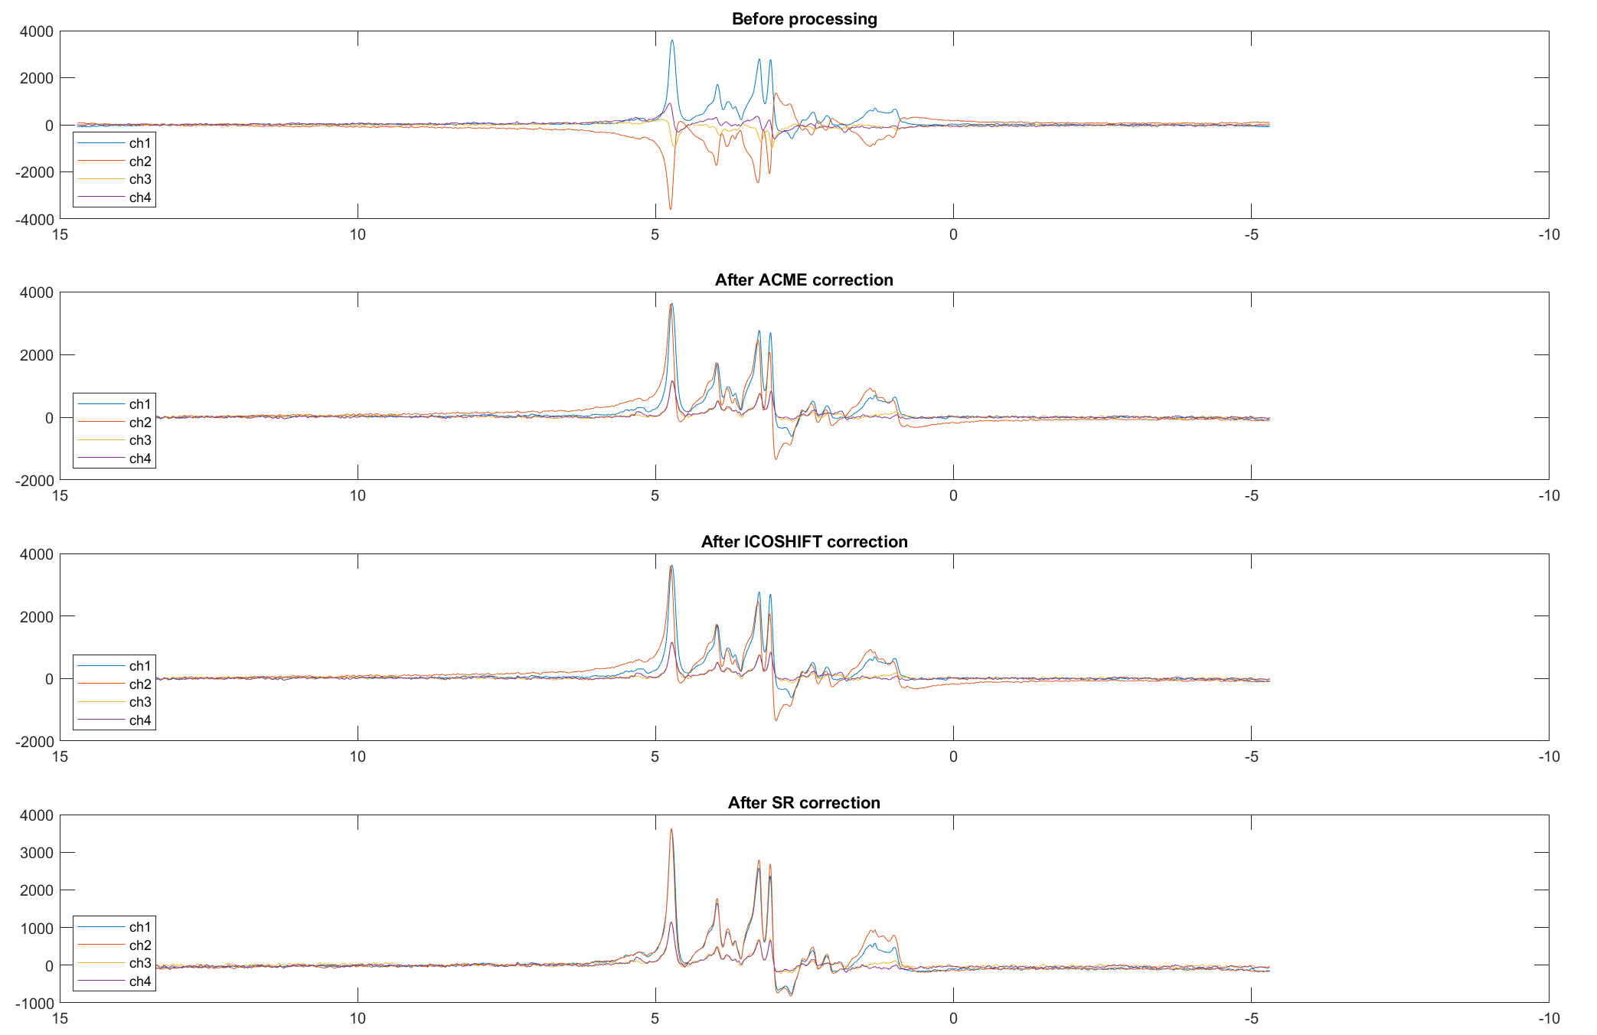
J-difference Editing Toolkit (JET)
3.1 Coil-channel combination
1. Initialization
ON spectra
2. Loader
3. Spectrum Registration
4. Spectral Fitting
5. Report

Slide 13
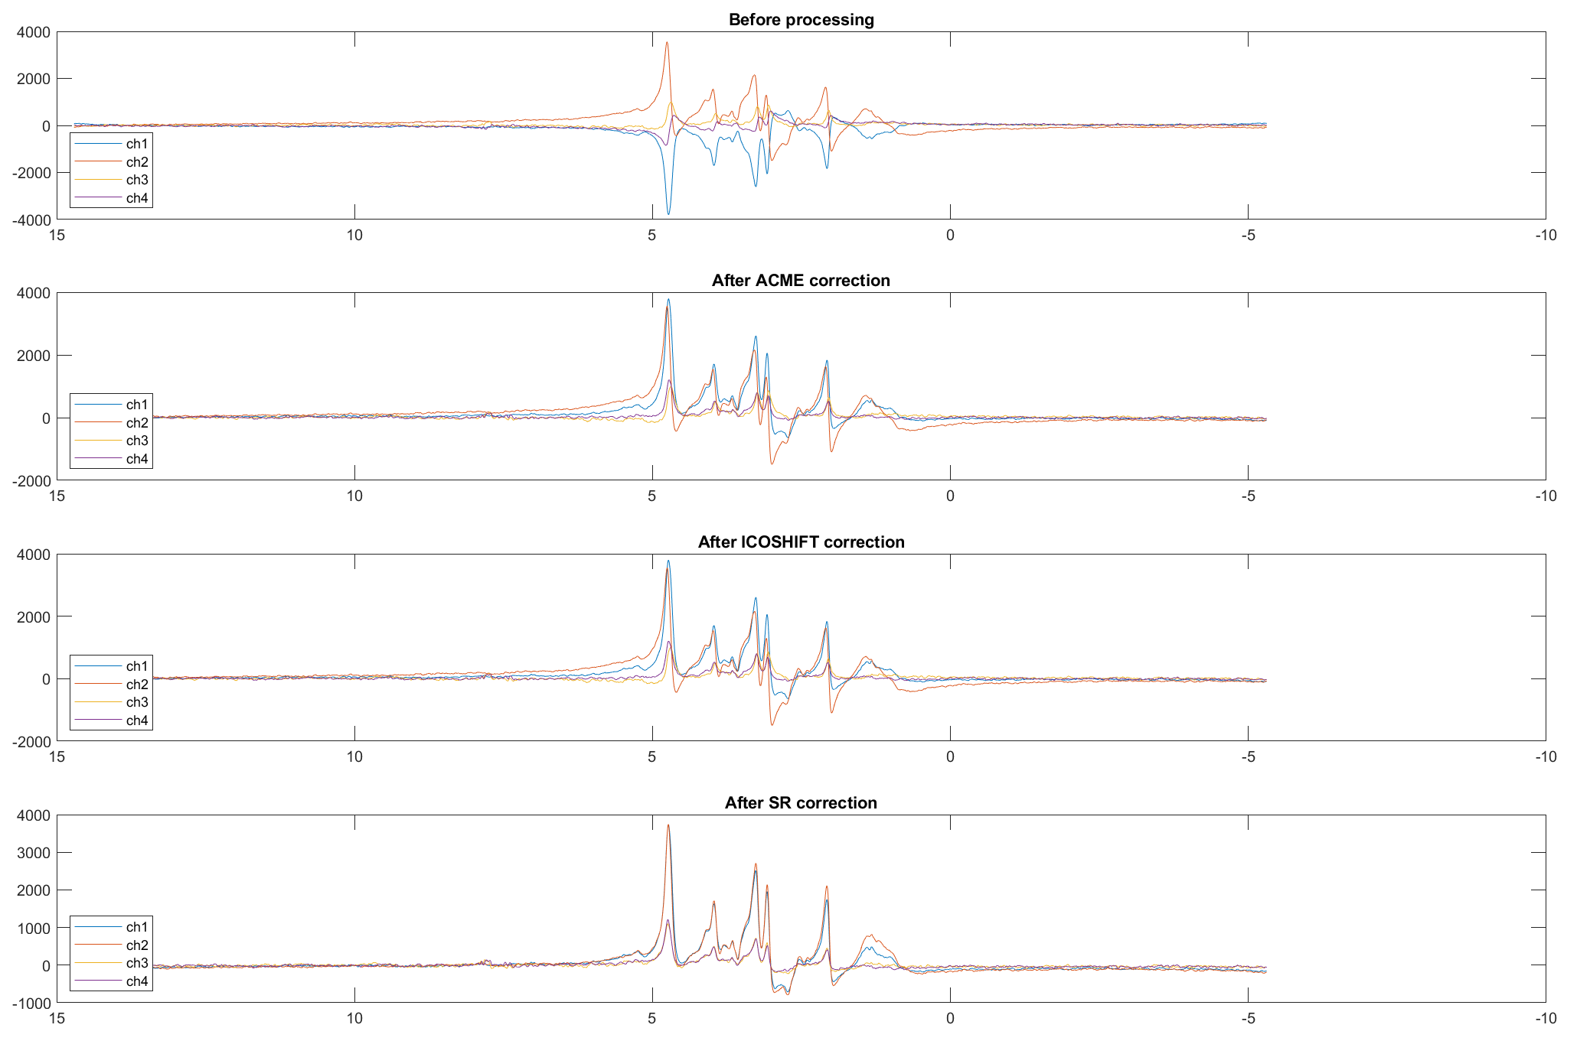
J-difference Editing Toolkit (JET)
3.1 Coil-channel combination
1. Initialization
OFF spectra
2. Loader
3. Spectrum Registration
4. Spectral Fitting
5. Report

Slide 14
J-difference Editing Toolkit (JET)
3.1 Coil-channel combination
1. Initialization
Technical Detail:
The JET Spectrum Registration algorithm for coil-channel combination (applied separately to the ON and OFF spectra) uses a least square fitting method to minimize the difference between an iteratively updated spectra template and the coil-channel-specific mean spectra with three degrees of freedom: frequency, zero-order phase, and amplitude.
This process estimates the necessary frequency, zero-order phase and amplitude for the correction, and such coil-channel-specific frequency and phase shifts are applied to every repetition within each coil channel to generate aligned spectra. In contrast, the amplitude corrections are only used to facilitate accurate estimation of frequency and phase shift, as well as for visualization and quantification of coil-channel sensitivity, but are not propagated to subsequent steps.
Please note that the coil-channel mean is taken as a high-SNR representation of the spectra from each coil channel, such that we can have more robust estimations of the coil-channel-specific shift parameters. We won’t naively take the mean and leave them like that for further processing, but rather only the parameters are utilized at this step.
2. Loader
3. Spectrum Registration
4. Spectral Fitting
5. Report

Slide 15
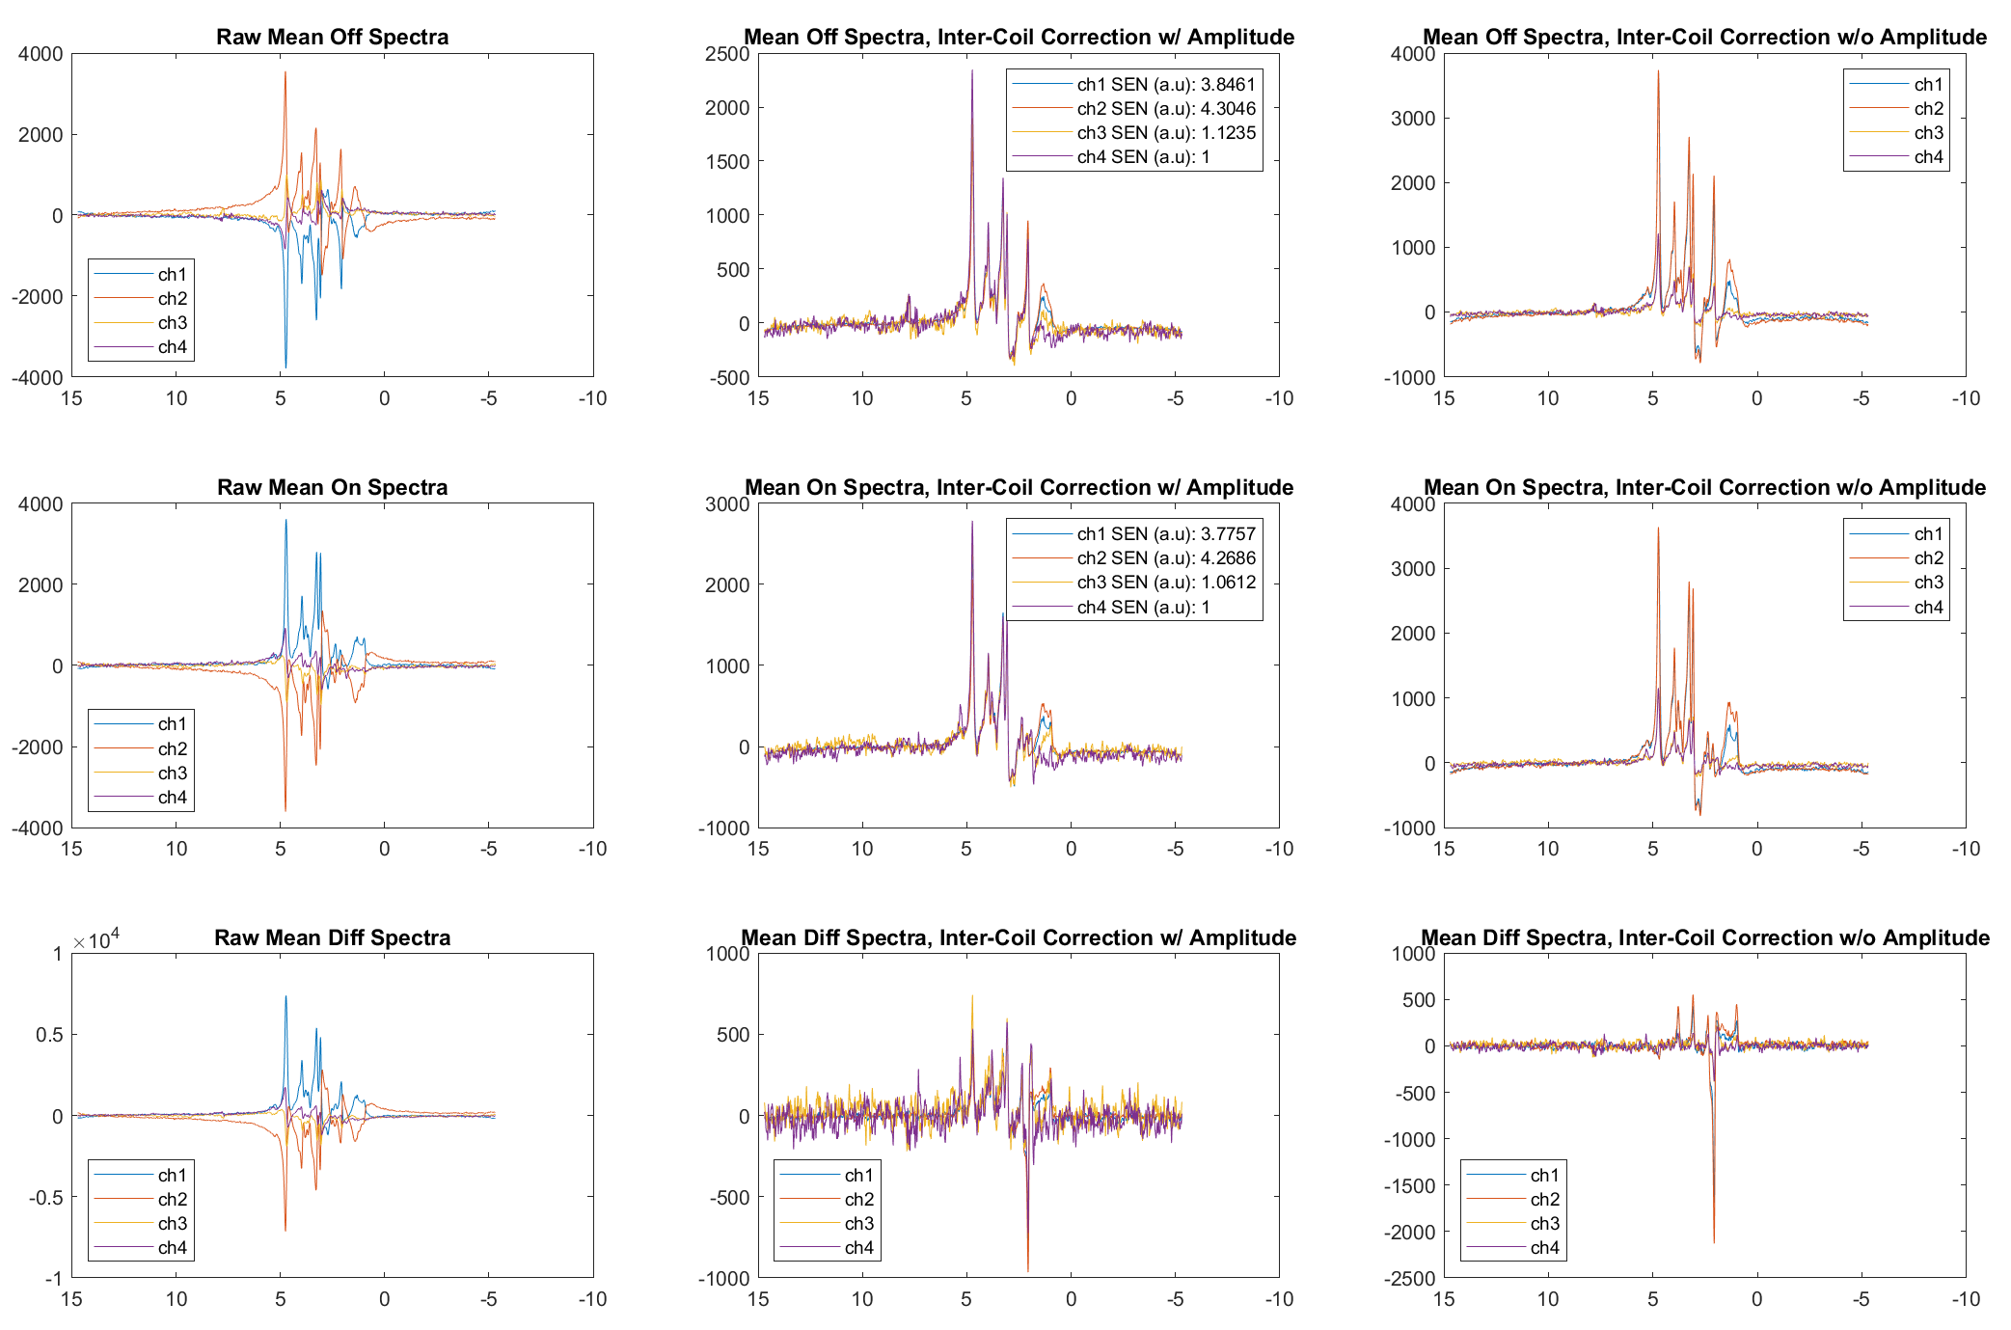
J-difference Editing Toolkit (JET)
3.1 Coil-channel combination
1. Initialization
2. Loader
3. Spectrum Registration
4. Spectral Fitting
5. Report

Slide 16
J-difference Editing Toolkit (JET)
3.2 Within-ON/OFF Registration & 3.3 ON-to-OFF Registration
1. Initialization
Incoming data: Two 2D spectra (ON spectra and OFF spectra)
Goal: Remove the frequency and phase differences that are specific to each repetition. Also align ON spectra to OFF spectra.
Strategy:
Use a repetition-wise smoothed 1D spectrum as the representation for each repetition to calculate the repetition-specific corrections required, and apply the corrections to each respective repetition.
Use the mean of ON spectra and mean of OFF spectra to find the frequency and phase corrections required to match the former to the latter, and apply the correction over all repetitions of the ON spectra.
Procedure:
Use ACME as phase correction initialization.
Use Icoshift as frequency correction initialization.
JET SR algorithm to correct for frequency and zero-order phase.
Outcome: Two 2D spectra (ON spectra and OFF spectra) after corrections.
2. Loader
3. Spectrum Registration
4. Spectral Fitting
5. Report

Slide 17
J-difference Editing Toolkit (JET)
3.2 Within-ON/OFF Registration & 3.3 ON-to-OFF Registration
1. Initialization
Technical Detail:
Within-ON/OFF Registration
The JET Spectrum Registration algorithm for within-ON/OFF registration (applied separately to the ON and OFF spectra) uses a least square fitting method to minimize the difference between an iteratively updated spectra template and the repetition-specific representative spectra with two degrees of freedom: frequency and zero-order phase.
This process estimates the necessary frequency and zero-order phase for the correction, and such repetition-specific frequency and phase shifts are applied to every repetition to generate aligned spectra.
Another thing to note is, just like in the coil-channel combination step we used the mean spectrum within the coil-channel as a high-SNR representative, here we use the inter-repetition gaussian-smoothed version (smoothing over the time axis) as the high-SNR representative for the single-repetition spectrum. Again, this is just for more robust estimation of the shift parameters (which are applied on the version without smoothing), not for any other purpose.
2. Loader
3. Spectrum Registration
4. Spectral Fitting
5. Report

Slide 18
J-difference Editing Toolkit (JET)
3.2 Within-ON/OFF Registration & 3.3 ON-to-OFF Registration
1. Initialization
Technical Detail:
ON-to-OFF Registration
The JET Spectrum Registration algorithm for ON-to-OFF registration (applied to the ON spectra only) uses a least square fitting method to minimize the difference between the mean OFF spectrum and the mean ON spectrum with two degrees of freedom: frequency and zero-order phase.
This process estimates the necessary frequency and zero-order phase for the correction, and such common frequency and phase shifts are applied to every repetition of the ON spectra to generate ON-OFF aligned spectra.
Just like before, we take the mean as high-SNR representations of the ON or OFF spectra.
After this step, all spectra within ON/OFF are aligned, and ON is aligned to OFF, and we can frequency-shift them together such that the NAA peak in OFF spectrum is at 2 ppm.
2. Loader
3. Spectrum Registration
4. Spectral Fitting
5. Report

Slide 19
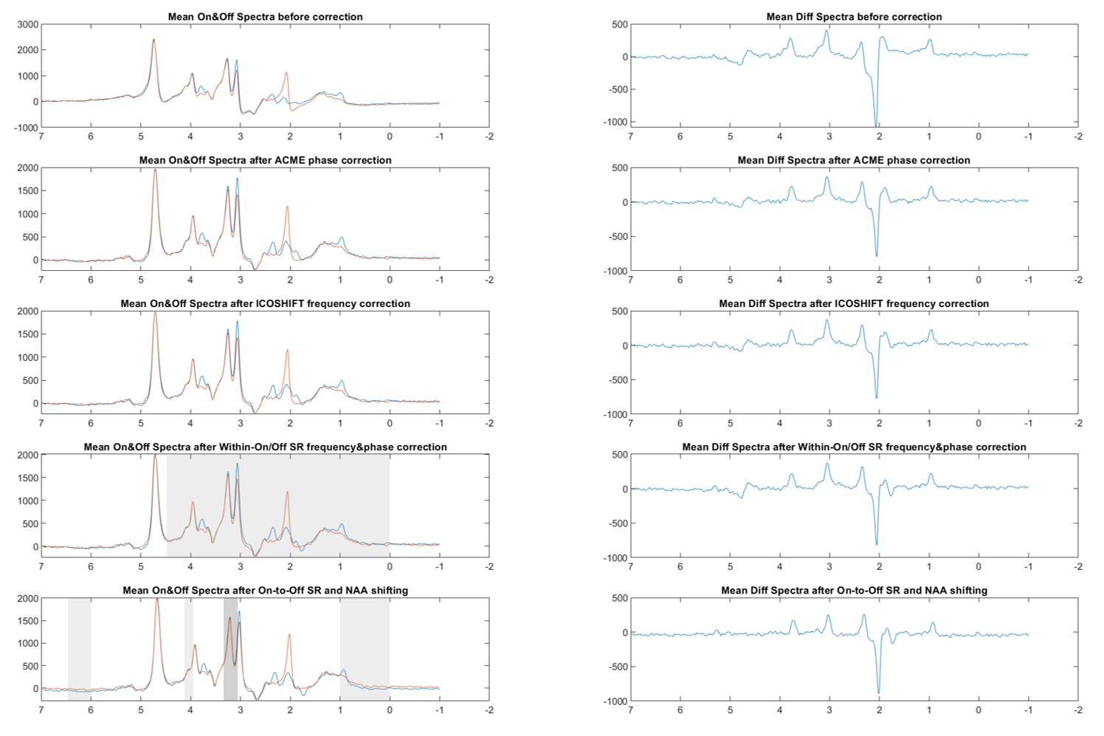
J-difference Editing Toolkit (JET)
3.2 Within-ON/OFF Registration & 3.3 ON-to-OFF Registration
1. Initialization
2. Loader
3. Spectrum Registration
4. Spectral Fitting
5. Report

Slide 20
J-difference Editing Toolkit (JET)
1. Initialization
Incoming data: The non-edited OFF spectrum and the edited DIFF spectrum (contains GABA).
Goal: Estimate metabolite levels.
Method:
Spectral quantification is performed by solving a separable nonlinear least-squares ﬁtting problem with simulated metabolite basis sets (de Graaf, 2011), which was numerically solved using a modiﬁed variable-projection procedure (VARPRO) (Poullet, 2007).
The fitting error, i.e. the standard deviation of the fitting residual, was calculated for each metabolite.
For GABA, co-edition of macromolecule was not taken into account, so that only GABA+ was obtained.
JET can further calculate the GABA ratios such as GABA+/GLX and GABA+/CR for cross-subject comparison.
Outcome: Estimated metabolite levels.
2. Loader
3. Spectrum Registration
4. Spectral Fitting
5. Report

Slide 21
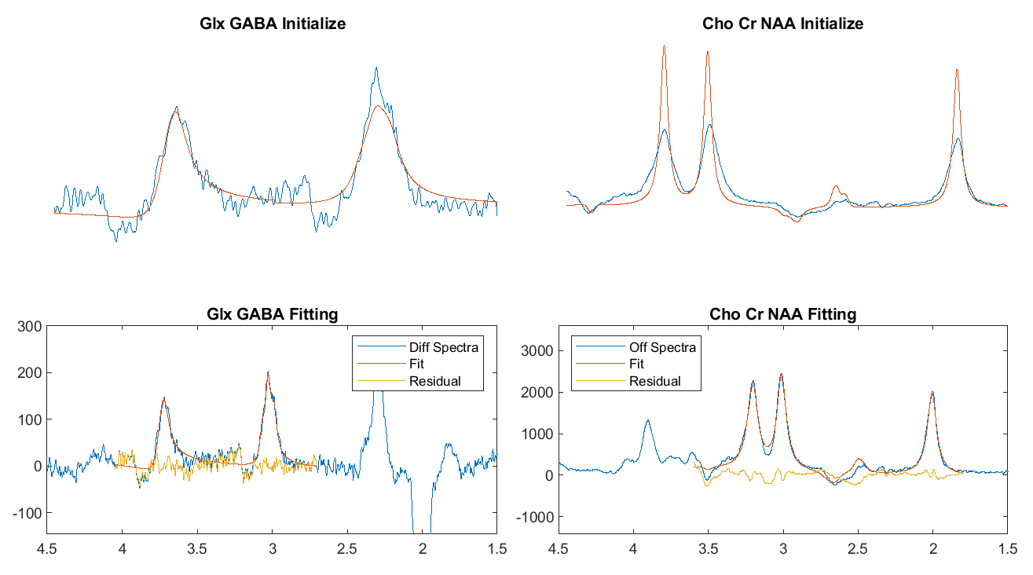
J-Editing Toolkit (JET)
1. Initialization
2. Loader
3. Spectrum Registration
4. Spectral Fitting
5. Report

Slide 22
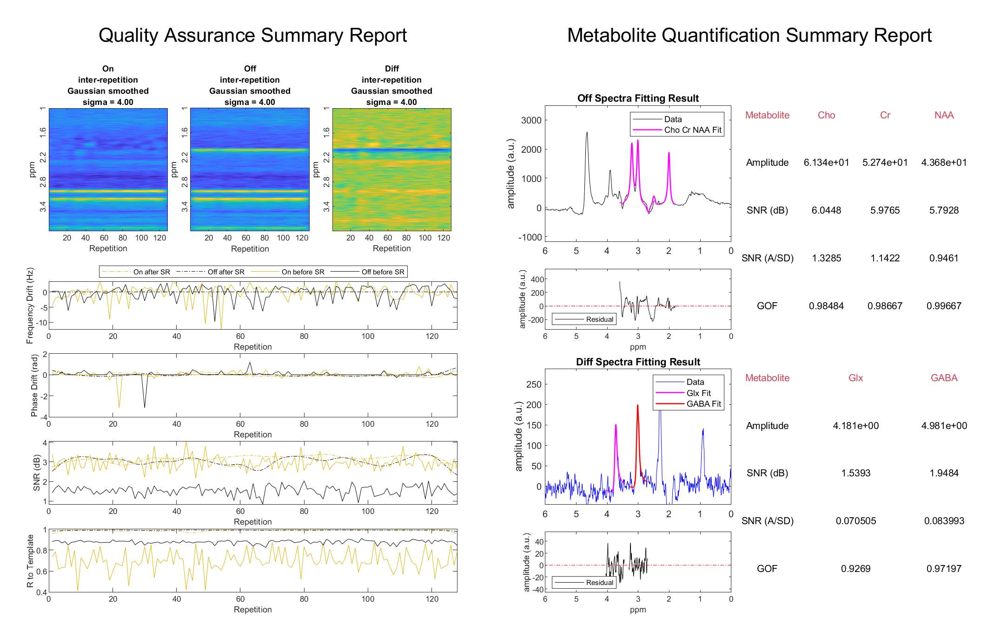
J-Editing Toolkit (JET)
1. Initialization
2. Loader
3. Spectrum Registration
4. Spectral Fitting
5. Report

