Slide 1
Story Studio Data Story
{USERNAME HERE}

Slide 2
Narrative Structuring
Overall Story: The figures collectively illustrate a comprehensive exploration of data characteristics and relationships within a dataset. They provide insights into the distribution, correlation, and potential impact of various features and target variables. The visualizations aim to uncover underlying patterns, such as the relationship between periods and content generation, the distribution of engineered features, and the interaction between features and target variables.
Objective: The primary objective of these figures is to highlight trends and comparisons within the dataset. The scatter plots and pairplot matrix focus on identifying relationships and correlations between features and target variables, while the histogram with KDE curve emphasizes the distribution characteristics of a newly engineered feature. Together, these visualizations aim to facilitate a deeper understanding of the data, aiding in feature selection, data preprocessing, and subsequent modeling tasks. The figures serve as a foundational analysis to guide further exploration and decision-making in predictive modeling and data-driven insights.

Slide 3
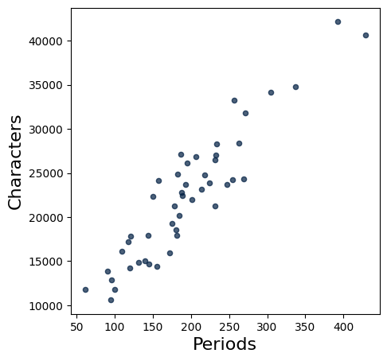
Figure Categories
Category: Trends/Time-Based Changes
Reason: The scatter plot illustrates a positive correlation between 'Periods' and 'Characters,' suggesting that as the number of periods increases, the number of characters also tends to increase. This indicates a trend where longer periods are associated with more characters, highlighting a potential relationship between the duration of periods and the amount of content generated. The focus on the relationship over different periods suggests a time-based change or trend.

Slide 4
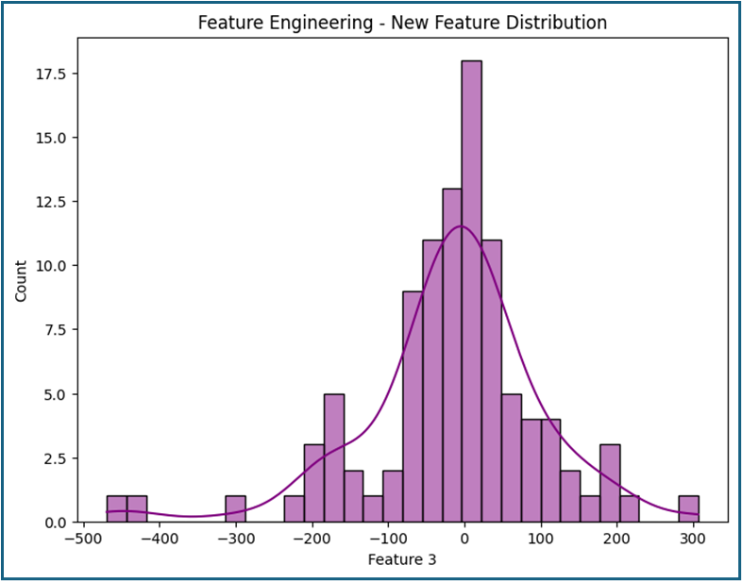
Figure Categories
Category: Overview/High-Level Insights
Reason: The figure provides a summary of the distribution characteristics of a newly engineered feature, 'Feature 3.' It offers a high-level view of the central tendency and spread of the data, which is crucial for understanding the feature's potential impact on further analyses or modeling tasks. The focus on the overall distribution pattern, including the histogram and KDE curve, aligns with providing a broad insight into the feature's behavior rather than delving into specific subcategories or comarisons.

Slide 5
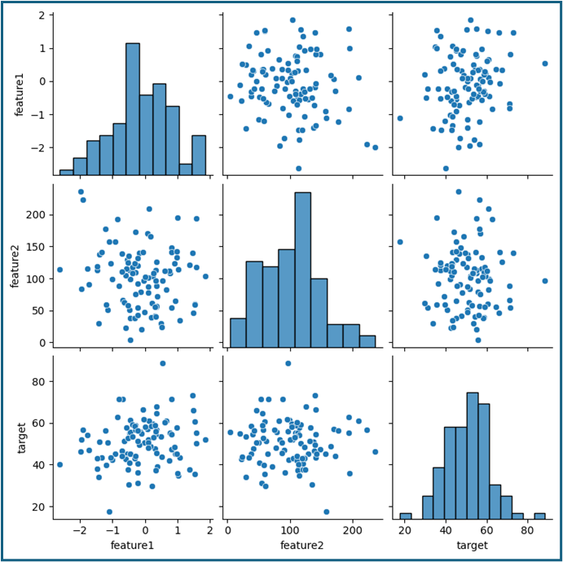
Figure Categories
Category: Overview/High-Level Insights
Reason: The figure titled "Pairplot of Features and Target" provides a comprehensive overview of the data's distribution and potential relationships between the variables "feature1," "feature2," and "target." The use of histograms and scatter plots in a 3x3 grid format allows for a high-level understanding of the data's characteristics, such as distribution patterns and correlations. This type of visualization is typically used for preliminary data analysis, making it suitable for the Overview/High-Level Insights category.

Slide 6
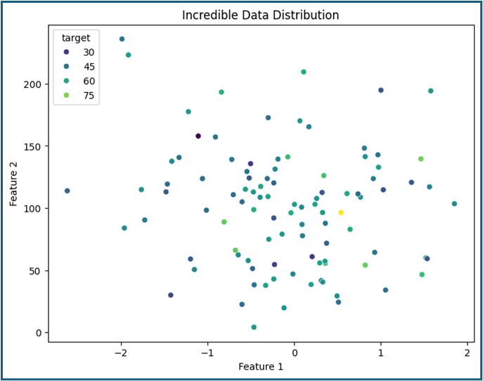
Figure Categories
Category: Overview/High-Level Insights
Reason: The scatter plot titled 'Incredible Data Distribution' provides a broad view of how data points are distributed across two features, with color coding to represent different target variable values. This visualization offers a high-level insight into the overall spread and clustering of data points, which is useful for identifying general patterns or clusters within the dataset. The lack of a clear linear relationship suggests a diverse distribution, making it an overview of the data's structure rather than focusing on specific details or comparisons.

Slide 7
Sequence
The "Overview to Detail" structure was chosen because it allows us to start with a broad understanding of the dataset and progressively focus on specific aspects. The sequence begins with the pairplot, which provides a comprehensive overview of the relationships and distributions among the features and target variable. This sets the stage for understanding the general data landscape.

Slide 8
Sequence
Next, the scatter plot offers a high-level insight into the distribution and clustering of data points across two features, adding another layer of understanding about the dataset's structure.

Slide 9
Sequence
The histogram with KDE then provides detailed insights into the distribution characteristics of a newly engineered feature, allowing us to zoom into specific data attributes.

Slide 10
Sequence
Finally, the scatter plot focuses on the relationship between periods and characters, highlighting a specific trend and correlation, which is crucial for understanding potential impacts on content generation.

