Slide 1
CSS7000 - INTERNSHIP Review - Presentation SMART ROOM SAFETY MONITORING SYSTEM USING ARDUINO
Student Details
Name | S. SAINTHAVI
Roll No | 20241CIT0159
Section | 5CIT03
Under the Supervision of, Supervisor / Faculty Guide: Dr Ranjitha P Presidency School of Artificial Intelligence & Advanced Computing Presidency University
Name of the Program: B.Tech – Computer Science and Engineering (IoT) Name of the HoD: Dr Sampath AK Name of the Program Internship Coordinator: Mr.Francis Vijaykumar Annareddy
Name of the School Internship Coordinator: Dr. Geetha Arjunan

Slide 2
Content
About the Organization / Academic Context
Working Domain and Technology
Team and Reporting Structure
Challenges Faced During Project Development
Objectives of the Work
Project Roadmap
GitHub Repository

Slide 3
About Company or Organization
Presidency University, Bengaluru
School: Presidency School of Artificial Intelligence & Advanced Computing
Program: B.Tech – Computer Science and Engineering (IoT)
Project context: Academic engineering project focused on practical IoT and embedded-system safety monitoring.
The project combines sensors, Arduino-based processing, visual indicators and an audible alarm to demonstrate a low-cost indoor safety solution.
Company/client-specific products and clients are not applicable to this academic project.

Slide 4
Working Domain / Technology
Domain: Internet of Things (IoT), Embedded Systems and Safety Monitoring
Controller: Arduino Uno
Sensors: DHT22 (temperature/humidity), MQ gas sensor, HC-SR04 ultrasonic sensor
Outputs: Green, Yellow and Red LEDs + Piezo buzzer
Programming: Embedded C/C++ using Arduino IDE
Simulation: Tinkercad for circuit design and initial validation
Core logic: Continuous sensing → threshold comparison → priority-based alert generation
Safety thresholds: Gas > 450; Temperature > 35°C; Distance < 15 cm

Slide 5
About the Team and Reporting Structure
Project Team
S. Sainthavi — 20241CIT0159
Chethana R
Yashika Naik
Tharani Pothineni
Working focus: sensor integration, Arduino programming, simulation, hardware testing and documentation.
Faculty Supervisor / Reporting Manager: To be updated (not specified in the supplied project material).
School Internship Coordinator: Dr. Geetha Arjunan

Slide 6
Challenges Faced During Project Development
Integrating multiple sensors and output devices with limited Arduino I/O resources.
Calibrating practical threshold values for gas, temperature and proximity alerts.
Handling sensor-reading errors, including invalid DHT22 readings.
Maintaining stable ultrasonic distance measurements and avoiding false proximity alerts.
Designing a clear priority order when more than one safety condition could occur.
Validating the design in simulation before moving to hardware testing.
Testing normal, gas-leak, high-temperature and proximity conditions systematically.

Slide 7
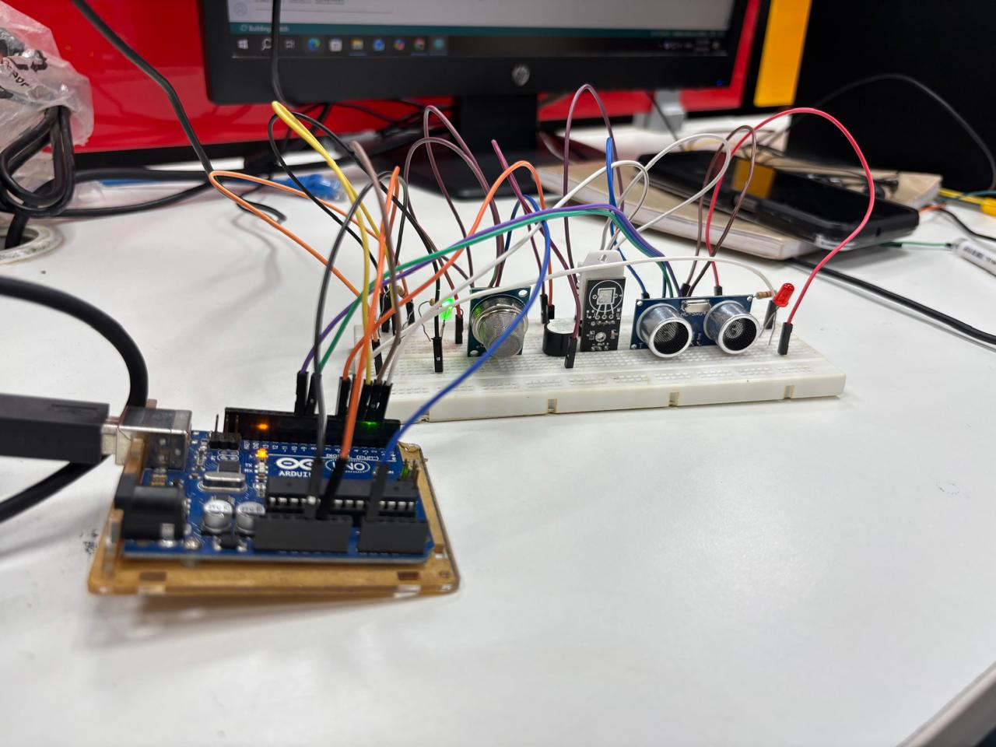
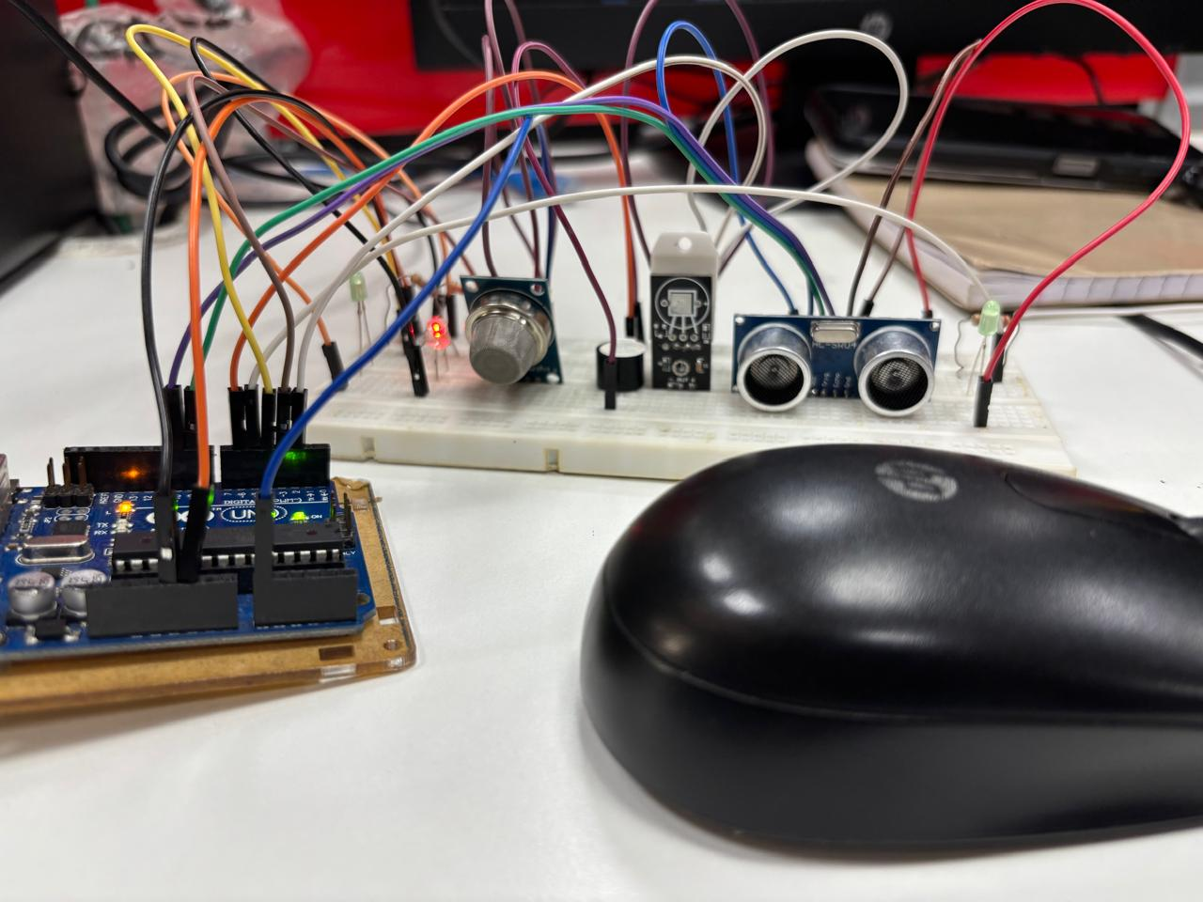
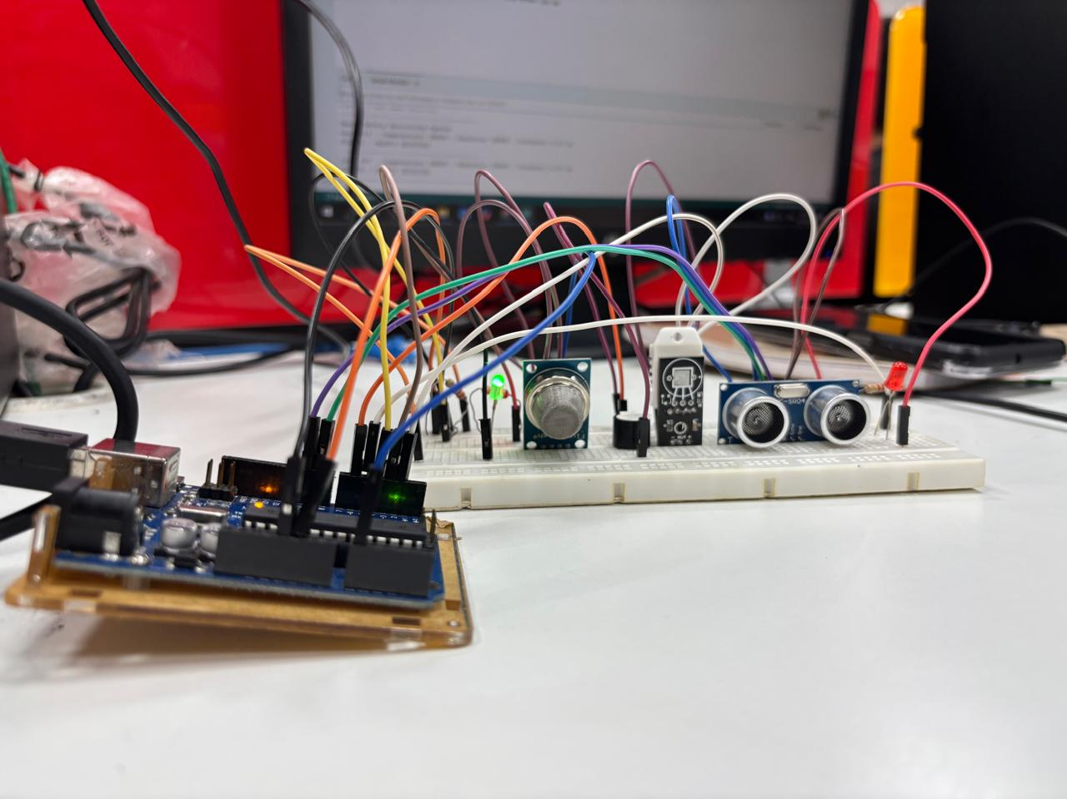

Slide 8
Objectives of the Work
Develop a low-cost indoor safety monitoring system using Arduino.
Monitor temperature and humidity using DHT22.
Detect gas leakage using an MQ-series gas sensor.
Detect objects entering a defined proximity zone using HC-SR04.
Provide immediate visual and audio alerts for unsafe conditions.
Implement a priority-based decision-making algorithm.
Validate the system through Tinkercad simulation and hardware testing.
Create a documented, reusable IoT project suitable for future cloud/mobile expansion.

Slide 9
WHAT I CONTRIBUTED IN THIS INTERNSHIP
I initiated the project by selecting the project title and contributed to the planning and organization of the required components. I was actively involved in arranging the hardware components and developing creative ideas to improve the project's presentation and functionality. I also contributed ideas for additional features and improvements that could make the system more innovative and practical. Along with the team, I participated in the development, testing, and documentation of the project.
Additionally, I independently developed an AI-based chatbot using NLP, and many other with the project details and implementation available through the GitHub link provided.

Slide 10
GitHub Link
Smart Room Safety Monitoring System Using Arduino
https://github.com/SAINTHAVI59/smart-room-safety-monitoring-system-using-arudino
Repository includes Arduino source code, hardware documentation, project report, simulation details,
test results and project assets.

Slide 11
Q&A

Slide 12
Thank you !!

