Slide 1
FINANCIAL SALES ANALYSIS REPORT
SAISHREE GANESAN

Slide 2
Financial Sales Dashboard – Russia 2023
Objective:
To analyze and visualize the financial sales performance of various companies across Russia for the year 2023 using interactive Power BI dashboards.
Tool Used: Power BI Desktop
Dataset: Financial Sales Dataset (Russia, 2023)

Slide 3
Key Metrics Overview
Total Sales: 264.07M
Total Profit: 99.36M
Total Units Sold: 5 Million
Highlights:
• Consistent sales across key months with strong profitability
• Positive growth in major regions and product categories

Slide 4
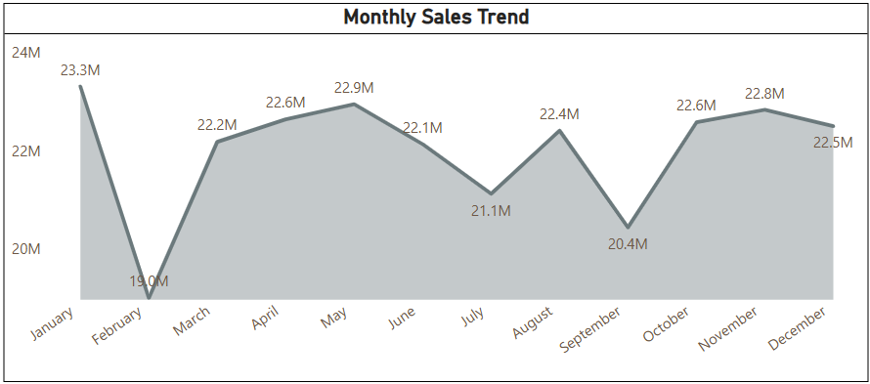
Monthly Sales Trend
• Peak sales months: April, October, and November (~22.8M each)
• Lowest performance in February due to seasonal decline
• Overall steady trend with strong year-end recovery
Insight:
Quarter 4 outperformed the rest of the year, showing successful end-of-year campaigns.

Slide 5
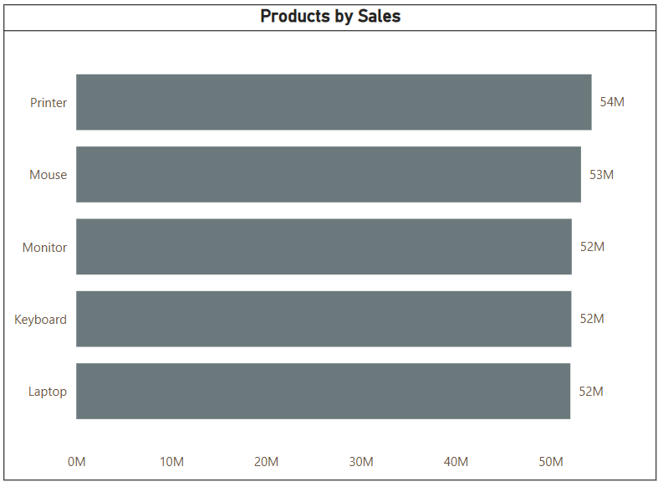
Product Performance
Top-Performing Products (by Sales):
1. Printer – 54.6M
2. Mouse – 53.1M
3. Monitor – 52.3M
4. Keyboard – 51.2M
5. Laptop – 50.2M
Profit by Product:
• Laptops: 39.79M
• Mouse: 20.3M
• Monitor: 19.5M

Slide 6
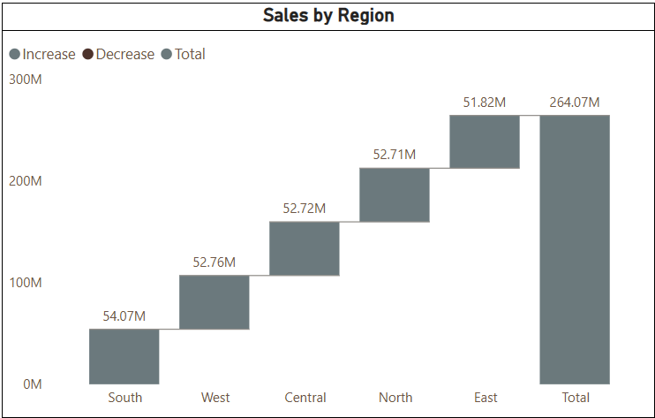
Regional Sales Insights
Sales by Region (2023):
• Central: 54.7M
• North: 52.7M
• East: 52.7M
• West: 52.7M
• South: 44.7M
Observation:
Central region leads overall, while South shows growth potential.

Slide 7
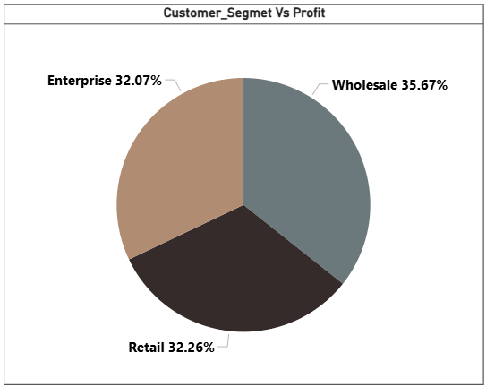
Customer Segment Analysis
Customer Segments by Profit Share:
• Enterprise – 32.07%
• Wholesale – 35.67%
• Retail – 32.26%
Insight:
Wholesale customers are the most profitable, followed closely by retail buyers.

Slide 8
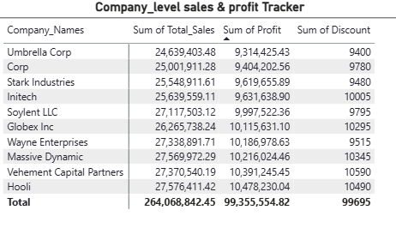
Company-Level Summary
Top Companies by Sales:
1. Umbrella Corp – 24.6M
2. Globex Inc – 25.9M
3. Wayne Enterprises – 27.7M
4. Massive Dynamic – 27.6M
5. Soylent LLC – 27.1M
Observation:
Consistent profit distribution with healthy discount management.

Slide 9
Key Insights & Business Impact
✅ Enterprise and Wholesale customers drive majority profit.
✅ Printers and Laptops are top revenue generators.
✅ Central region demonstrates strongest market share.
✅ Stable monthly growth pattern with end-year surge.
Business Impact:
• Improved strategic targeting by region and segment
• Enhanced profitability tracking
• Strengthened data-driven decisions for 2024 growth.

Slide 10
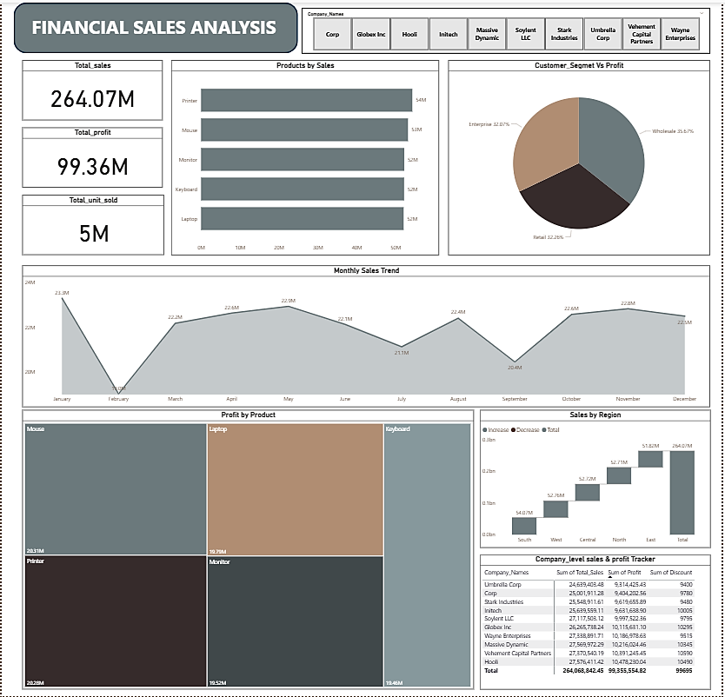

Slide 11
Conclusion
The Financial Sales Dashboard delivers a clear view of business performance across Russia for 2023. It highlights consistent growth, profitable customer segments, and product success — empowering stakeholders to make informed, data-driven decisions for future financial planning.

Slide 12


