Slide 1
Project Title
Voice Enabled AI for Medical Diagnostics

Slide 2

CONTENTS
Abstract
Literature Survey
Existing and Proposed System
Implementation
Conclusion
1

Slide 3

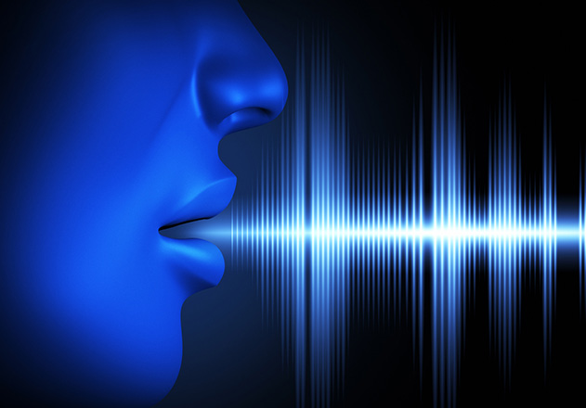
INTRODUCTION
Voice-enabled AI is changing how doctors figure out what's wrong with us. It uses talking instead of typing to help doctors understand our health better. It also lets us keep an eye on our health ourselves. This new way of doing things makes healthcare easier and more accurate for everyone.
2

Slide 4
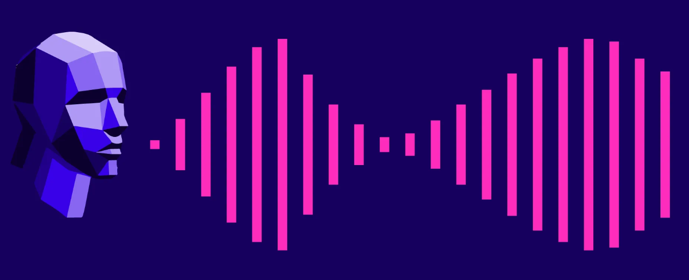
ABSTRACT
In the realm of healthcare, the integration of voice technology with artificial intelligence has ushered in a revolutionary approach to medical diagnostics.
Voice-enabled AI systems have the remarkable ability to understand and analyze spoken language, simplifying the process of gathering vital health information. This innovation not only assists healthcare professionals in making more precise diagnoses but also empowers individuals to take an active role in monitoring their own health.
This transformative synergy of cutting-edge technology and natural human communication promises to make healthcare more accessible, accurate, and patient-centered, potentially redefining the way we perceive and access medical diagnostics in the future.
3

Slide 5
LITERATURE SURVEY
S.No | Published Year | Author and Journal | Findings
1 | 2002 | Ngai and Wat | The initial classification is made to know how advanced technologies and enable various sectors.
2 | 2007 | Kitchen ham and charters | A systematic review in means of identifying, evaluating and interpreting all available research relevant to a particular research question, topic, or phenomenon of interest.
3 | 2015 | Boell and Cecez-Kecmanovic | The systematic process should be reproducible, objective, transparent, unbiased and rigorous.
4 | 2018 | Ali et al | Made his contribution to investigate how cloud computing benefits the healthcare sector and to investigate how blockchain technology benefits the finance sector.
4

Slide 6
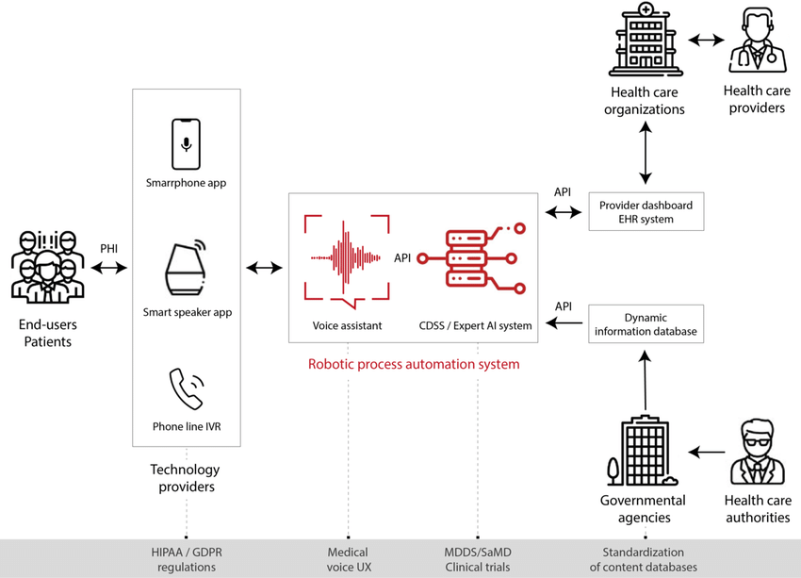
PROPOSED SYSTEM
PROPOSED SYSTEM
The proposed system introduces a comprehensive electronic health record (EHR) system to replace the existing manual record-keeping.
Patients can access their records online, schedule appointments through a user-friendly web portal, and receive automated appointment reminders via email or SMS.
The proposed system also includes features like prescription management, billing, and reporting tools to enhance the overall efficiency and quality of patient care.
5

Slide 7

IMPLEMENTATION
Users interact with the AI system by speaking into a microphone or a voice-enabled device. The system captures their voice input. The AI system utilizes speech recognition technology to convert the spoken words into text or structured commands, making the user's voice input machine-readable.
The converted text is processed by the NLP module. NLP helps extract relevant information, such as symptoms, medical history, and patient descriptions, from the user's input. The AI system employs a machine learning or deep learning model trained on vast medical data. This model analyzes the extracted information to make medical assessments and diagnoses based on patterns and medical knowledge.
The system generates a written response or structured output that includes a medical diagnosis, treatment recommendations, and educational information. The text-based response is transformed into spoken words using TTS technology, making it accessible and understandable to the user.
The AI communicates the diagnosis and recommendations to the user in a natural and understandable voice through a user interface or a voice assistant.
The system can integrate with electronic health records (EHR) and other healthcare
infrastructure to access the patient's medical history and provide a comprehensive
view of their health.
6

Slide 8

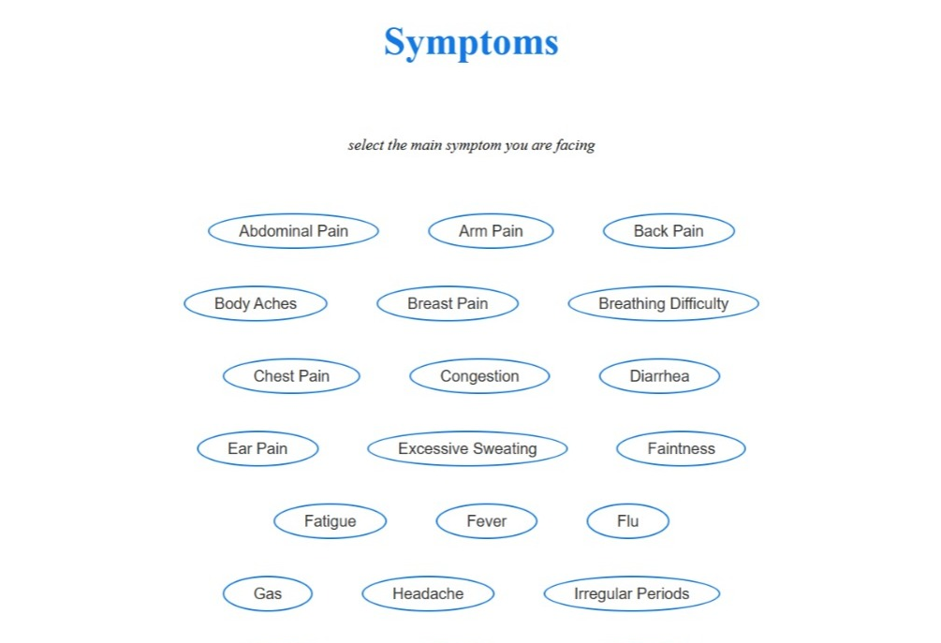
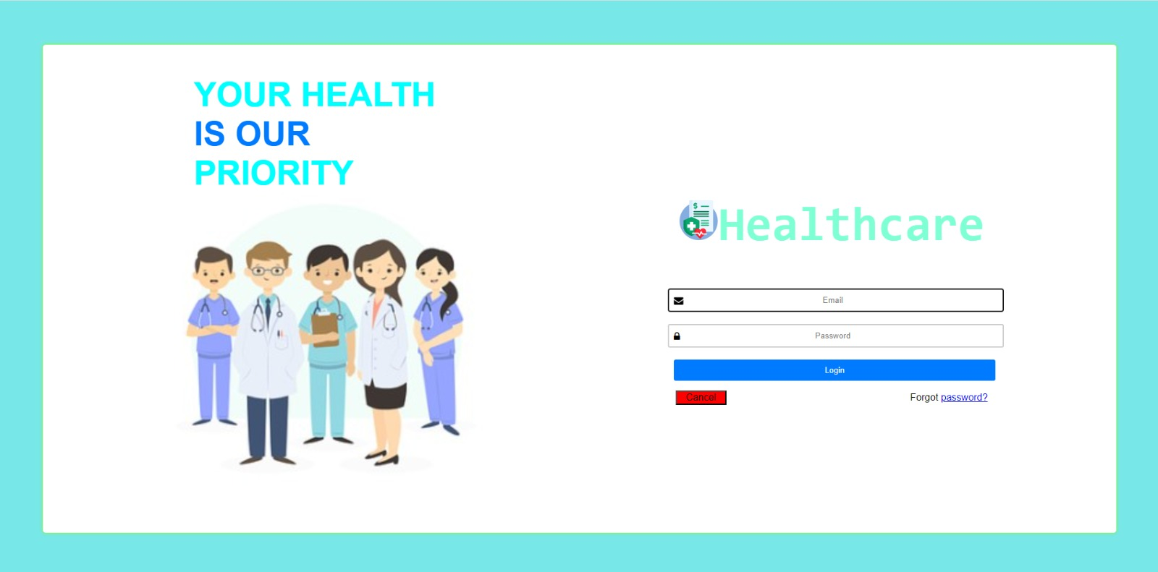
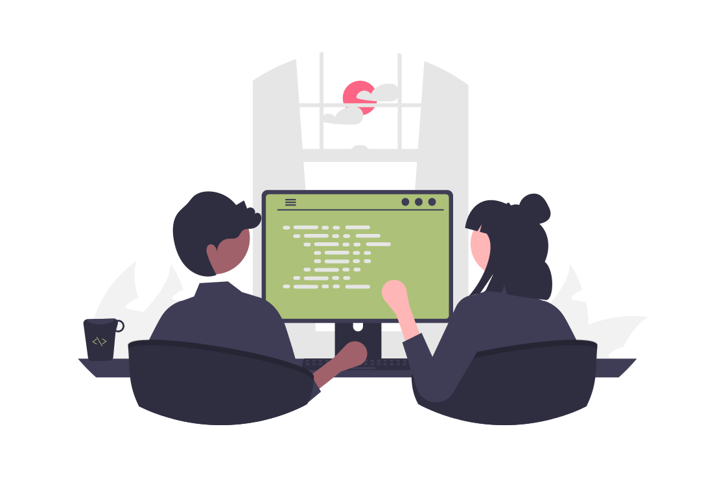

STATUS
WEBSITE [ FRONTEND ]
GIT HUB LINK
7

Slide 9
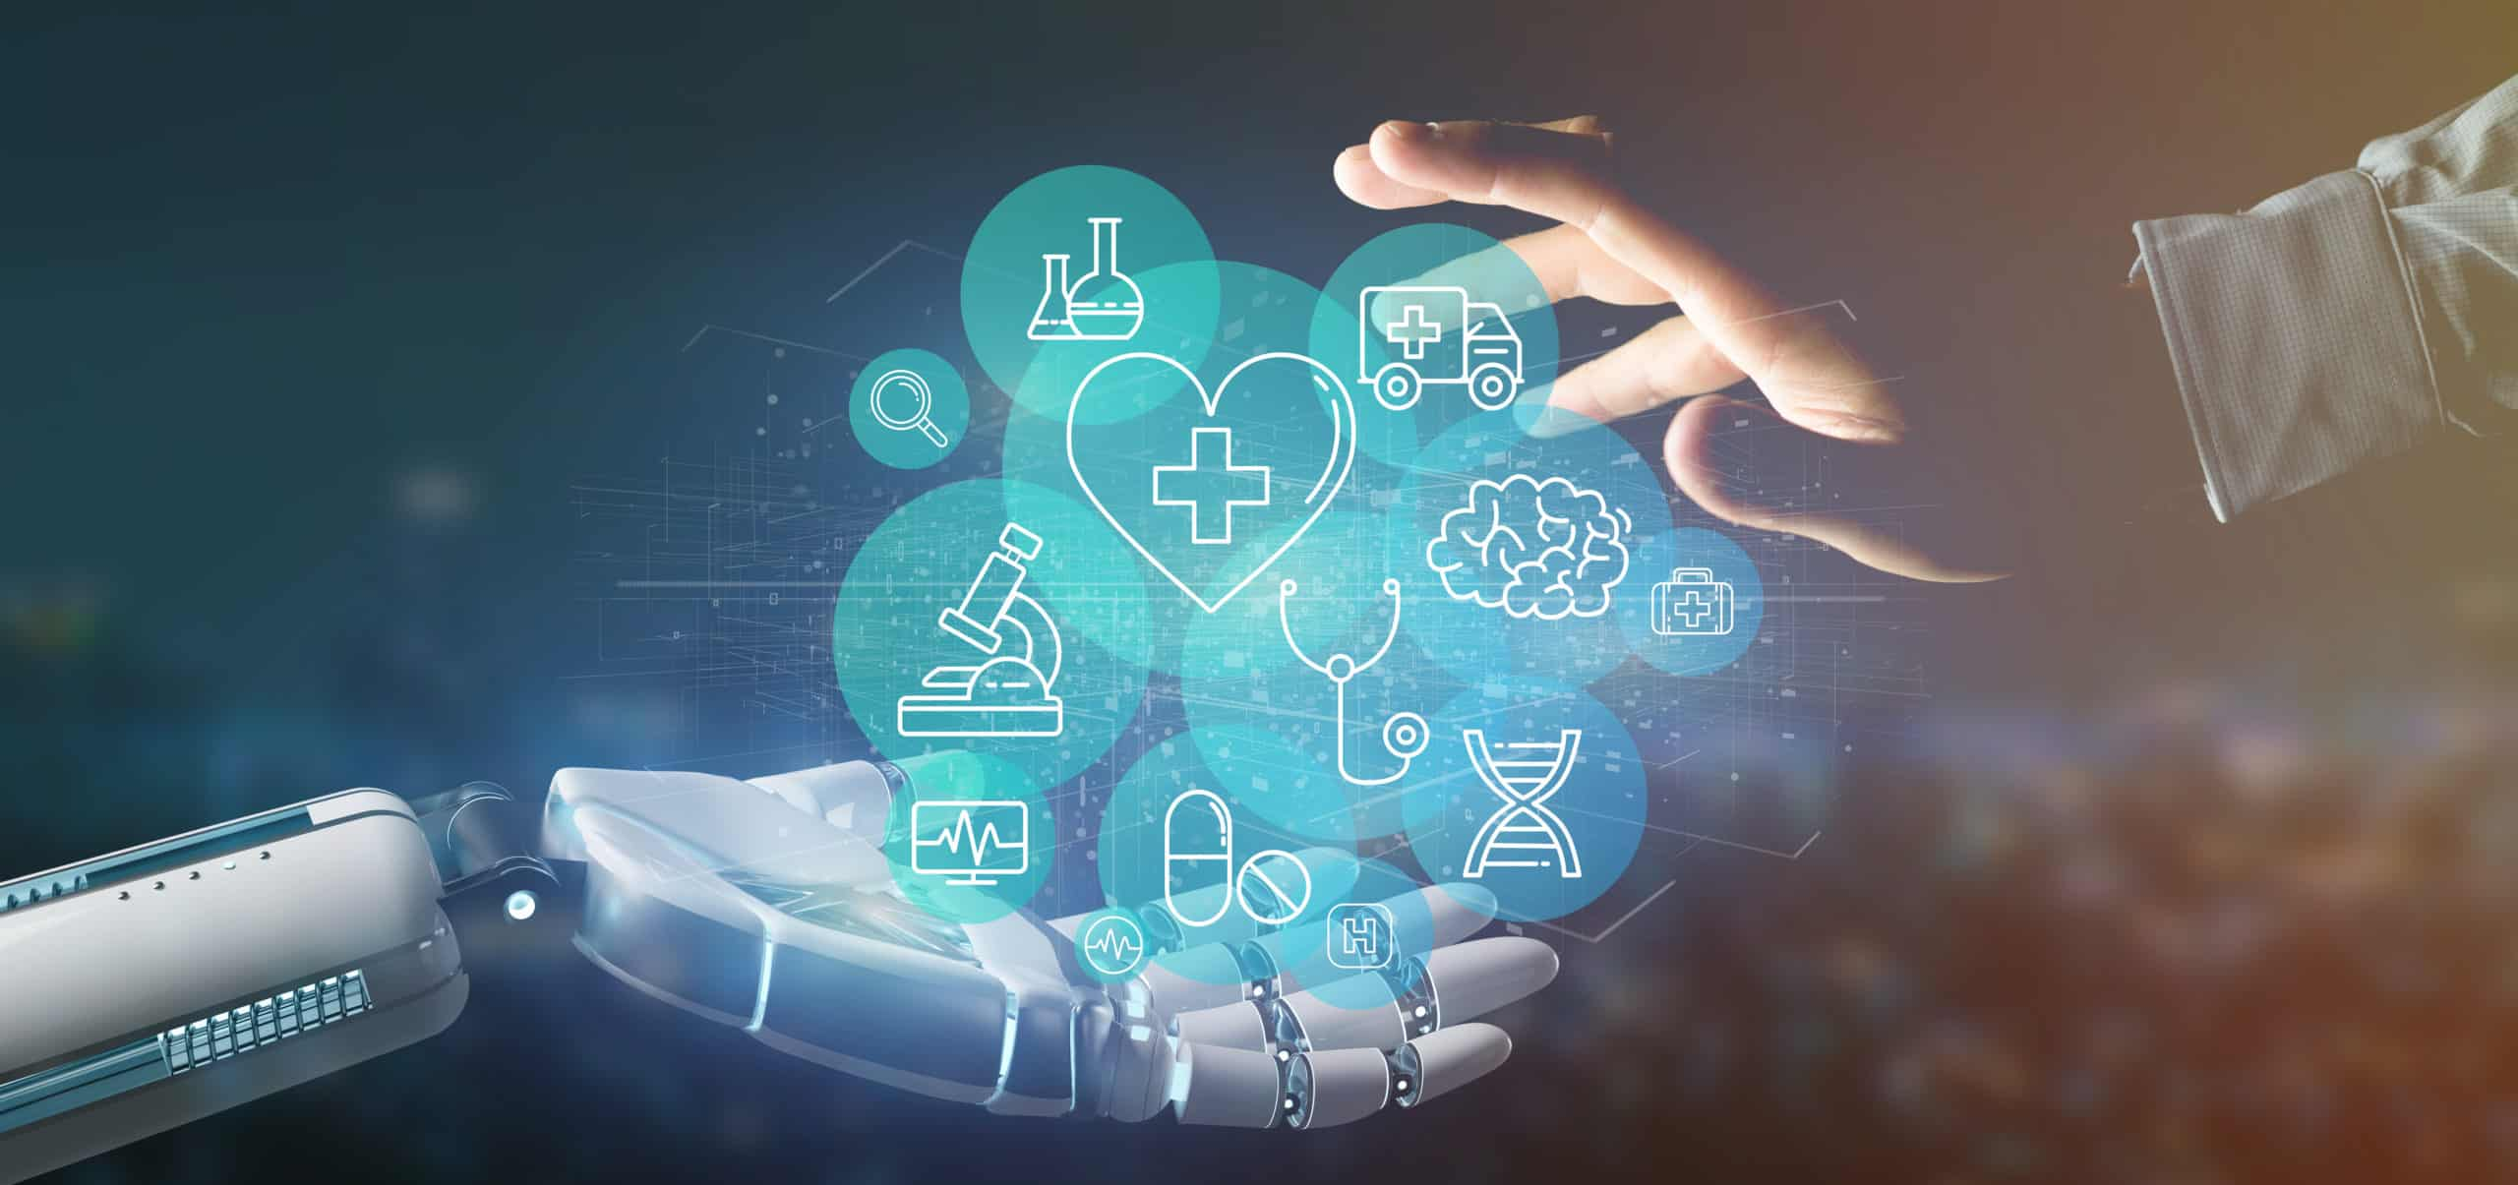
CONCLUSION
In conclusion, Voice-Enabled AI for medical diagnosis represents a transformative leap in healthcare technology, redefining the way patient information is collected, diagnoses are made, and healthcare professionals interact with their patients.
This innovative approach harnesses the power of speech recognition, natural language processing, and artificial intelligence to streamline the entire diagnostic process.
8

Slide 10

Thank You

