Slide 1
Video-Based Sign Language Gesture Accuracy Prediction using CNN-RNN Model
BY
312420104136-SAISHYAM R
312420104165-SURENDAR R

Slide 2
INTRODUCTION
The world is hardly live without communication, no matter whether it is in the form of texture, voice or visual expression. Gestural communication is always in the scope of confidential and secure communication.
Sign language is a form of gesture used by the deaf and dumb community for communication when audio is impossible, typing and writing are difficult. It has regional variations like ISL and ASL, and can be performed using one or two hands in isolated or continuous forms.
Gesture recognition technology can greatly benefit the deaf and hard-of-hearing community, improving their ability to communicate with the hearing world

Slide 3
MOTIVATION
Sign language is learned by deaf and dumb, and usually it is not known to normal people, so it becomes a challenge for communication between a normal and hearing impaired person.
Its strike to our mind to bridge the between hearing impaired and normal people to make the communication easier.
Sign language gesture recognition from video sequences using CNNs and RNNs shows great potential and could help improve communication for people who use sign language.

Slide 4
OBJECTIVE
The primary objective is to improve communication between the deaf and hard-of-hearing community and the hearing community.
The project involves developing and training CNN and RNN models, testing the system's accuracy and efficiency, evaluating its performance using relevant metrics, exploring potential applications in real-world scenarios, and identifying areas for future research and development.

Slide 5
LITERATURE REVIEW
Author | Publication | Year | Problem | Methodology | Remark
H. Alabkari, H. Elgibreen, and M. R. Al-khaldi | International Conference on Computing, Networking and Communications (ICNC) | 2019 | Recognizing Sign Language Recognition | CNN | Proposes a sign language recognition system using CNN that achieves high accuracy rates on a publicly available dataset.
M. Al-Rousan, M. Al-Fahoum, A. Al-Rababah | International Conference on Advanced Machine Learning Technologies and Applications (AMLTA) | 2020 | recognizing Arabic Sign Language Recognition | Deep Neural Networks | Presents a deep learning-based approach for recognizing Arabic sign language gestures with high accuracy rates.
Tripathi, Kumud, and Neha Baranwal GC Nandi | Procedia Computer Science | 2015 | Continuous Indian Sign Language Gesture Recognition and Sentence Formation | Hidden Markov Model (HMM) with context-free grammar rules | presents a system for continuous Indian sign language recognition in video sequences with high accuracy rates.
A. Hamad, H. Aly, and F. E. Abd El-Samie | IEEE | 2019 | Recognizing real-time hand gesture recognition for ASL | CNN | Presents a real-time system for Arabic sign language recognition using CNN that achieves high accuracy rates.

Slide 6
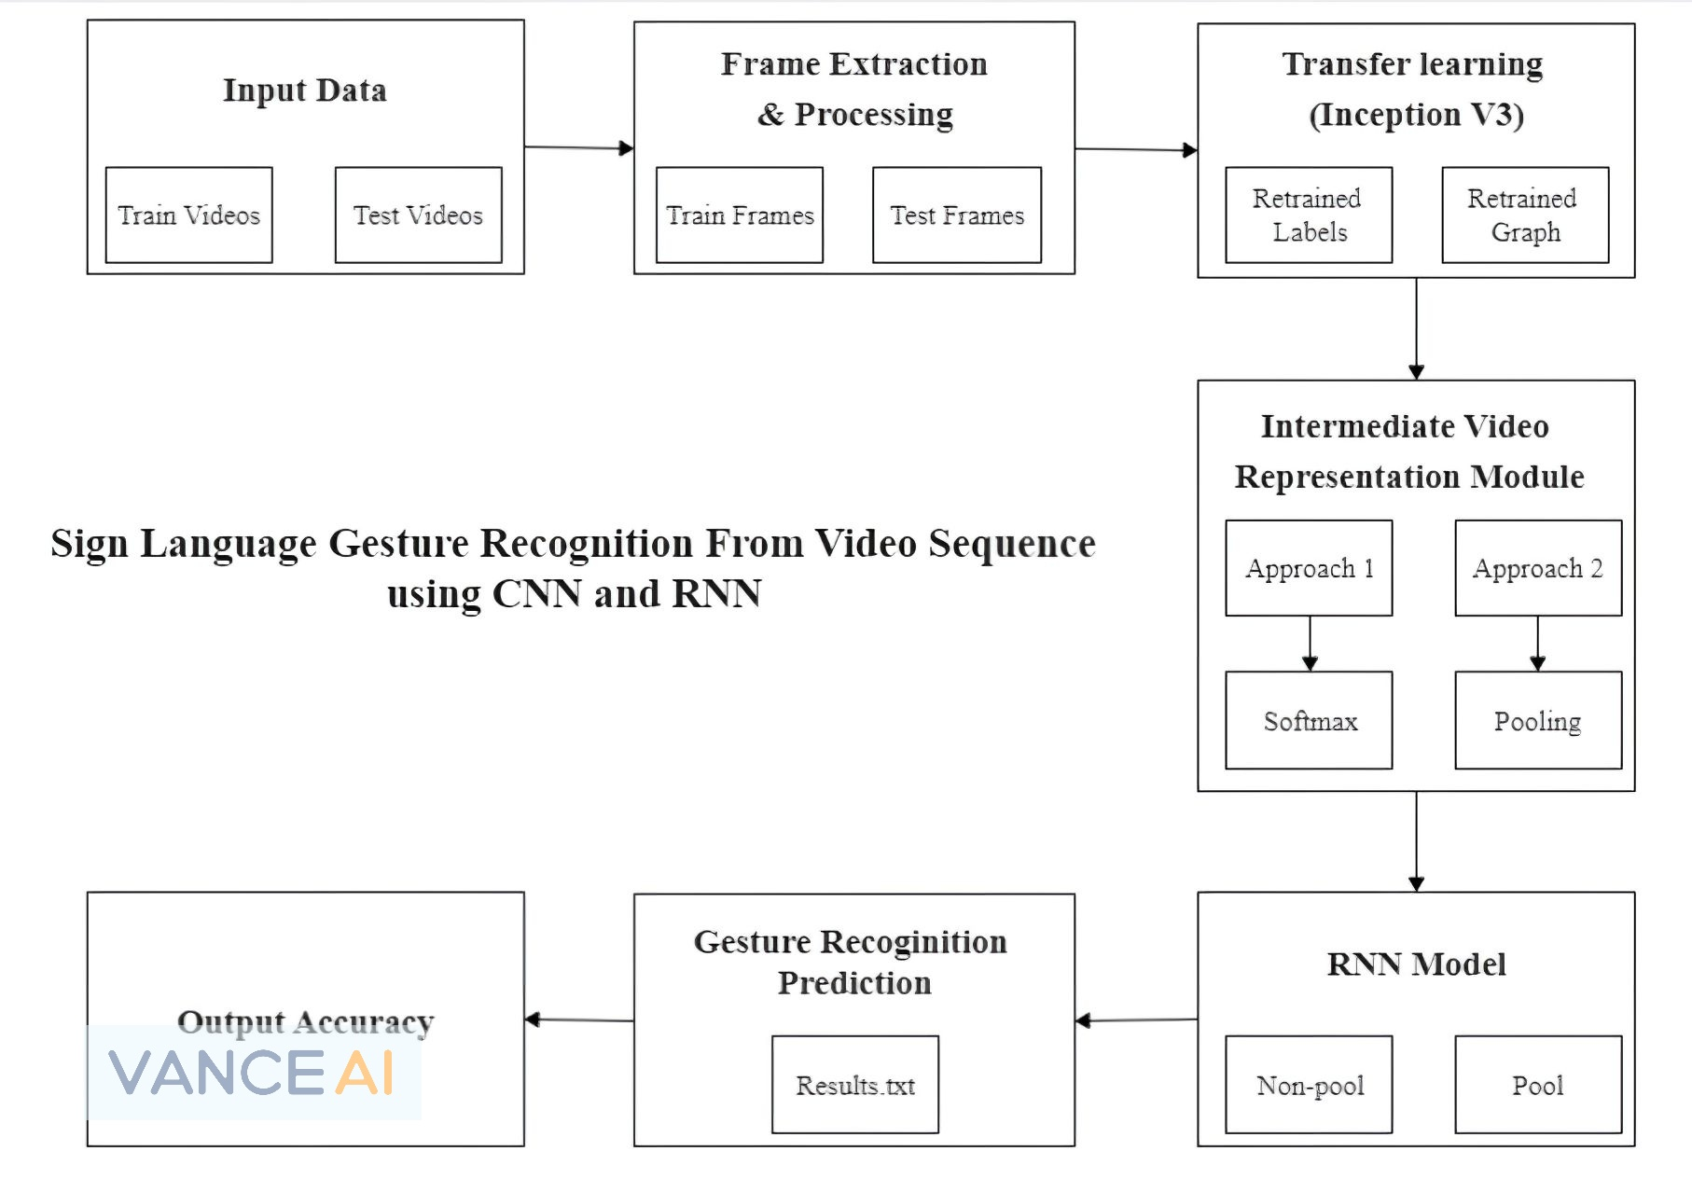
SYSTEM ARCHITECTURE
Output Accuracy
Architecture Diagram

Slide 7
The project architecture includes datasets, data pre-processing, data extraction, and training using CNN and RNN algorithms to recognize hand gestures in videos.
The dataset consists of 200 videos of Argentinian Sign Language (LSA) gestures, which is unique as it is not widely studied.
Data preparation involves creating two folders for training and testing videos, with subfolders for each gesture category.
Frames are extracted from each video and transferred to the Inception v3 image classification model for gesture recognition.
The output of SoftMax or last pool layer is used to represent videos as a sequence of n-dimensional vectors or 2048-dimensional vectors, which are stored separately for training and testing data.

Slide 8
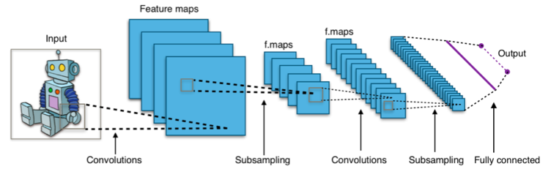
ALGORITHMS
Convolutional Neural Network (CNN):
Neural networks, as its name suggests, is a machine learning technique which is modeled after the brain structure. It comprises of a network of learning units called neurons. These neurons learn how to convert input signals into corresponding output signals forming the basis of automated recognition. A convolutional neural network is a type of feed­forward artificial neural network in which the connectivity pattern between its neurons is inspired by the organization of the animal visual cortex.
1.1 CNN Summarized in 4 Steps:
There are four main steps in CNN: convolution, subsampling, activation and full connectedness.
Typical Convolutional Neural Network Architecture

Slide 9
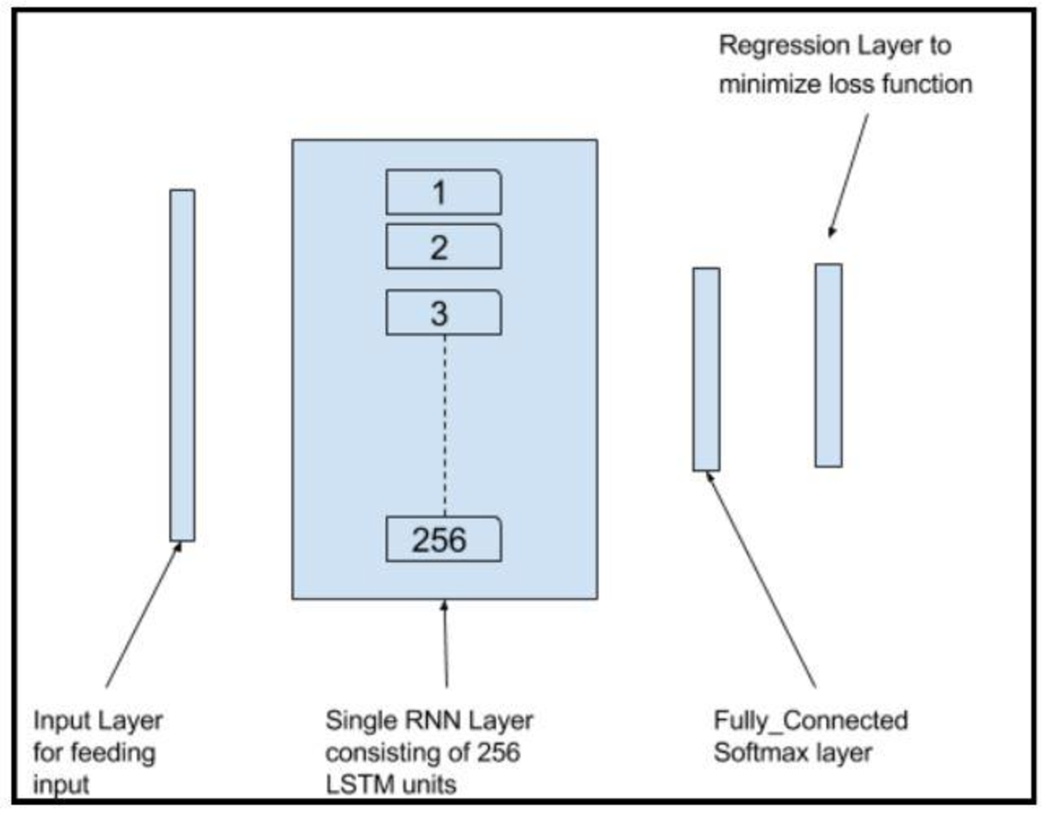
2. Recurrent Neural Network (RNN) :
Humans don’t start their thinking from scratch every second. We don’t throw everything away and start thinking from scratch again. Our thoughts have persistence. Traditional neural networks can’t do this but Recurrent Neural Networks can. There is information in the sequence itself, and recurrent nets use it to perform tasks that feedforward networks can’t.
Recurrent networks are distinguished from feedforward networks by the fact that they have feedback loop, ingesting their own outputs moment after moment as input. They’re especially useful with sequential data because each neuron or unit can use its internal memory to maintain information about the previous input.
RNN Model

Slide 10
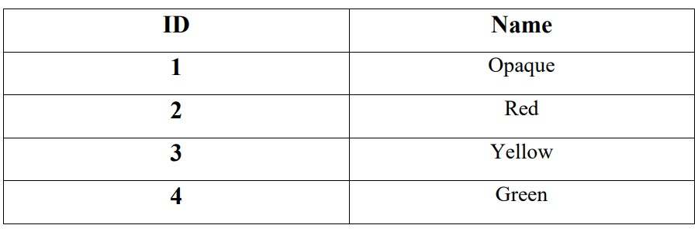
EXPERIMENTAL DESIGN
We have used two approaches to train the model on the temporal and the spatial features. Both approaches differ by the inputs given to RNN to train it on the temporal features
Data Set Used:
The data set used for both the approaches consists of Argentinian Sign Language(LSA) Gestures, with around 200 videos belonging to 4 gestures categories. 10 non-expert subjects executed the 5 repetitions of every gesture thereby producing 50 videos per category or gesture.
Out of the 50 gestures per category, 75% i.e. 40 were used for training and 25% i.e. 10 were used for testing.

Slide 11
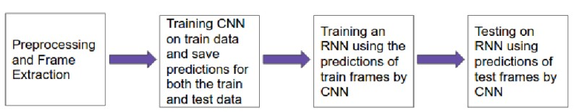
2. Methodology:
First, we will extract the frames from the multiple video sequences of each gesture.
After the first step, noise from the frames i.e background, body parts other than hand are removed to extract more relevant features from the frame.
Frames of the train data are given to the CNN model for training on the spatial features. We have used inception model for this purpose which is a deep neural net.
Store the train and test frame predictions. We’ll use the model obtained in the above step for the prediction of frames.
The predictions of the train data are now given to the RNN model for training on the temporal features. We have used LSTM model for this purpose.

Slide 12
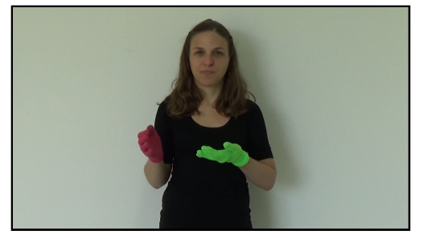
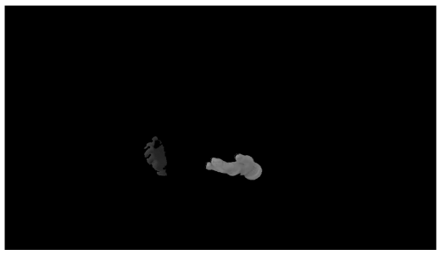

3. Frame Extraction and Background Removal:
Each video gesture video is broken down into a sequence of frames. Frames are then processed to remove all the noise from the image that is everything except hands. The final image consists of grey scale image of hands to avoid color specific learning of the model
One of the Extracted Frames
Frame after extracting hands (Background Removal)

Slide 13
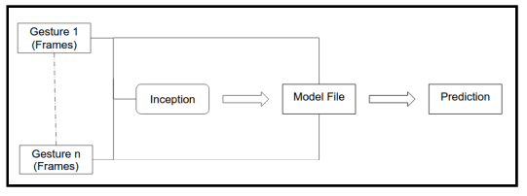
4. Train CNN(Spatial Features) and Prediction:
The first row in the below illustration is the video of a gesture Elephant. The second row shows the set of frames extracted from it. The third row shows the sequence of predictions for each frame by CNN after training it.
Train CNN and Prediction

Slide 14
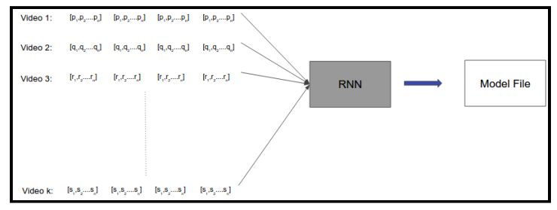
5. Training RNN (Temporal Features):
Train RNN Illustration
6. Limitations:
The length of a probabilistic prediction by CNN in the sequences of predictions of frames is equal to the number of classes to be classified. In our case it is equal to 4 because we have 4 classes to classify. Therefore the length of feature vector of each frame for the RNN is dependent upon the number of classes to be classified. Less are the number of classes, less would be the length of feature vector for each frame.

Slide 15
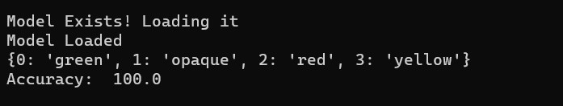
RESULTS
Result of Approach 1
Average accuracy obtained using this approach is 100%
Result of Approach 2
The second approach also provided a better accuracy as first approach because of the fact that in the first approach the input to the RNN was a sequence of 46 dimensional prediction while in the second approach the RNN was being given a sequence of 2048 dimensional pool layer output. This gave RNN more number of feature points to distinguish among different videos.

Slide 16
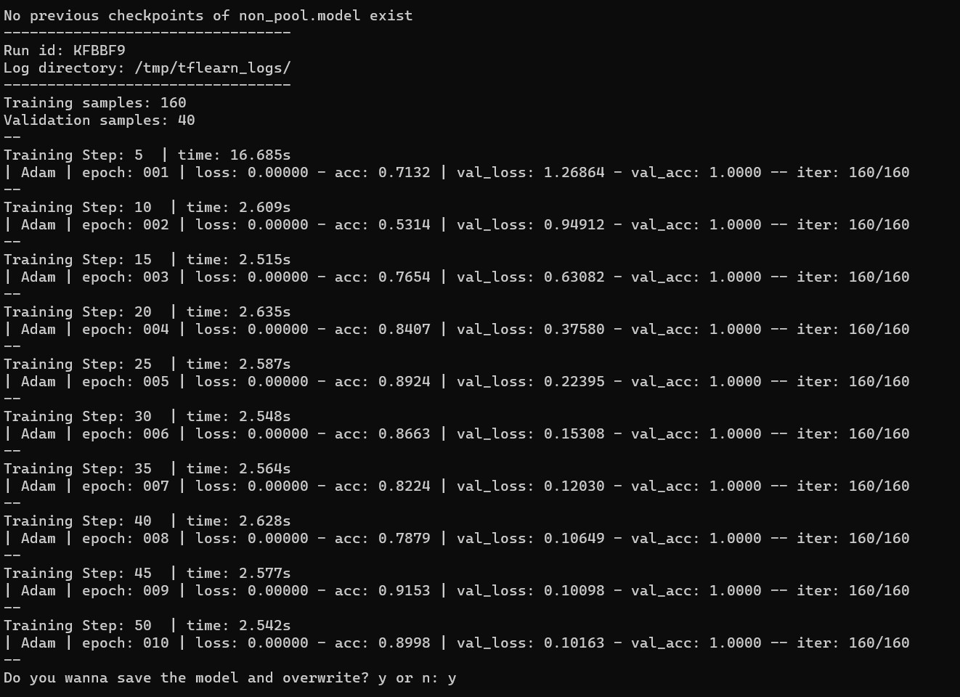
Performance Analysis
Approach 1

Slide 17
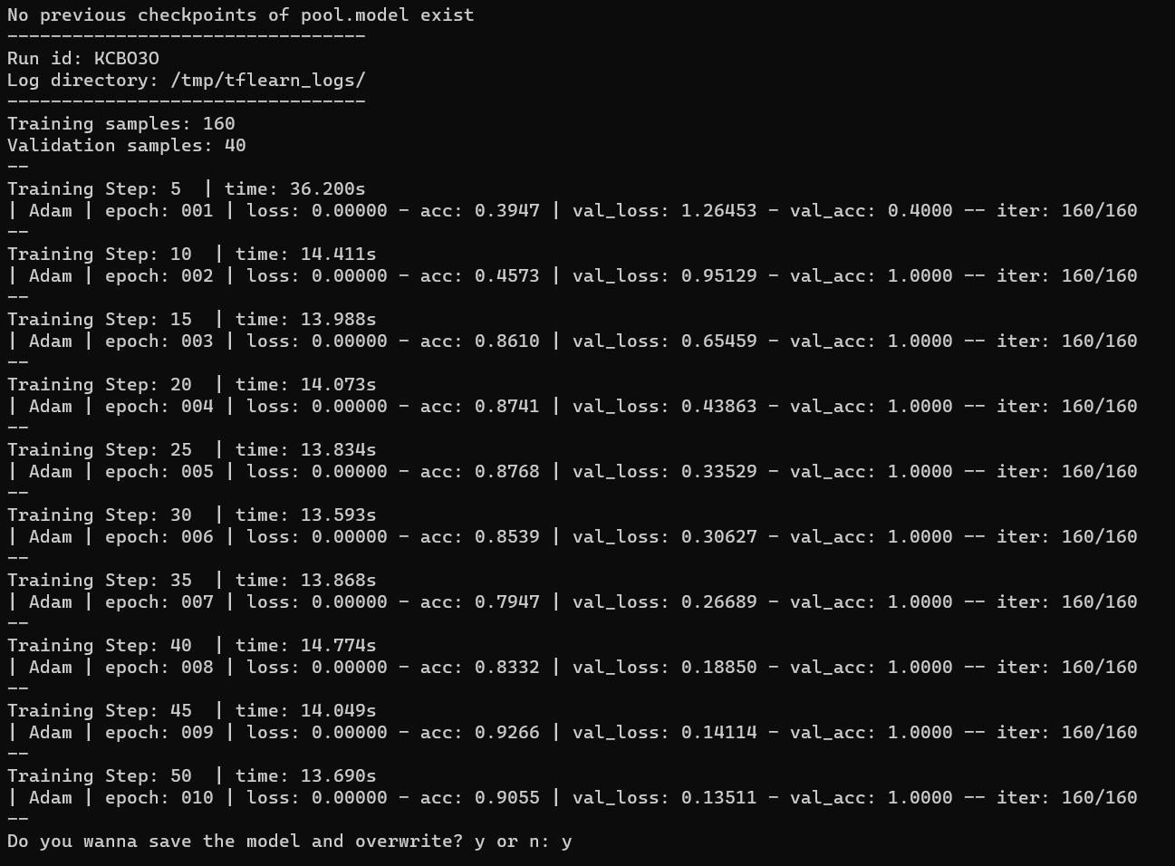
Approach 2

Slide 18
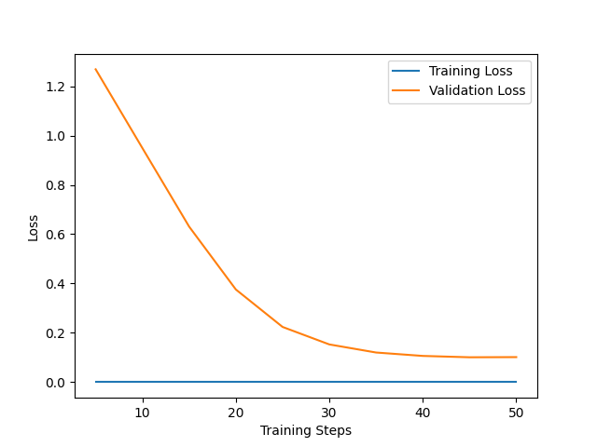
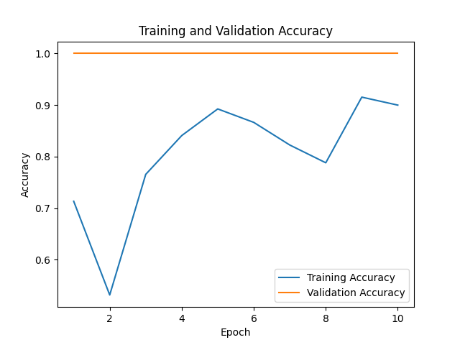
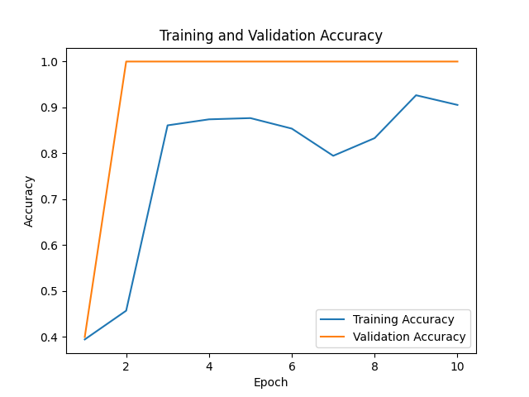
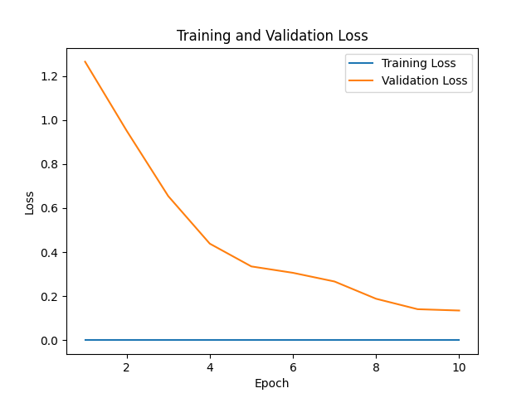
Graph Analysis
Approach 1 Accuracy
Approach 1 Loss
Approach 2 Accuracy
Approach 2 Loss

Slide 19
CONCLUSION AND FUTURE WORK
In conclusion, the report presented a successful system for recognizing isolated hand gestures from the Argentinian Sign Language (LSA) using both spatial and temporal features. The use of Convolutional Neural Network (CNN) and Recurrent Neural Network (RNN) models achieved an accuracy of 100% in classifying the gestures. The report also identified the challenge of recognizing continuous sign language gestures and proposed further work on real-time gesture recognition for individual gestures and sentence-level sign language.
For future work, the focus could be on combining the CNN and RNN models into a single model to improve the overall efficiency and accuracy of the system. Additionally, exploring the use of different datasets and incorporating other features such as facial expressions and body language could enhance the recognition of sign language gestures. The proposed system could also be tested and evaluated in different contexts and environments to assess its performance in real-world scenarios.

Slide 20
REFERENCES
[1] H. Alabkari, H. Elgibreen, and M. R. Al-khaldi, "Sign Language Recognition Based on Convolutional Neural Networks," in Proceedings of the 2019 International Conference on Computing, Networking and Communications (ICNC), 2019.
[2] M. Al-Rousan, M. Al-Fahoum, and A. Al-Rababah, "Arabic Sign Language Recognition System Using Deep Neural Networks," in Proceedings of the 2020 International Conference on Advanced Machine Learning Technologies and Applications (AMLTA), 2020.
[3] Tripathi, Kumud, and Neha Baranwal GC Nandi. "Continuous Indian Sign Language Gesture Recognition and Sentence Formation." Procedia Computer Science 54 (2015): 523-531.
[4] A. Hamad, H. Aly, and F. E. Abd El-Samie, "Real-Time Hand Gesture Recognition for Arabic Sign Language Using Convolutional Neural Network," in Proceedings of the 2019 IEEE 9th Annual Computing and Communication Workshop and Conference (CCWC), 2019

Slide 21

THANK YOU

