Slide 1
2016 Fall UMKC Hackathon
Team Doritos (ASE – Team 16):
Rajesh Gupta, Kollipara (21)
Sai Sriharsha Sudulaguntla (50)
Lava Kumar, Surparaju (52)
Raghu Pavan, Vallamkonda (54)

Slide 2
Investment Plan Analytics:
Problem statement:
Design a web application to collect the customer information and to process them and obtain a best possible to the investor.
Implementation details:
Designed a web application using java servlet application.
Collected the sample 401k data, analyzed & processed the data using MySQL DB.
Collected the input criteria from customer and provided a best possible investment plan.

Slide 3
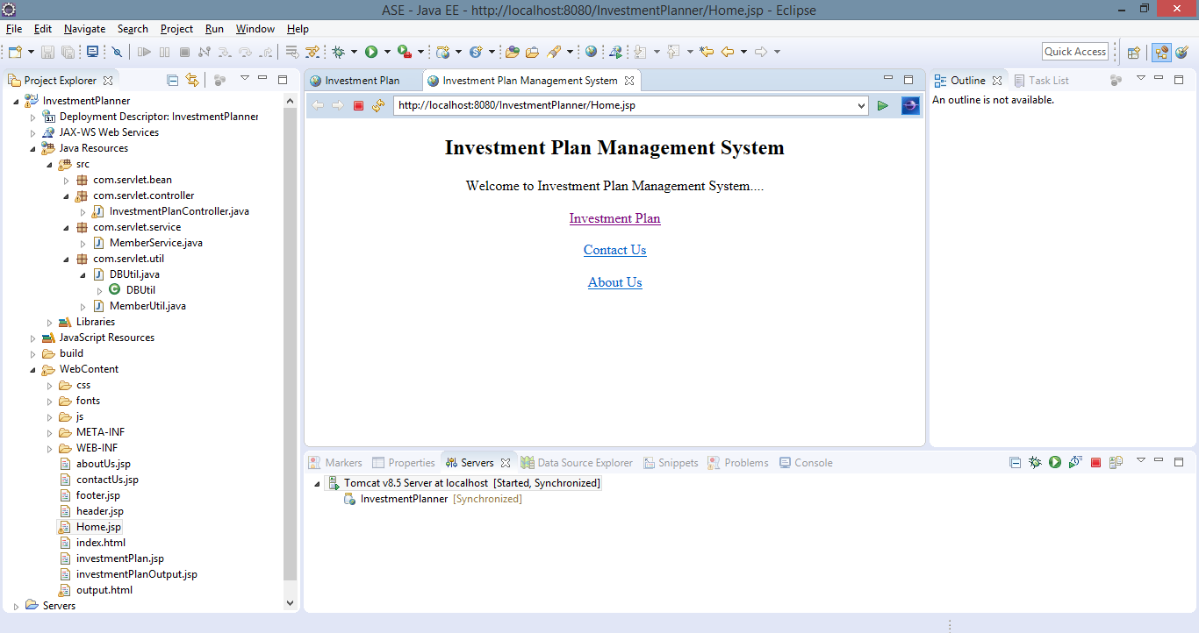
Web Application:
Home Screen:

Slide 4
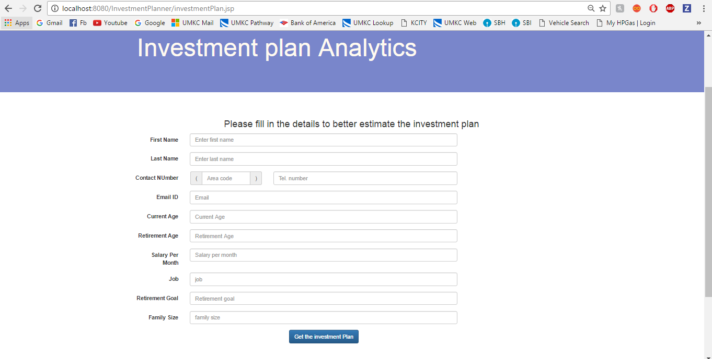
Web Application:
Home Screen: Customer Input screen:

Slide 5
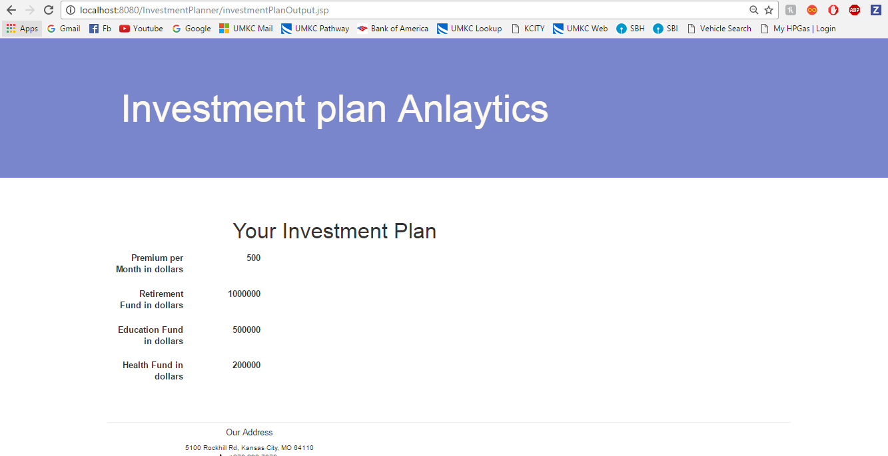
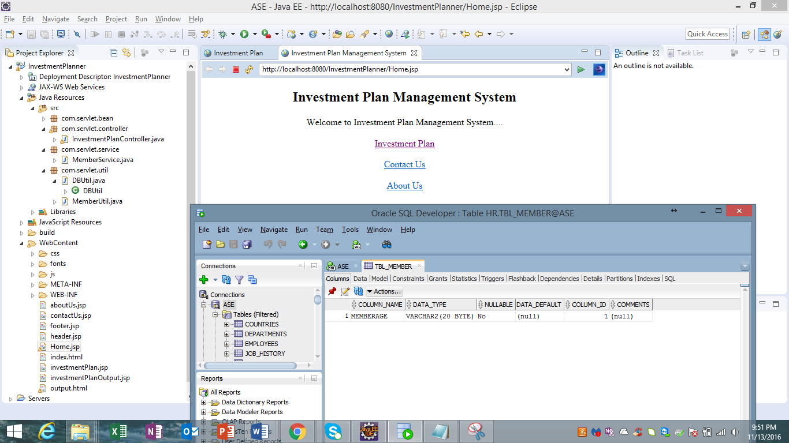
Web Application:
Investment Plan: SQL Data base:

