Slide 1

WEB DESIGN
Designing Your Future !
Done by: jasmeen Kathuria, darice Milliken, lesiy moliner & jose marcano

Slide 2
Welcome To KM3
Professional Software Development Company
Created in Object Oriented Software Development Class
Known for Website Services, such as building websites, providing designs, hosting services, payment options e-commerce, and marketing.

Slide 3
A Website From Us
Includes 4/5 Pages
2 Forms
Social Media Icons
Map For Contact Page
Designing a logo
Blog/Newsletter
E-commerce
Chat Window
Tech Support

Slide 4
Hosting Services
A web hosting service is a type of Internet hosting service that allows individuals and organizations to make their website accessible. Two important details
Availability
Uptime
Downtime
SLA

Slide 5
Hosting Services Continued
Types of Web Hosting Services
Free web hosting service
Shared web hosting service
Reseller web hosting
Virtual Dedicated Server
Dedicated hosting service
Managed hosting service
Colocation web hosting service
Cloud hosting
Clustered hosting
Grid hosting
Home server

Slide 6

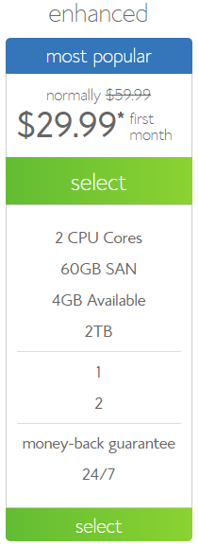
KM3 Recommendations
BLUEHOST
Web hosting company owned by Endurance International Group. It is one of the 20 largest web hosts, hosting over 1.9 million domains. Offers:
Shared hosting
Virtual Dedicated Server
Dedicated server hosting

Slide 7
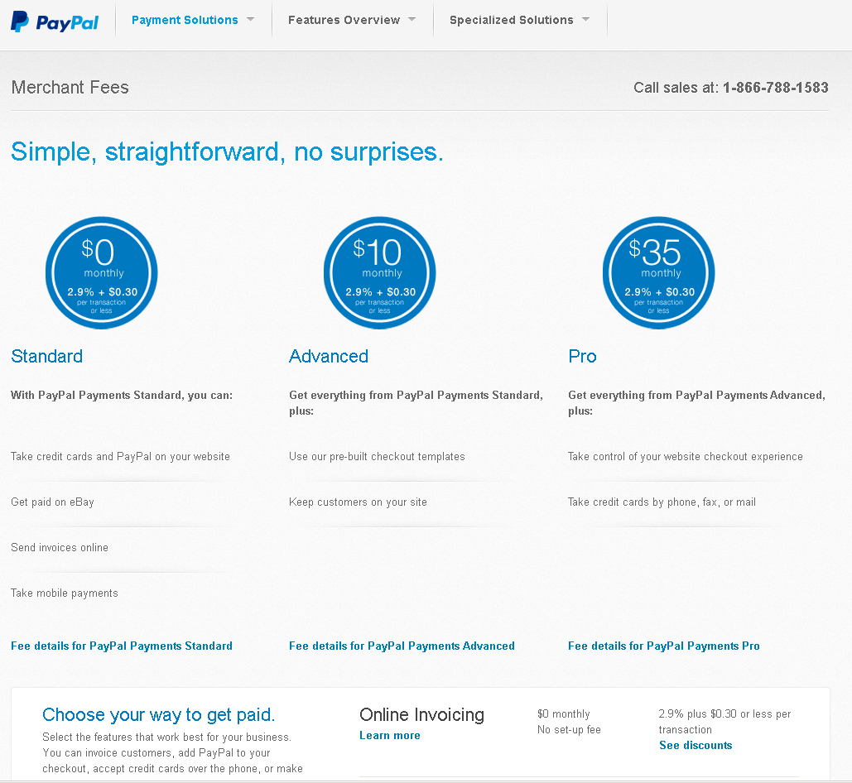
Merchant Account
PayPal

Slide 8
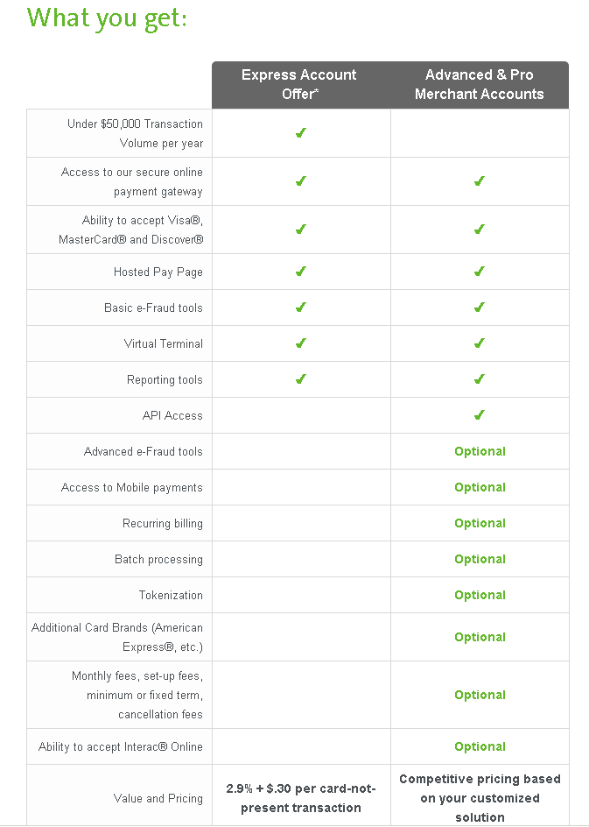
Merchant Account
Moneris

Slide 9
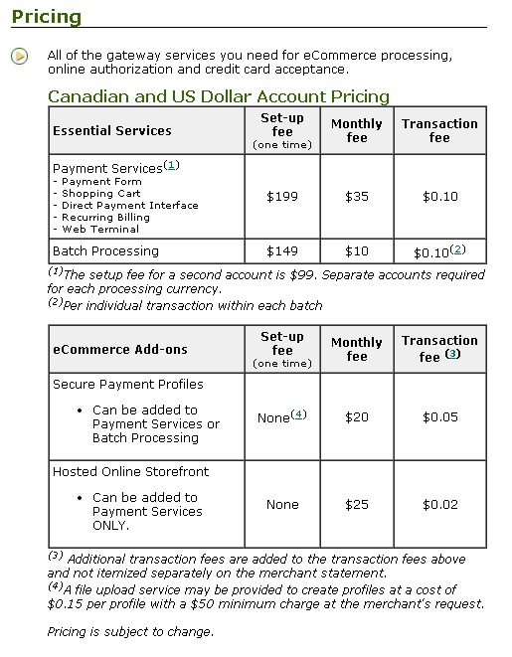
Merchant Account
TD Canada Trust

Slide 10
Merchant Account
Criteria/ Banks | Set Up Fee | Monthly Fee | Transaction Fee
PayPal | Free | $0 | 2.9% plus $0.30 or less per transaction
Moneris | None | None | 2.9% + $.30 per card-not-present transaction
TD | $199 | $35 | $0.10

Slide 11
Payment Options

Slide 12
E-commerce Packages Requirements

Slide 13
E-commerce Comparisons

Slide 14
KM3 Overview

Slide 15

Want To Know Us More ????
Were giving away free Information Sessions Tomorrow, Be Sure To Come !!!!!!!!

Slide 16



