Slide 1

WEB DESIGN
Designing Your Future !
Done by: jasmeen Kathuria, darcie Milliken, leisy moliner & jose marcano

Slide 2
Welcome To KM3
Professional Software Development Company
Created in Object Oriented Software Development Class
Known for Website Services, such as building websites, providing designs, hosting services, payment options e-commerce, and marketing.

Slide 3
WEBSITE

Slide 4
A Website From Us
Includes 4/5 Pages
2 Forms
Social Media Icons
Map For Contact Page
Designing a logo
Blog/Newsletter
E-commerce
Chat Window
Tech Support

Slide 5
HOSTING

Slide 6
Hosting Services
A web hosting service is a type of Internet hosting service that allows individuals and organizations to make their website accessible.
Important details
Availability – Website is publicly reachable
Uptime vs Downtime - System itself being online
SLA (Service Level Agreement) or the Terms of Service

Slide 7
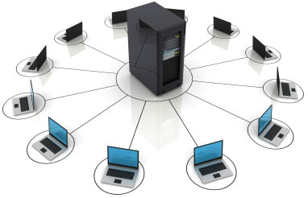
Hosting Services Continued
Types of Web Hosting Services
Free web hosting service
Shared web hosting service
Reseller web hosting
Virtual Dedicated Server
Dedicated hosting service
Managed hosting service
Colocation web hosting service
Cloud hosting
Clustered hosting
Grid hosting
Home server

Slide 8
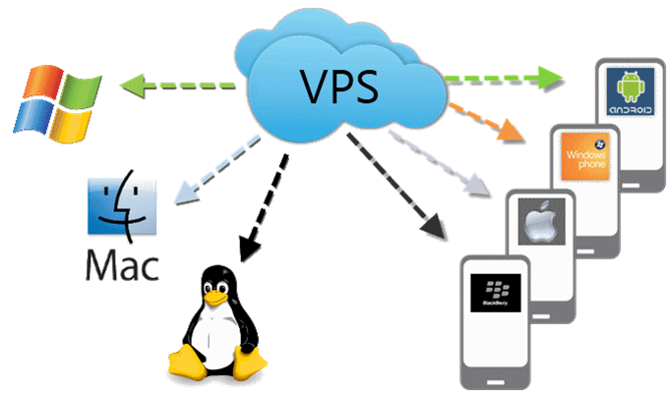
Hosting Services Continued
Types of Web Hosting Services
Free web hosting service
Shared web hosting service
Reseller web hosting
Virtual Private Server
Dedicated hosting service
Managed hosting service
Colocation web hosting service
Cloud hosting
Clustered hosting
Grid hosting
Home server

Slide 9

Hosting Services Continued
Types of Web Hosting Services
Free web hosting service
Shared web hosting service
Reseller web hosting
Virtual Private Server
Dedicated hosting service
Managed hosting service
Colocation web hosting service
Cloud hosting
Clustered hosting
Grid hosting
Home server

Slide 10
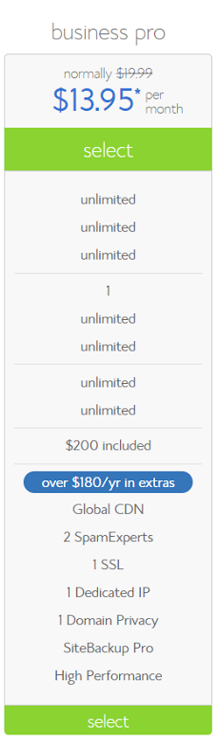
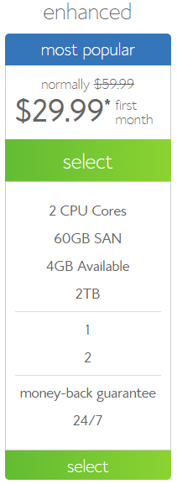
Recommendations
BLUEHOST
Web hosting company owned by Endurance International Group. It is one of the 20 largest web hosts, hosting over 1.9 million domains.
Shared hosting
Virtual Dedicated Server
Added features like CPU throttling

Slide 11
PAYMENT OPTIONS

Slide 12
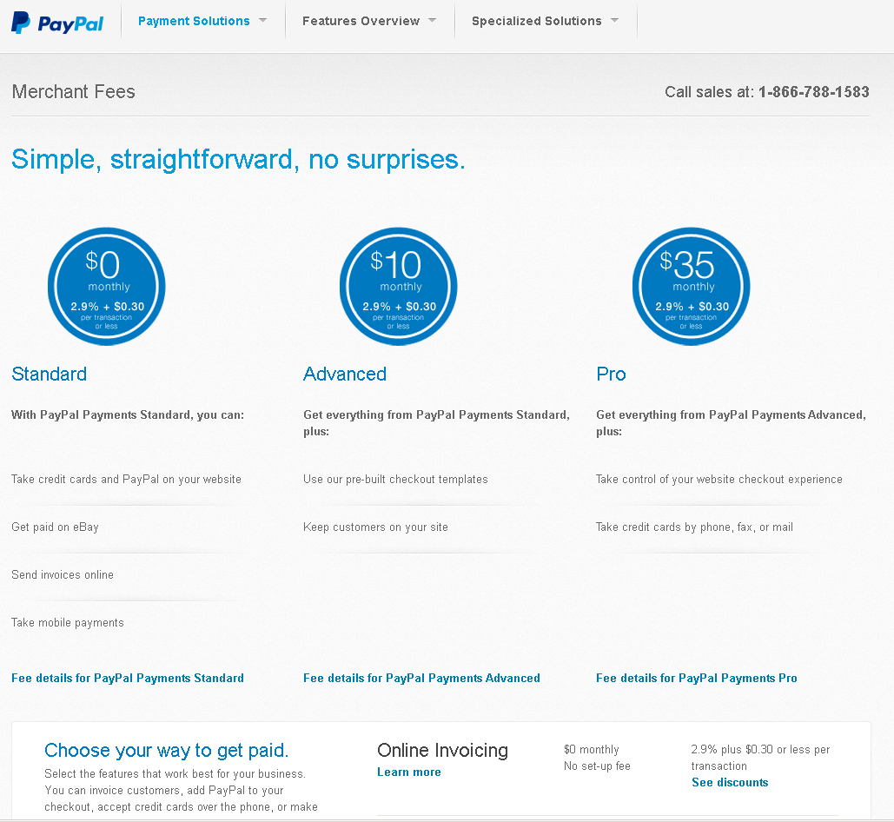
Merchant Account
PayPal

Slide 13
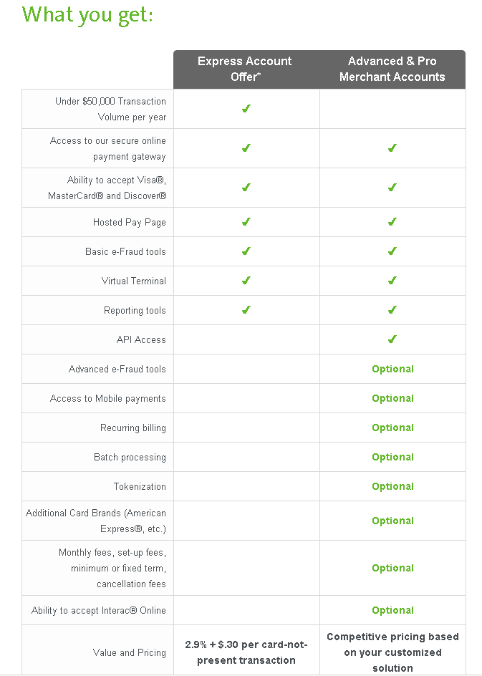
Merchant Account
Moneris

Slide 14
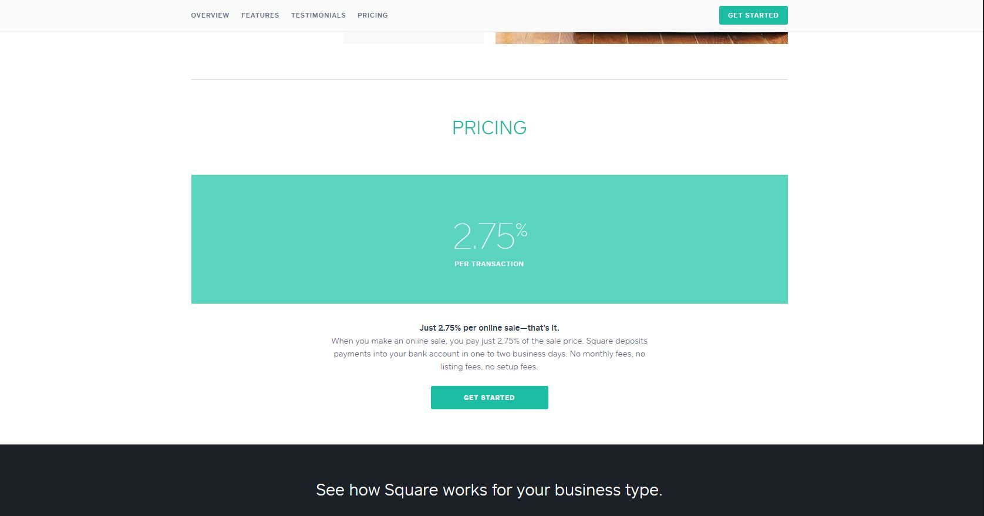
Merchant Account
Square

Slide 15
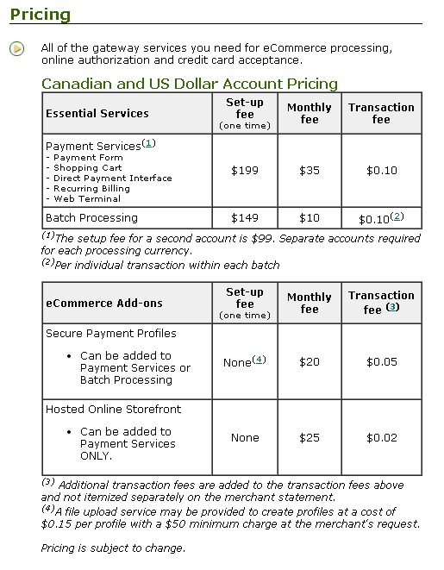
Merchant Account
TD Canada Trust

Slide 16
Payment/ Merchant Summary
Criteria/ Banks | Set Up Fee | Monthly Fee | Transaction Fee | Service Availability | Volume Discount | Debit
PayPal | Free | Free | 2.9% plus $0.30 or less per transaction | Web, Mobile | Yes | No
Moneris | Free | Free | 2.9% + $.30 per card-not-present transaction | Web, Mobile | Yes | Yes
Square | Free | Free | 2.7% + $0.30 per transaction | Mobile | No | No
TD | $199 | $35 | $0.10 | Web, Mobile | Yes | Yes

Slide 17
SHOPPING CARTS

Slide 18

E-commerce Packages Requirements
Online / In-person / Mobile
Consistent inventory management (no over-booked packages)
Ability to add options to the packages and have it reflected in the price
Flexibility to add more kinds of products later based on changing business needs

Slide 19
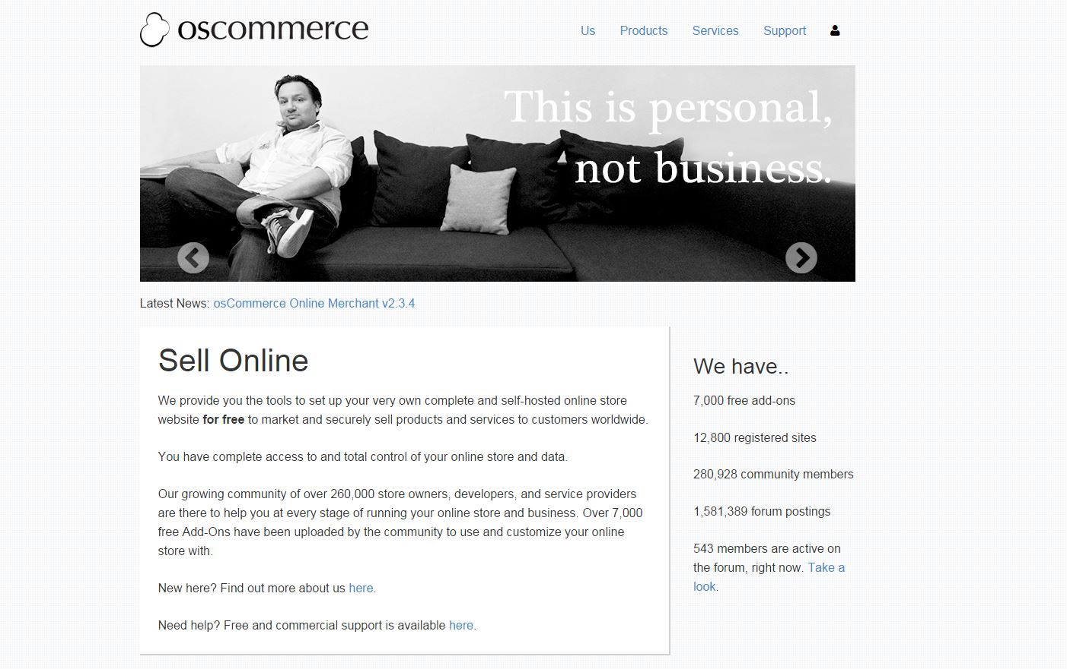
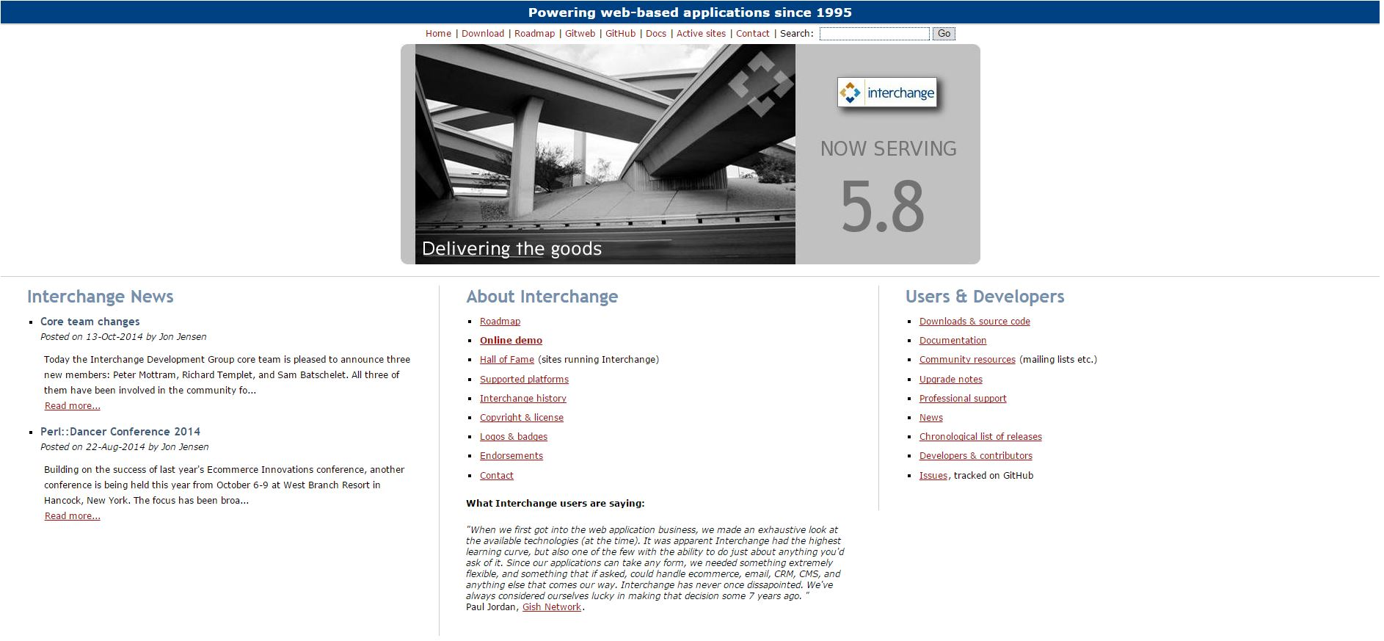
E-commerce Packages Free Options
osCommerce
Interchange

Slide 20
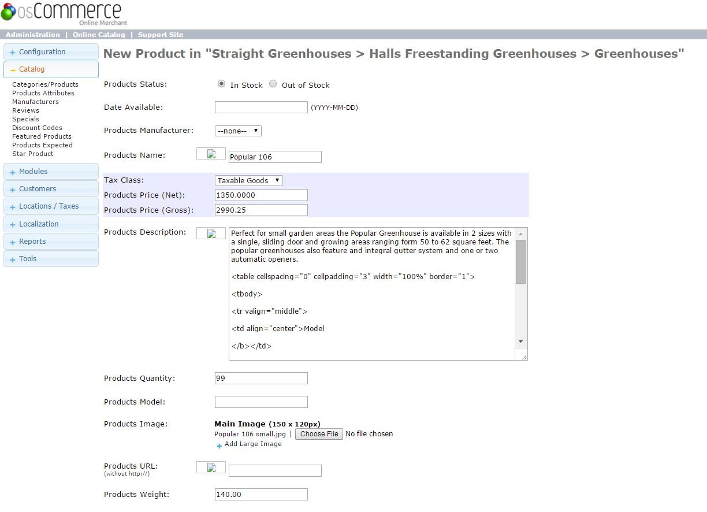
osCommerce

Slide 21
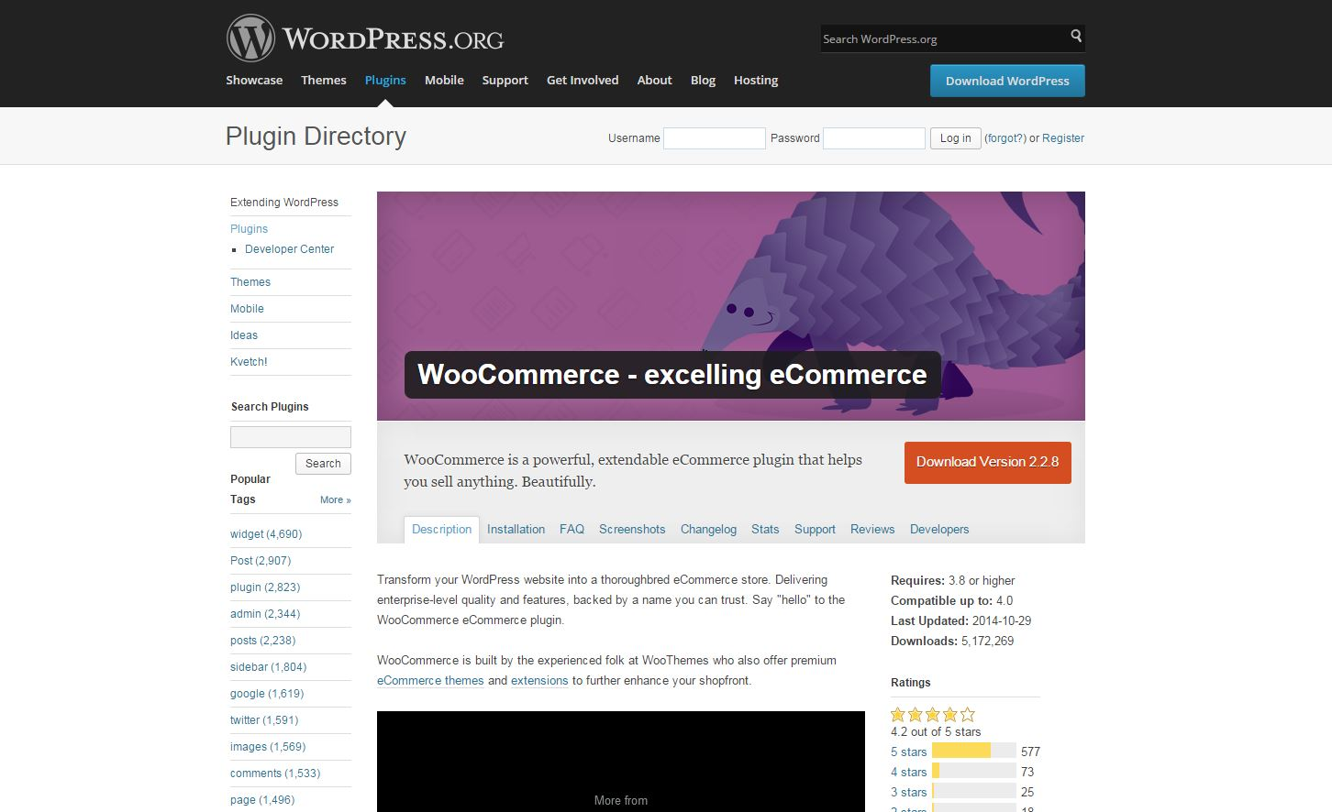
E-commerce Packages Wordpress/WooCommerce
Lots of themes and extensions
Flexible
Costs of extensions adds up
Payment extension = $79.00 Product Import Suite (import from csv) = $199.00 Product add-on extension (to add options) = $49.00 Composite Products = $79.00. Booking extension = $249.00 WooCommerce POS (in person)… etc.
Example: Golf Lesson Booking

Slide 22
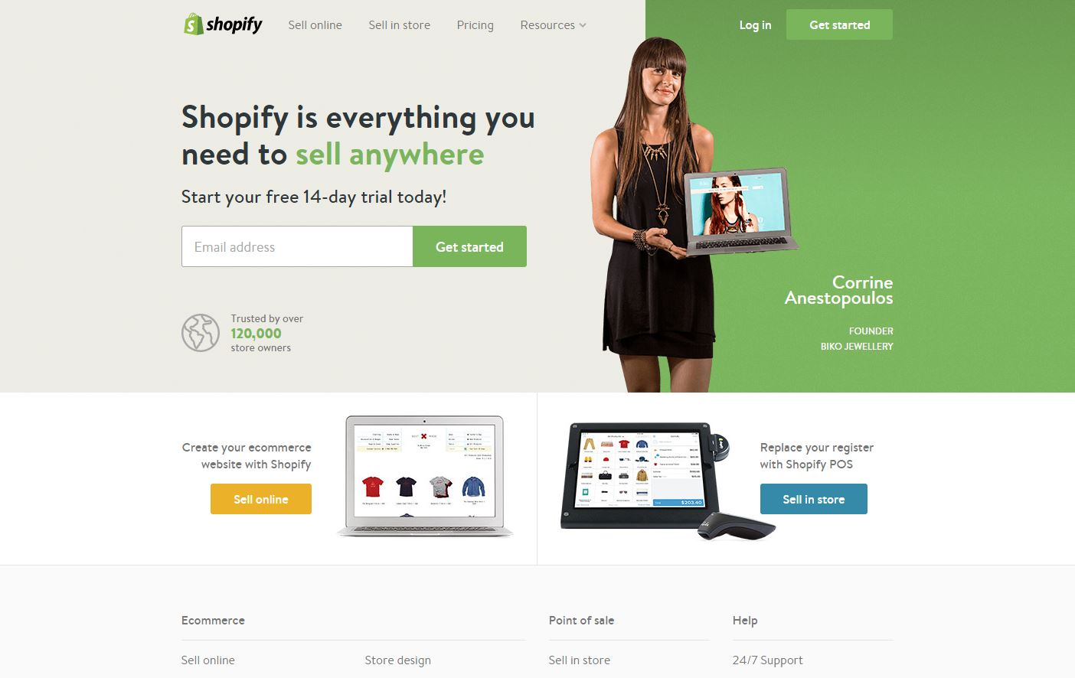
E-commerce Packages Shopify
Hosting, website, payments, online/in-person/mobile all in one place
Canadian company
BookThatApp extension
Online & In-store bundle $219/month with a low transaction fee Online: 2.25% + 30¢ In Person: 2.15% + 0¢ For a $4000 vacation package, $90 fee (2.25%) vs $116 (2.9%).
Example: Candle making classes

Slide 23
SUMMARY

Slide 24
MOMC Comparison
 | Cost (40%) | Flexibility/ Add-ons (40%) | Reliability (up/down time) (20%) | Weighted Average
Client builds it themselves | 4 / 10 | 5 / 10 | 1 / 10 | 3.8
Client pays us to use an e-comm package | 6 / 10 | 8 / 10 | 8 / 10 | 7.2
Outsource the whole thing | 10 / 10 | 10 / 10 | 10 / 10 | 10

Slide 25
Conclusion
Packages are great if you want to save money and get up and running sooner rather than later
Custom-built solutions cost more but will exactly fit your business needs, easier to build on top of
If you are setting up your own hosting, shared hosting is best. Use a VPS.

Slide 26

Want To Know More?
Information Session

Slide 27



