Slide 1

Ransomware
Group#8
Rashmika Adusumilli – 11770425 Esther Eze - 11886695
Mounika Chavagani – 11737704 Sai Teja Uppu – 11691244

Slide 2
Agenda
Ransomware
Related Works
Encryption
Decryption
Infection
Monitoring
Detection
Mitigation
Conclusion

Slide 3
Ransomware
It is a type of malware which prevents the victims to access the files on the device.
Malware is hidden inside of a legitimate file.
Strong Encryption such as AES-128 is used for Encryption.
Once the ransom amount is paid, the key for decryption is sent.
Ransomware payments were estimated to be $1.1 bn in 2019, $999m in 2020, $1.25bn in 2023 and $813m in 2024.

Slide 4
Related Works
CryptoDrop is an early warning system to detect Ransomware.
Sgandurra developed new ways to spot malware by analyzing programs.
Kok and colleagues used fake files to understand how latest ransomware works to create better early detection systems.
Nissim started using machine learning to recognize regular and harmful encryptions.

Slide 5
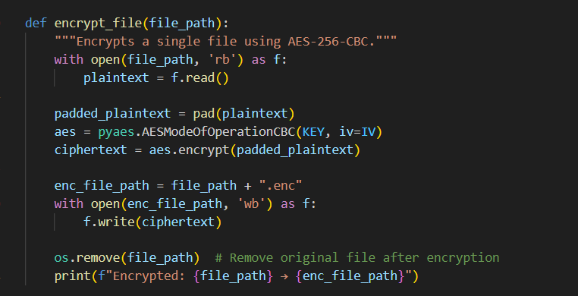
Encryption
Once the malware is installed, all the files in the target system will be encrypted.
AES algorithm is used for encryption.
Target files: C:\Users\rashm\Desktop\Confidential
Pyaes tool is used for encrypting.

Slide 6
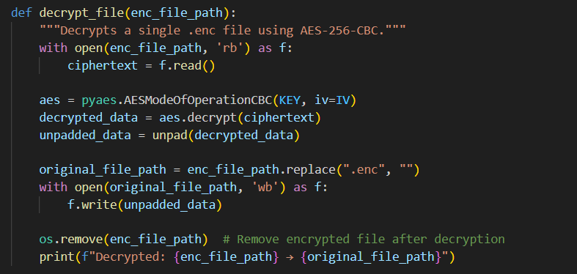
Decryption
Once the ransom is paid, the code is given to decrypt the files in the target system
AES algorithm is used for decryption.
Target files: C:\Users\rashm\Desktop\Confidential
Pyaes tool is used for encrypting.

Slide 7
Infection
The encryption code is in Python.
PyInstaller can be used to convert the python code to .exe file.
This .exe file should be sent to the victim as Phishing.
Phishing is a process of attacker sending malicious programs within emails as legitimate files so the victims can install them.

Slide 8
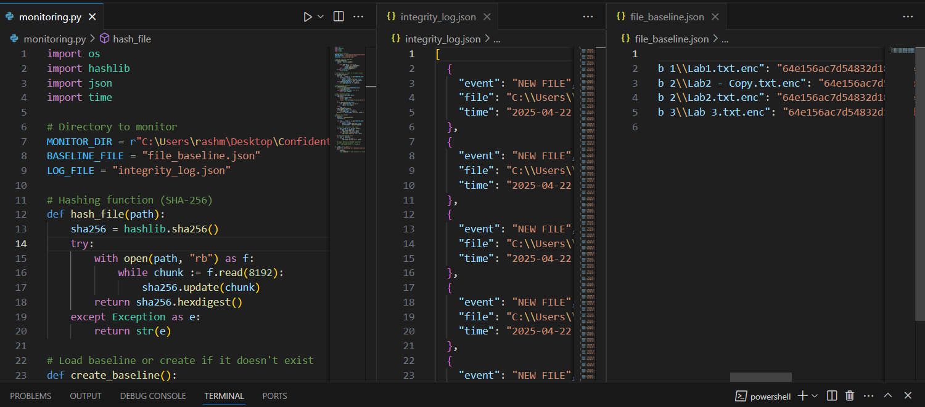
Monitoring
Create an base line File which stores the hash values of each file in the system.
Run the program in regular intervals and compare the hash values.
Write the changes into a integrity log file.
Hashlib is used to creating the hash of the file.

Slide 9
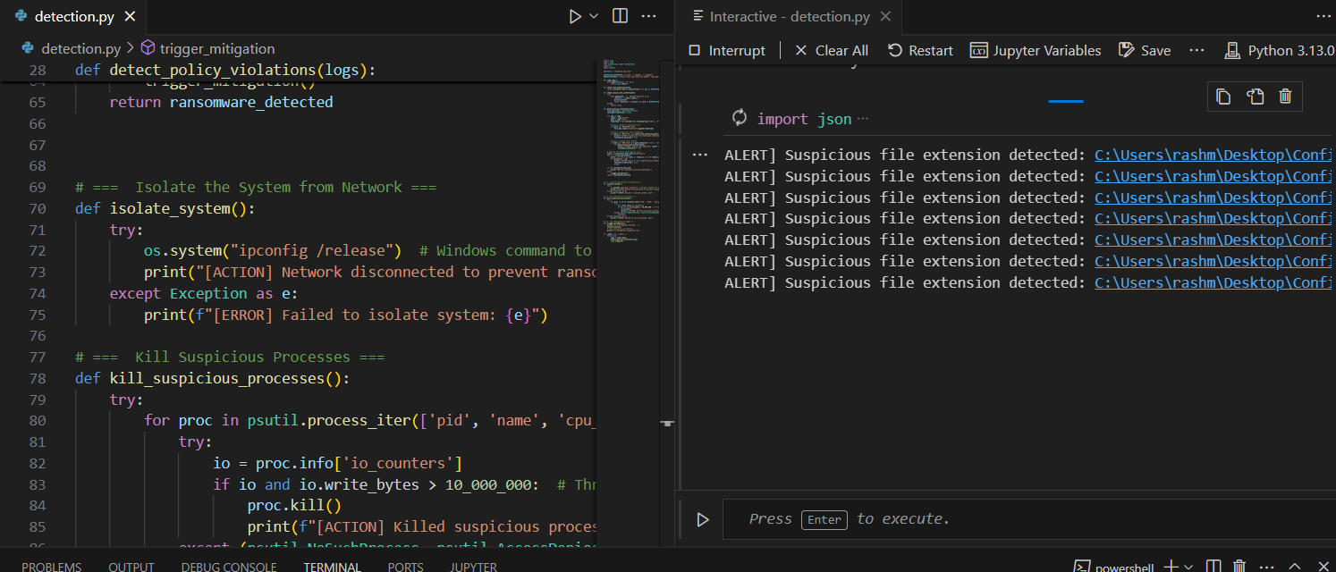
Detection
Check the integrity log in regular intervals to detect abnormal changes.
New files created with .enc, .locked, .crypted.
Files include texts such as your files have been encrypted, decrypt, bitcoin.

Slide 10
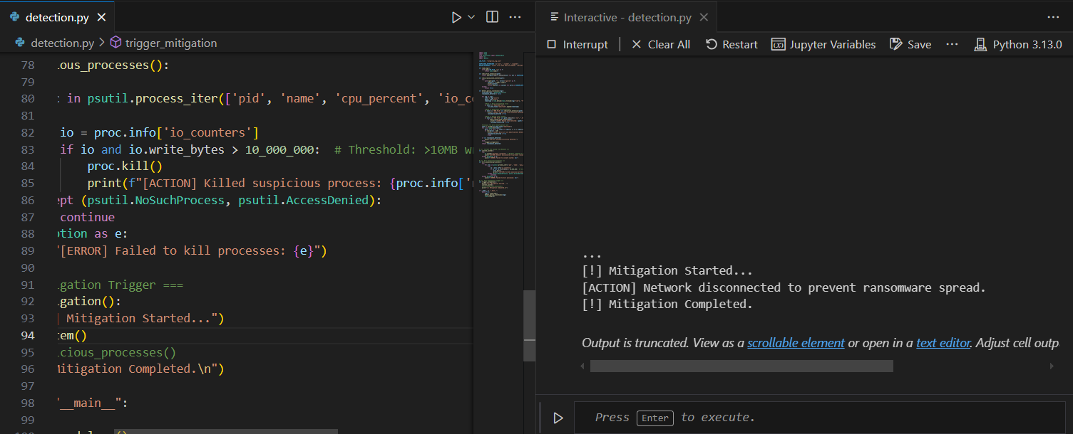
Mitigation
Once the ransomware is detected, we can take steps such as isolating the system and killing suspicious process.
Isolate System include turning of the Wifi.
Killing Suspicious process include killing process with 10,000,000 bytes writes.

Slide 11
Tools used
Python 3
PyInstaller
Pyaes
Psutil
Hashlib
Json
Time
os

Slide 12
References
[1] M. Ryan, Ransomware Revolution: the rise of a prodigious cyber threat, vol. 85. Springer International Publishing, 2021.
[2] S. Kamil, H. S. A. Siti Norul, A. Firdaus, and O. L. Usman, “The rise of ransomware: A review of attacks, detection techniques, and future challenges,” in 2022 International Conference on Business Analytics for Technology and Security (ICBATS), 2022.
[3] K. Mohanty, V. Goswami, S. N. Qurashi, and R. K. Barik, “Ransomware and its future trends: A scientometric analysis,” Scientific Modelling and Research, vol. 9, no. 1, pp. 15–43, 2024.
[4] B. Çalışkan, İ. Gülataş, H. H. Kilinc, and A. H. Zaim, “The recent trends in ransomware detection and behaviour analysis,” in 2024 17th International Conference on Security of Information and Networks (SIN), 2024, pp. 1–8.
[5] K. W. Kug, 명지대학교/보안경영공학과, Y. S. Ryu, and S. B. Shin, “Implementation of reliable dynamic honeypot file creation system for ransomware attack detection,” Jouranl of Information and Security, vol. 23, no. 2, pp. 27–36, 2023.
[6] J. Ispahany, M. R. Islam, M. Z. Islam, and M. A. Khan, “Ransomware detection using machine learning: A review, research limitations and future directions,” IEEE Access, vol. 12, pp. 68785–68813, 2024.

Slide 13
Conclusion
Identify what Ransomware is.
Create Encryption and Decryption code.
Mimic process of Monitoring, Detection and Mitigation.

Slide 14

Thank you

