Slide 1

MACHINE LEARNING-BASED WHEAT YIELD PREDICTION WITH OPTIMIZATION FOR ACCURATE FORECASTING

Slide 2
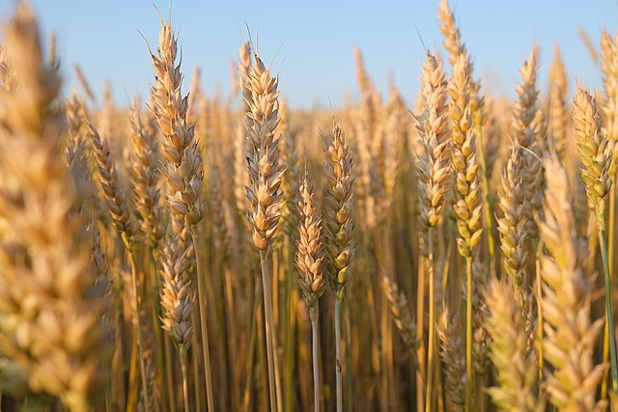

content
ABSTRACT
PROBLEM DEFINITION
OBJECTIVE & SCOPE
WHY THIS PROJECT?
SYSTEM ARCHITECTURE
LITERATURE SURVEY
PROJECT PLAN
IMPLEMENTATION AND ANALYSIS
REFERENCES

Slide 3

ABstract
Wheat yield prediction is essential for food security and helps in resource planning and risk management.
Traditional methods lack precision and fail to consider complex environmental factors affecting crop growth.
Deep learning algorithms analyze large datasets to identify patterns missed by traditional approaches.
A mobile application will provide farmers with easy access to yield forecasts and decision-support tools.

Slide 4
CONT..
Real-time environmental data integration ensures timely and more accurate yield predictions.
Cloud deployment will enable scalability, remote access, and efficient data management.
The proposed system offers improved accuracy and adaptability to changing environmental conditions.
Enhanced predictions will help farmers make informed decisions and promote sustainable wheat production.
Our project combines ML models, real-time data, and mobile accessibility, offering accurate, farmer-friendly, and scalable wheat yield predictions.

Slide 5

PROBLEM DEFINITION
Existing models lack precision due to limited data sources.
These approaches depend on static data sources, limiting prediction accuracy.
Traditional models cannot adapt to dynamic environmental changes and evolving conditions.

Slide 6
CONT..
Few mobile applications integrate ML-based wheat yield predictions for farmers.
Lack of real-time insights and farmer-friendly decision support tools.
Government policies and subsidies are not integrated with yield prediction systems.
Your system fills these gaps by combining ML models, real-time data, cloud storage, and farmer-friendly UI.

Slide 7
objective
Scope

Slide 8
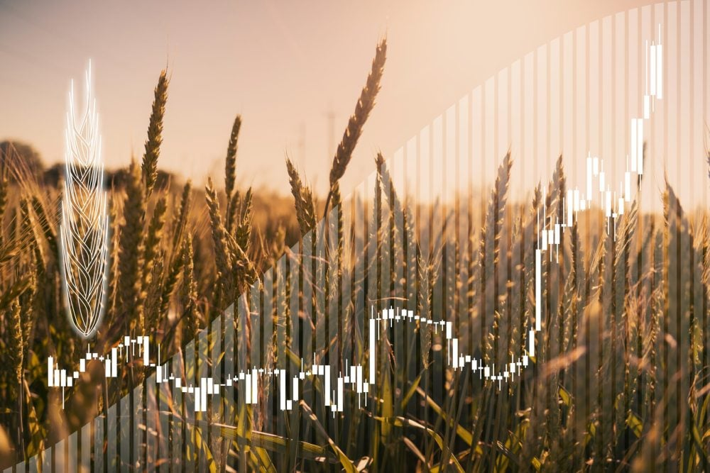
Develop a machine learning-based wheat yield prediction system with high accuracy.
Integrate climate forecasts, soil health, and remote sensing data for better predictions.
Implement a mobile app with an intuitive user interface for farmers

Slide 9
Provide detailed reports comparing different ML models (e.g., Random Forest, Linear Regression,Decision Tree).
Enable farmers to give feedback, attach photos, and track government schemes.
Deploy the backend on the cloud (Render) for real-time scalability.

Slide 10
WHY THIS PROJECT?
Combines multiple data sources (weather, soil, satellite data) for better accuracy.
Uses machine learning models (Random Forest, XGBoost, etc.) to enhance prediction.
Provides a mobile application for farmers with real-time yield insights.
Integrates with government schemes to assist farmers in decision-making.
Cloud-based deployment for real-time, scalable access to predictions.

Slide 11
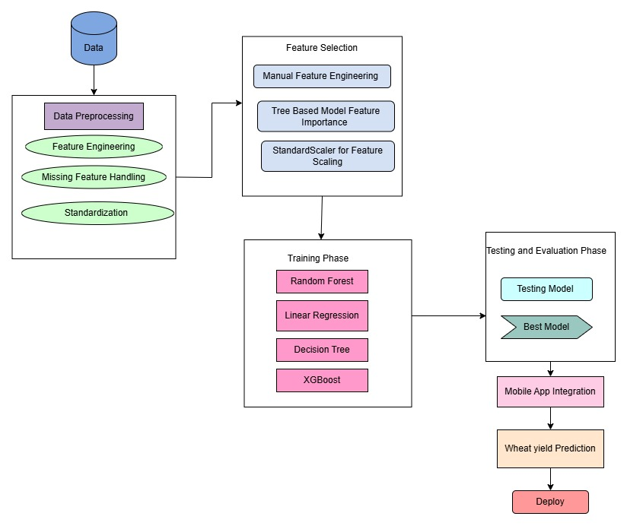

SYSTEM
ARCHITECTURE

Slide 12
LITERATURE SURVEY
Predicting Wheat Yield Using Climate and Soil Data
This study integrates remote sensing and machine learning to enhance wheat yield prediction using satellite spectral and environmental data. While effective, it requires high-quality imagery and complex preprocessing.
A Deep Learning Approach for Wheat Yield Forecasting Using Remote Sensing Data
This paper applies deep learning to remote sensing data for accurate yield forecasting. It captures complex patterns but demands large datasets and high computational power.
A Hybrid Model for Wheat Yield Prediction Based on Remote Sensing and Weather Data
This study combines remote sensing and weather data for improved yield prediction. However, its effectiveness depends on data consistency and high-quality weather inputs.

Slide 13
PROJECT PLAN
1.Data Preprocessing
Cleaned data and handled missing values.
Engineered new features for better accuracy:
Applied StandardScaler for feature normalization.
2. Feature Selection
Correlation Analysis: Removed features with correlation > 0.85.
Feature Importance Analysis:
  Used Random Forest & XGBoost to rank features.
  Dropped features with low importance (< 0.02 weight).

Slide 14
3. Model Development
Implemented Machine Learning Models:
  Random Forest
  Decision Tree
  Linear Regression
Evaluated models using:
  R² Score – Variance explained.
  MAE – Measures absolute prediction error.
  RMSE – Measures deviation from actual values.
  Integrated XGBoost to improve accuracy.

Slide 15
4. Backend API Development
Developed Flask API (app2.py) to process inputs and return predictions.
Implemented data validation for input integrity.
Provided graphical analysis (scatter plots, residual plots, feature importance graphs) using Matplotlib.
5. Mobile Application Development
Built an Android app using Android Studio with Retrofit for API communication.

Slide 16
6. Deployment & User Engagement
Cloud-based deployment for real-time and scalable access.
Integrated with government schemes for decision support.
Designed an intuitive user interface for farmers to easily access predictions.

Slide 17
IMPLEMENTATION AND ANALYSIS
Implemented Linear Regression (LR), Random Forest (RF), and Decision Tree (DT) to compare performance.
Calculated performance metrics (R² Score, RMSE, MAE) for each model.
Selected the best-performing model based on accuracy and error analysis.
Integrated XGBoost to further enhance prediction accuracy.

Slide 18
Developed a mobile app using Android Studio for wheat yield prediction.
Implemented features such as farmer input collection, real-time yield forecasting, weather insights, and government scheme integration.
Enabled CSV file uploads for bulk predictions.
Created a Flask-based API (app2.py) to process farmer inputs and return model predictions.

Slide 19
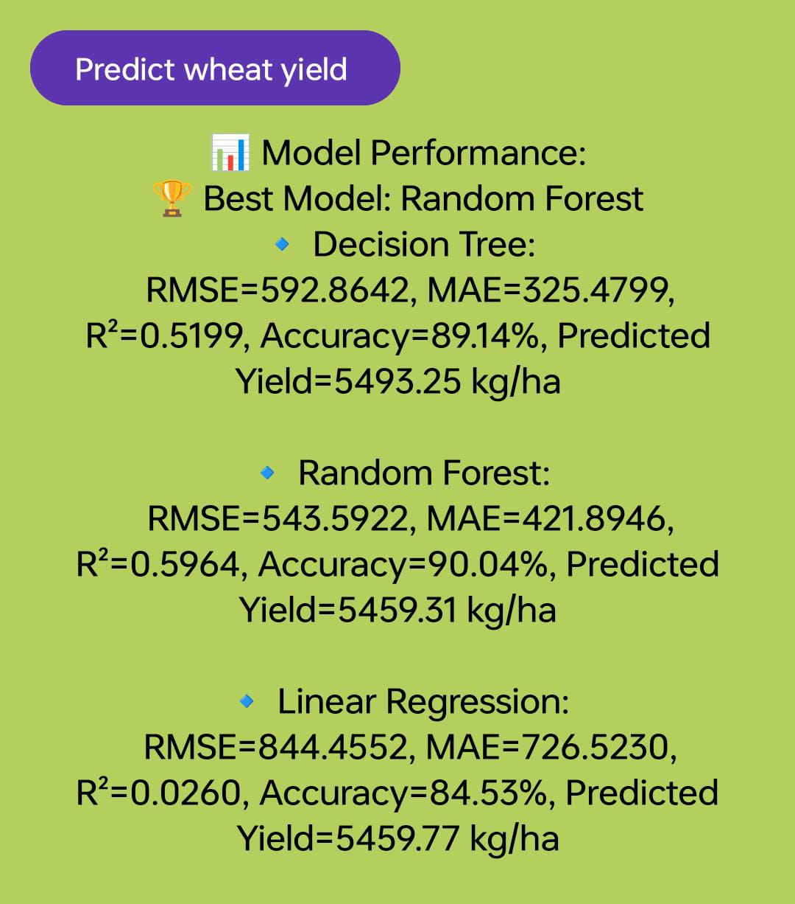
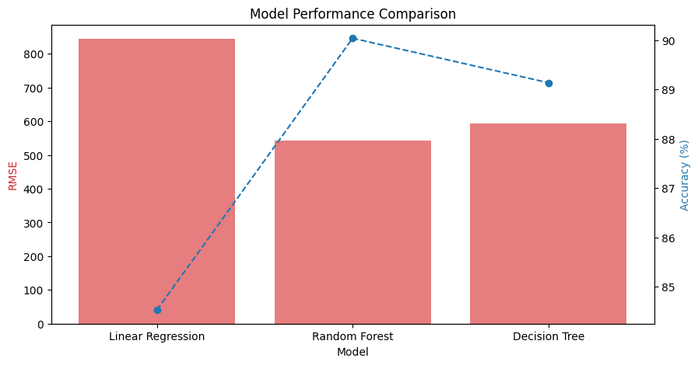
Output in App
Model Performance Comparison graph

Slide 20
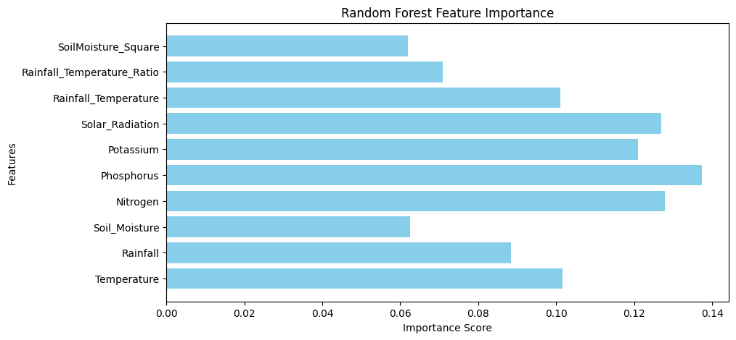
Feature Importance Graph(Random Forest)

Slide 21
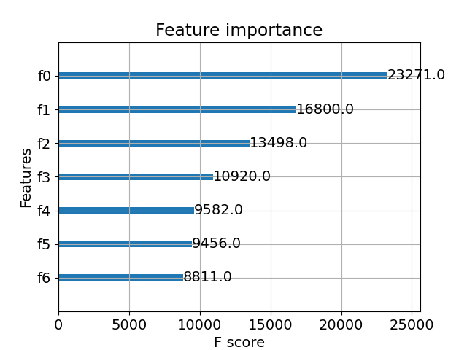
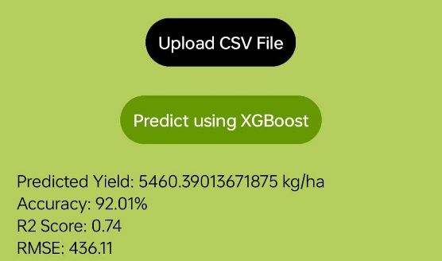
Output for XGBoost Model
Feature Importance Graph

Slide 22
ANALYSIS
Evaluated machine learning models using performance metrics: Accuracy, RMSE, MAE, and R² Score.
Compared predicted yield values with actual yield data to assess model reliability.
Generated performance charts (e.g., RMSE vs. Accuracy) to visualize model efficiency.
Analyzed feature importance using Random Forest and XGBoost to identify key factors influencing wheat yield.
Refined models based on observations from graphical and statistical analysis to improve precision.

Slide 23
REFERENCE
Y. Di, M. Gao, F. Feng, Q. Li, and H. Zhang, ‘‘A new framework for winter wheat yield prediction integrating deep learning and Bayesian optimization,’’ Agronomy, vol. 12, no. 12, p. 3194, Dec. 2022.
M. U. Ahmed and I. Hussain, ‘‘Prediction of wheat production using machine learning algorithms in northern areas of Pakistan,’’ Telecommun. Policy, vol. 46, no. 6, Jul. 2022, Art. no. 102370.
3. Lobell, D. B., Schlenker, W., & Costa-Roberts, J. (2011). "Climate trends and global crop production since 1980." Science, 333(6042), 616-620.
4. You, J., Li, X., Low, M., Lobell, D. B., & Ermon, S. (2017). "Deep Gaussian process for crop yield prediction based on remote sensing data." AAAI Conference on Artificial Intelligence.
5. Khaki, S., & Wang, L. (2019). "Crop yield prediction using deep neural networks." Frontiers in Plant Science, 10, 621.

Slide 24
THANK YOU!

