Slide 1
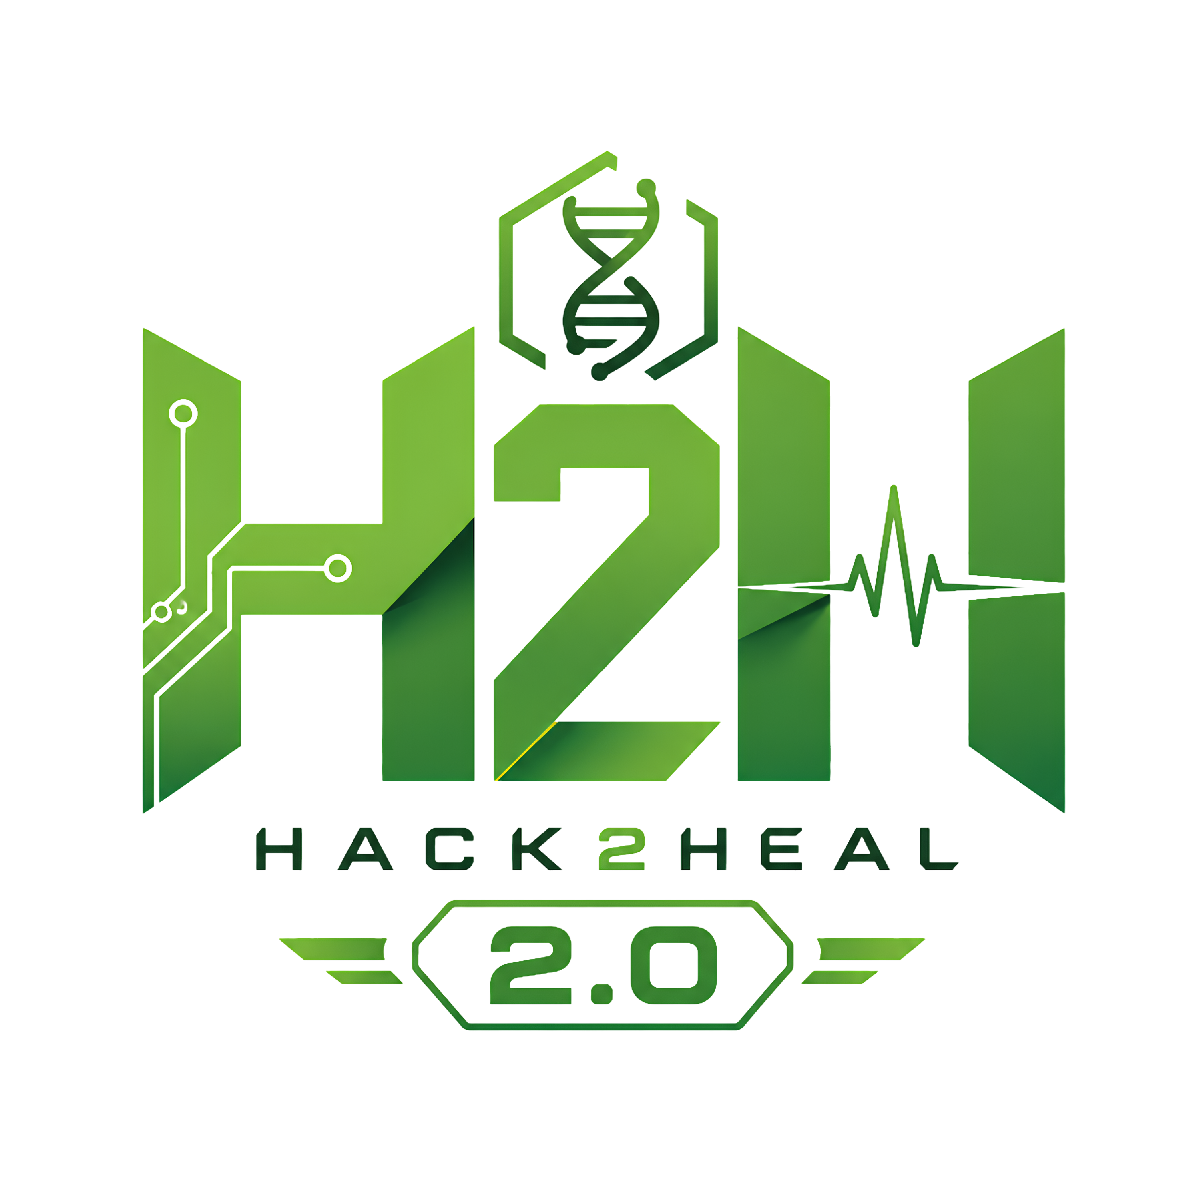

Hack2Heal 2.0
Global Healthcare Hackathon
SENTINEL — Community Outbreak Early Warning System
Team Name – Sentinel
Team Lead – V.A SAI VENKATESH

Slide 2
SENTINEL — Community Outbreak Early Warning System
Sentinel
Sentinel
Proposed Solution (Describe your Idea/Solution/Prototype)
Core Solution: A zero-cost outbreak early-warning system combining icon-based reporting, vernacular voice capture (Vosk/Bhashini), and spatiotemporal cluster analysis to detect disease patterns in rural areas.
Addressing the Problem: Replaces complex, text-heavy tools with voice notes and messaging apps rural communities already use, connecting isolated household symptoms to alert local health centers before outbreaks spread.
Innovation & Uniqueness: Tracks multi-stage symptom progression instead of single keywords, and integrates automated WHO verbal autopsies to capture vital mortality data from unrecorded deaths.

Slide 3
TECHNICAL APPROACH
Sentinel
Your Team Name
Technologies Used:
  Intake & Mobile: Flutter (icon-based UI), Telegram Bot API (voice/text).
  Speech & AI: Bhashini, Vosk, Google Gemini API.
  Backend & Analytics: Python (FastAPI), spatiotemporal scan statistics.
  Storage & Hosting: Supabase (PostgreSQL + PostGIS), Redis, Render/Vercel.
Methodology & Implementation:
  Voice/Icon Reporting: Captures local dialect voice notes or tap-inputs without requiring literacy.
  AI Structuring: Transcribes vernacular audio and parses inputs into standardized symptom stages.
  Spatiotemporal Engine: Scans geographic progression patterns to detect micro-clusters before hospitals fill up.
  WHO Verbal Autopsy: Gathers voice-based illness histories for unrecorded deaths to recover lost mortality data.
  Automated Escalation: Triggers real-time alerts to local Primary Health Centres and district dashboards.

Slide 4
FEASIBILITY AND VIABILITY
Sentinel
Your Team Name
Feasibility
Adoption: Uses pre-existing habits (voice notes on messaging apps) with zero training curve.
Cost: Operates entirely on free-tier cloud tools and India's open Bhashini AI.
Challenges & Risks
Adoption: Low literacy levels and rural smartphone discomfort.
Data Quality: Regional dialect diversity and background audio noise.
Operations: False alarms overloading Primary Health Centre staff.
Cultural: Navigating bereavement sensitively during post-mortem reporting.
Mitigation Strategies
Zero-Text UX: Icon-first app paired with vernacular voice capture.
Hybrid STT: Vosk offline engine backed by Bhashini speech models.
Progression Filters: Alerts trigger only on multi-case symptom progressions, not raw counts.
WHO Framework: Low-burden, respectful voice flows designed specifically for grieving families.

Slide 5
IMPACT AND BENEFITS
Sentinel
Your Team Name
Target Audience Impact
Villagers: Report illness instantly via voice in local dialects without needing literacy or digital skills.
ASHA Workers: Gain early cluster warnings, replacing guesswork with clear, targeted intervention areas.
Primary Health Centres: Receive real-time geographic alerts, enabling rapid containment before clinics overflow.
Key Benefits
Social: Protects vulnerable rural families and recovers critical cause-of-death data from unrecorded fatalities.
Economic: Cuts outbreak response expenses and operates on a zero-recurring-cost cloud infrastructure.
Systemic: Modernizes rural disease surveillance by linking remote villages directly to district health systems.

Slide 6
RESEARCH AND REFERENCES
Sentinel
Your Team Name
References & Research Work
WHO Verbal Autopsy Standards: Built on the WHO Verbal Autopsy Instrument (WHO Standards for Ascertaining and Attributing Causes of Death) for structured post-mortem voice capture. Link: who.int
Spatiotemporal Outbreak Detection: Implements principles from Martin Kulldorff's Space-Time Scan Statistics (SaTScan methodology) for localized epidemiological cluster detection. Link: satscan.org
National Disease Surveillance Framework: Aligned with India's Integrated Disease Surveillance Programme (IDSP) guidelines for rural district reporting. Link: idsp.mohfw.gov.in
Indic Speech AI Infrastructure: Powered by Project Bhashini (National Language Translation Mission, MeitY) for regional voice transcription. Link: bhashini.gov.in

