Slide 1

Smartphone Price Prediction
Group 7
Group Members :
Akhil Vaitla Janardhan
Arunkumar Muthuswamy
Nabeel Khan
Venkata Satya Surya Sai Vineet Atyam
Zhijie Xu
December 2, 2021

Slide 2
Agenda
I. Project Overview
II. Data Collection & Cleaning
III. Analysis & Visualization
IV. Results & Summary
Group 7

Slide 3

Project Overview
Develop a robust framework for predicting smartphone prices based on data from past smartphone prices.
In this presentation, we will include a little explanation about the procedures to get our final dataset first. Because we know those processes could cause potential bias or human error, which may impact our results/observations in an unexpected way.​
Apply different techniques for understanding the relationship between the data and predicting the price of the smartphones
The more high-quality data you have, the more confidence you can have in your decisions.
Group 7

Slide 4
Data Collection and Cleaning
Data Collection
Smartphone data were collected from GSM Arena in a scheduled manner
Data was collected for the OEM : Samsung, Realme, Huawei, Motorola
Created python project to scrape smartphone data from GSM Arena
Data Cleaning
Major challenge in this problem was the data type. Every column was in their textual representation which must be cleansed for the prediction
Using certain features were straightforward, needed simple parsing. However, there were certain features which needed aggregation of other features and similar data from other websites
Examples: Number of bands, CPU score was a result of aggregation and mapping from websites like TechCenturion.
Group 7

Slide 5
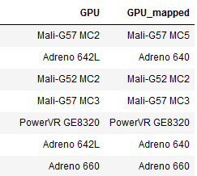
Data Collection and Cleaning
CPU Score & GPU Score
Centurion Mark which is one of the industry-leading benchmarking techniques to evaluate the performance of a processor has been used as a feature in place of the CPU processor name
Used fuzzy logic to map existing CPU and GPU name to the closest GPU name and the corresponding Centurian Mark (score) as illustrated in the table on right.
Other Features
Number of bands - Extracted the number of frequency supported in each band and constructed the total no of bands
Maximum no of cores, Clock Speed & Frequency – From the CPU description, it was possible to calculate the above features Ex: Octa-core (2x2.2 GHz Cortex-A76 & 6x2.0 GHz Cortex-A55)
Group 7

Slide 6
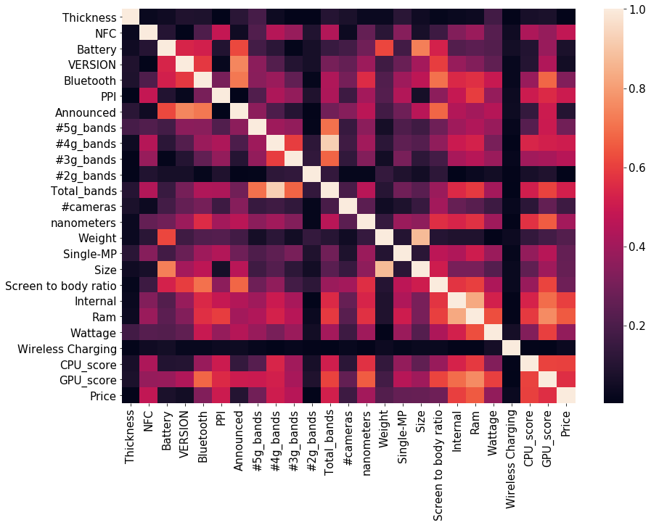
Analysis
Correlation
Heatmap
Average Correlation between features is 0.26 (absolute value).
So, feature reduction was not required
Group 7

Slide 7

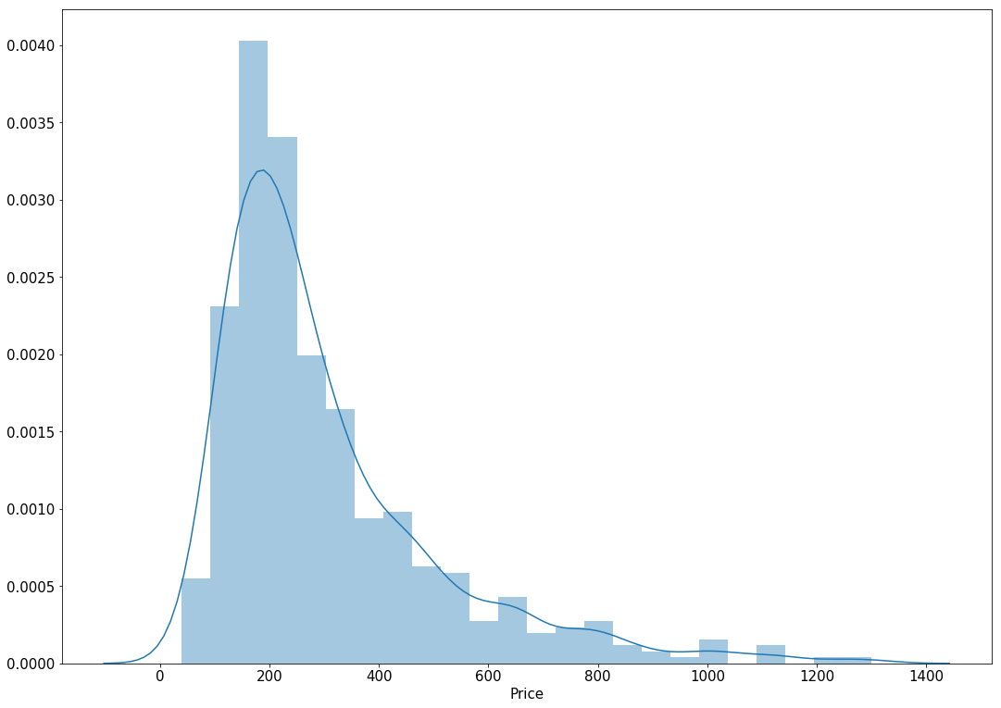
Analysis
Price Distribution
Dataset consists of Android phones from Samsung, Huawei, Motorola, and Realme with an average price of ~300$.
Group 7

Slide 8
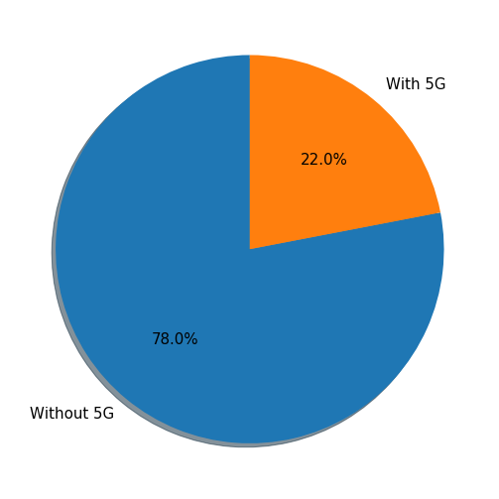
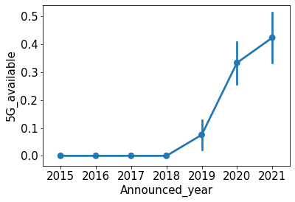
Analysis
5G Adoption
.
5G Enabled Smartphone percentage
Group 7

Slide 9
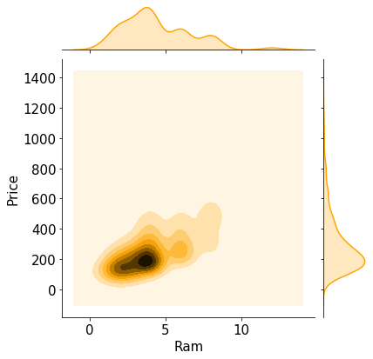
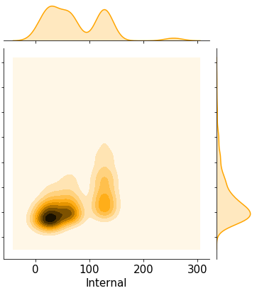
Analysis
RAM & Internal Memory
Trend of RAM and Internal Memory vs Price.
Group 7

Slide 10
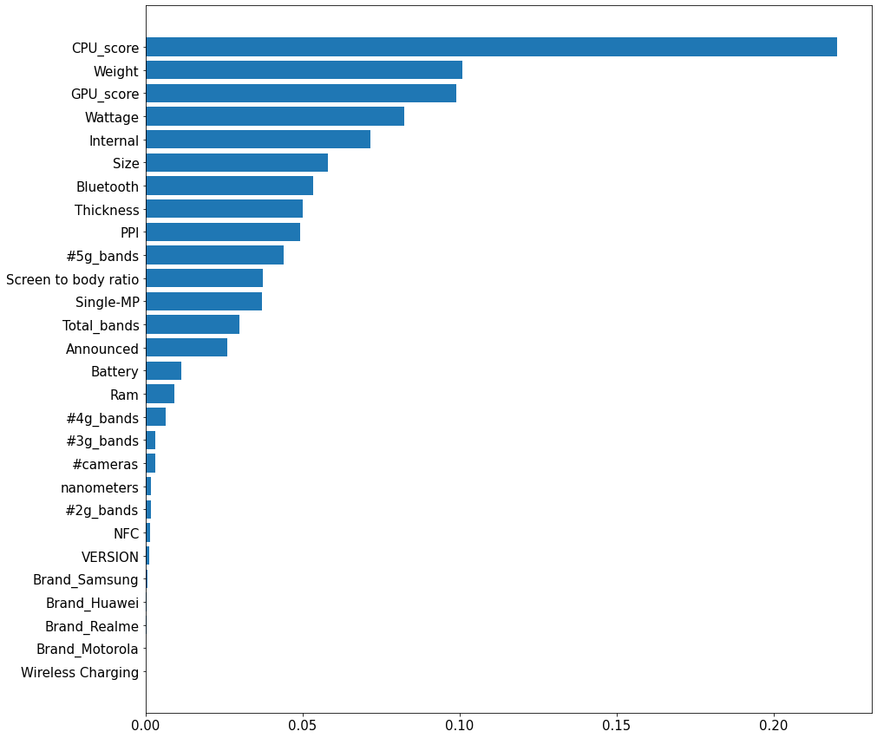
Analysis
Feature Importance
CPU_score consistently pop up as the most important feature for Price Prediction.
GPU_score as consistently in top 3 features.
Group 7

Slide 11
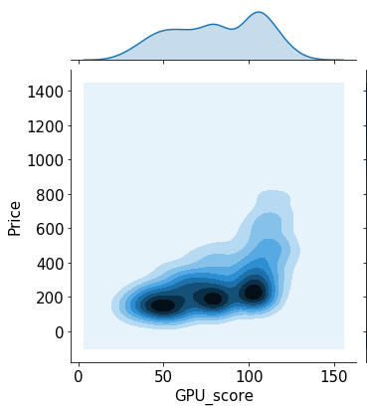
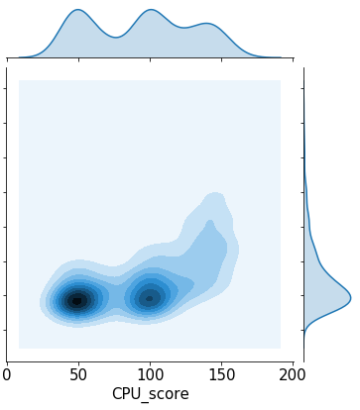
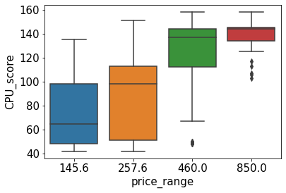
Analysis
CPU & GPU performance
We can see positive trend of Price vs CPU and GPU Scores
Group 7

Slide 12

Impact :
We can use our models to test if a smartphone is valuable to buy
Results & Summary
Conclusion:
Random Forest performed best w.r.t. Median Absolute Percent Error with 16% error
Group 7

Slide 13

Thank you
Group 7

