Slide 1
CSE 445 Machine Learning
Predicting Health Expenses of Patients
Name - Kazi Sajid Mahmud
ID - 2013388042

Slide 2
Motivation
Cost Containment: With healthcare costs continuously rising, there's a growing need to identify strategies for containing expenses while maintaining quality care. Predicting health expenses helps in allocating resources efficiently and proactively managing high-cost patients.
Risk Management: By predicting which patients are at higher risk for significant healthcare expenses, healthcare providers and insurers can implement targeted interventions aimed at preventing or mitigating costly health events, thus improving patient outcomes and reducing financial burden.
Personalized Care: Understanding patients' future healthcare expenses allows for the delivery of more personalized care plans tailored to individual needs and risk profiles. This fosters a patient-centered approach and enhances overall satisfaction with the healthcare experience.

Slide 3
Brief Description
Data Analysis: Utilizing patient medical histories, demographics, and other relevant factors to analyze patterns and trends in healthcare utilization and associated costs.
Validation and Deployment: Evaluating model performance using validation techniques like cross-validation and deploying the finalized model into production environments, integrating it with healthcare systems to enable real-time predictions and decision support.
Cost Projection: Using predictive analytics to estimate future healthcare expenses for individual patients or populations, enabling healthcare providers and insurers to allocate resources effectively and tailor interventions to mitigate high-cost scenarios.

Slide 4
Expected Outcome And Problem Statement
Problem Statement:
Accurately forecast healthcare expenses for individual patients and populations.
Identify patients at high risk of incurring significant healthcare costs.
Implement proactive interventions to improve patient health outcomes and reduce unnecessary expenses.
Expected Outcome:
Improved Patient Care : Tailored care plans that address individual risk factors and needs, leading to better health outcomes and patient satisfaction.
Cost Savings : A reduction in unnecessary procedures, hospital readmissions, and emergency department visits, leading to significant cost savings for both healthcare providers and patients.

Slide 5
Flow Diagram
Data
Eda
and Preprocessing
Model
Deploy

Slide 6
Technology Stack
Programming Languages & Framework : Python, Javascript, HTML, Tailwind CSS, Pyscript, Django
Data Collection : Kaggle and Data from Users
Data Processing and Analysis :
Pandas : Python library for data manipulation and analysis.
NumPy : Fundamental package for scientific computing with Python, used for numerical operations and array manipulation
Scikit-learn : Python library for machine learning algorithms such as regression, classification, and clustering.
Data Visualization: MatplotLib and Seaborn for plotting data
Testing : Python Selenium Automation Testing
Deployment : GitHub IO and Netlify

Slide 7
Feature List
People can enroll themselves in our system
People can provide us with their data
People can take suggestions from our system
People can see the statistics of the data
People can visualize data
People can get suggestions on how to cut costs
People can give their valuable feedback
People can post and see other people's posts
People can filter and view data

Slide 8
Dataset Details
We have almost 1,500+ data in our data set
The data parameters are age, sex, bmi, children, smoker, region and charges
Age, sex, bmi, children, smoker and region will be used for training our machine model here
Charge will be act like a level for our machine model
100% data will be used for data pre processing
We will use 80% data for training
We will use 10% data for test
We will use the remaining 10% data for validation
In the batch learning period data will remain the same
Data will be taken from the user during the online based learning period
Data will be add to the data set for learning and more accurate result

Slide 9
Diagram About Project
Data Collection
Data Pre Process
Choose The Algorithm
Create The Machine Model
Training Period
Test The Software Version
Create The Software Version(Web)
Test The Machine Model Again
Try To Increase The Accuracy
Test Machine Model
Deployment
Test After Deployment
Release and Open Source
Batch Learning
Online Learning

Slide 10
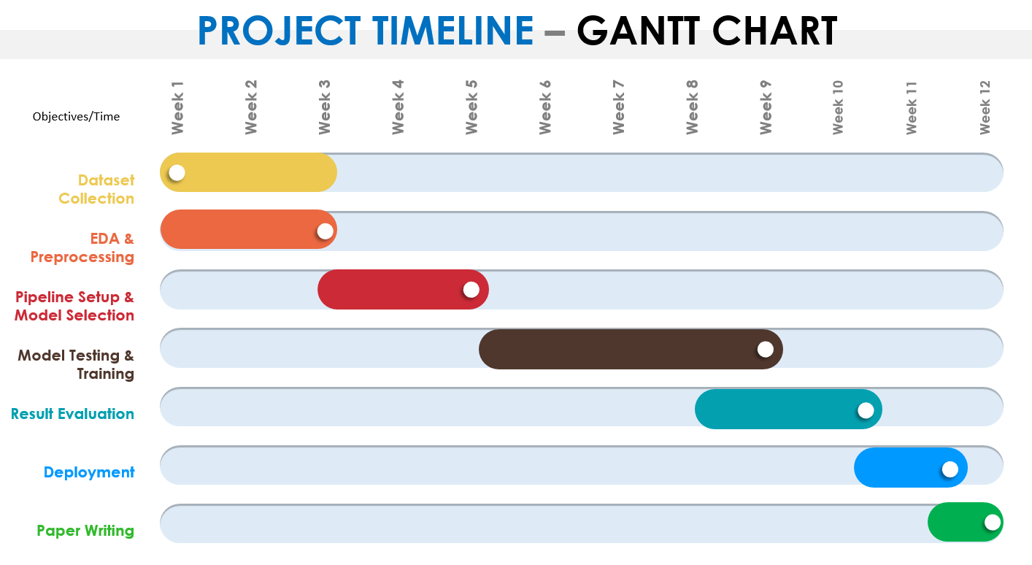

Slide 11
References
Taloba, A.I. et al. (2022) Estimation and prediction of hospitalization and medical care costs using regression in machine learning, Journal of Healthcare Engineering. Available at: https://www.hindawi.com/journals/jhe/2022/7969220/ (Accessed: 01 March 2024).
Morid, M.A., Kawamoto, K., Ault, T., Dorius, J. and Abdelrahman, S. (2017). Supervised Learning Methods for Predicting Healthcare Costs: Systematic Literature Review and Empirical Evaluation. AMIA Annual Symposium Proceedings, [online] 2017. Available at: https://www.ncbi.nlm.nih.gov/pmc/articles/PMC5977561/.

Slide 12
Thank You

