Slide 1
School of Computer Science & Engineering AI Application Development – IA1
AI-Based Weekly Employee Well-Being Pulse System

Slide 2
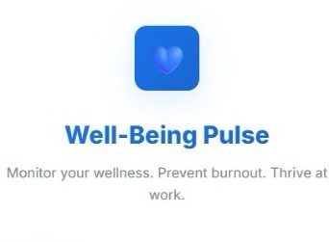
Team members & roles
Team member name | Role
Pranjal Shastry | Team Lead
Pranav Ajith | Customer Contact Lead
Sajil S Nair | Development Lead
Rashmi | Test Lead
Pranav Prakashan | Developer

Slide 3
Problem Statement
Front-line employees often experience high levels of stress due to continuous customer interaction, heavy workloads, and demanding targets. However, organizations usually lack a structured system to regularly monitor employee well-being and detect early signs of burnout. This project aims to develop an AI-based system that collects weekly employee feedback, analyzes their stress and emotional state, and provides insights to improve employee well-being and workplace productivity..
Summary:
Front-line employees experience significant stress due to multiple factors:
High workload: Managing numerous tasks simultaneously increases pressure.
Constant customer interaction: Handling complaints, queries, and expectations can be emotionally draining.
Irregular work hours: Shift patterns and overtime disrupt work-life balance.
Limited support: Lack of timely guidance or assistance adds to frustration.
Organizations face challenges in monitoring employee well-being:
No real-time monitoring: Absence of systems to track stress levels and burnout as they occur.
Delayed intervention: Issues are often addressed only after performance or attendance declines.
Lack of personalized support: Employees do not receive tailored resources based on their stress patterns.

Slide 4
User/ Customer Understanding
Front-line employees need a simple way to report their weekly work stress, workload, and overall well-being. Managers need insights into employee stress levels and burnout risks to support their teams. This system helps both by collecting feedback and providing meaningful analysis.
Conducted interviews with employees
High stress and workload issues identified
Real-time tracking: Continuous monitoring helps identify stress patterns early, preventing burnout before it escalates.
Simple weekly reporting: Employees can easily log their stress levels, workload, and overall well-being without disrupting their daily tasks.
Insightful manager dashboards: Managers gain access to clear visualizations and summaries, making it easier to understand team well-being at a glance.
Proactive interventions: Early identification of high-risk individuals or teams enables timely support, workload adjustments, and wellness resources.
Improved team performance: Better monitoring and support result in higher
productivity, morale, and job satisfaction.
No structured feedback system
Managers lack visibility

Slide 5
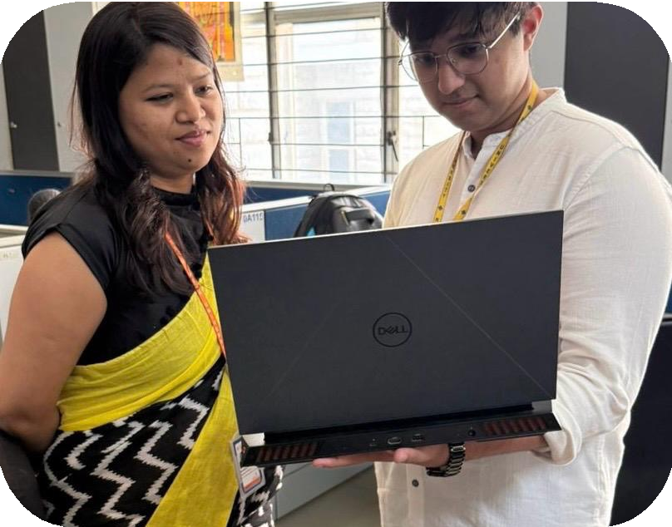

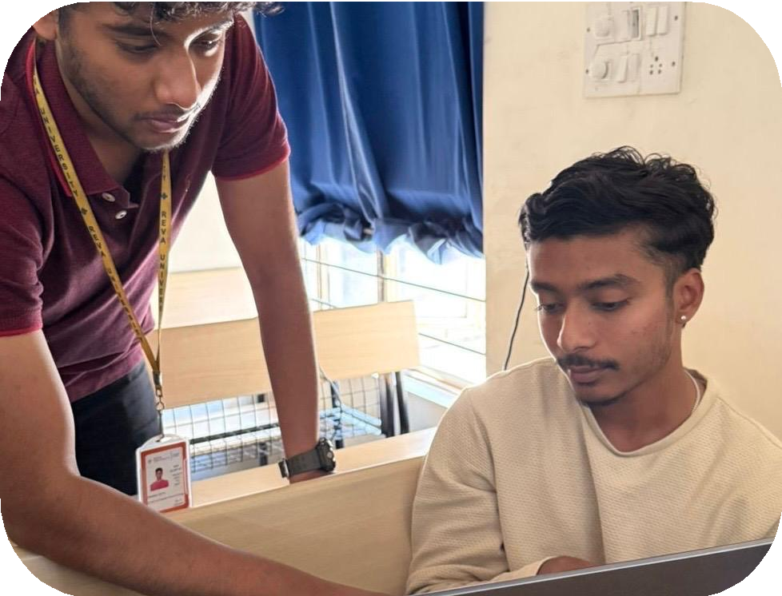
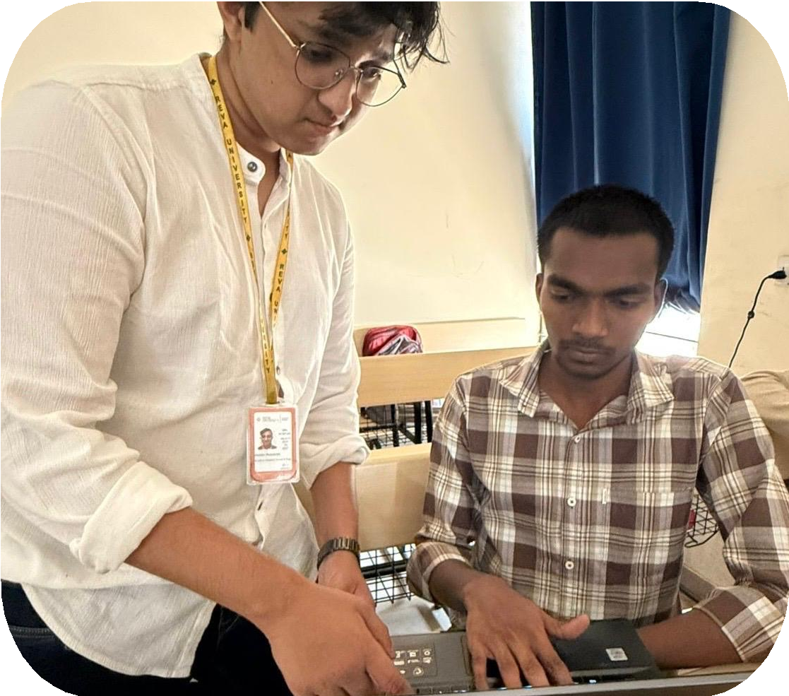
Ideal Customer Profile (ICP)
NAME: pragya
Target Users: sales staff Age Group: 35 years
Work Environment: service industries
Responsibilities:, meeting targets
Needs: A simple system to report weekly work experience and monitor stress and well-being
NAME:meghana Age Group: 24 years
Work: Junior Software Engineer / Developer (SDE I). Much of the day is spent writing, debugging,
Responsibilities:Participating in code reviews to learn team standards and best practices.
NAME:karthik
Age Group: 23 years
Work: Senior Software Engineer (SDE II/III). Work involves designing and implementing complex components or medium- complexity projects independently.
Responsibilities:
Mentoring junior engineers and providing constructive feedback during code reviews.
NAME:parimal
Age Group: 23 years
Work: Writing, testing, and debugging code for small, specific features under senior supervision.
Responsibilities: Completing assigned tickets, attending daily stand-ups, and learning the team's tech stack.
Skills: Proficiency in one core language (like Python or Java) and basic version control using Git.

Slide 6

Customer Persona (CP)
Name: Ahaana Singh
Age: 21
Profession: CSA Student / Intern at a Real Estate Company
Background:
1. Works as a Business Development Executive at a real estate company.
2. Responsible for reaching out to potential clients, scheduling property discussions, and following up on leads.
Pain Points:
1. Managing multiple calls, meetings, and sales targets creates a packed schedule.
2. Constant coordination with clients and meeting deadlines can be stressful and tiring.
3. Maintaining consistent follow-ups with prospects requires significant time and effort.
Needs:
1. Better tools or systems to manage client communication and scheduling efficiently.
2. Improved support to balance workload and reduce stress during busy work periods.
3. Short breaks or recovery time to maintain productivity and focus.

Slide 7

Customer Persona (CP)
Name: Karthik
Age: 23
Profession: Senior Software Engineer (SDE II/III)
Background:
1.Works on designing and developing complex software components.
2.Mentors junior engineers and conducts code reviews.
Pain Points:
1.Balancing development work with mentoring responsibilities.
2.Handling tight deadlines and complex technical issues.
Needs:
1.Tools to improve productivity and collaboration.
2.Better work-life balance and stress management support.

Slide 8




Product USP
The system uses AI-based sentiment analysis to automatically evaluate employee feedback and identify emotions such as positive, negative, or neutral, helping organizations understand real feelings without manual effort. It includes burnout detection by analyzing stress levels and feedback patterns to classify employees into low, moderate, or high risk, enabling early intervention. With weekly tracking, employees regularly submit their well- being data, allowing continuous monitoring and trend analysis over time. Additionally, a manager insights dashboard provides a clear visual overview of team stress levels, burnout risks, and performance trends, helping managers make informed decisions and improve the overall work environment.
AI SENTIMENT ANALYSIS
BURNOUT DETECTION
WEEKLY TRACKING
MANAGER INSIGHTS
DASHBOARD

Slide 9
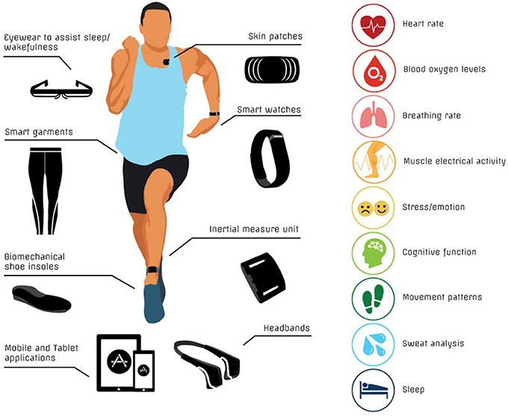
Use Cases & High level Requirements
Employees log into the system and submit weekly feedback about their stress level, workload, emotional state, and work experience.
The system collects and stores the feedback data securely in the database.
AI-based sentiment analysis processes the textual feedback to identify positive, neutral, or negative sentiment.
The system evaluates stress levels and sentiment to determine the employee’s burnout risk (Low, Moderate, High).
Employees receive personal well-being reports with stress summaries and suggestions.
Managers access dashboards showing team stress levels, burnout risks, and weekly trends to support better decision-making.

Slide 10
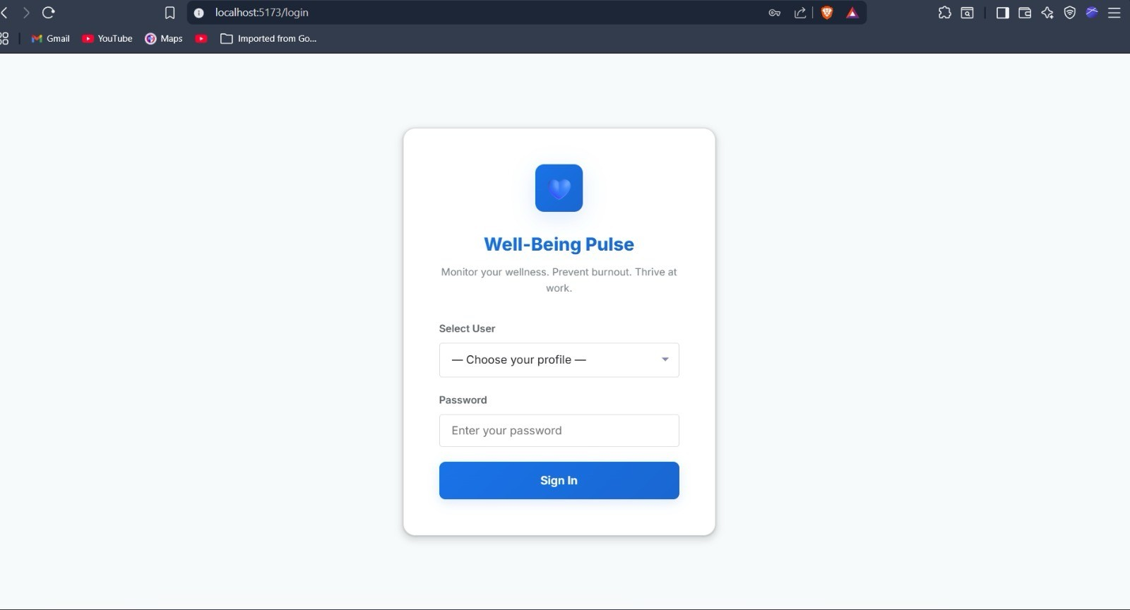
Proof of Concept (PoC) / Prototype Demo

Slide 11
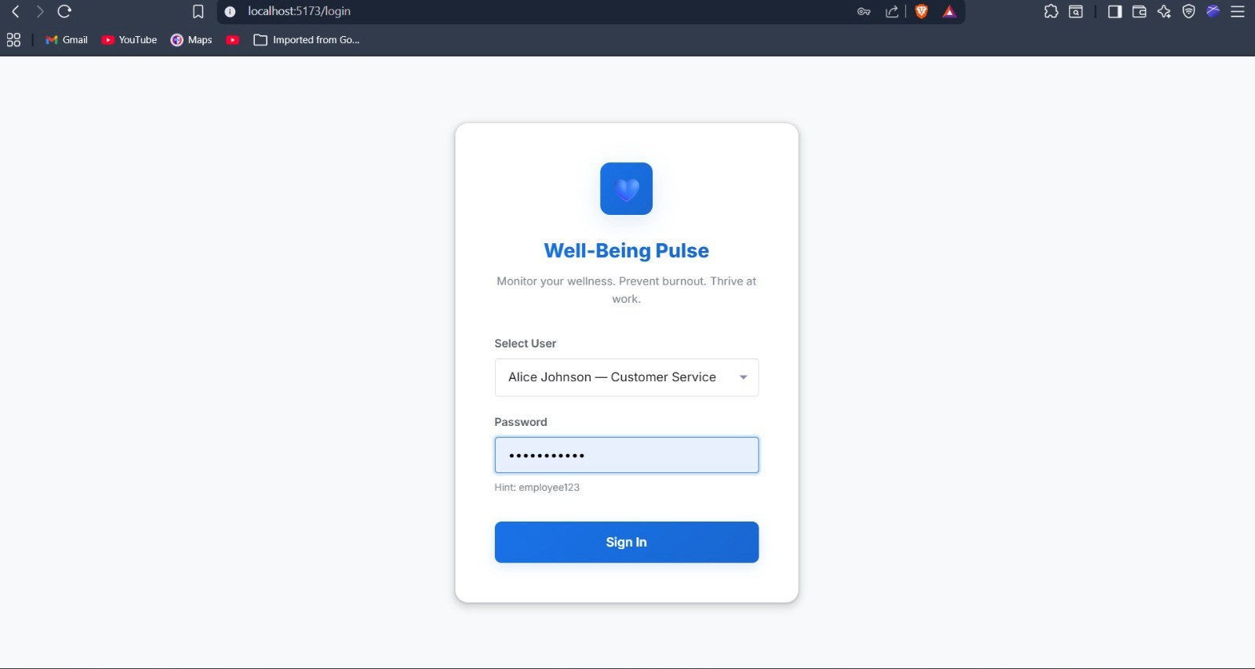
Proof of Concept (PoC) / Prototype Demo

Slide 12
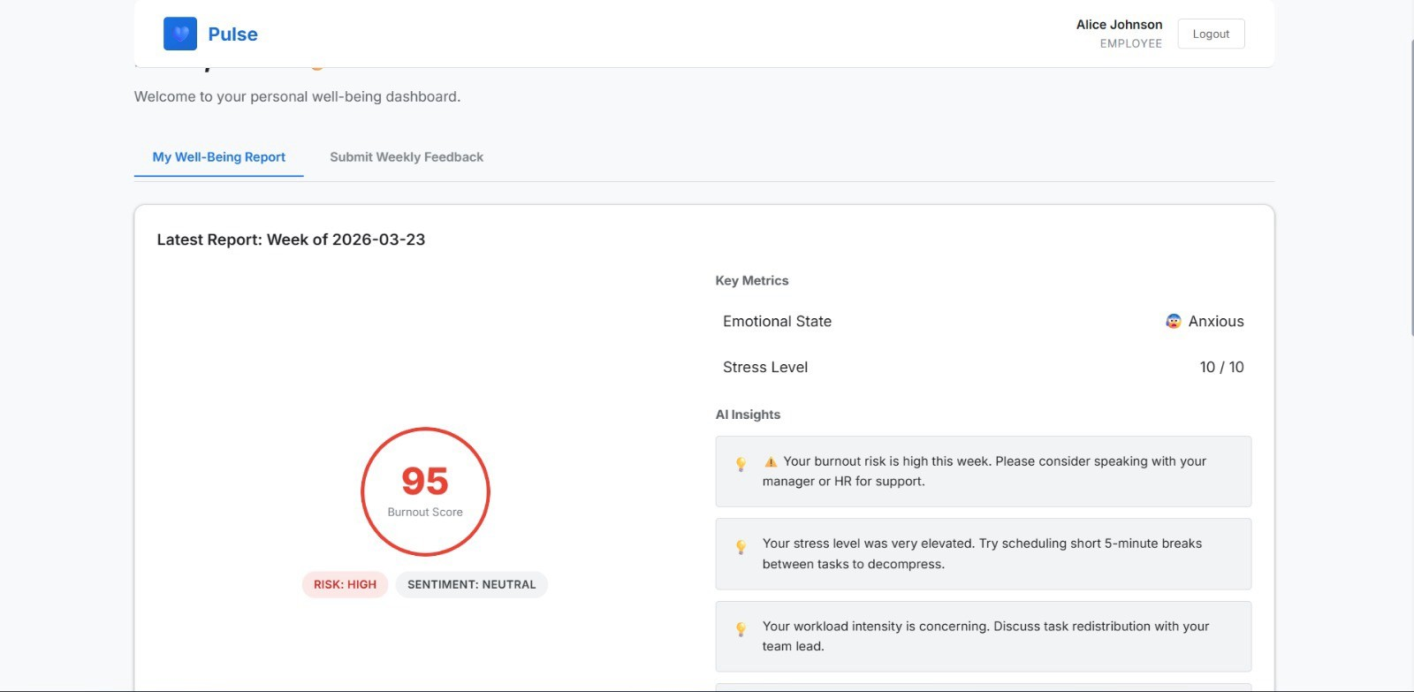
Proof of Concept (PoC) / Prototype Demo

Slide 13
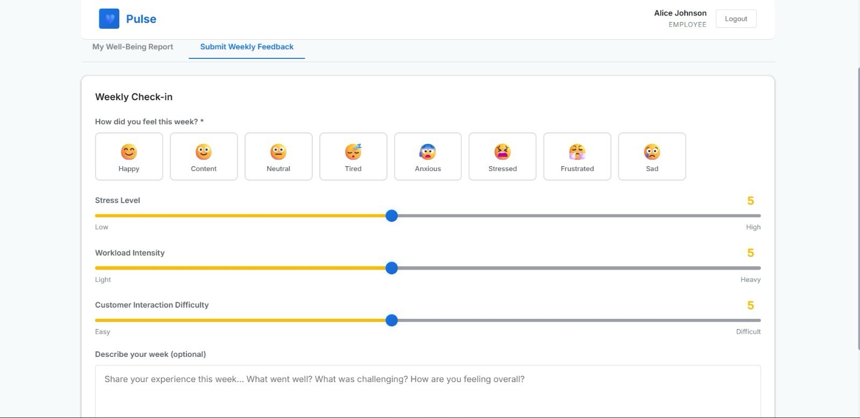
Proof of Concept (PoC) / Prototype Demo

Slide 14
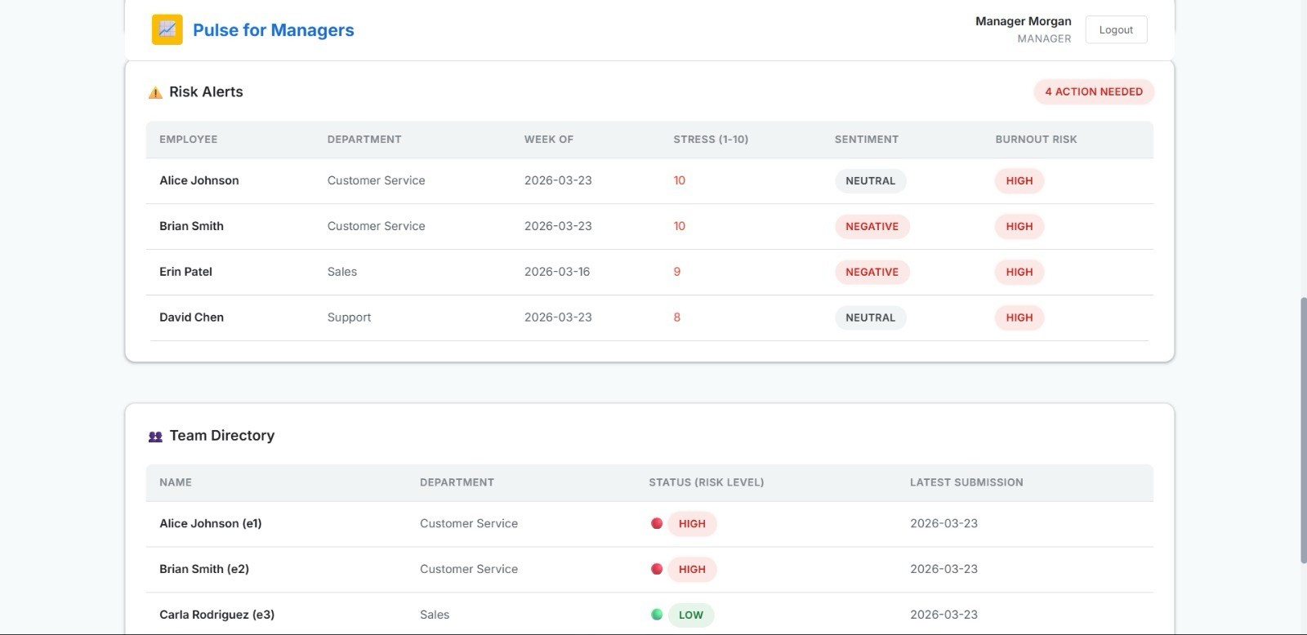
Proof of Concept (PoC) / Prototype Demo

Slide 15
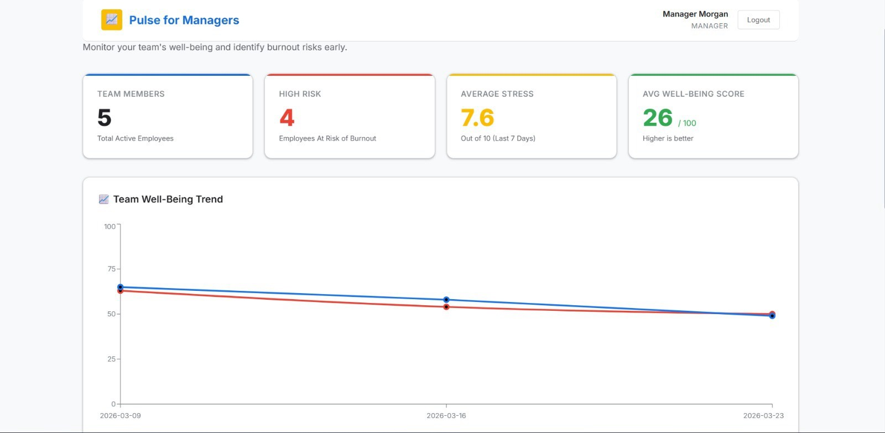
Proof of Concept (PoC) / Prototype Demo

Slide 16
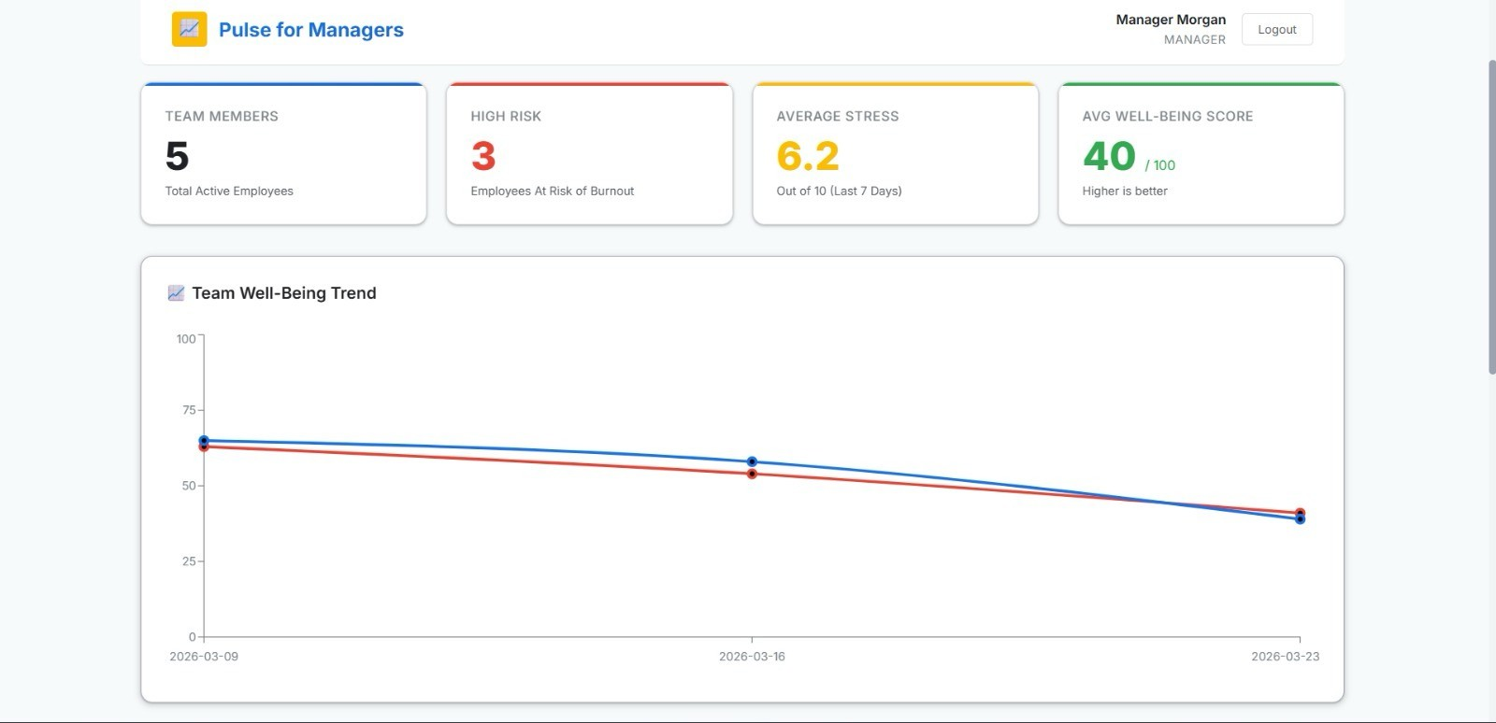
Proof of Concept (PoC) / Prototype Demo

