Slide 1

REVA UNIVERSITY
School of Computer Science and Engineering
AI-Based Weekly Employee
Well-Being Pulse System
Monitoring · AI Analysis · Burnout Prevention
PRESENTED BY
GUIDE DETAILS
Pranjal B Shastry SRN: R23EF233
Pranav Prakashan SRN: R23EF187
Guide Name: Prof. Shankar Rana
Mini Project Presentation | Phase 2
School of Computer Science and Engineering | REVA University
E2E | 1 / 12

Slide 2
AI-Based Weekly Employee
Well-Being Pulse System
Group no: D25
Group name:-Wellbeing Analytics Team
Group Members:
Pranav AJITH SRN: 187 Project Leader
SAJIL S NAIR SRN: 233 Developer Lead
Pranav AJITH SRN: 187 Documenter Lead
Name of the Guide: Prof. Shankar Rana
Designation: Assistant Professor

Slide 3
Table of Contents
01
06
Planning
Modules Identified
02
07
Project Scope
Draft of Acceptance / Survey Paper
03
08
Methodology
Conclusions
04
09
Requirement and Cost Analysis
References
05
Developing Project Execution Timelines
School of Computer Science and Engineering | REVA University
AI-Based Well-Being Pulse System
E2E | 2 / 12

Slide 4
01 | Planning
Problem Identification, Objectives & Project Rationale
Problem Statement
Planning Objectives
Sales & customer support employees face continuous, high-pressure workloads with little visibility into their mental health trajectory.
Performance targets create persistent anxiety; stress accumulates silently over weeks before becoming visible.
Traditional HR processes are reactive — burnout is detected only after productivity has already dropped significantly.
No structured, data-driven mechanism exists to measure employee emotional health on a weekly cadence.
Absence of early-warning systems means managers cannot intervene proactively before burnout occurs.
Design a lightweight weekly survey mechanism that captures both quantitative ratings and qualitative free-text responses.
Integrate AI-powered Natural Language Processing to automate sentiment analysis at scale — removing subjectivity from feedback interpretation.
Build a tiered burnout risk classification model (Low / Moderate / High) based on multi-factor analysis.
Develop dual-role dashboards for employees and managers to visualize trends and act on insights.
Ensure historical data persistence to support longitudinal workforce health trend analysis across departments.
Pilot the system within a front-line workforce segment and benchmark outcomes against baseline productivity metrics.
School of Computer Science and Engineering | REVA University
AI-Based Well-Being Pulse System
E2E | 3 / 12

Slide 5
02 | Project Scope
What the System Covers — Target Users, Features & Boundaries
System Scope & Overview
Target Users & Key Features
Collect structured weekly well-being feedback from front-line employees via a Friday digital survey covering five working days.
Apply NLP sentiment analysis on employee free-text responses to derive emotional polarity scores (Positive / Neutral / Negative).
Compute a composite burnout risk score by weighting stress levels, workload intensity, emotional state, and customer interaction difficulty.
Generate personalized AI-driven well-being reports for each employee with actionable improvement suggestions.
Provide aggregated, anonymized team analytics for managers, enabling proactive workforce health management.
Maintain a persistent historical database of entries to support cross-week trend analysis and longitudinal reporting.
Target Users:
Sales Staff
Customer Service Reps
Support Agents
Team Managers
HR Personnel
Key Features:
Weekly Friday Survey (quantitative + qualitative)
AI/NLP Sentiment Scoring Engine
Burnout Risk Classification: Low / Moderate / High
Role-Based Dashboards (Employee & Manager)
Historical Data Storage & Trend Visualization
School of Computer Science and Engineering | REVA University
AI-Based Well-Being Pulse System
E2E | 4 / 12

Slide 6
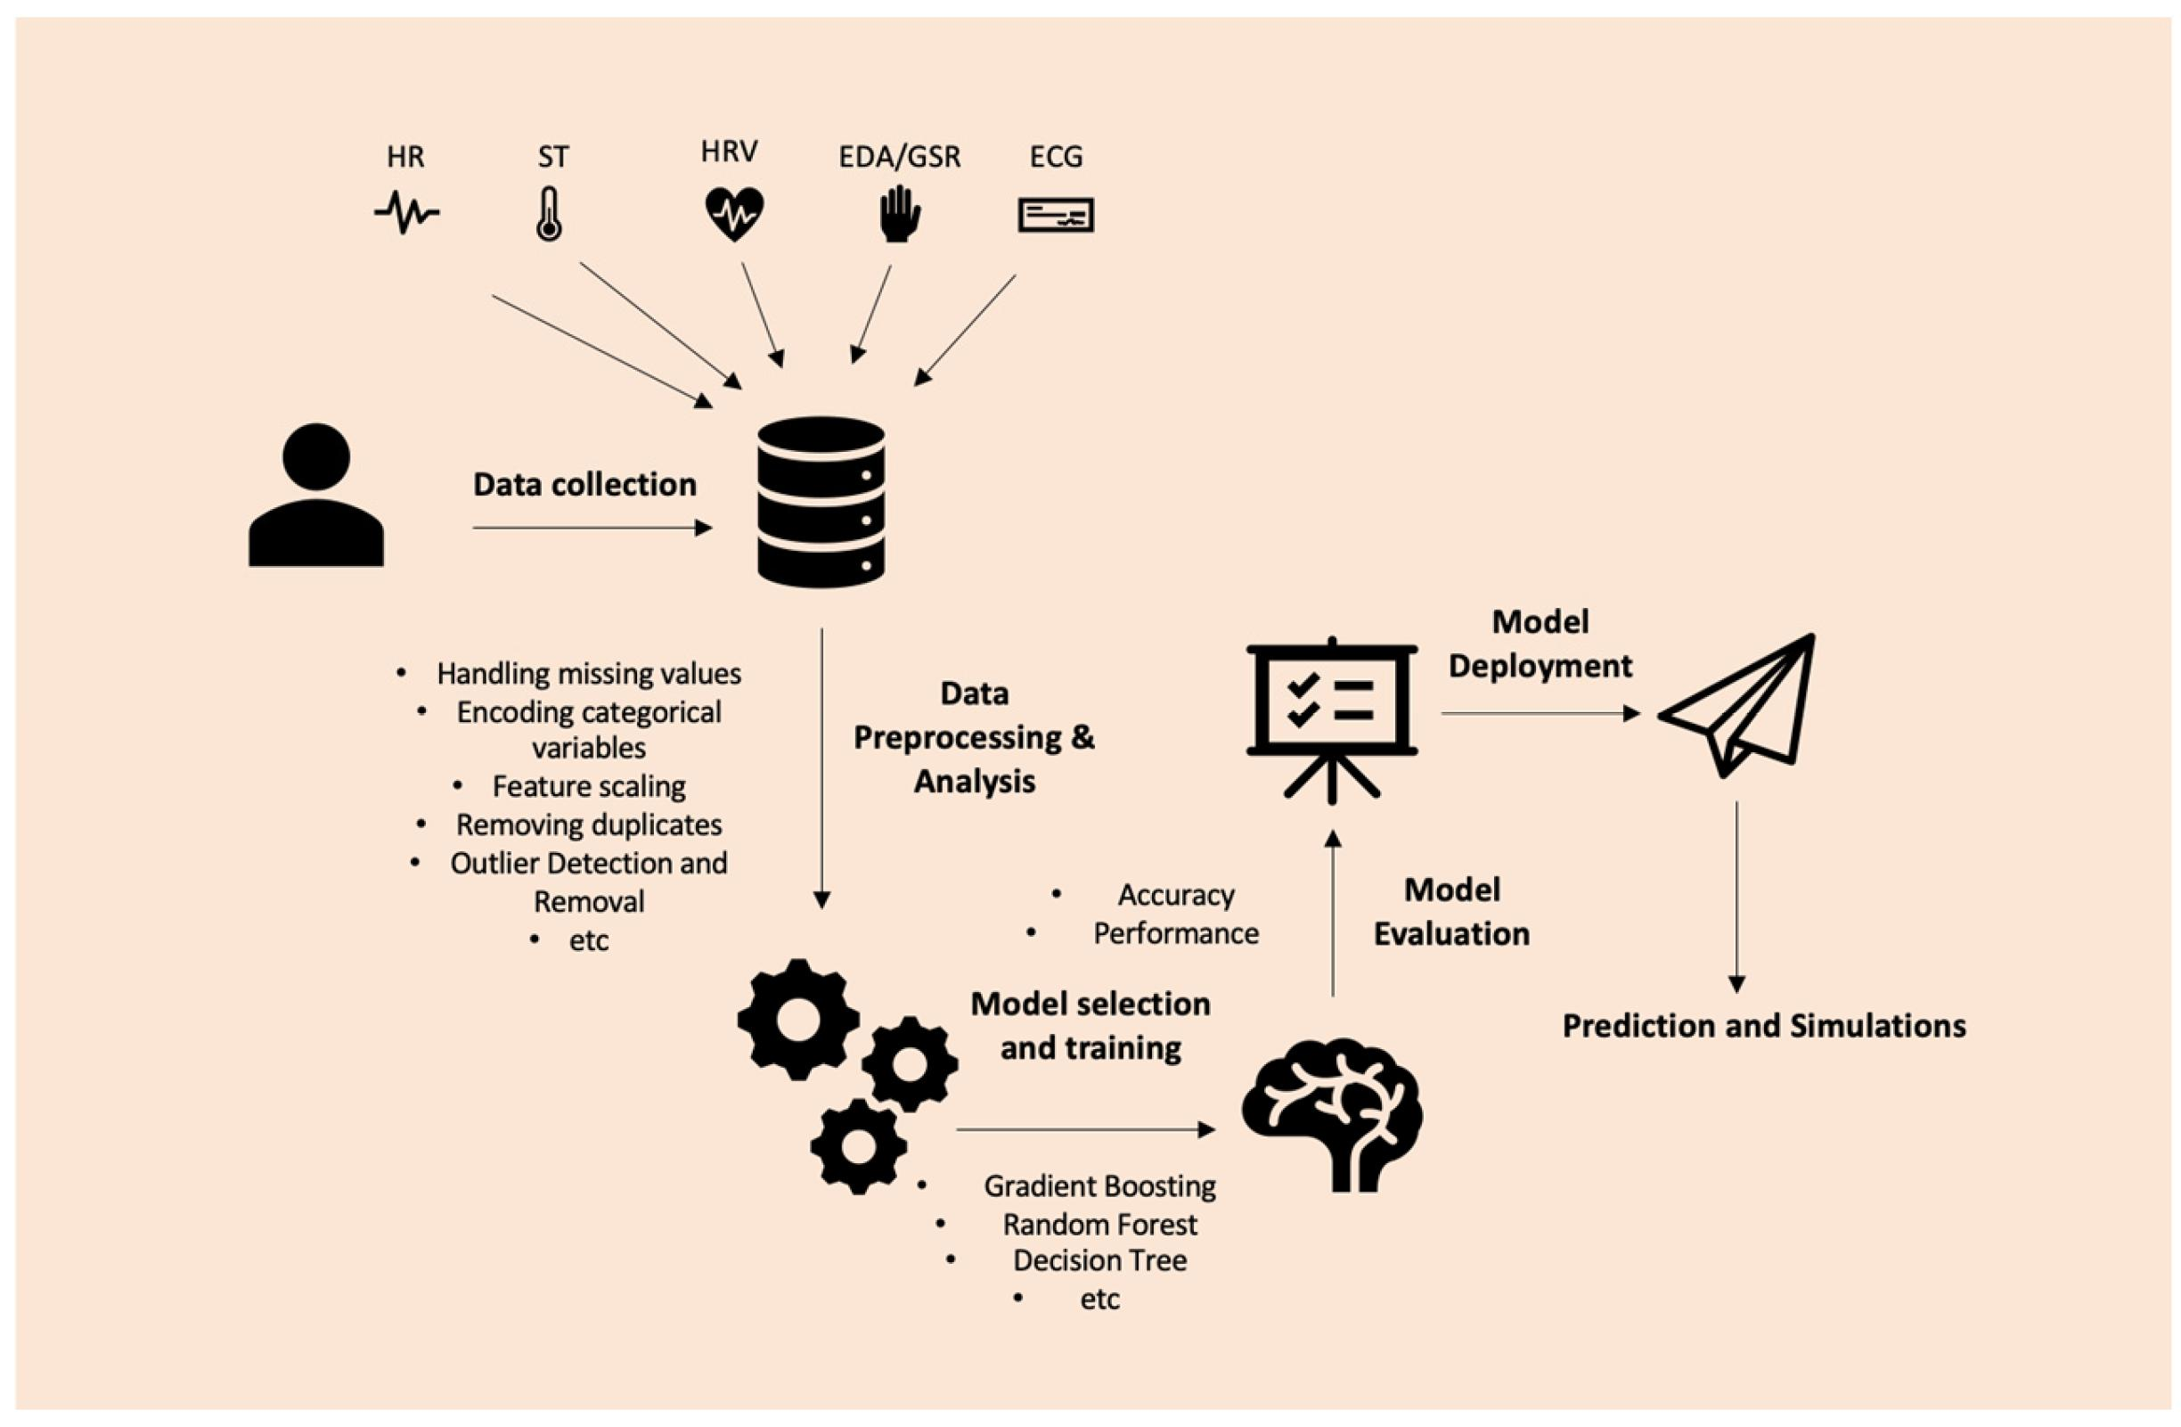
03 | Methodology
System Architecture, Workflow & Technology Stack
Employee
Login
▶
Submit
Feedback
▶
Data
Processing
▶
AI / NLP
Analysis
▶
Risk
Calculation
Technology Stack
Frontend: React.js / Bootstrap · Chart.js · HTML5/CSS3/JS
Backend: Python (Flask / Django) · REST API · JWT Auth
AI / NLP: NLTK · TextBlob · VADER · Scikit-learn · Custom Scoring
Database: MySQL / PostgreSQL · Employee & Feedback Tables
Deployment: Docker-ready · Cloud-compatible (AWS / GCP / Azure)
Agile iterative development with weekly sprint cycles — feedback and AI model tuning after each iteration.
Data pipeline: structured form inputs → numerical normalization → NLP sentiment classification → composite scoring.
School of Computer Science and Engineering | REVA University
AI-Based Well-Being Pulse System
E2E | 5 / 12

Slide 7
04 | Requirement and Cost Analysis
Functional, Non-Functional Requirements & Estimated Project Cost
Functional Requirements
Non-Functional & Cost Estimates
User authentication system with role-based access control (Employee / Manager / HR / Admin roles).
Weekly structured feedback form with quantitative sliders and mandatory free-text field, auto-closing every Friday.
NLP engine to tokenize, clean, and classify free-text responses into sentiment categories with polarity scores.
Composite burnout risk scoring algorithm combining stress, workload, emotional state, and NLP output.
Employee personal dashboard with weekly stress charts, AI-generated insights, and risk notifications.
Manager dashboard with team-wide heatmaps, individual risk flags, and exportable PDF reports.
Automated alert system notifying managers when an employee enters Moderate or High risk classification.
Scalability: Handle 500+ concurrent users without performance degradation.
Security: All data encrypted at rest and in transit; GDPR-compliant data handling.
Availability: 99.5% uptime SLA with failover database configuration.
Performance: Survey submission & dashboard load time under 2 seconds.
Privacy: NLP sentiment data stored without PII linkage in analytics layer.
Cost Summary
Cloud Hosting (1 yr)
₹ 12,000
Domain & SSL
₹ 1,500
DB Storage (1 yr)
₹ 4,000
NLP Libraries
Open Source
Total Estimate
₹ 17,500
School of Computer Science and Engineering | REVA University
AI-Based Well-Being Pulse System
E2E | 6 / 12

Slide 8
05 | Developing Project Execution Timelines
Sprint-Based Agile Schedule & Milestone Planning
Phase 1
Requirements & Design [Week 1–2]
Stakeholder interviews, scope definition, wireframe design, DB schema planning.
Phase 2
Backend Development [Week 3–5]
REST API setup, authentication system, feedback form logic, database integration.
Phase 3
AI / NLP Integration [Week 6–7]
NLTK/TextBlob pipeline, scoring algorithm, risk classification model, unit testing.
Phase 4
Frontend & Dashboards [Week 8–9]
React UI, employee & manager dashboards, Chart.js visualizations, role-based routing.
Phase 5
Testing & Deployment [Week 10–11]
Integration testing, user acceptance testing, bug fixes, cloud deployment, demo.
Phase 6
Documentation & Review [Week 12]
Final report, survey paper draft, presentation preparation, project review submission.
School of Computer Science and Engineering | REVA University
AI-Based Well-Being Pulse System
E2E | 7 / 12

Slide 9
06 | Modules Identified
Core System Modules & Their Functional Responsibilities
M1 Employee Module
M2 AI / NLP Analysis Module
Secure login and role-based session management for each employee.
Weekly survey form auto-activated every Friday with fields for emotional state, stress level, workload, and free text.
Historical submission viewer — employees can review their past week-by-week entries.
Notification system: reminder alerts before Friday cutoff; risk alerts when burnout level escalates.
Personal profile management with department, team, and manager linkage.
Text preprocessing pipeline: tokenization, stop-word removal, stemming/lemmatization via NLTK.
Sentiment polarity classification using VADER and TextBlob, producing Positive / Neutral / Negative scores.
Numerical ratings normalized and weighted using a custom scoring algorithm (Scikit-learn).
Composite Overall Stress Score calculated as weighted average of all input dimensions.
High-risk input auto-flagging for immediate escalation to the manager dashboard.
M3 Burnout Detection Module
M4 Dashboard Module
Multi-factor risk engine evaluating: stress score > 7/10, negative NLP sentiment, heavy workload rating.
Consecutive-week tracking: 3+ weeks of Moderate risk automatically upgrades classification to High.
LOW RISK (0–40): Employee managing well — standard monitoring continues.
MODERATE RISK (41–70): Signs present — manager auto-notified for check-in recommendation.
HIGH RISK (71–100): Burnout imminent — urgent HR/manager intervention flag triggered.
Employee Dashboard: weekly emotional & stress summary, personal AI insights, historical trend charts.
Manager Dashboard: team-wide stress heatmap, employee risk distribution, weekly trend comparisons.
HR Dashboard: department-level aggregated trends, exportable well-being reports (PDF).
Chart.js powered visualizations: line charts, risk gauge dials, sentiment distribution pie charts.
Real-time data refresh — dashboards update automatically upon new feedback submission.
School of Computer Science and Engineering | REVA University
AI-Based Well-Being Pulse System
E2E | 8 / 12

Slide 10
07 | Draft of Acceptance / Survey Paper
Research Documentation, Paper Scope & Submission Plan
Survey Paper Scope & Contribution
Submission Plan & Draft Status
The survey paper reviews existing employee well-being monitoring systems and identifies the gap in AI-driven, real-time mental health assessment tools in corporate settings.
Surveys 25+ academic and industry papers on NLP-based sentiment analysis, burnout detection, HR analytics, and workforce health monitoring systems.
Proposes a novel multi-factor composite scoring model integrating structured survey data with NLP polarity output — not covered by existing literature.
Benchmarks against prior approaches: manual HR surveys, pulse check apps, and static questionnaire systems, showing superior scalability and objectivity.
Documents experimental outcomes including risk prediction accuracy, false-positive rates, and employee self-reporting reliability.
Paper Title: 'AI-Driven Employee Well-Being Monitoring Using NLP Sentiment Analysis and Multi-Factor Burnout Risk Scoring'.
Target Conferences / Journals: IEEE Xplore, Springer LNCS, IJCAI Workshop on AI for Social Good, or equivalent peer-reviewed venue.
Current Draft Status: Abstract and Introduction finalized; Literature Review section 70% complete; System Architecture section in progress.
Methodology section to include full description of scoring algorithm, dataset construction, and evaluation metrics (Precision, Recall, F1-Score).
Ethics & Privacy section to address GDPR compliance, data anonymization strategy, and informed consent protocols for employee participants.
Submission target: End of academic term — final draft to be reviewed by project guide prior to submission.
School of Computer Science and Engineering | REVA University
AI-Based Well-Being Pulse System
E2E | 9 / 12

Slide 11
08 | Conclusions
Expected Outcomes, System Impact & Future Directions
↓ 40%
↑ 25%
7 days
500+
Estimated Burnout
Risk Reduction
Projected Team
Productivity Gain
Average Early
Detection Window
Concurrent Users
Supported
Key Takeaways & Expected Outcomes
The AI-Based Weekly Well-Being Pulse System bridges the long-standing gap between silent employee distress and actionable managerial insight — replacing reactive HR processes with proactive, data-driven mental health management.
Systematic weekly monitoring via structured surveys enables early detection of burnout trajectories, significantly reducing the risk of complete burnout events that damage both employee well-being and organizational productivity.
The NLP-powered sentiment analysis engine makes feedback interpretation objective, scalable, and free from human bias — processing hundreds of responses within seconds and extracting nuanced emotional signals from free text.
Dual-role dashboards empower employees with self-awareness and managers with team visibility — creating a healthier feedback culture where mental health data informs operational decisions.
Historical trend analysis enables HR teams to identify seasonal stress patterns, department-level risk clusters, and the long-term effectiveness of workplace wellness interventions.
The system contributes to building a human-centric, data-informed organizational culture — aligning employee well-being goals with measurable business outcomes including retention, productivity, and engagement scores.
School of Computer Science and Engineering | REVA University
AI-Based Well-Being Pulse System
E2E | 10 / 12

Slide 12
09 | References
Academic & Technical Sources
[1] Maslach, C., & Leiter, M. P. (2016). Burnout. In Stress: Concepts, Cognition, Emotion, and Behavior. Academic Press, pp. 351–357.
[2] Hutto, C. J., & Gilbert, E. (2014). VADER: A Parsimonious Rule-based Model for Sentiment Analysis of Social Media Text. ICWSM 2014.
[3] Loria, S. (2018). TextBlob: Simplified Text Processing. Release 0.15.3. https://textblob.readthedocs.io
[4] Bird, S., Loper, E., & Klein, E. (2009). Natural Language Processing with Python. O'Reilly Media, Inc.
[5] Pedregosa, F., et al. (2011). Scikit-learn: Machine Learning in Python. Journal of Machine Learning Research, 12, 2825–2830.
[6] Gallup (2023). State of the Global Workplace Report — Employee Engagement & Well-Being. Gallup Press.
[7] WHO (2019). Burn-out an 'Occupational Phenomenon': International Classification of Diseases. World Health Organization.
[8] Flask Documentation (2023). Flask — Web Development, One Drop at a Time. Pallets Projects. https://flask.palletsprojects.com
[9] React.js Documentation (2024). React — A JavaScript Library for Building User Interfaces. Meta Open Source. https://react.dev
[10] Chart.js Documentation (2024). Chart.js — Simple Yet Flexible JavaScript Charting. https://www.chartjs.org
School of Computer Science and Engineering | REVA University
AI-Based Well-Being Pulse System
E2E | 11 / 12

Slide 13
REVA UNIVERSITY
School of Computer Science and Engineering
Thank You
Questions & Discussion Welcome
Pranav Ajith (187) · Sajil S Nair (233)
AI-Based Weekly Employee Well-Being Pulse System | Mini Project Phase 2
School of Computer Science and Engineering | REVA University
E2E | 12 / 12

