Slide 1
PERSONALIZED DASHBOARD
GROUP NO. 4
Soham Patil – A41
Yash Kamble – A52
Nirav Savla – A59

Slide 2
Introduction
In today's fast-paced world, managing productivity efficiently is crucial for both individuals and teams. Our project aims to address this need by creating a comprehensive, personalized productivity dashboard designed to streamline daily tasks and enhance productivity. The dashboard is structured into two tiers: a free tier for individual users and a premium tier for teams, each offering a unique set of features tailored to different needs.

Slide 3
Objectives :
Our projects is divided into two parts, a free tier and a premium tier the services are
Free Tier:
Weather Updates: Stay informed about the latest weather conditions.
To-Do List: Organize tasks efficiently with an intuitive to-do list.
Notes App: Jot down ideas and important information in an easy-to-use notes app.
Drawing Board : You can draw your imagination here, and can even save it as an image.

Slide 4
Literature Survey
Article Name (Year) and Author | Advantages | Disadvantages
"Enhancing Productivity with Custom Dashboards" (2022) by J. Smith | 20% increase in productivity | Data privacy and tool integration
"Real-Time Collaboration in Productivity Tools" (2023) by A. Johnson | 15% improvement in team coordination | Data consistency and low latency
"Integrating Health and Productivity Metrics" (2024) by L. Wang | 10% improvement in well-being and efficiency | Accurate health data integration
"Customizable UX for Productivity Tools" (2024) by S. Davis | 30% increase in user satisfaction and engagement | Balancing customization with usability

Slide 5
Problem Statement :
In our project, we aim to empower individuals and teams to achieve their full potential by providing a unified platform that addresses all aspects of productivity. By combining essential tools with advanced features, we're creating a ecosystem where efficiency meets collaboration.

Slide 6
Proposed Methodology :
Planning and Structure: Conduct user research to identify needs, outline project scope, and create a detailed project plan.
UI/UX Design: Develop wireframes and interactive prototypes, and refine them based on user feedback.
Development and Deployment: Implement front-end and back-end components, integrate features, and deploy the application.
Testing and Quality Assurance: Perform unit, integration, and user acceptance testing to ensure functionality and fix any issues.
Feedback: Launch a beta version, collect user feedback, and make continuous improvements based on user input.

Slide 7
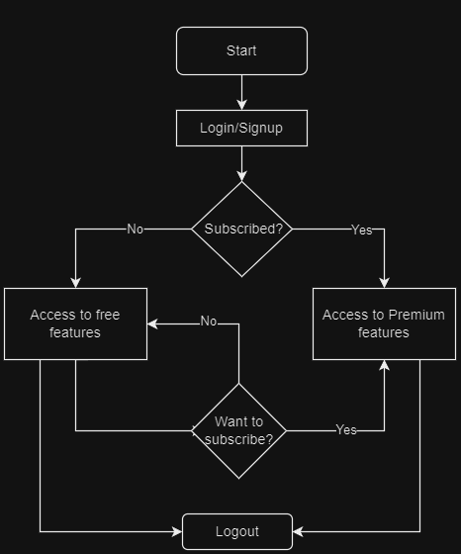

Slide 8
Target Audience :
Students juggling academic responsibilities
Professionals managing complex projects
Remote teams seeking seamless collaboration
Anyone looking to optimize their daily productivity

Slide 9



Technologies Used :
Programming languages :
HTML
CSS
JS
MONGO DB
IDEs :
VS CODE

Slide 10
Conclusion :
Our project represents a leap forward in productivity management. By seamlessly integrating essential tools for both individuals and teams, we're not just creating a dashboard – we're building a comprehensive productivity ecosystem. From basic task management to advanced analytics, our project adapts to users' needs, empowering them to achieve more. As we look to the future, we envision ProDash as the go-to platform for anyone seeking to optimize their workflow and maximize their potential.

Slide 11
References :
Evernote : https://evernote.com/
Milanote : https://milanote.com/
Documentation: "Google Calendar API“ : https://developers.google.com/calendar/api/guides/overview
Notion : https://www.notion.so/

Slide 12

THANK YOU

