Slide 1
Social Media Dashboard
Interactive visualization of Social Media Dashboard using D3.js
Presented by
B.Saketh Reddy
Reg.No.:9925051013

Slide 2
PROJECT SHOWCASE
Social Media
Dashboard
An interactive, unified dashboard that tracks followers, engagement, and reach across 6 major social platforms in real time.
6
9.4M
31M
Platforms
Followers
Impressions
Social Media Dashboard • Project Overview
2/ 6

Slide 3
Why We Built It
Solving the hassle of managing multiple disconnected social media channels.
THE PROBLEM
THE SOLUTION
Scattered Data
One Unified Dashboard
✔ A single screen with all key numbers ready at a glance.
✔ Uniform metrics for direct, side-by-side platform comparison.
✔ Instant 7-day, 30-day, and 90-day time horizon filtering.
✔ Runs fast directly in the browser with zero login or server delay.
✕ Checking 6 different social apps every week takes too much time.
✕ Each platform defines engagement and impressions differently.
✕ Manual spreadsheets are slow to maintain and prone to errors.
✕ No instant way to spot which channel gives the best ROI.
Social Media Dashboard • Project Overview
3 / 6

Slide 4
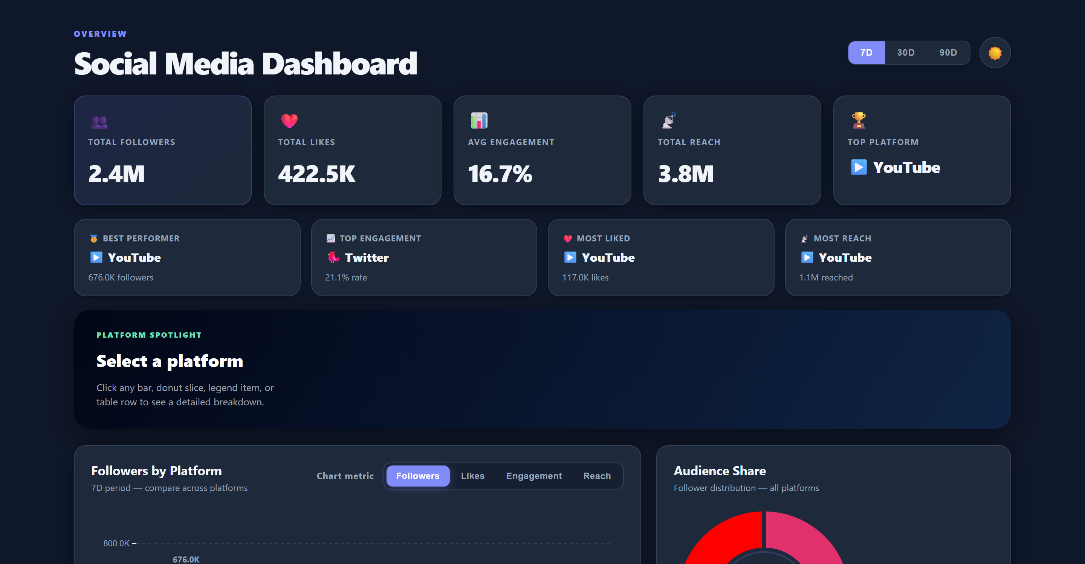
Dashboard Overview
Top-level KPIs, dynamic insights, and interactive platform spotlight.
Executive KPI Cards
Displays total followers, likes, reach, and average engagement rate with live 7D / 30D / 90D scaling.
Best Performer Strip
Automatically spots top performers, engagement leaders, and most liked platforms without manual math.
Platform Spotlight
Click on any platform to see focused normalized progress bars compared against the network maximums.
Live view: Executive KPI cards, insights strip, and platform spotlight.
Social Media Dashboard • Project Overview
3 / 6

Slide 5
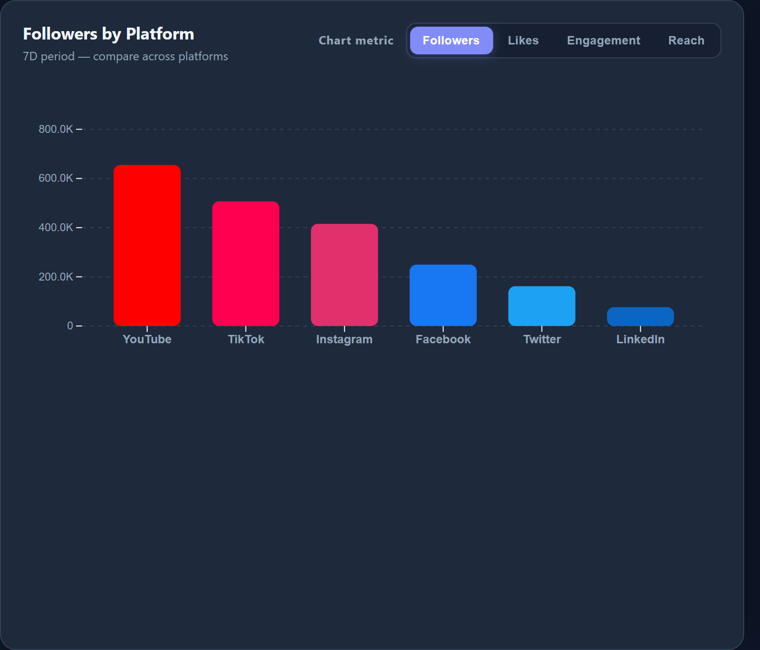
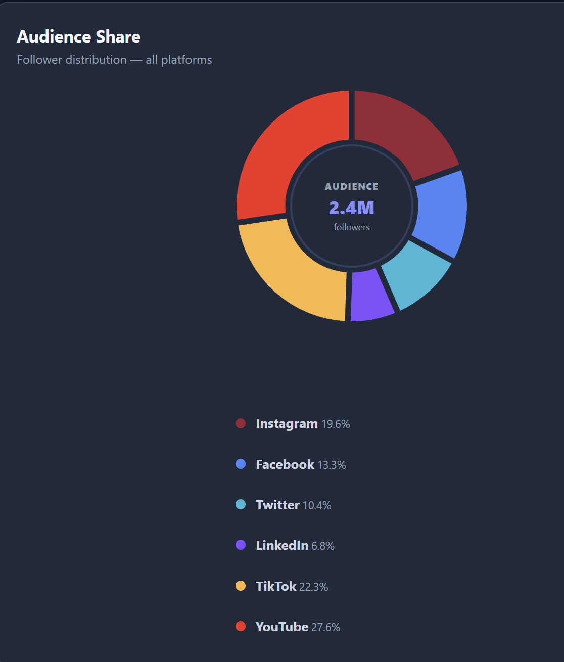
Interactive Visual Analytics
Data visualizations built with D3.js for quick cross-channel comparison.
Comparative Bar Chart
• Switch between Followers, Likes, Engagement, and Reach.
• Color-coded bars for each brand (Instagram, YouTube, etc.).
• Interactive hover tooltips reveal exact metrics and percentages.
Audience Share Donut
• Visualizes follower share across all 2.4M followers.
• Interactive legend dims unselected slices on hover.
• Clicking any slice focuses the platform across the dashboard.
Live view: Comparative bar chart and proportional audience share donut.
Social Media Dashboard • Project Overview
4 / 6

Slide 6
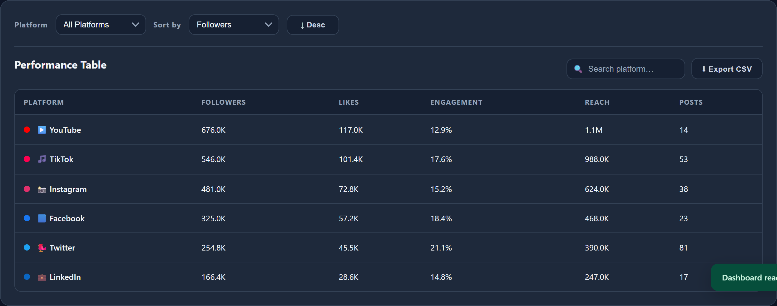
Performance Table & Export
Inspect granular numbers, sort columns, and export data in one click.
🔍 Instant Live Search
Filter platforms by typing in the search box — table results update in real time.
⇅ Multi-Column Sorting
Sort by Followers, Likes, Engagement, Reach, or Posts in ascending or descending order.
⬇ One-Click CSV Export
Export filtered table data to a clean CSV file ready for Excel or Google Sheets.
Live view: Filterable, sortable platform table with instant search and CSV export.
KEY BENEFIT: ZERO SERVER ROUNDTRIPS
All table calculations, sorting, and CSV formatting happen instantly in memory, providing a smooth 60fps user experience.
Social Media Dashboard • Project Overview
5 / 6

Slide 7
Architecture & Roadmap
Built with pure web standards and planned for future expansion.
Technology Stack
Planned Enhancements
• HTML5 & CSS3:
Semantic layout, CSS variables for dark/light themes, and responsive CSS grid.
1
Live API Connections
Direct OAuth sync with Meta Graph API, YouTube Data API, and TikTok.
• JavaScript:
Lightweight state management, instant filtering, and zero heavy frameworks.
2
PDF / Image Export
One-click button to download executive PDF summary cards.
• D3.js (v7):
Custom SVG data visualizations, smooth scale transitions, and hover tooltips.
3
Progressive Web App
• Firebase Hosting Ready:
Pre-configured firebase.json for instant, global CDN edge deployment.
Install-to-home-screen mobile support for fast smartphone checks.
THANK YOU!
Social Media Dashboard • Project Overview
6 / 6

