Slide 2




We have all had crazy dreams where we were running around in a random forest.
What if it was a game!!

Slide 3
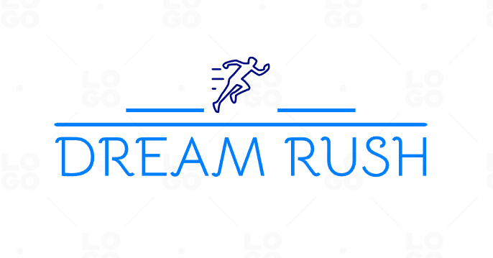

Slide 4
Dream rush is a Third Person Perspective, Single Player, Finite Game,
Built On Unity
How To Play
Collect the orbs .
Avoid the trains.
Use the left and right arrow keys to switch lanes.
Avoid the crates or lose your orbs
Collect as many as orbs possible and reach the finish line to WIN the game!!

Slide 5
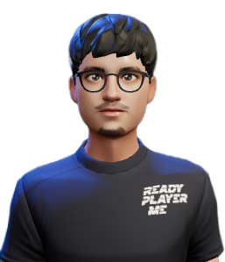
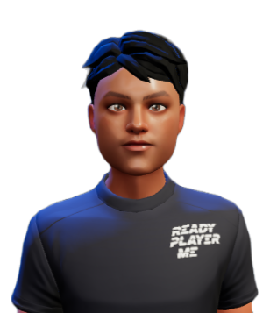
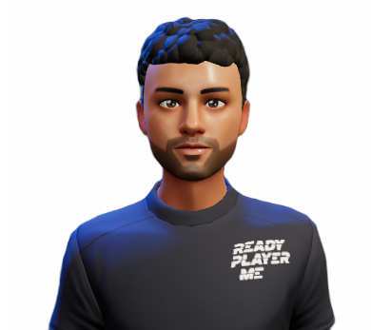
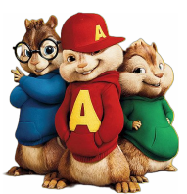
Mutasim
PES1UG21CS338
V Naga Saketh
PES1UG21CS355
Ashay Naik
PES1UG21CS118

