Slide 1
Project Overview
FastAPI Document-Query Web App
Tech Stack: FastAPI, Tailwind CSS, HTML templates, JavaScript & jQuery
Core Components:
Authentication (Register/Login)
Dashboards
Document upload, storage, query
System Health endpoint

Slide 2
Auth & Dashboard Flow
Register → Login → Dashboard
Dashboard View:
User info (username/email)
Actions: Upload, View, Ask a Question, Health

Slide 3
Document Upload & Management
Upload Page:
Title, Description, .txt File Picker, Upload Button
Stored Document View:
Title, File Name, Date, Description
Select for Query

Slide 4
Ask a Question (Query Page)
Select a document → Ask a question
UI shows doc info + chat-style interaction
Uses GPT to respond based on document context

Slide 5
System Health Endpoint
Health Page shows:
Status (e.g., 'healthy')
Database connectivity
Simple visual indicator panel

Slide 6
Summary & Next Steps
Achievements:
Auth, Upload, Q&A, Health
Future Enhancements:
DOCX support
User-based doc access
UI/UX improvements

Slide 7
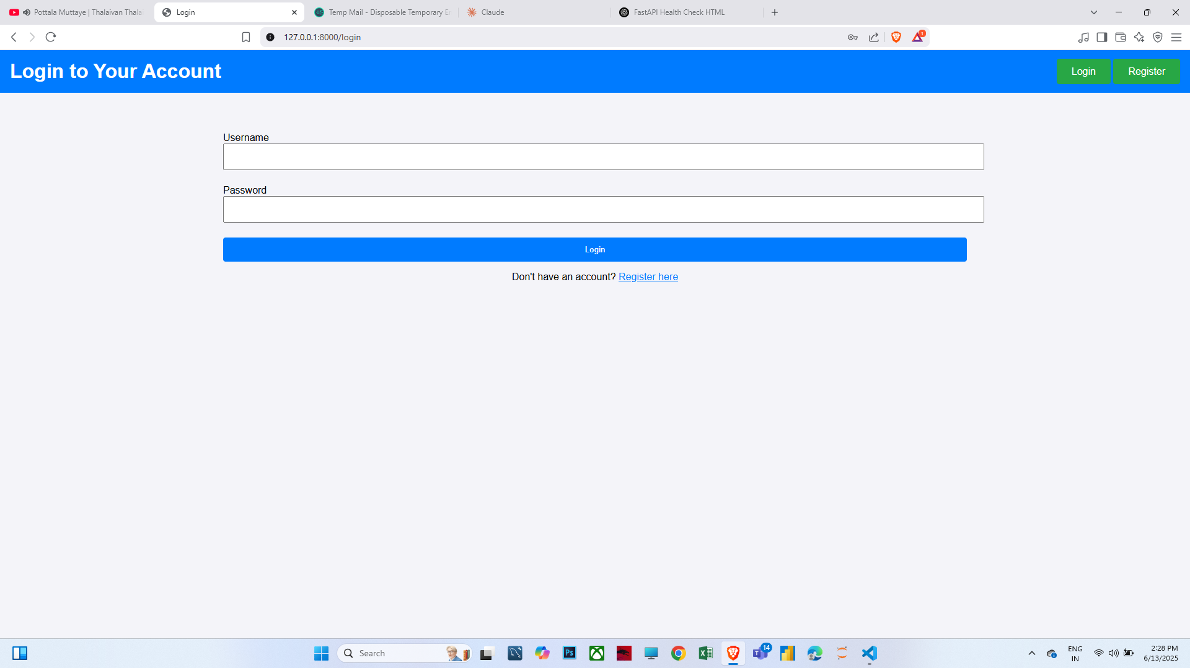

Slide 8
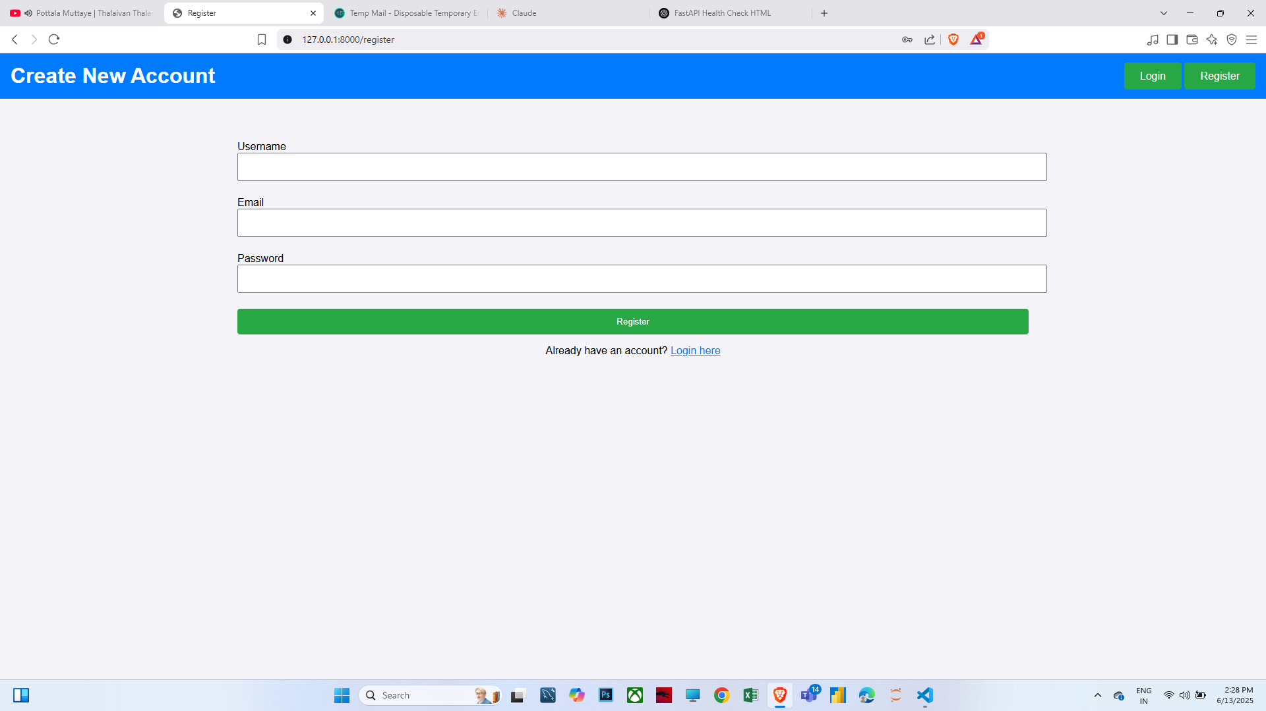

Slide 9
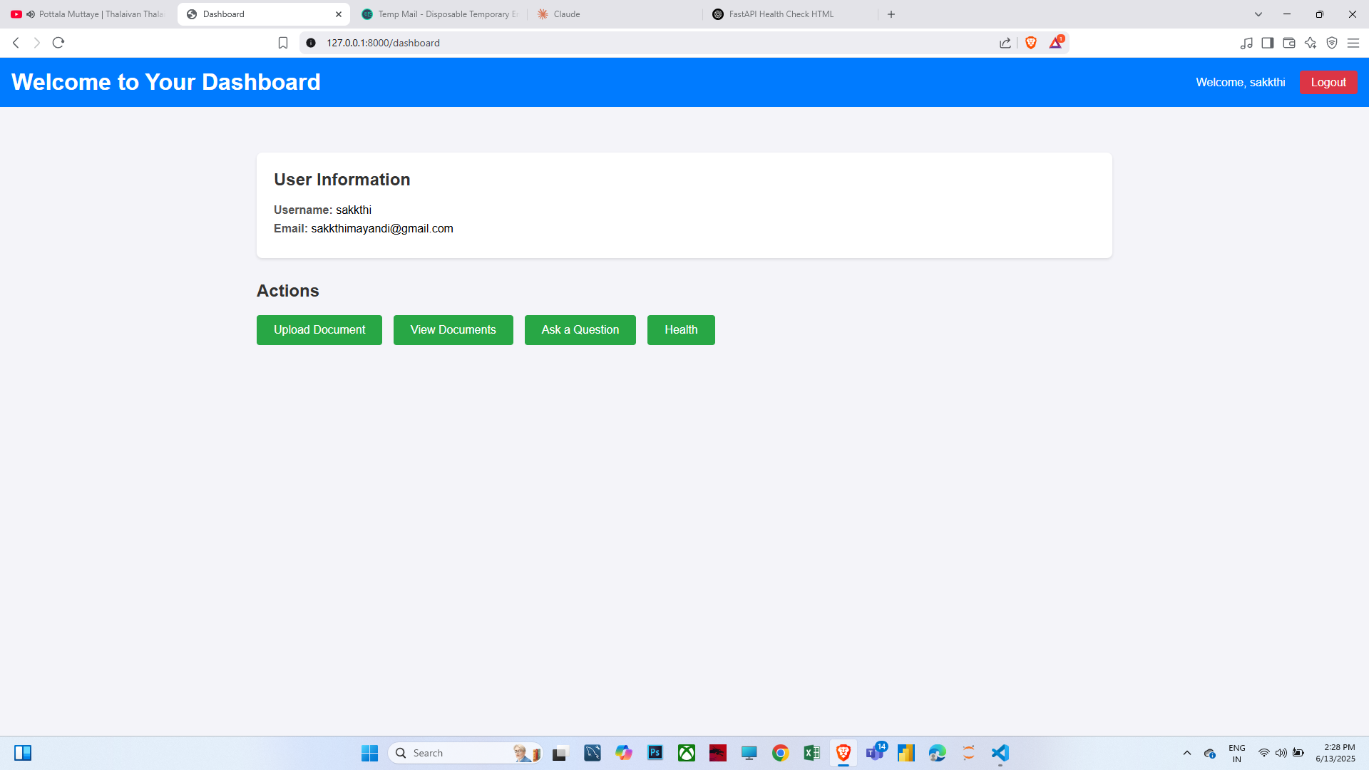

Slide 10
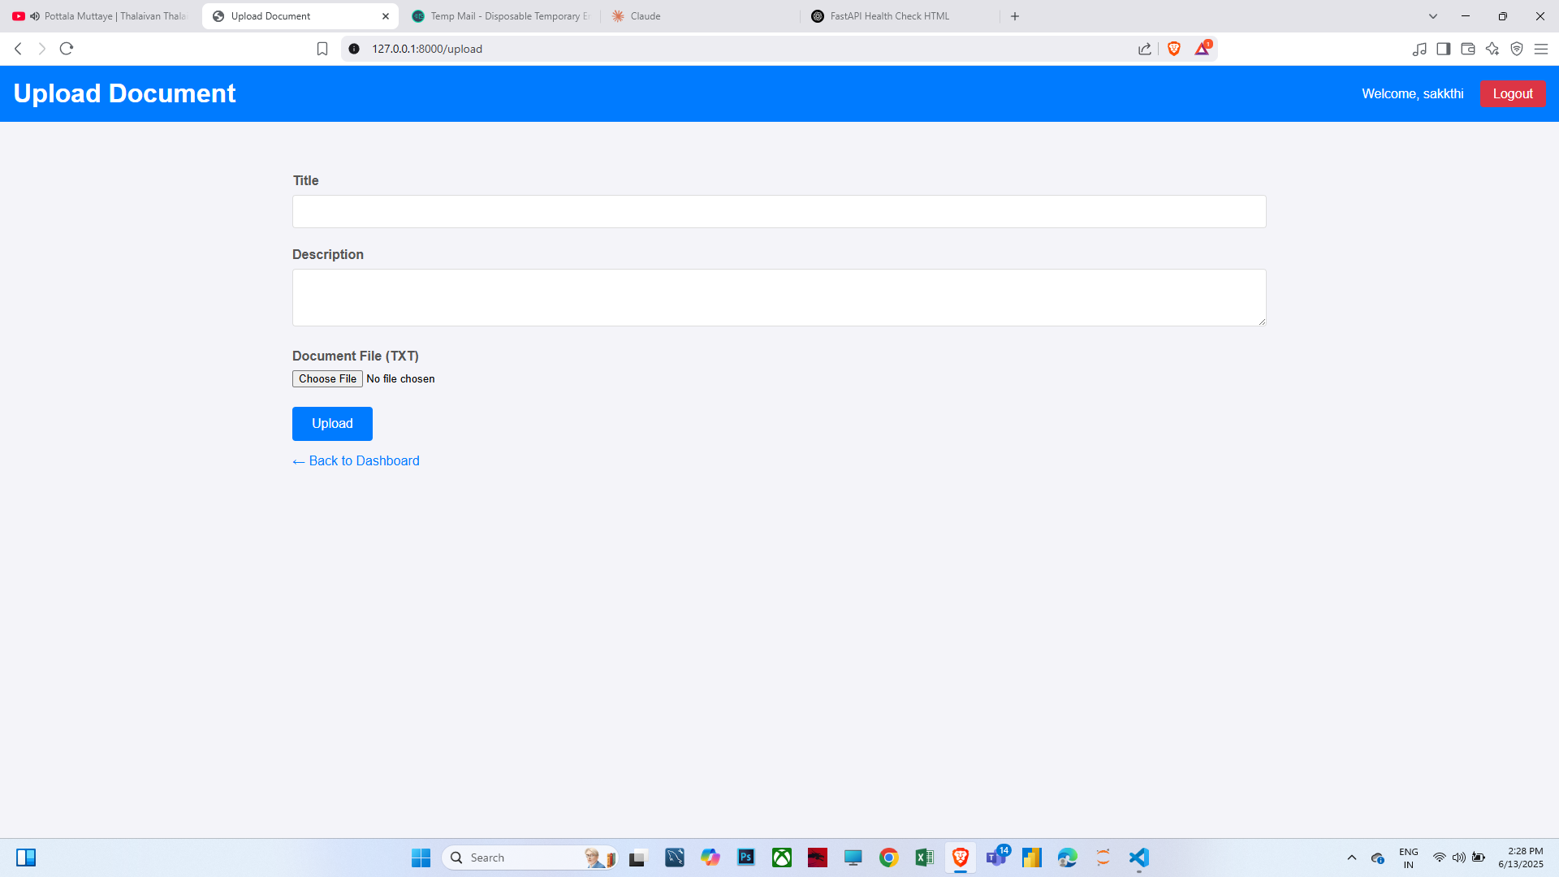

Slide 11
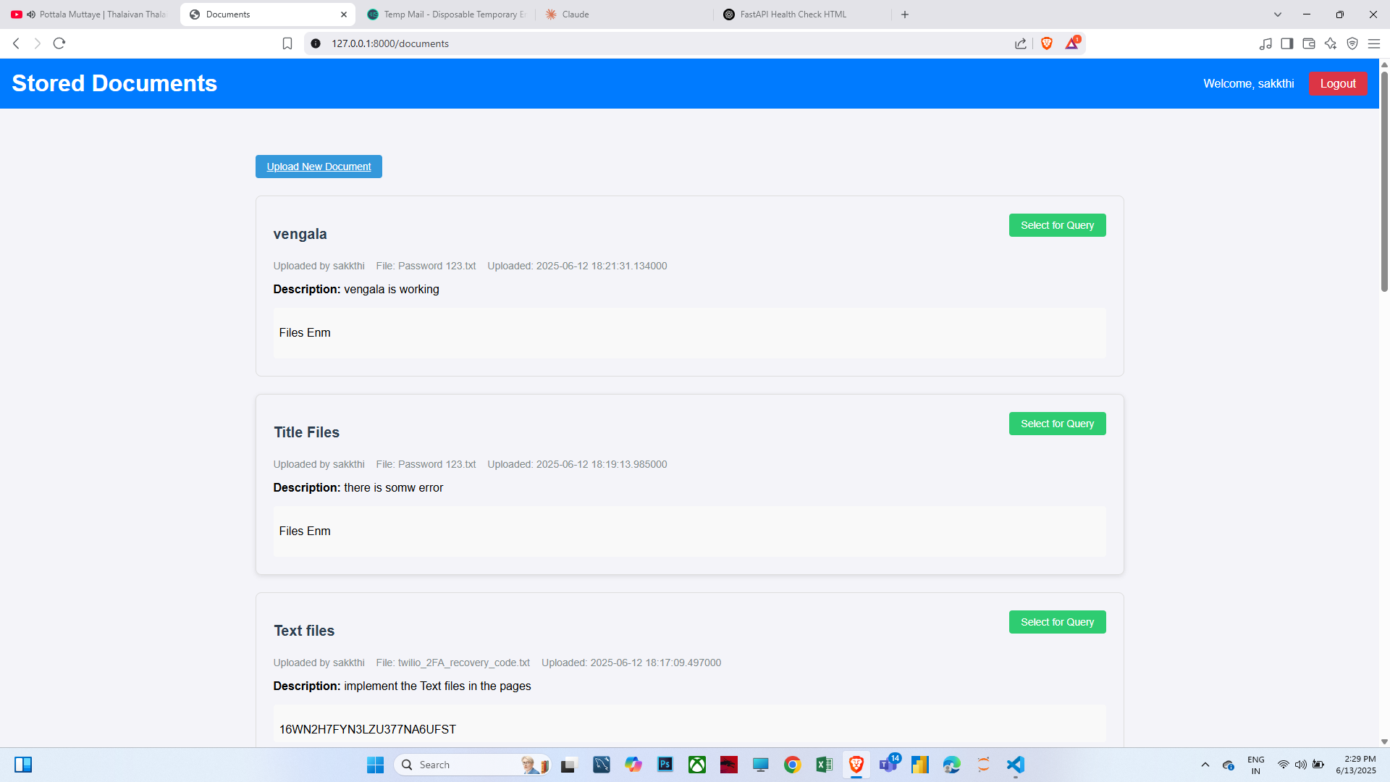

Slide 12
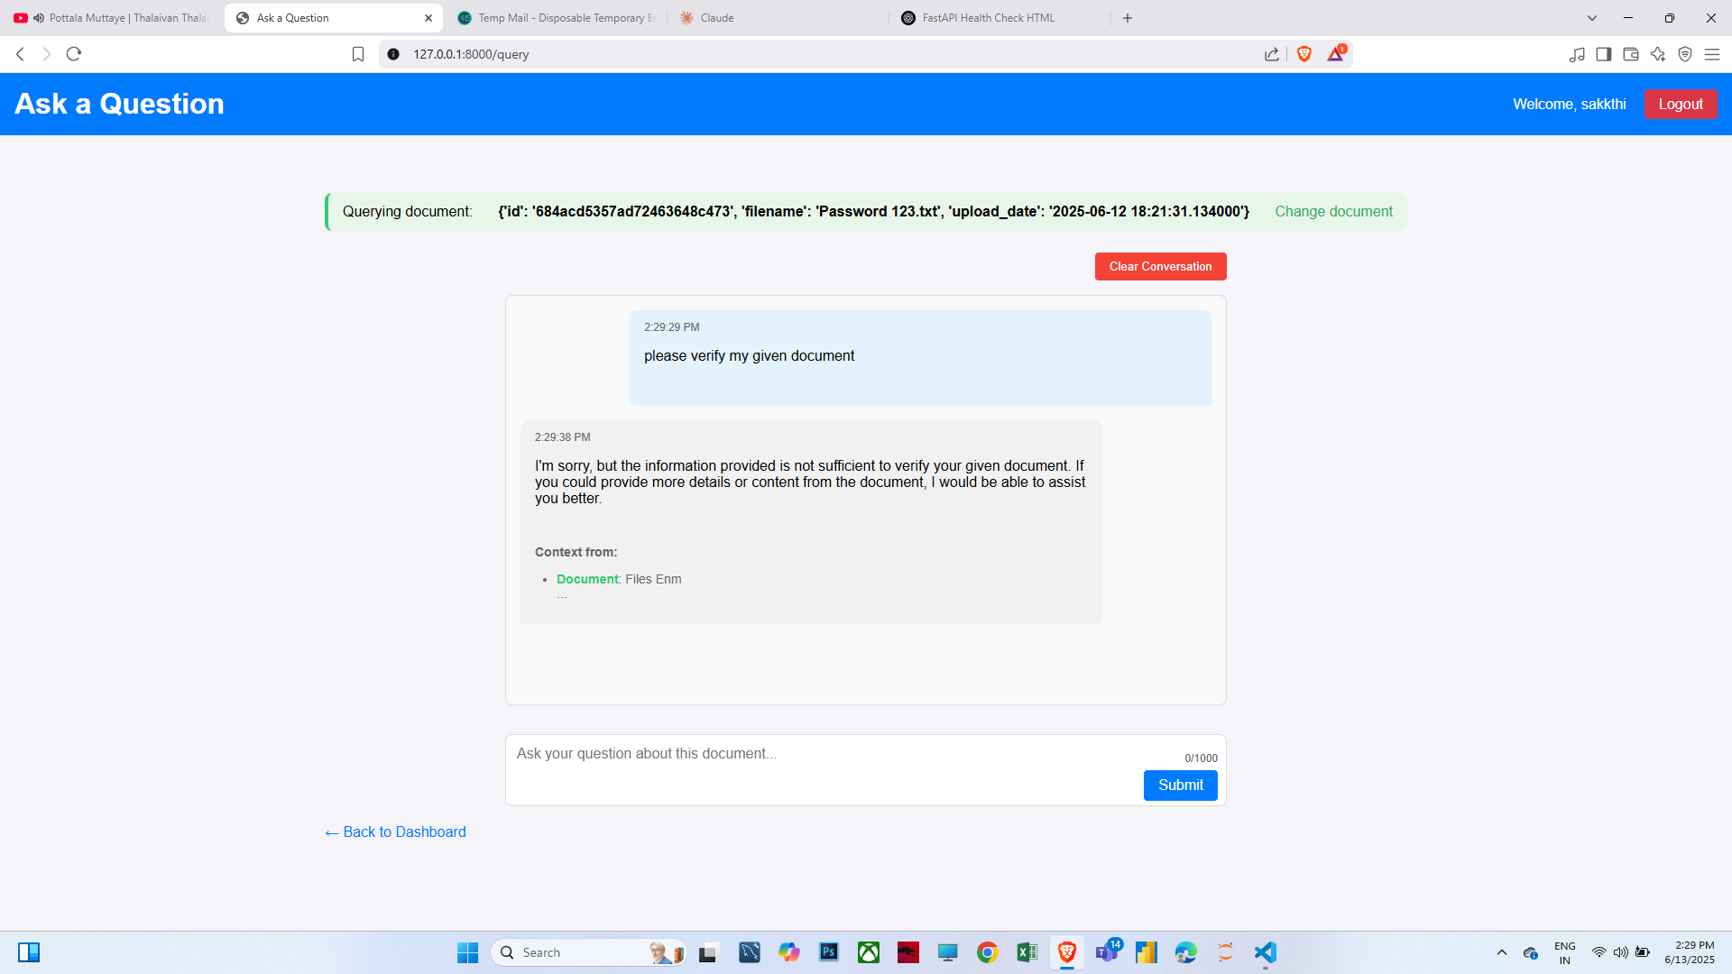

Slide 13
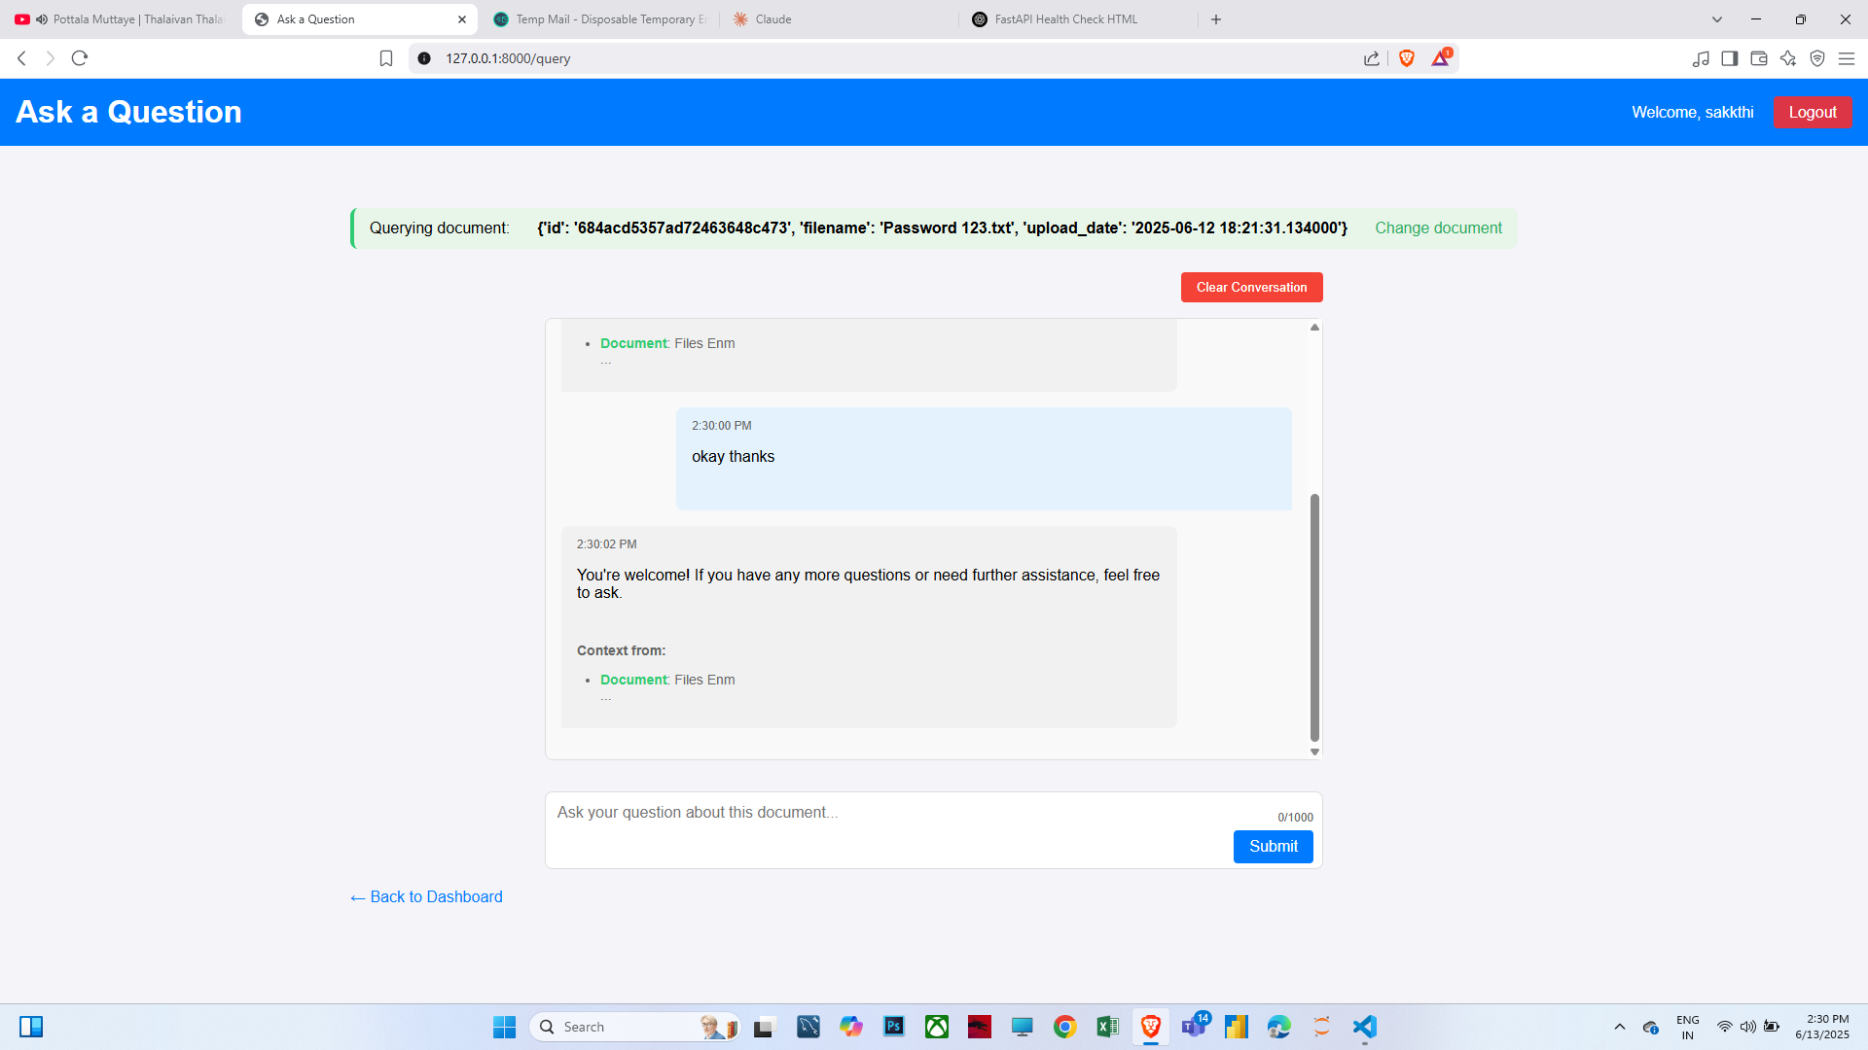

Slide 14
