Slide 1
Sales Performance Dashboard Summary
Prepared by: Saksham Pathak
Date: 07-08-2025

Slide 2
Objective
The objective of this Power BI dashboard is to analyze the sales, profit, quantity, and profit margin across different regions, segments, and categories for the Sample Superstore dataset. The dashboard aims to enable quick decision-making through interactive and insightful visuals.

Slide 3
Dataset Overview
The dashboard uses the Sample Superstore dataset, which contains:
- Order ID
- Order Date
- Sales
- Profit
- Quantity
- Segment
- Category
- Region

Slide 4
DAX Measures Created
- Total Sales
- Total Profit
- Total Quantity
- Profit Margin

Slide 5
Dashboard Layout
The dashboard layout includes:
- KPI cards for Total Sales, Total Profit, Total Quantity, Profit Margin
- Line chart showing sales trend over time
- Pie chart for sales by segment
- Bar chart for sales by category
- Slicers for Region, Segment, and Category

Slide 6
Key insights
1. Overall Performance
Total Sales: $2.3M
Total Profit: $286K
Profit Margin: Low at 12%, indicating pricing or cost issues.
Total Quantity Sold: 38,000 units
2. Segment Analysis
Consumer Segment is the strongest performer, driving 50%+ of total sales.
Corporate follows with around 30% share.
Home Office contributes the least (18.7%).
Stakeholders should focus on strengthening Home Office segment and nurturing Consumer segment further.

Slide 7
Key insights
3. Regional Analysis
Region | Sales | Profit | Profit Margin
East | $1.16M | $134K | 12%
West | $706K | $91K | 13%
Central | $429K | $60K | 14%
South | $706K | $92K | 13%
East Region leads in sales ($1.16M) but has a low profit margin.
Central Region has a relatively better profit margin (14%) despite lower sales, suggesting greater efficiency.
Opportunity exists to replicate Central’s margin strategies in higher-volume regions like East.

Slide 8
Key insights
Category Analysis
Technology is a key category, consistently driving the highest share in most regions.
Furniture and Office Supplies have lower contribution and weaker margins, indicating room for optimization in their pricing, procurement, or marketing.
Time-based Trends
Sales show a strong spike early on but then decline steadily over time.
This suggests seasonal spikes or potential marketing fatigue — stakeholders should investigate causes of this drop-off and plan campaigns to smooth sales throughout the year.

Slide 9
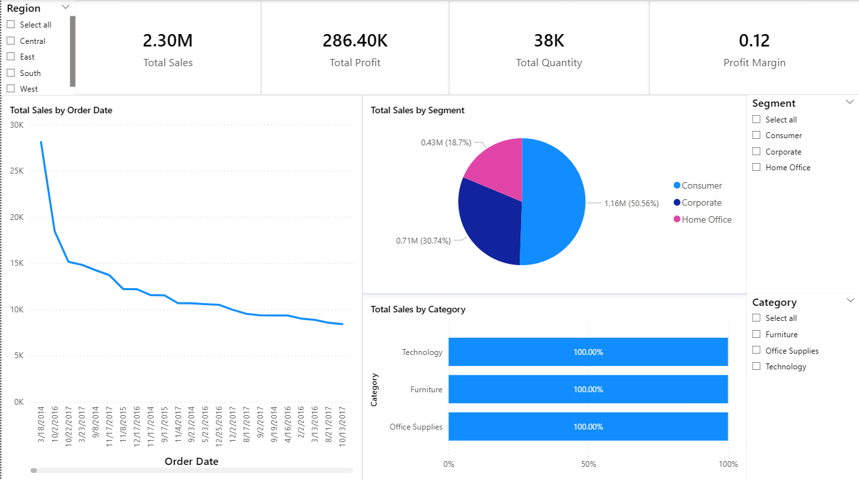
Screenshot [dashboard]

Slide 10
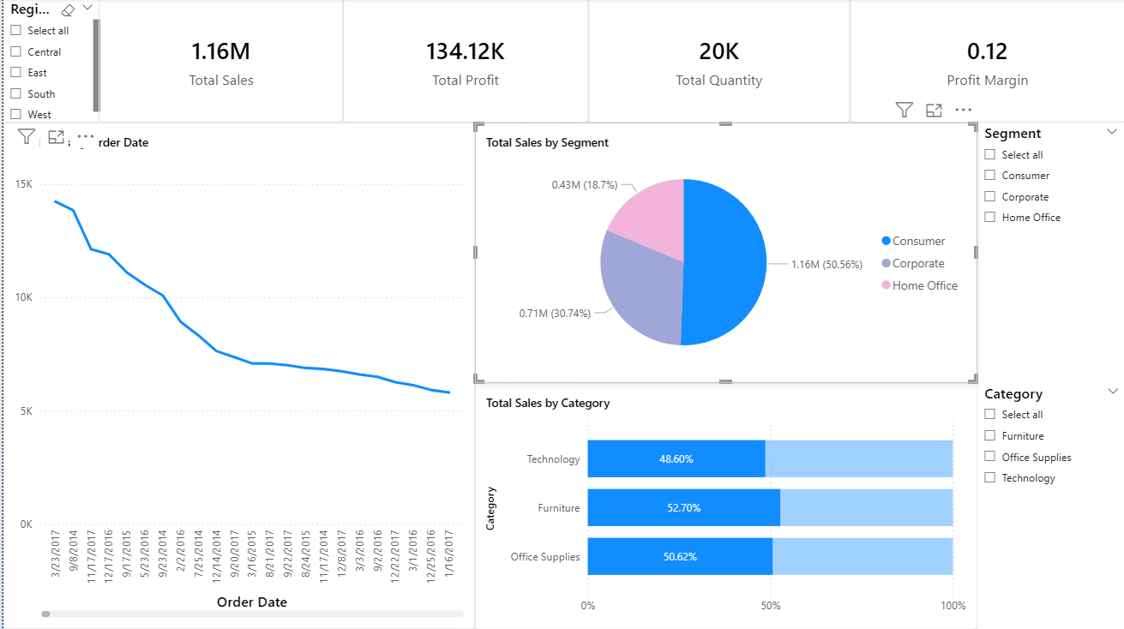
Screenshot [consumer]

Slide 11
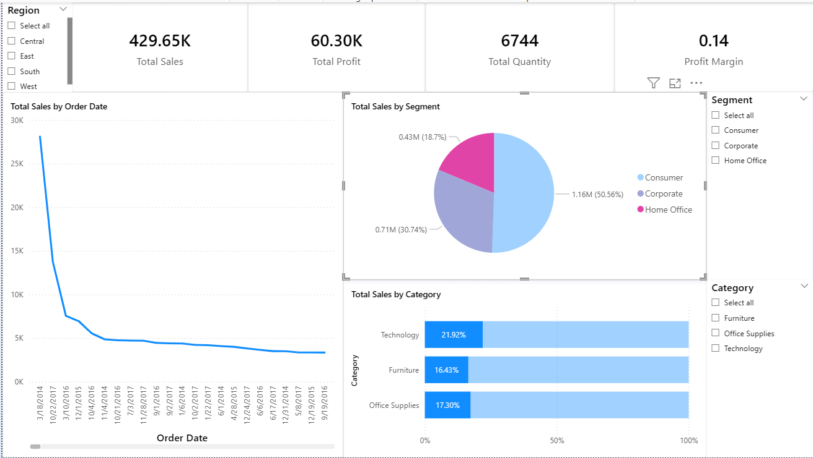
screeNshot [Home office]

Slide 12
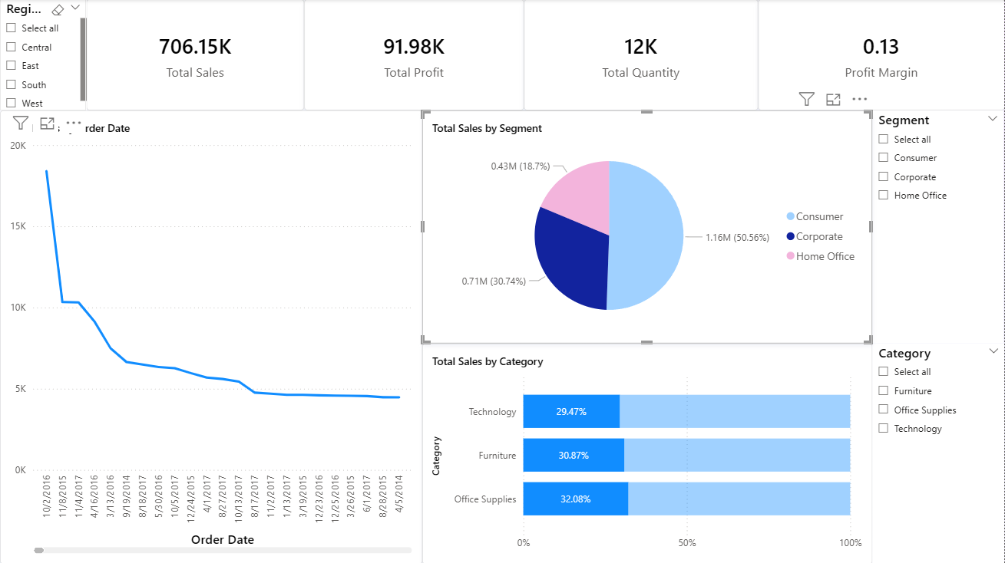
screeNshot [Corporate]

