Slide 1
Project Presentation of Full Stack Enginnering
On
Online Learning Platform
ED4U
Submitted To:
Mr.Rahul
Department of Computer Science and Engineering,
Chitkara University, Punjab
Submitted By:
Arshpreet Singh (2210991370)
Arsh Verma (2210991363)
Saksham Garg (2210992221)

Slide 2


Introduction
Ed4U is a fully functional ed-tech platform that enables users to create, consume, and rate educational content. The platform delivers a smooth and interactive learning experience that makes education more engaging and accessible for students. It offers a platform where instructors can highlight their expertise and connect with learners worldwide
Facilitates an online learning experience with the integration of instructors, students, and course management in one place.

Slide 3
OBJECTIVE
The primary objective of Ed4U is to create a robust ed-tech platform that facilitates the creation, consumption, and rating of educational content. The platform aims to:
Provide a seamless and interactive learning experience for students.
Enable instructors to create, showcase, and distribute their educational content to a global audience.
Integrate a rating system to gather user feedback and improve content quality.
Build a diverse marketplace where instructors from all over the world can monetize their courses and students can access a wide range of high-quality educational content.
Provide a secure and fair platform for both instructors and students to engage in transactions, course creation, and learning.
3

Slide 4
ARCHITECTURE OVERVIEW
Frontend Layer: User Interface (Web)
Backend Layer: RESTful API for course management, user authentication, payments.
Database Layer: Stores user data, course content, transactions.
Third-party Integrations: Payment gateway (razorpay), email service for notifications

Slide 5
USER AUTHENTICATION AND AUTHORIZATION
1.User Types:
Instructor:
Instructors are users who can create and upload courses, set pricing, manage their content, and view analytics for their courses (e.g., how many students enrolled, ratings, etc.).
They will have access to additional features compared to regular students, such as course creation and editing, and tracking student progress in their courses.
Student:
Students are the learners on the platform. They can browse and enroll in courses, complete courses, and track their progress.
They only have access to viewing, enrolling in, and interacting with courses but do not have permissions to create or modify courses.

Slide 6
USER AUTHENTICATION AND AUTHORIZATION
2.Authentication Flow :
Sign-Up:
Users (students, instructors, admins) sign up by providing essential information such as email address, password, and role selection (student, instructor, or admin).
After the initial sign-up form submission, an OTP (One-Time Password) is sent to the user’s email address. This is an extra layer of security to verify that the email address is valid and that the person signing up is the legitimate user.
OTP Verification:
After receiving the OTP, the user enters it into the verification page to confirm their email address.

Slide 7
USER AUTHENTICATION AND AUTHORIZATION
Login:
Once the OTP has been verified and the user is successfully registered, they can log into the platform using their email and password
The login process checks the credentials against the stored data and authenticates the user.
JWT Authentication:
After successful login, a JSON Web Token (JWT) is generated and sent to the user's browser or app.
The token contains user-specific information and permissions, granting access to the relevant features based on the user’s role (instructor, student, admin).
JWT is used for stateless authentication to ensure secure interactions with the platform.

Slide 8
Payment Flow
1.Course Selection:
Student browses and selects a course.
2.razorpay Checkout:
Student is redirected to razorpay for payment.
3.Payment Confirmation:
After completing the payment, razorpay sends a confirmation.
4.Access Granted:
Student is redirected back to ED4U with access to the purchased course.

Slide 9
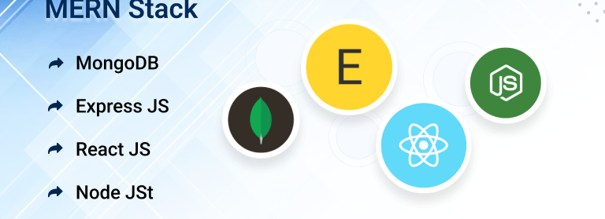
TECH - STACK
.
Back-End : Node js, Express js
DataBase : MongoDB Atlas

Slide 10
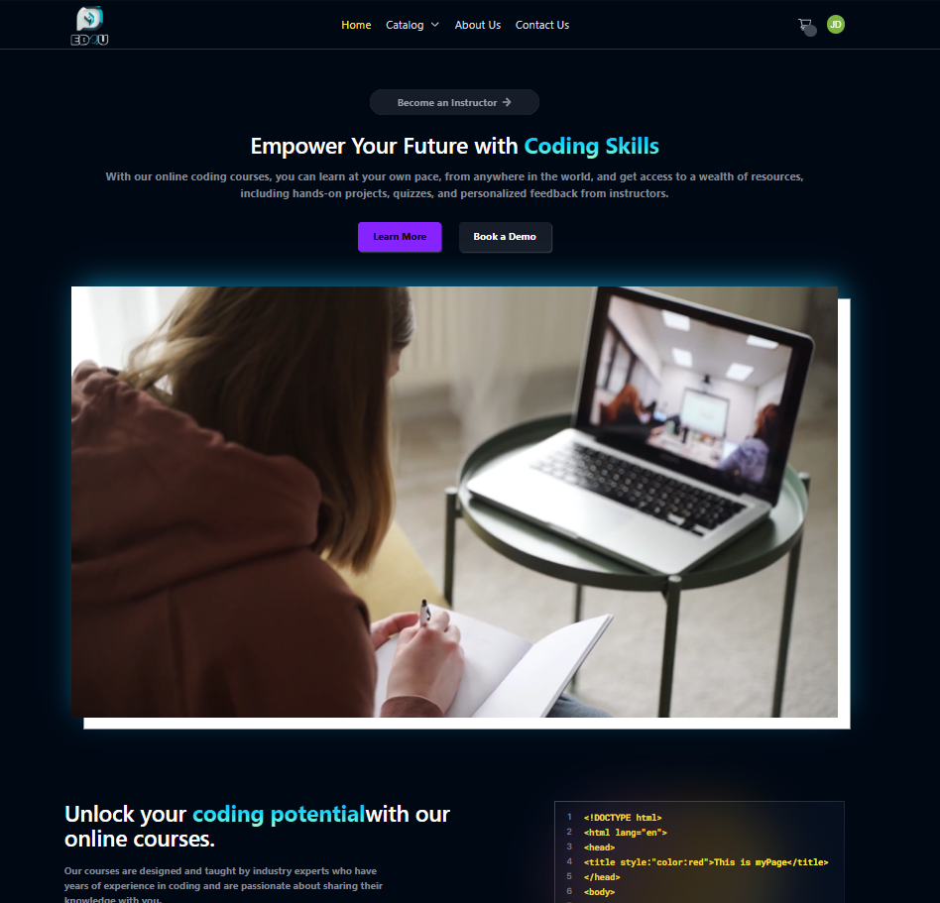
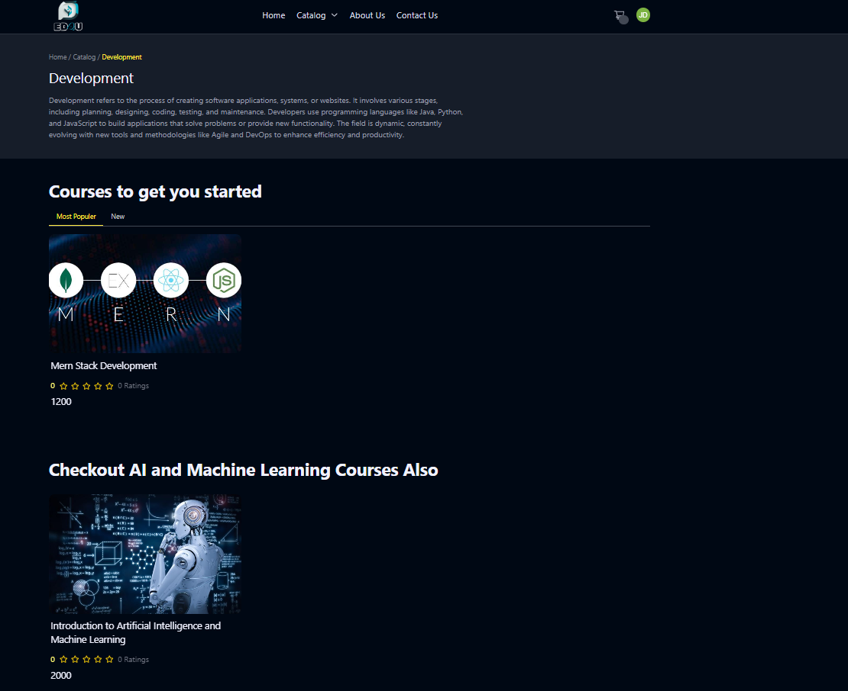
Front End
-Home page
Catalog (All courses)-

Slide 11
Key Features
Instructor & Student Roles: Instructors can create, manage, and sell courses, while students can easily enroll and track their progress.
Razorpay Integration: Secure payment system for students to purchase courses and for instructors to receive earnings.
Course Creation Tools: Simple, intuitive tools for course creation, accessible to both experienced and beginner instructors.
Progress Bar: A visual indicator that helps students track their learning progress and motivates course completion.
Global Accessibility: Multi-currency support and a platform open to users from all over the world, ensuring a broad reach.

Slide 12
CONCLUSION
In conclusion, ED4U is a comprehensive and inclusive e-learning platform that empowers instructors to create and share courses easily, while providing students with a seamless, engaging learning experience. With features like razorpay integration, intuitive course creation tools, progress tracking, and global accessibility, ED4U fosters a dynamic, secure, and motivating environment for learners and educators alike, making quality education accessible to everyone, regardless of age or experience.
12

Slide 13
Thank You
13

