Slide 1
ACADEMIC CAPSTONE PROJECT
Game-Theoretic Model for Spectrum Sharing in 5G/6G Networks
Distributed Interference Mitigation via Exact Potential Games & Sequential Best-Response
PRESENTED BY:
• Saksham Jain — 2427030737
• Priyanshi Sharma — 2427030746
SUBMITTED TO:
Dr. Shweta Sharma
Department of Computer Science & Engineering

Slide 2
MOTIVATION & SCOPE
Problem Statement & Project Objectives
Challenges in 5G/6G Spectrum Sharing
• Hyper-Dense Deployment: Massive densification of small cells, D2D links, and unlicensed NR-U creates intense co-channel interference.
• Signaling Overhead: Centralized resource orchestration requires real-time global channel state information (CSI), creating latency bottlenecks.
• Lack of Coordination: Uncoordinated access leads to packet collisions, elevated link outage rates, and throughput collapse.
• Tragedy of the Commons: Selfish links maximize individual data rates without internalizing mutual interference imposed on neighbors.
Project Objectives & Technical Goals
✔ Game-Theoretic Formulation: Model distributed spectrum sharing as an Exact Potential Game (EPG) with proven stability.
✔ Guaranteed Convergence: Guarantee convergence to a Pure-Strategy Nash Equilibrium (PNE) without infinite cycling.
✔ Sequential Best-Response: Design an autonomous, low-complexity decision algorithm executing independently on distributed links.
✔ Comprehensive Benchmarking: Quantify performance against Random, Round-Robin, One-Pass Greedy, and Global Exhaustive Search over 100 realistic topologies.

Slide 3
NETWORK TOPOLOGY & PHYSICAL LAYER
Proposed System Model & Wireless Channel Physics
Network Deployment
• Field Area: L × L = 300 m × 300 m square field
• Active Links: N = 20 distributed Tx-Rx pairs
• Channels: K = 4 orthogonal subbands (20 MHz each)
• Carrier: f_c = 3.5 GHz (5G Mid-band / C-band)
• Placement: Tx uniform in field; Rx cluster radius U[10, 40] m with angle U[0, 2π)
Propagation & Noise Model
• Free Space PL: PL_0 = 20*log10(4π*1*f_c/c) ≈ 43.33 dB
• Pathloss Exponent: n = 3.5 (Dense Urban / Microcell)
• Shadow Fading: X_ji ~ N(0, σ_sh^2) with σ_sh = 6 dB
• Transmit Power: P = 23 dBm (≈ 199.53 mW per link)
• Thermal Noise: σ^2 = -174 + 10*log10(B) + NF = -93.99 dBm (NF = 7 dB, σ^2 ≈ 3.99e-10 mW)
SINR & Capacity Formulations
• Channel Gain: g[j,i] = 10^(-PL_dB(d_ji)/10) from Tx j to Rx i
• Interference: I_i = Σ_{j ≠ i, a_j = a_i} P * g[j,i]
• Link SINR: SINR_i = P * g[i,i] / (σ^2 + I_i)
• Shannon Capacity: R_i = B * log2(1 + SINR_i) [bps]
• Outage Outset: Declared when SINR_i < 0 dB (SINR < 1.0 linear)

Slide 4
GAME FORMULATION
Game-Theoretic Formulation: Exact Potential Game
Mathematical Formulation (Game G1)
• Players & Strategy Space: N communication links {1..N}. Strategy a_i ∈ {0, ..., K-1} represents channel selection.
• Symmetrized Coupling Matrix: W[i,j] = P * (g[i,j] + g[j,i]) / σ^2 (W[i,i] = 0). W is symmetric (W[i,j] = W[j,i]), internalizing mutual interference.
• Individual Utility Function: u_i(a) = - Σ_{j ≠ i} W[i,j] * I(a_i = a_j). Each player seeks to minimize mutual interference on its chosen channel.
• Exact Potential Function: Φ(a) = - Σ_{i < j} W[i,j] * I(a_i = a_j) = 1/2 * Σ_i u_i(a). Global scalar function reflecting network-wide interference cost.
Exact Potential Property & Theorem
POTENTIAL GAME IDENTITY:
Δu_i(a_i → a'_i, a_-i) ≡ ΔΦ(a_i → a'_i, a_-i)
✔ Exact Alignment: Every unilateral change in player i's utility produces the exact same change in the global potential function Φ.
✔ Absence of Cycles: Because action space K^N is finite and every unilateral improvement strictly increases Φ, infinite cycles/oscillations cannot occur.
✔ Pure NE Guarantee: Sequential best response is mathematically proven to terminate at a Pure Strategy Nash Equilibrium (PNE) in finite steps.
✔ Local Maxima of Φ: Every PNE is a coordinate-wise local maximum of Φ.

Slide 5
ALGORITHM ARCHITECTURE
Sequential Best-Response Dynamics & Verification
STEP 1: Initialization
Random State Assignment
• Instantiate random topology (Tx in field, Rx in cluster).
• Assign initial channels a_i ~ Uniform({0..K-1}).
• Calculate initial potential Φ_init and baseline sum-rate.
STEP 2: Best Response
Asynchronous Optimization
• Permute player update order randomly in each round.
• For link i, evaluate utility u_i(k, a_-i) for all channels k ∈ {0..K-1}.
• Identify best candidate channel k* = argmax u_i(k, a_-i).
STEP 3: Threshold Switching
Hysteresis & Tie-Breaking
• Switch to k* only if improvement Δu > ε (ε = 10^-9).
• Ties strictly keep current channel to prevent chattering.
• Log monotonic increase in Φ and network sum-rate after each switch.
STEP 4: NE Verification
Independent Audit
• Full round with 0 switches signals convergence.
• Run independent verify_NE() auditing all N × (K-1) deviations.
• Confirm zero profitable unilateral moves exist across the network.
Key Algorithmic Advantage: Fully decentralized decision-making with O(K) complexity per link. No central coordinator required.

Slide 6
SIMULATION METHODOLOGY
Experimental Setup & Implemented Baselines
Canonical Simulation Parameters
Benchmarked Allocation Strategies
• Proposed NE (G1): Decentralized Sequential Best-Response maximizing potential Φ(a) until pure NE.
• Random Allocation: Uncoordinated channel selection; benchmarked over 50 Monte Carlo draws averaged per topology.
• Round-Robin: Deterministic periodic assignment a_i = i mod K. Perfectly balances channel loads without channel awareness.
• One-Pass Greedy: Sequential assignment where links 0..N-1 make a single greedy decision with no iterations.
• Exhaustive Optimum: Brute-force evaluation of all K^N assignments (3^8 = 6,561 combinations for N=8, K=3) finding true global optima.
• Statistical Rigor: 100 independent random topologies (seeds 0–99). Reported with 95% Confidence Intervals & paired Wilcoxon tests.
Parameter | Default Value
Network Area (L × L) | 300 m × 300 m
Active Links (N) | 20 Tx-Rx pairs
Orthogonal Channels (K) | 4 subbands (20 MHz each)
Carrier Frequency (f_c) | 3.5 GHz (Mid-band 5G)
Transmit Power (P) | 23 dBm (≈ 199.53 mW)
Thermal Noise & NF | -93.99 dBm (NF = 7 dB)

Slide 7
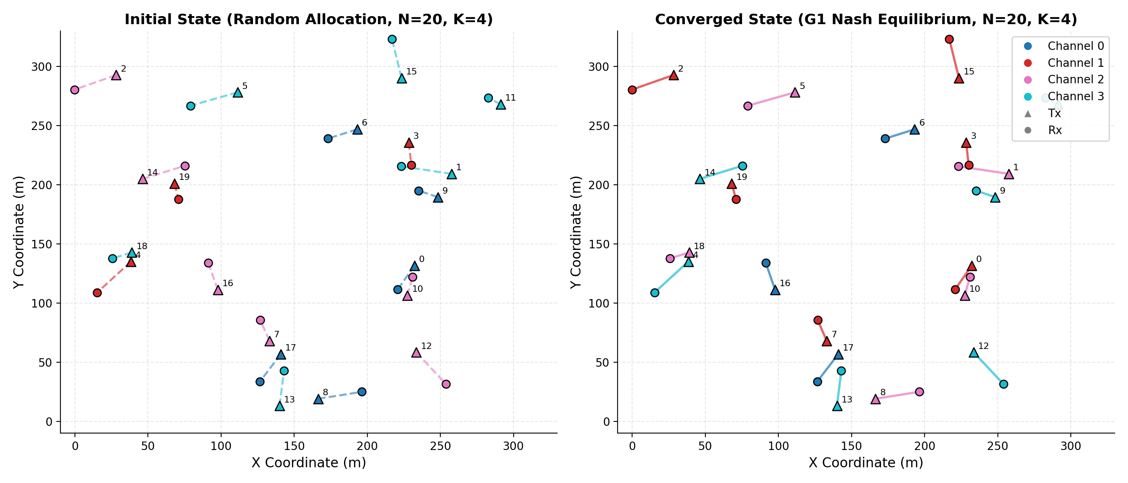
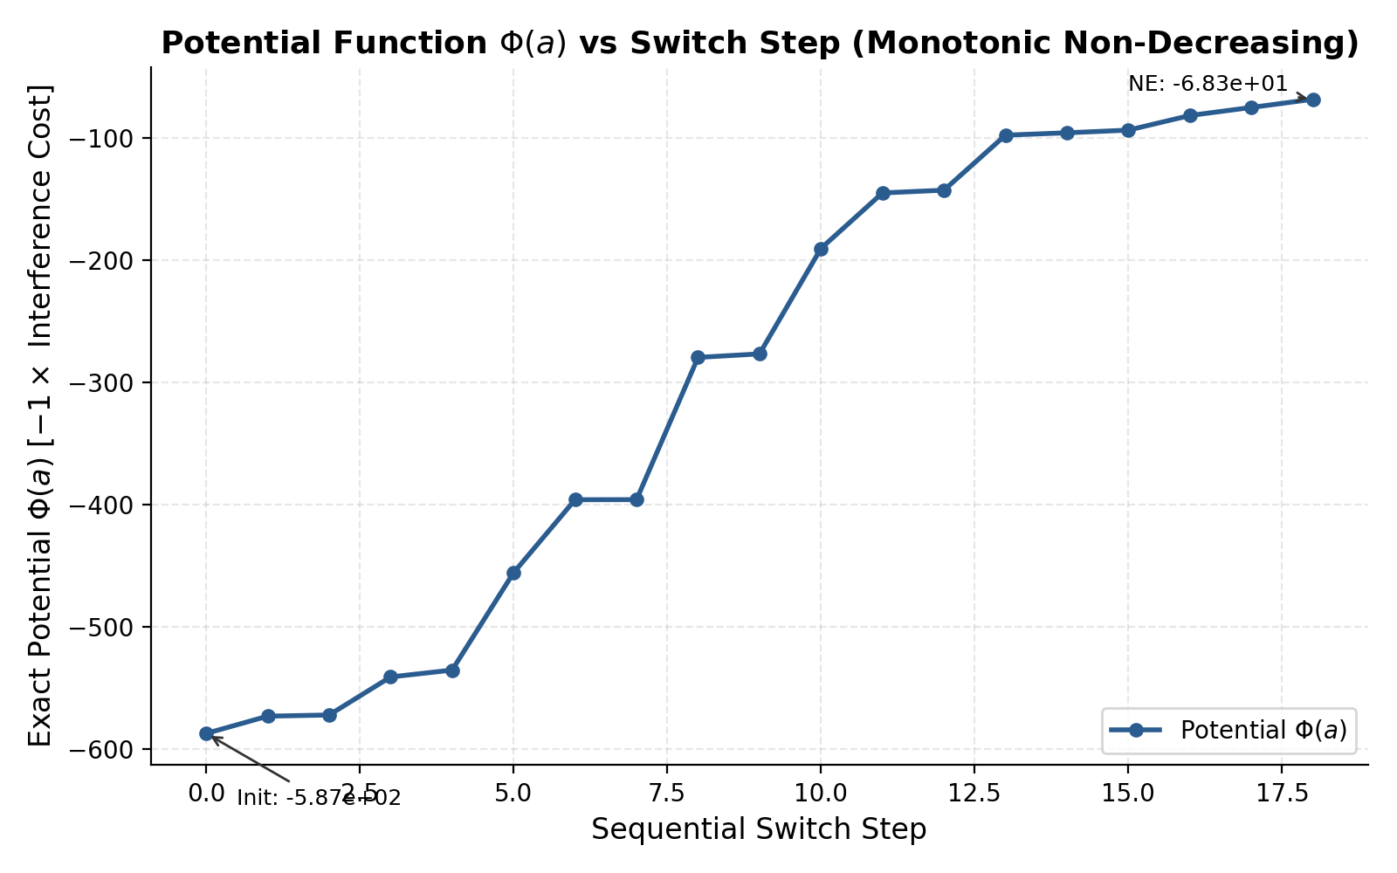
EXPERIMENT E1: SINGLE-TOPOLOGY DYNAMICS
Simulation Convergence: Monotonicity & Throughput
POTENTIAL IMPROVEMENT
ΔΦ = +519.02
Initial Φ: -587.37 → Final NE: -68.34. Strictly non-decreasing on all 18 switches.
THROUGHPUT EVOLUTION
Sum-Rate: +681.24 Mbps
Initial: 1,918.29 Mbps → Final: 2,599.53 Mbps (+35.5% capacity growth).
CONVERGENCE SPEED
4 Rounds (2.91 ms)
Converged to verified Pure NE in 4 rounds, 18 channel switches on N=20.

Slide 8
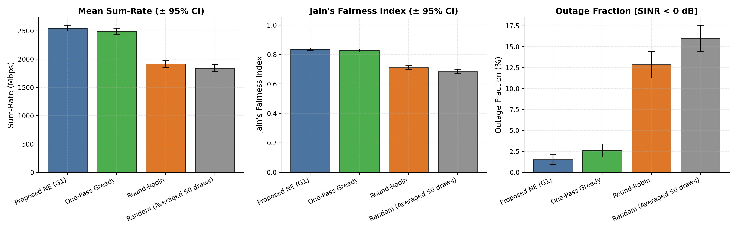
EXPERIMENT E2: BASELINE BENCHMARKING
Baseline Performance Comparison: N=20, K=4 (100 Topologies)
Statistical Comparison Across 100 Real Topologies
Method | Sum-Rate | 5th-Pct | Jain | Outage
Proposed NE (G1) | 2552 Mbps | 49.9 Mbps | 0.836 | 1.5%
One-Pass Greedy | 2498 Mbps | 44.0 Mbps | 0.827 | 2.6%
Round-Robin | 1916 Mbps | 13.4 Mbps | 0.710 | 12.8%
Random (50 avg) | 1844 Mbps | 10.2 Mbps | 0.684 | 16.0%
✔ Throughput: Proposed NE delivers +38.4% higher sum-rate than Random and +33.2% over Round-Robin.
✔ Statistical Significance: Paired Wilcoxon signed-rank test confirms p = 3.90e-18 against Round-Robin/Random, and p = 4.81e-07 against One-Pass Greedy.
✔ Outage Suppression: Link outage (SINR < 0 dB) slashed from 16.0% (Random) down to 1.5%.

Slide 9
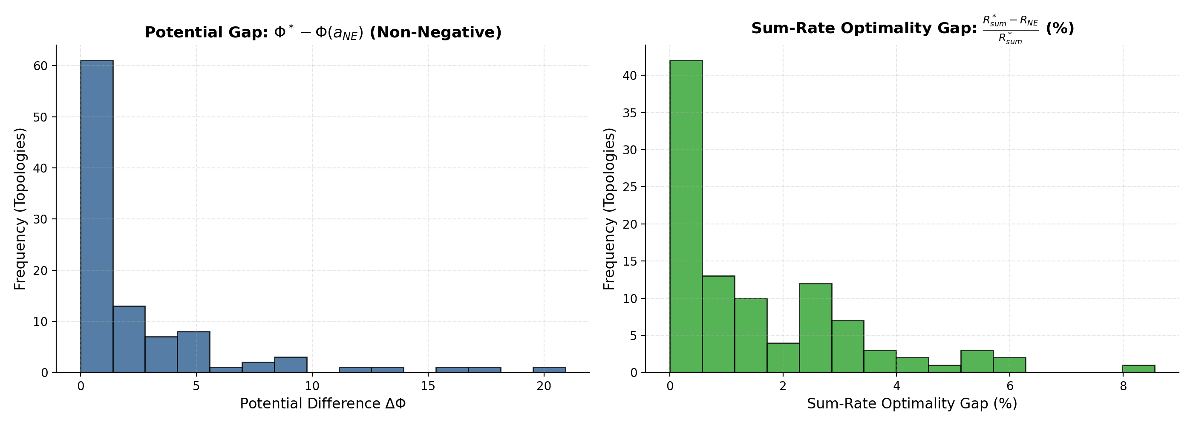
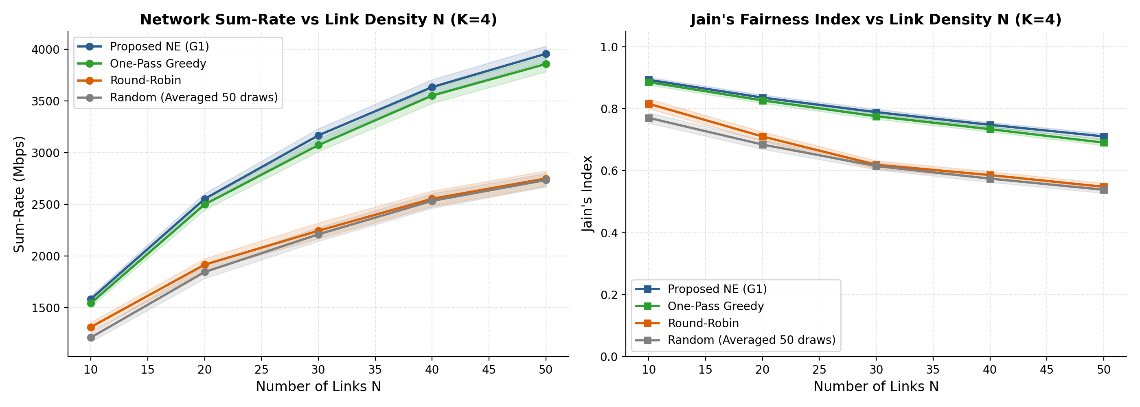
IN-DEPTH TECHNICAL INSIGHTS
Optimality Gap, Scaling & Game Dynamics
Near-Global Optimality
1.54% ± 0.35% Gap
Evaluated against 3^8 = 6,561 exhaustive states on N=8, K=3. Proposed NE achieves within 1.54% of global sum-rate ceiling.
Density Scaling (N=10..50)
Scalable Capacity
As network density grows 5x, sum-rate scales gracefully while Jain fairness index stays superior to all baselines.
Potential (G1) vs Rate (G2)
100% vs 87% Convergence
• Exact Potential (G1): 100.0% convergence in an average of 3.68 ± 0.19 rounds (14.7 switches). Zero cycling.
• Direct Rate Game (G2): Only 87.0% convergence. Suffers from limit cycles in 13% of topologies due to asymmetric externalities.
• Complexity Impact: G2 required 159.5 average switches vs only 14.7 for G1 (10x faster convergence).
• Theoretical Justification: Proves that Exact Potential alignment is indispensable for stable distributed spectrum sharing.

Slide 10
PROJECT SUMMARY
Conclusions, Limitations & Future Scope
Key Conclusions & Achievements
✔ Guaranteed Stability: Proven and empirically validated 100% convergence to Pure Nash Equilibrium across all 100 tested network topologies.
✔ Significant Throughput Gain: +38.4% throughput gain over random allocation while reducing outage to 1.5%.
✔ Low Decentralized Overhead: Rapid convergence in < 4 rounds per network, making it highly viable for real-world 5G NR-U and 6G small cells.
✔ Near-Optimum Performance: 1.54% optimality gap compared to exponential-complexity exhaustive search.
Practical Limitations & Future Scope
• Assumes reciprocity for mutual interference matrix W; can be extended to asymmetric channels via generalized potential games.
• Future enhancement: Joint channel selection and dynamic transmit power control (Water-filling / Q-learning).
Key Academic References
[1] D. Monderer and L. S. Shapley, 'Potential Games,' Games and Economic Behavior, vol. 14, no. 1, pp. 124–143, May 1996.
[2] G. Scutari, D. P. Palomar, and S. Barbarossa, 'Competitive Design of Service Providers in Cognitive Radio Networks,' IEEE JSAC, 2008.
[3] 3GPP TR 38.889, 'Study on NR-based access to unlicensed spectrum (NR-U),' 3rd Generation Partnership Project, 2020.
[4] Y. Xu et al., 'Exact Potential Game for Spectrum Allocation in Dense Small-Cell 5G Networks,' IEEE TVT, 2019.
Thank You!
Questions & Discussion

